Slide 1
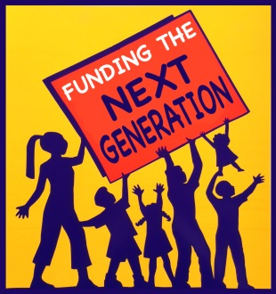
Funding the Next Generation April 7, 2015
The Development of the San Francisco Children’s Fund
Sandboxes to Ballot boxes

Slide 2
The Children’s Fund
“Softening the Ground”
Creating the framework
Getting on the Public Agenda
Building the network of planners and supporters
First Goal: An “official” city agenda for children
Rationale: Provide the basis for progress in policy and funding
Coordinate policy and program approach
Target: Board of Supervisors and Mayor
Allies: Children and youth service providers
Strategies:
Researching other models
Engaging partners and allies
Developing and implementing a community process
Creating a proposal
Building a coalition of allies
Negotiating with policymakers
Media and public testimony
Approval of a San Francisco Agenda for Children
Assessment of results

Slide 3
Criteria for Public Policy Issue
Why Needs of Children are an important public policy issue
Requires public action – not just private struggle
High community benefit – impacts many people and future of City
Addresses urgent unmet needs
Cost-effective to address
Requires a comprehensive approach
Many solutions are known and proven

Slide 4
The Children’s Fund
Naming the Problem
Understanding Barriers and Assumptions
Building a Specific Proposal
Mounting a Campaign
Second Goal: A Children’s Budget
Rationale: Funding is the major barrier
Target: Mayor, Board of Supervisors, Department heads
Allies: Service providers, Parents, Youth
Opponents: Competitors for funding
Strategy: Build a powerful community-based coalition to influence the SF budget process and increase resources for services for children, youth and families.

Slide 5
The Children’s Fund
The Children’s Budget
Campaign Strategies and Tactics
3 Years
Research – The budget and the budget process
Create a network of “our people” –
Create a consensus about process
Document needs
Build a proposal
Create a compelling document
Enlist Multiple Endorsers
Maximize Use of Earned and Paid Media
Public education campaigns
Meetings with decision-makers
Testimony at hearings

Slide 6
Children’s Fund
Hallmarks of the Children’s Budget Process
Training – New role for service providers
Community voices – Parents and youth play major role
Backbone organization – Advocate - leadership, organizer, “cover”
Strategies – Creative, varied
High level of knowledge, research, information, documentation
Flexibility
Risk-taking
Friends “inside”
Big enough to matter – small enough to win
Persistence and omnipresence

Slide 7
Heroic efforts
HIGHLIGHTS
Answered: where can we get the money – ideas for re-allocation – gardeners, police, business tax, protocol office, county range, luxury boxes, golf fees, colas on high salaries
Posted budget in rotunda of City Hall
Guerilla theatre, posters on telephone polls, youth speak-outs, candidate forums
Tracking system for budget expenditures by City
Changed budget process
Wins included MOCYF, youth unit at HSA,
Themes – Drugs, Earthquake, Violence
Final meeting with Mayor – competing with Fire Dept.

Slide 8
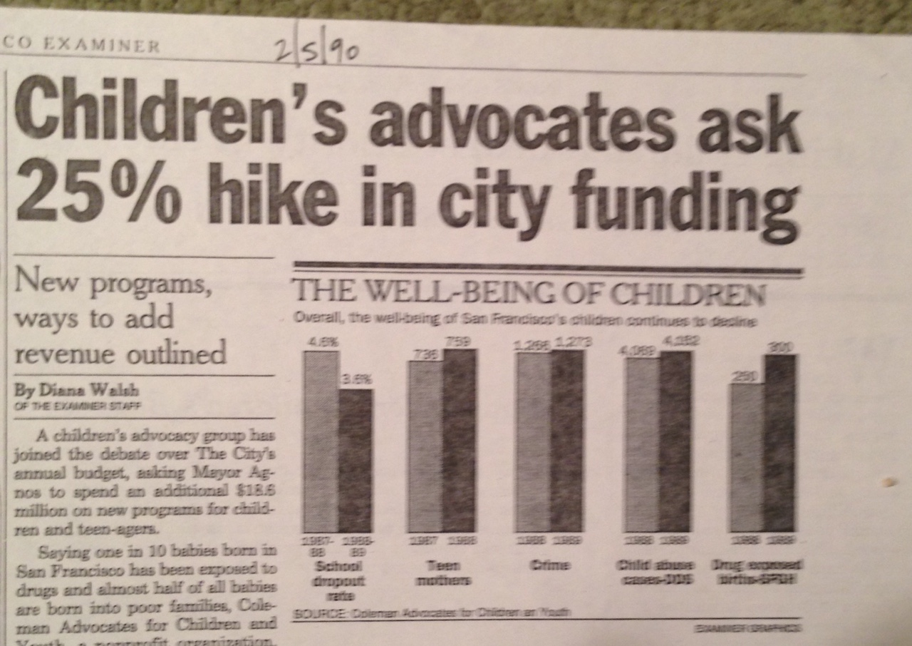

Slide 9
Children’s Fund
Evaluation and Next Phase
Did we win or lose? – Analysis of results
Criteria included – Cost-benefit? Continued unmet need? Potential for larger wins with different strategy? Perceptions of base? Effort vs. gain?
Developing an alternative strategy and policy proposal
Institutionalization – dedicated annual funding – moving beyond the budget process
New forum for decision-making – an election! – going to the people
Washington Post “Daring Assault on the Political Establishment”

Slide 10
Children’s Fund
Crafting a New Policy
The Children’s Amendment
Goal – Sustainable, stable, funding for broad range of children’s services – no more annual battles
Institutionalization – City charter
Models – Required funding in city charter
Revenue Stream – New funds or reallocations – rational for “carve-out”
Specific objectives – What can be funded
Potential Sabotage – Baseline budget; Prohibitions
Implementation – Administration, planning, oversight

Slide 11
The Petition Process
Seizing the Initiative
Creating a Window of Opportunity
Utilizing the Political Stream – Elections
Capturing Public Support
Mobilizing Outside Government
Seeking traditional political support – NO WAY
Utilizing the Initiative process
Taking the initiative
Framing the issue – The Children’s Amendment
68,000 signatures – POLITICAL LESSON OF A LIFETIME

Slide 12
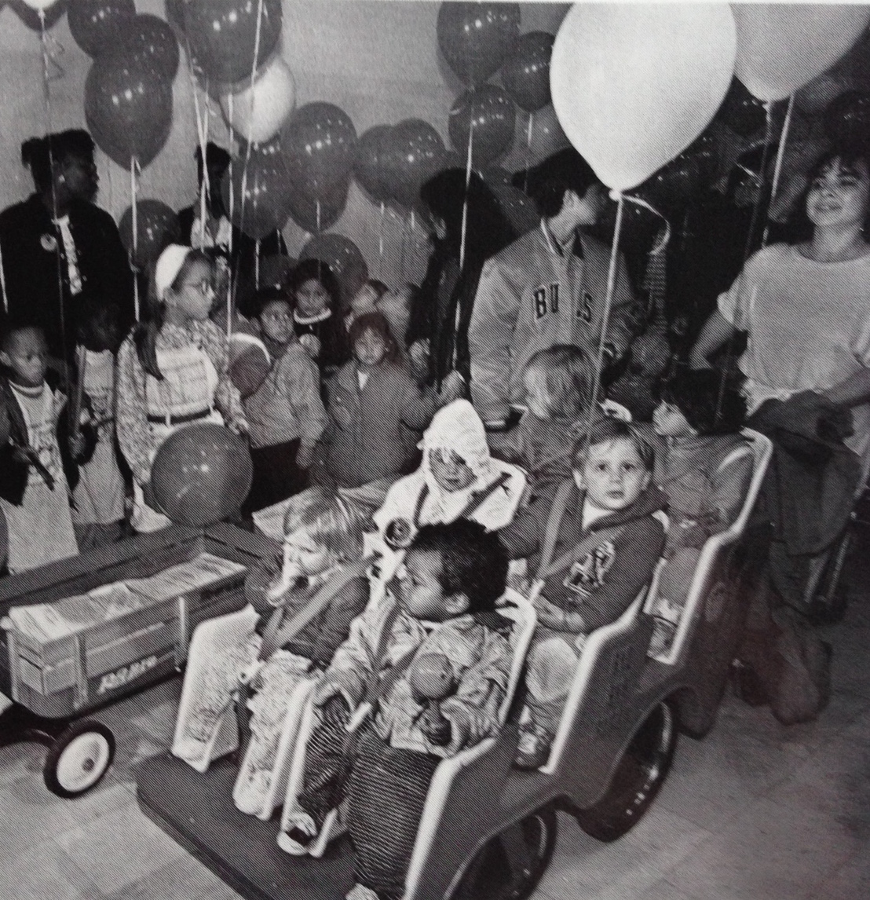

Slide 13
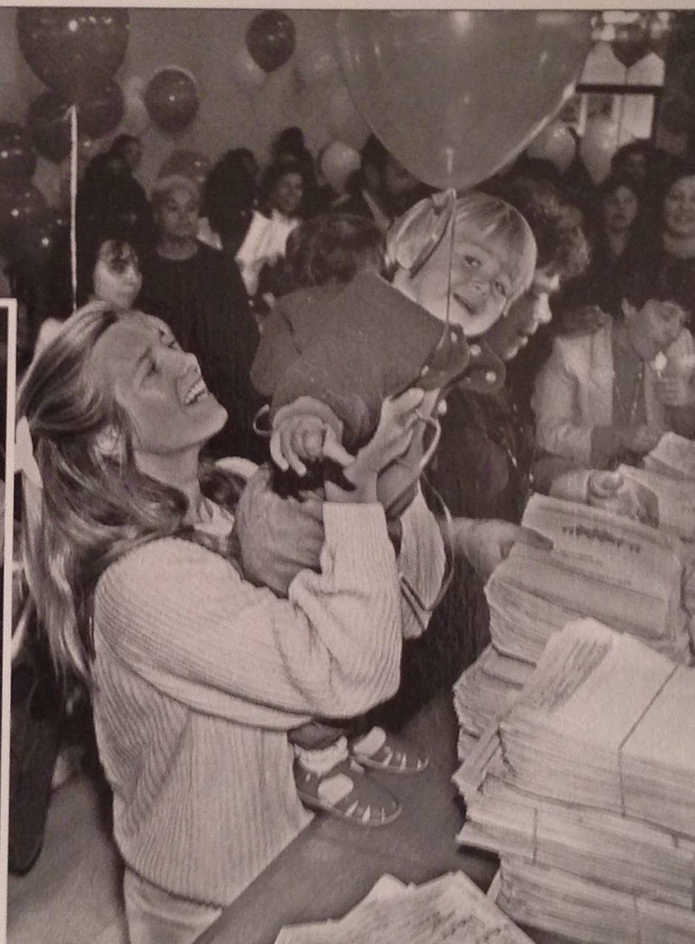

Slide 14


Slide 15
The electoral process
Power of elections to communicate and seize the agenda
Campaign video “I Wish I Were a Princess”
High civic engagement in campaign
Voices of parents and youth
Utilizing the media
Outpacing opponents
Relentless – respond to EVERYTHING
Creative tactics
Strong leadership

Slide 16
THE CAMPAIGN
MESSAGES
Children can’t vote – brochure
Serious crisis
Investing is cost-effective
Services make a differences
These are all our children
MORE BALLOT ARGUMENTS THAN EVER BEFORE
TREMENDOUS OPPOSITION – SF CHRONICLE, CHAMBER OF COMMERCE, LEADING POLITICIAN, NEIGHBORHOOD PAPERS
NATIONAL – NOT LOCAL - COVERAGE

Slide 17
Making Lemonade
TURNING OPPOSING ARGUMENTS INTO WINS
Ballot box budgeting – democracy at its best
Ties our hands – that’s the point
Special interest politics – children are everyone’s interest
Bad government – feeding children is good government
Takes money away from other needs – cost effective, promotes efficiency
Moral blackmail – only necessary because of secrecy

Slide 18


Slide 19
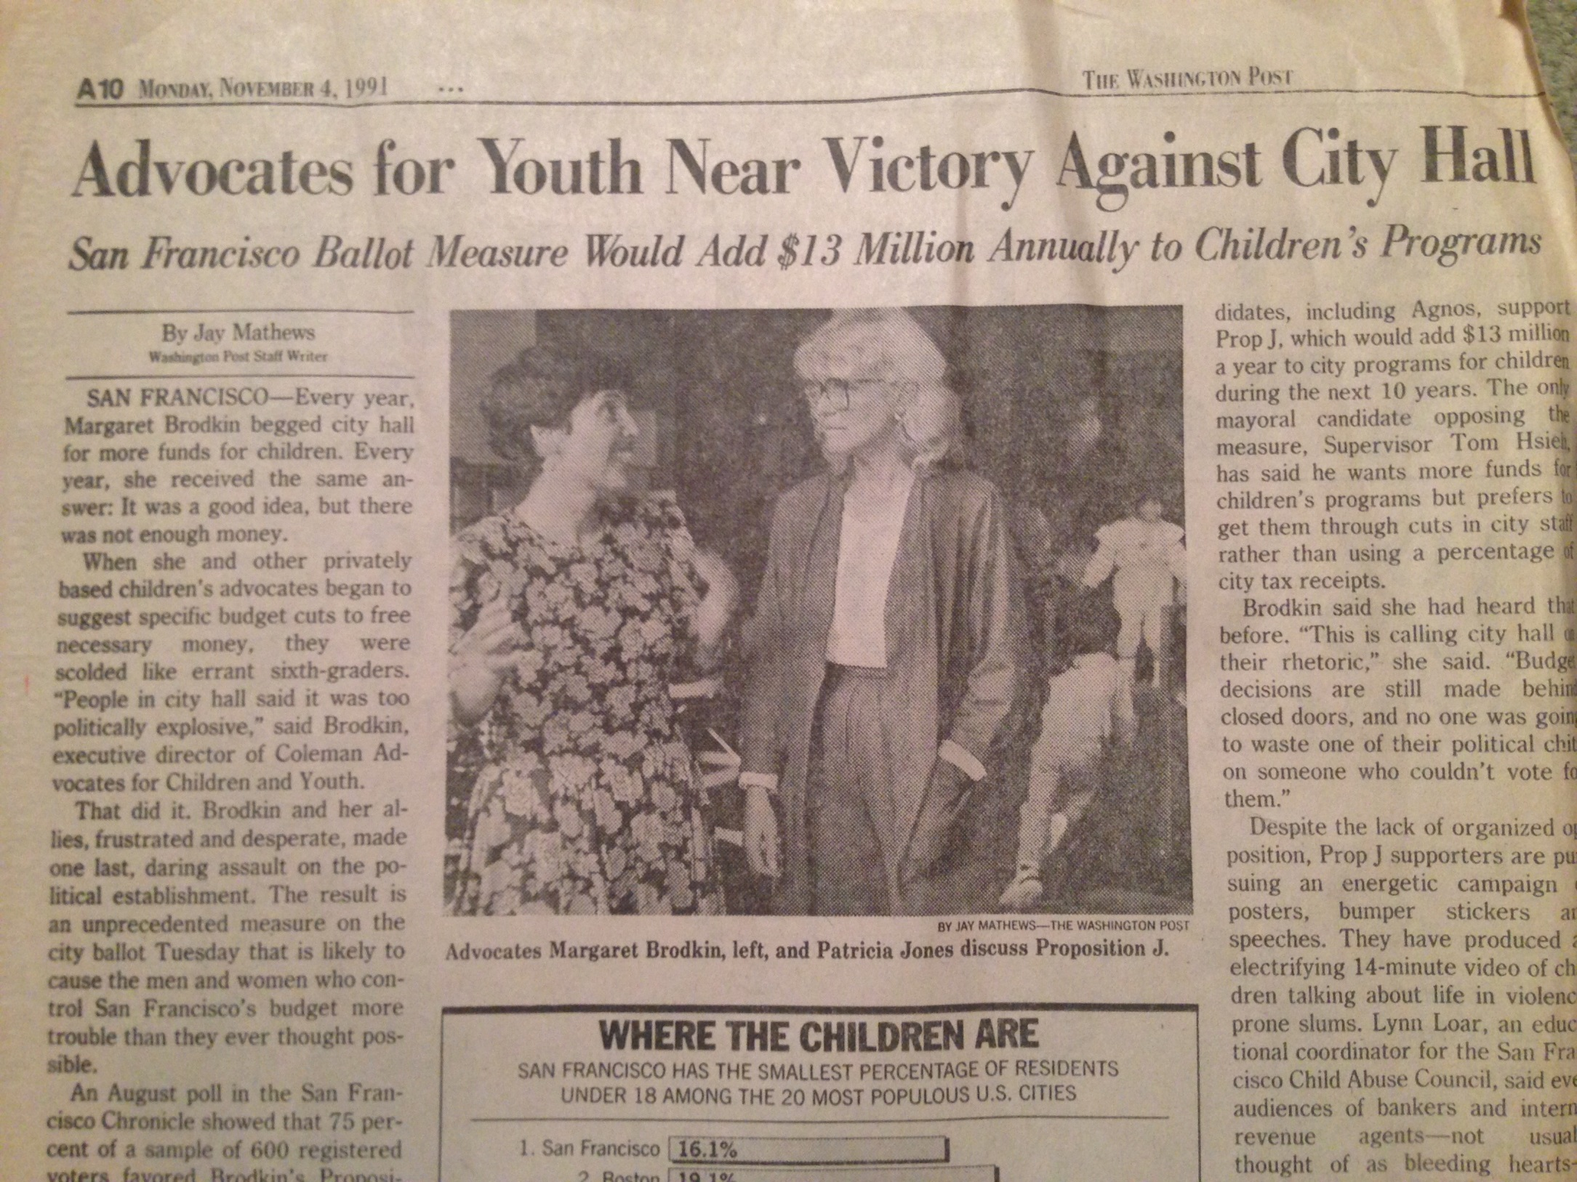

Slide 20
The Children’s Amendment
Outcomes
Far Exceeded Expectations
Vastly increased funding – starting with $12 M annually (1992), coming year $74 M.
No budget cuts in children’s services
Created city department as hub of planning for kids servicess
Supported innovation and experimentation – neq models, new populations, new neighborhoods
Leveraged dollars from all levels
Resulted in more funding for kids, not less
Changed the budget process for kids
Built a children’s constituency – ownership by the public
Replicated in SF and throughout country
Transformed the SF service delivery system
National attention

Slide 21
Post election strategies
NOT ALL SMOOTH SAILING
Passed by 54.5%
Conflict over money
Conflict over staffing of MOCYF
Political interference over funding
COLEMAN CHANGES GEARS
The Kids Network
Y-MAC and youth
Monitoring

Slide 22
The Children’s Fund
Lessons Learned – And Still Learning
Take the initiative – Frame the issue. Just do it.
Think big
It takes time to build a major policy change
Outcome is always uncertain – requires risk
Requires concrete alternative plan – that includes how it will be implemented – positive solution
Elections are powerful venues for advancing policy change.
Money triggers change
Requires political activity.
Must empower public – parents, youth, community organizations
Kids are a winning issue.
“Small group of committed citizens” can provide leadership.
It’s NEVER over!

