Slide 2
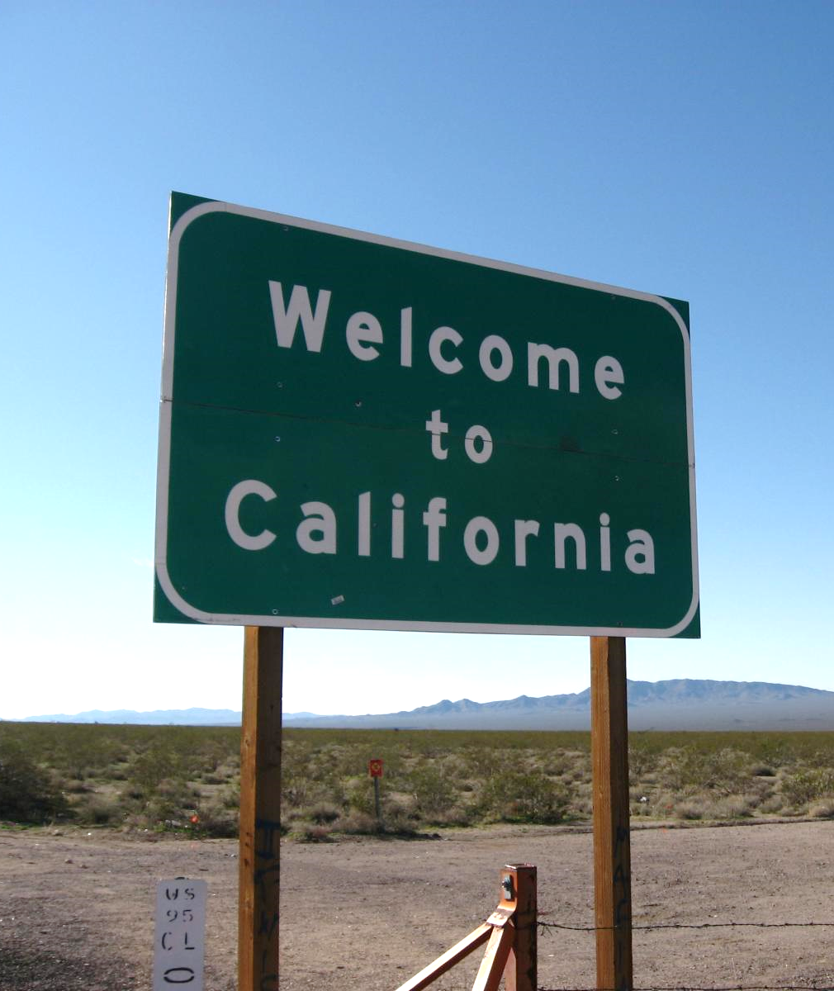
Opportunity for California in 2016
Rising confidence in the economy and government
Favorable voter demographics
Widespread perception of need
Strong polling numbers
Presidential year turnout
Solid organization

Slide 3


Recent FM3 Survey Research on Local Funding for Children and Youth
Upcoming Local Measures:
Napa County (June 2016)
City of Sacramento (June 2016)
City of Richmond (November 2016)
Sonoma County (November 2016)
Solano County (November 2016)
Yolo County (November 2016)
San Joaquin County (TBD)
San Mateo County (TBD)
Santa Clara County (TBD)
Prior polling from LA County, Fresno County, the city of Oakland and locations outside CA – Arizona, Hawaii, Texas, and national surveys

Slide 4
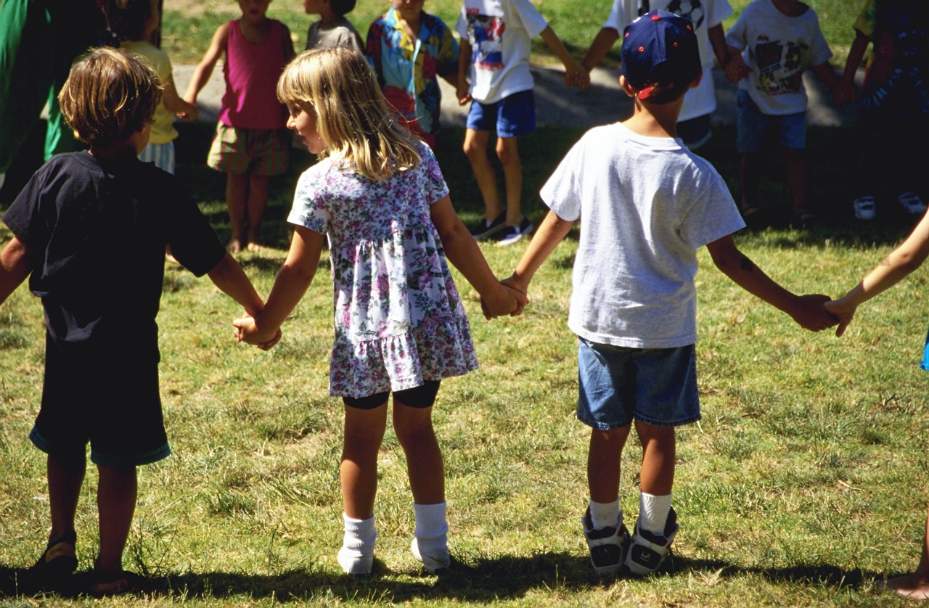
These polls have shown remarkable consistency in the context for local measures to fund children and youth services. The following are key findings that cut across the research.

Slide 5

The voter mood is steadily improving.
#1:

Slide 6
Feelings about the direction of the state have stabilized in recent years.
Q1. Generally speaking, would you say that things in California are going in the right direction, or have they pretty seriously gotten off on the wrong track?

Slide 7

Concern about taxes is minimal.
#2:

Slide 8
Statewide, issues like the drought, health care and schools are top concerns...
Ext./ Very Ser.
83%
82%
67%
66%
60%
60%
59%
55%
2015 California Statewide Survey

Slide 9
…while taxes barely register.
Ext./ Very Ser.
52%
51%
49%
45%
43%
42%
35%
21%

Slide 10

Voters appreciate the critical importance of helping kids while they are very young.
#3:

Slide 11
More than six in ten voters recognize the ages before five as the most important time for child development.
What do you think is the most important age for developing a child’s capacity to learn?
62%
2015 FM3/POS National Voter Survey for NAEYC

Slide 12

Voters recognize the long-term benefits of these investments.
#4:

Slide 13
Voters believe increased access to early education will have broad benefits for society.
(% Believing Expanded Access to Early Education is Likely to Produce Each Benefit)
2015 FM3/POS National Voter Survey for NAEYC

Slide 14

Voters believe we all share responsibility for helping kids grow up successfully.
#5:

Slide 15
Locally, voters feel a strong sense of collective responsibility for helping kids.
All Solano County residents have a shared responsibility in helping local children grow up healthy and ready to learn
Total Agree 81%
Total Disagree 18%
2014 Solano County Voter Survey

Slide 16

Voters perceive a great need for additional funding for kids.
#6:

Slide 17

Only one-quarter believe children are well-prepared for kindergarten.
How prepared do you think San Mateo County’s children are for learning when they enter kindergarten: are they…
Extremely/Very Prepared 24%
Not Very/Not At All Prepared 9%
2016 San Mateo County Survey

Slide 18
Youth services rank in a top tier of funding needs.
I am going to read a short list of public services in San Joaquin County. Please tell me if you think there is a great need for additional funding, some need, a little need or no real need for additional funding for that service.
Great/Some Need
88%
81%
77%
72%
72%
67%
63%
56%
52%
2016 San Joaquin County Voter Survey

Slide 19

Awareness of the existing infrastructure to fund youth services is minimal.
#7:

Slide 20


Awareness of First Five is low, but attitudes are positive.
Total Fav. | Total Unfav.
58% | 26%
65% | 24%
60% | 20%
27% | 4%
2014 Solano County Voter Survey

Slide 21

Remember the critical importance of the ballot question.
#8:

Slide 22
Model Specific Tax Ballot Question
SONOMA COUNTY YOUNG CHILDREN’S SERVICES MEASURE. To expand access to early education, health, and nutrition services for infants/children through age 5; help prevent child abuse/neglect; support all parents with child development, reading, math and kindergarten readiness; help at-risk and homeless children; attract, train and retain highly-qualified early educators; shall Sonoma County enact a ¼ cent sales tax for 9 years providing $18,000,000 annually with citizens oversight, public disclosure of spending, mandatory annual audits?
2016 Sonoma County Survey

Slide 23
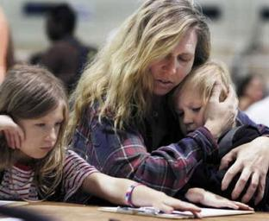
Addressing homelessness and mental health have emerged as top priorities.
#9:

Slide 24
Helping kids stay in school is a top priority.
Ext./Very Impt.
88%
83%
75%
76%
77%
76%
69%
2016 San Joaquin County Survey

Slide 25

Voters prioritize helping at-risk youth – but generally don’t like to draw distinctions.
#10:

Slide 26
Youth involved in the justice system and with mental health problems are seen as the highest priorities for assistance.
I am going to read you a list of some of different groups of youth that may benefit from these services. Please tell me how high a priority you think it should be to provide additional funding to help that group of youth: one of the highest priorities, a high priority, a medium priority, or a low priority.
One of the Highest/High
81%
80%
80%
79%
79%
78%
73%
2015 City of Richmond Survey

Slide 27
Majorities rate every subgroup a high priority.
One of the Highest/High
73%
71%
71%
67%
67%
56%
54%
2015 City of Richmond Survey

Slide 28
Some tax mechanisms fare better than others.
#11:

Slide 29
Not surprisingly, a set aside fares best.
Total Supp. | Total Opp.
75% | 23%
64% | 34%
60% | 36%
45% | 53%
38% | 57%
2015 Santa Clara County Survey

Slide 30

The profile of persuadable voters is consistent.
#12:

Slide 31
Typical Poll Segmentation of Voters
Consistent Yes: Voters who consistently indicated they would vote yes on the measure.
Consistent No: Voters who consistently indicated they would vote no on the measure.
Swing: Voters who do not fall into any of the other categories – remaining consistently undecided or switching positions.
The following slide shows demographic groups that disproportionately fall into one category or the other.
2015 Napa County Survey

Slide 32
Demographic Profile of the Segments
Consistent Yes | Swing | Consistent No
48% of the Electorate | 23% of the Electorate | 29% of the Electorate
Liberal Democrats | Independents Ages 18-49 | Multi-Republican Households
Democrats Ages 18-49 | Moderate/Conservative Democrats | Republican Men
Ages 18-29 | Have Children Under 5 | Republicans
Liberal | Board of Supervisors District 4 | Republicans Ages 50+
Democratic Women | Liberal/Moderate Independents | Conservative Republicans
Multi-Democrat Households | Moderate | Liberal/Moderate Republicans
Ages 75+ | Ages 30-39 | Republican Women
Single Democrat Households | Mixed Partisan Households | Conservative
Democrats | Independents | Ages 65-74
Board of Supervisors District 1 | Ages 50-64 | Children's Ages 6-14 Years
Democratic Men | Voters of Color | Unincorporated City
Democrats Ages 50+ | City of Napa | Board of Supervisors District 3
HH Income Under $60,000 | Conservative | Ages 40-49
Latinos | Single-Democrat Households | Men Ages 50+
Ages 65+ | Election Day Voters | HH Income $120,000+
Voters of Color | Women Ages 50+ | Board of Supervisors District 5
Men Ages 18-49 | Democrats Ages 50+ | Have Children
2015 Napa County Survey

Slide 33

There is strong consistency in the top messages.
#13:

Slide 34
Top-Testing “Yes” Messages
Message | % Very Convincing
(BRAIN DEVELOPMENT) Research shows that 90% of a child’s brain development occurs before age five. These critical years lay the foundation for the rest of a child’s life. By expanding access to quality pre-school, we can help ensure that every child in Sonoma County gets off to strong start.
(SCHOOL READINESS) By increasing access to quality pre-school programs, this measure strengthens K-12 education. Currently, over half of Sonoma County kids enter kindergarten unprepared and are reading below grade level in third grade. Studies show that kids who go to high quality pre-school are more likely to read proficiently by the third grade, and more likely to graduate and go on to college.
(EQUITY) Pre-school should not be a luxury only available to a few families. In Sonoma County, the cost of sending a child to pre-school is nearly $13,000 dollars per year – that’s 39% of the median annual income for Sonoma County women. This measure will make early education available and affordable to families of all incomes, including middle-class families.
50%
46%
45%
2016 Sonoma County Survey

Slide 35
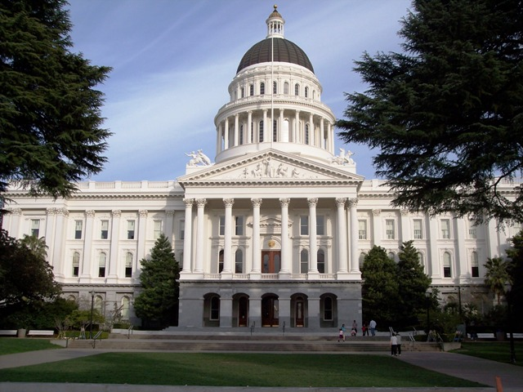
Distrust in how government will spend the money remains one of our biggest obstacles.
#14:

Slide 36
Top-Testing Opposition Messages
Message | % Convincing
(WASTE) The idea of helping children is a noble goal, but County government is full of bureaucracy and wasted money. There is no way to be sure that government will spend money effectively or make a difference for the children it is meant to help.
(USE OF FUNDS) There are bigger priorities for our County than paying for parents to send their kids to preschool. We need to focus on improving our K through 12 schools and our local economy.
(PARENTS) Parents, and not County government, should be responsible for raising and caring for children. It is not fair to make taxpayers pay to address needs that parents should be addressing.
51%
51%
41%

Slide 37
This concern heightens the importance of accountability provisions.
I am going to read you some other possible provisions of this measure. Please tell me whether you would be more likely or less likely to vote for the measure if that provision were included.
Difference
+50%
+46%
+38%
+38%
2015 Santa Clara County Survey

Slide 38

Adults who work with youth are credible messengers.
#15:

Slide 39
The most trusted messengers on the issue include local parents, teachers, and CBO’s.
Difference
+78%
+74%
+74%
+54%
+46%
+45%
+44%
+41%
+41%
+41%
+40%
+40%
+37%
Local parents of teenagers
Local public school teachers
Local community-based organizations serving children and youth
Local teenagers
The West Contra Costa Unified School District
Local police
Owners of local businesses
Local ministers or other religious leaders
The Richmond Chamber of Commerce
The RYSE Youth Center
An expert on youth development from UC Berkeley
The League of Women Voters
Local labor unions
2015 City of Richmond Survey

Slide 40

Perceptions of early childhood educators are overwhelmingly positive.
#16:

Slide 41
Voters see early childhood educators as important members of the community.
Ext./ Very Impt.
96%
96%
88%
77%
76%
41%
2015 FM3/POS National Voter Survey for NAEYC

Slide 42
Most voters believe that early childhood educators are paid too little.
Thinking of the early childhood educators who serve children in your community in the years before they enter kindergarten, do you think they are paid too little, too much or about right?
2015 FM3/POS National Voter Survey for NAEYC

Slide 43
One final reminder…
#17:

Slide 44

Stay on the
Front of the
Brownie Box!
Notes:
43

