Slide 1
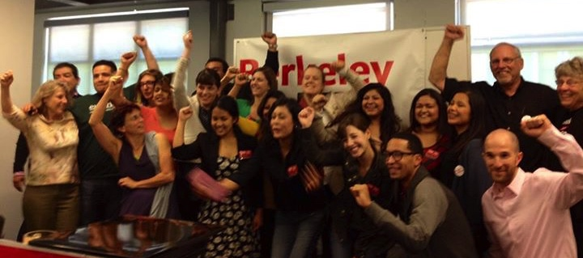
How Berkeley Beat Big Soda
& your city can too!
Holly Scheider, MPH
hollyscheider@icloud.com

Slide 2
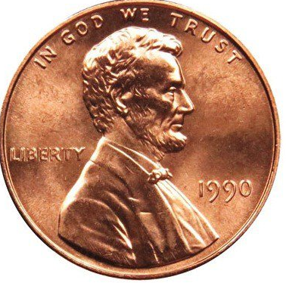
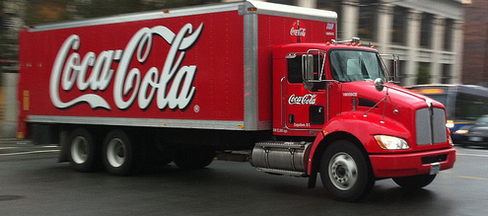
Bay Area Sugary Drink Tax Basics
Penny per ounce
Excise tax: paid by distributors
Ballot initiative – decided by Voters
General tax – goes into general fund

Slide 3
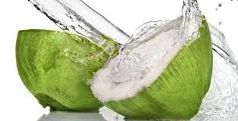

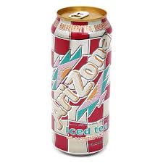
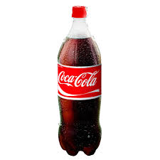
Bay Area Sugary Drink Taxes:
What does it tax?
Taxed – products with added caloric sweetener
Not taxed
Regular soda
Presweetened iced teas
Sports & energy drinks
Commercial syrups for fountains & sugary drink preparation
Other drinks with added sugar
Water
100% juice
Coconut water
Coffee or tea not presweetened
Infant formulas
Medical drinks
Products that are primarily milk
Alcoholic beverages (already taxed)
Diet soda

Slide 4

Bay Area Sugary Drink Tax Basics 2
General tax requires simple majority to win but $ goes to general fund = all Bay Area taxes
A designated tax requires super majority (67%) – in 2014, SF tried this approach and lost with 55%
All Bay Area tax initiatives create commissions to advise City Council on how to spend funds

Slide 5
Outcome from Berkeley tax
$1.5 million raised first year:
15% to administer and evaluate - $225,000
Remaining funds divided equally: $637,500 each
  school district garden and nutrition program
  community programs targeting communities with highest diabetes rates
Need to continue to advocate through coalition and advisory commission to ensure funding allocation.

Slide 6
Bay Area Soda Tax: History
2012 – Richmond lost: 33% of vote
  Beverage Association spent $2.5 million to defeat
2014 – Berkeley won: 76% of vote
- $2.4 million spent to defeat
2014 – San Francisco lost: 55% of vote
- $10 million spent to defeat
2016 – Albany won: 72%
Oakland won: 61%
San Francisco won: 62%
- $30 million spent in 2016 to defeat Bay Area taxes

Slide 7
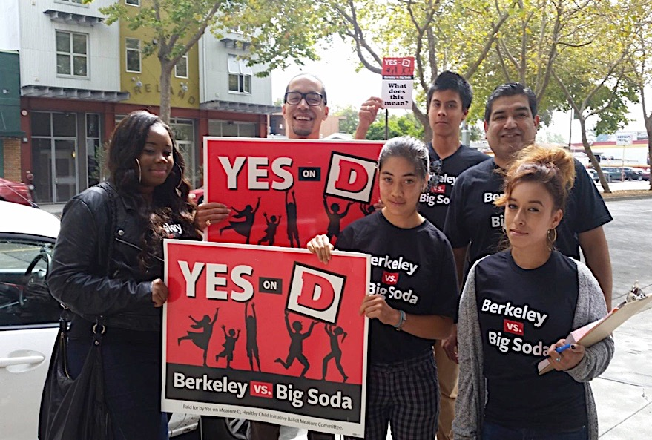
Overview of Strategy: Getting Started
Polling
Recruit leaders & build coalition
Engage community
Business outreach
Frame the issue:
  Health of our Kids
  Big Soda’s target marketing and profit motive
Resources: people, RAISE $, expertise, NGOs
Strategic policy decisions to ensure winnability
Notes:
Vital

Slide 8
How we pre-empted Big Soda play book
Big Soda tried to…
Buy off organizations and churches of color
Convince local business that it will hurt their profits
Distract voters: “Grocery Tax”
Confuse voters by attacking the measure
So we tried to...
1. Meet with key organizations / leaders through our pre-existing relationships
Meet with leaders & neighborhood businesses to neutralize
2a. Focus the measure on the big companies that market to kids while easing the law for local business
3. Educate the community about the science behind this policy &
3a. Tell voters that Big Soda has huge profits to lose. Who do you trust?
4. Stay on message – what the measure is and what it is not
“Confusion is the last resort of scoundrels.” - Harry Snyder

Slide 9
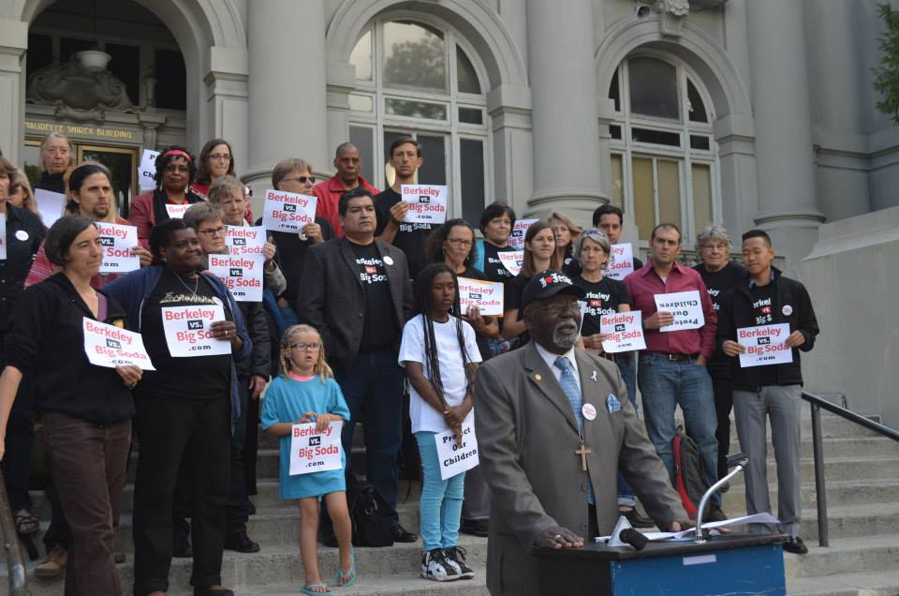
Community Engagement / Mobilization
Communities of Color – events, leadership organizations, canvassing neighborhoods, youth
Schools / parents: PTA, etrees, events, volunteer recruitment
UC: SPH internship, student leadership, faculty
Soda Series: targeting different voting groups, especially hills voters and UC faculty & staff
Local business: lots of outreach to explain the health impact and recruit supporters. Debate at Chamber of Commerce.
Role of youth: Ecology Center & LCHC hired teen and young adults to canvass. Tried to get funding for youth outreach and education before we started.
Bloomberg funds enabled hiring 30 people for the last two weeks.

Slide 10
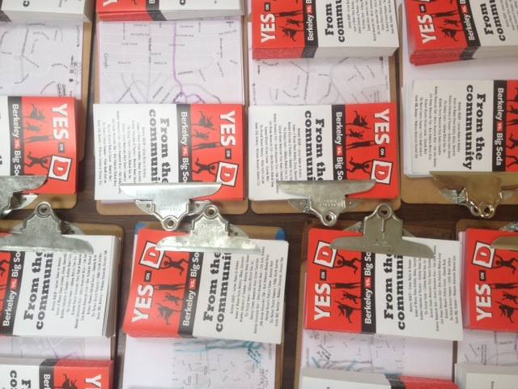
Resources in Berkeley
People! Volunteers who will give time & expertise
NGOs that will share resources: Berkeley Ecology Center and Latino Coalition for Healthy California
Outside experts: public health, media, political
Funding: minimum budget - $75 - 100,000
  Goal for local fundraising: $100,000
  Goal for outside donations: $50,000+

Slide 11
Lessons Learned from 2016 campaigns
Build a strong and diverse coalition with leadership that the community trusts
Early signed endorsements from key community organizations and leaders
Reach out to local business through customers, doctors, dentists, electeds
FUNDRAISE early
Keep it all on the QT as long as you can
Paid political consulting and community outreach
Media coverage

Slide 12
Money in 2014
Berkeley Totals:
Yes on D: $919,951
No on D: $2,445,107
As of end of Sept 2014:
Yes - $150,000
No - $1.8 million
In Berkeley, we were winning by 59-69% before Bloomberg’s donation
$650,000 was for TV Bloomberg bought – did not tell us
Berkeley Yes w/o TV:
  $269,000

Slide 13
Money in 2016
Albany:
Yes - $8550
No - $217,486
Oakland:
Yes - $10,726,986
No - $ 7,306,489 + Bay Area media
San Francisco 2016:
Yes - $12,068,264
No - $22,645,556
Big Soda spent over $30 million to defeat 2016

Slide 14
Why did Bay Area soda taxes win?
Community mobilization – engaging key leaders and communities of color before going public
History of nutrition education programs
Bay Area voters hate big corporations
We told the truth – health impacts, health inequities
Good policy decisions for winning
Voter outreach – lots of door knocking and calls; paid and volunteer
Political expertise and organizers
Community Commissions to advise allocation

Slide 15
Assess your community’s readiness
Polls:
  Raising Funds for a poll gives you information about how voters think and how easy it will be to fundraise
Who will oppose?
  Who do you need to reach out to neutralize?
  American Beverage Association will spend millions to defeat
Wedge communities –
  Communities of color – drink more soda, targeted by the beverage industry, history of sponsorship
  What are your relationships with key organizations and leaders in your wedge communities?
Community Assets:
  What are your community’s strengths that you can build on – leaders, organizations, volunteers, funders?
Leadership:
  Will your community’s elected officials unite in support?
  Who will be front-runners?
Analyze vulnerabilities, political divisions, etc in your city – be ruthless
Notes:
examined data, wondered about the questions, why so different than statewide results

Slide 16
Difference between passing the tax and the Public Health win
BALLOT BOX WIN:
Possible to pass tax by convincing 50% +1 of voters
Risk: alienate most vulnerable from health message: Drink LESS sugar
PUBLIC HEALTH WIN
Highlight health disparities and Big Soda target marketing of Latinos and African Americans
Requires engaging the communities targeted by Big Soda marketing, who also have disproportionate rates of diabetes
Notes:
Vital to

Slide 17
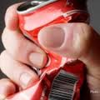
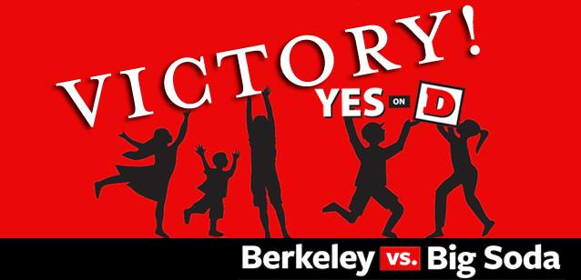
Together, we can beat Big Soda!
Holly Scheider, MPH
hollyscheider@icloud.com

Slide 18
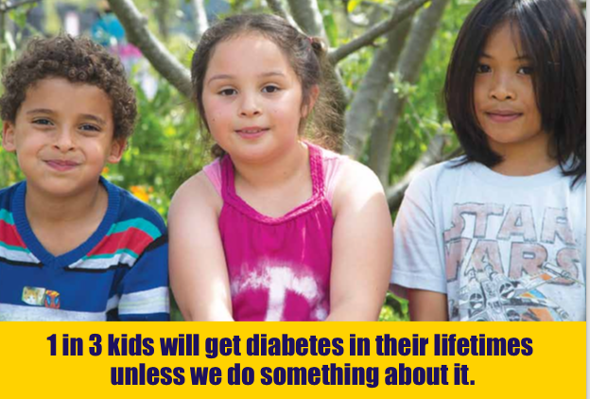
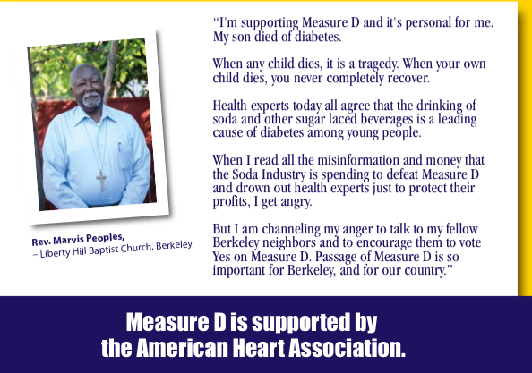
Berkeley vs Big Soda best mail piece

Slide 19
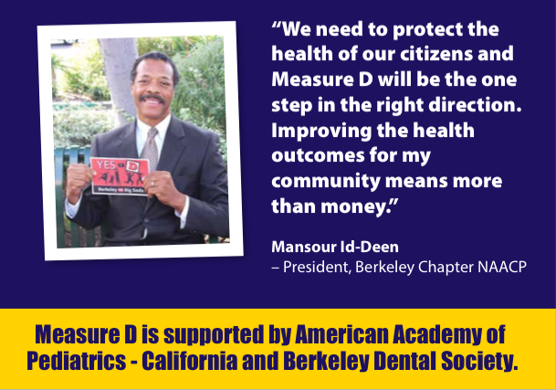
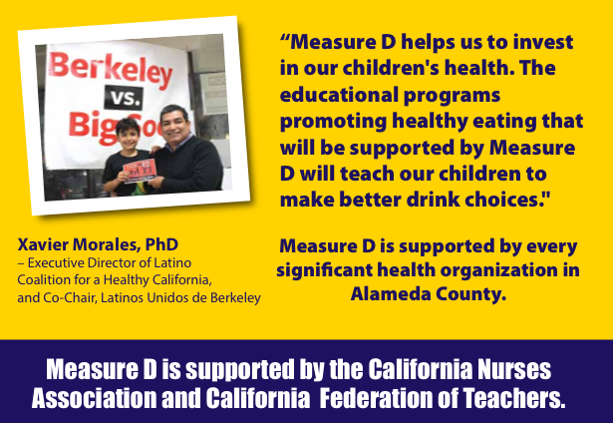

Slide 20

Framing the Issue:
Individual Responsibility
It’s the individual’s choice what to drink → You are responsible for your bad choices → You are responsible if you get sick as a result
Parents are responsible to make healthy choices for their kids
Not government’s job
Lets Big Soda off hook
Victim blaming

Slide 21
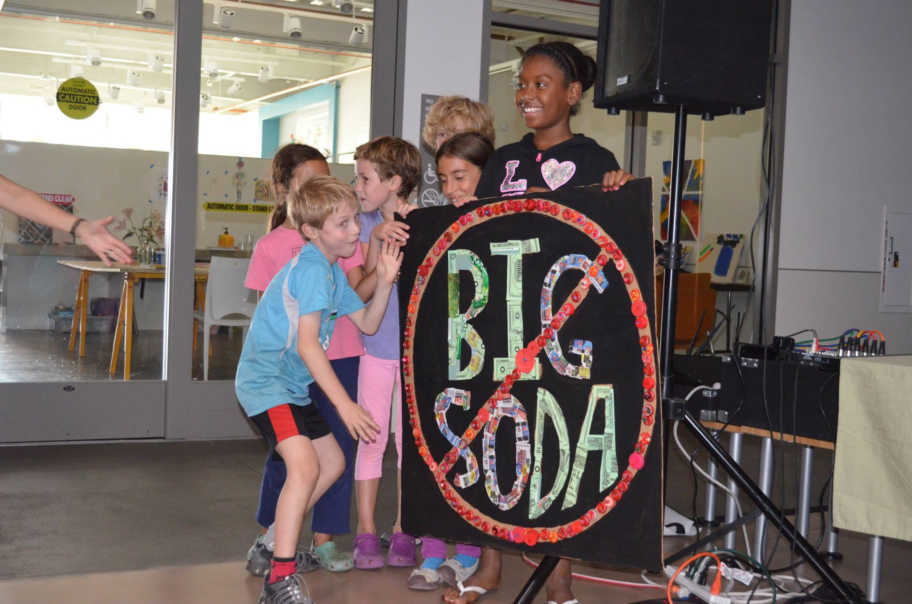
Framing the issue: Environmental
GOAL: To improve health by changing the environment in which people are bombarded by triggers and opportunities to consume sugary drinks
Industry tactics -- saturates our environment: price, placement, product (addictive), marketing, sponsorship
Big Soda is motivated by PROFIT $$$ and does not care about health
Taxes hold Big Soda responsible for harm caused by its products

Slide 22
Opposition messages
  Grocery Tax
  Money grab by City
  Can’t trust Council
  Will harm local business
  Unfair – why focus on drinks?

Slide 23
Voter Polls
Polls: we did several polls and looked at statewide polls.
Initial poll was funded by the Coalition and conducted Sept. 2013: showed 62-67% support – with little difference between general and designated tax. Compared to 48% support for parcel tax to fund child health programs (BUSD cooking and gardening).
City funded poll of registered voters – conducted in March and April. These polls included questions about a sugary drink tax on survey of potential ballot initiatives for 2014. Results remarkably similar: 66% general / 64% designated
Bloomberg polls – “strong”
Campaign funded tracking conducted on Oct 2014 – 3 weeks before the election. 64% with 5% margin of error would vote yes. 94% of respondents had heard of the campaign.
2014 Field poll statewide shows that over 70% support a tax that funds obesity prevention.
Notes:
examined data, wondered about the questions, why so different than statewide results

Slide 24
Key decisions in Berkeley soda tax effort:
  Timing: Berkeley needed to generate funding to sustain existing programs that would literally dry up without this funding. Our only opportunity is NOW -- not in 2016 = too late.
Unite on Goals: Ultimately we united around children’s health / obesity / diabetes prevention. Not enough money would be raised for universal pre-school.
Focus on the ultimate goal -- improve health, specifically metabolic diseases like diabetes that is on the rise, disproportionately impacts African Americans, Latinos, low income.
Build a BROAD coalition: we realized that we would only pass the tax and accomplish our goal of health if we brought on the communities most impacted – and likely to be most targeted by the ABA’s tsunami of money to defeat.
Include communities of color in process, decision making and leadership.
Engage and activate lead organizations representing African Americans and Latinos, churches, university, students, BUSD parents and teachers, dentists, medical professionals.
City political leadership: Reached out to all City leadership - Council members and candidates, School Board and candidates – and ultimately gained unanimous support

Slide 25
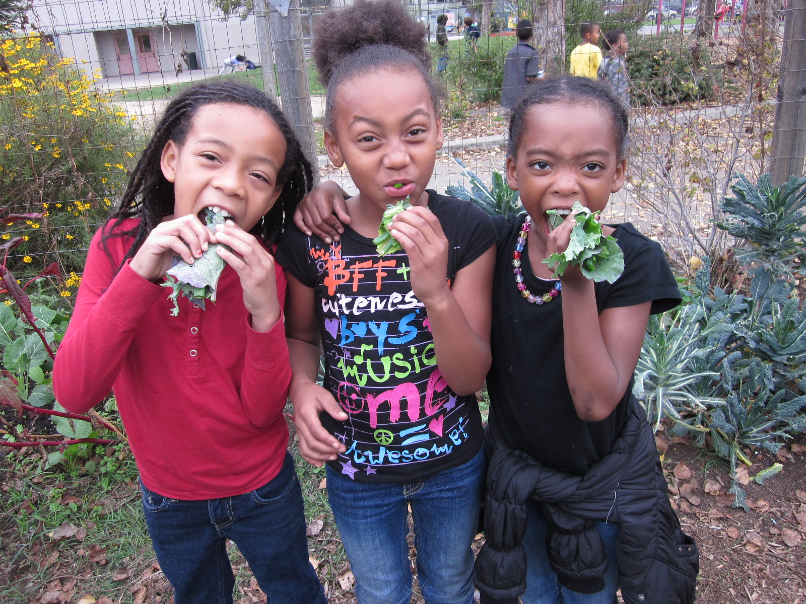
Community Assessment: Was Berkeley Ready?
Conduct local Polls:
We did several local polls: Sept 2013, Mar 2014 & Oct 2014
Compared local to statewide polls
Who are our natural allies?
Schools / teachers, parents, health workers, public health,
People concerned about medical costs, health equity
Who will oppose?
Business: chains, convenience stores, what about local stores / restaurants?
Voters who oppose taxes & sin taxes (because it is the wrong approach)
Wedge communities: people of color – find out where they stand
White voters who feel guilty about potential burden of tax on people of color
American Beverage Association will spend millions to defeat
Berkeley Assets = Community history:
Strong track record on health policy: school garden program & school lunch initiative
Berkeley: first in the nation to pass tobacco control, curb cuts, divestment…
Leadership:
CBOs – Ecology Center, PTAs
All City Council & School Board endorsed Measure D
Notes:
examined data, wondered about the questions, why so different than statewide results

Slide 26
Analyze Community Vulnerabilities:
Ruthless assessment of community vulnerabilities, political divisions, etc.
What will Big Soda focus on? They have $, high paid consultants, no ethics
Wedge communities: Communities of Color
  Drink more soda, targeted by the beverage industry,
  In Richmond, Big Soda bought off organizations & churches
  In Berkeley, few voters of color but white guilt was big concern
How did we respond?
Recruited people of color to be part of leadership and decision making
Educated key organizations (NAACP, Latinos Unidos) – gained endorsement
Needed more contact with people of color in the community to offset Big Soda’s campaign but did not have money to do this until the end of campaign
A true win requires more than votes.
It requires standing TOGETHER against Big Soda.

Slide 27
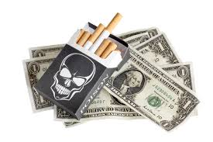
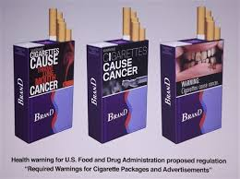
Lessons from Tobacco Prevention
Start Local: too much industry money in state politics
Engage your community: build broad coalition to educate voters & advocate to local leaders
Strategic Decisions to increase chances of winning
Frame the issue:
Highlight the health impacts
Profits at expense of our health
Industry targets people of color, children, low income

Slide 28
Public visibility and media:
Organized a good showing at City Council -- demonstrating the broad support for the issue
Media: met with media, framed the issue, earned media & op eds
Recruiting super star spokespeople -- tried for Alice Waters, Michael Pollan, got Robert Reich, Anna Lappe, Marian Nestle, Bittman
Ground campaign -- mass voter outreach, canvass, phone banking, events,
fundraising
visual -- lawn signs everywhere - demo public support
Bloomberg bump
mailings / response to industry attack - keep turning it back on the industry and stick to our message about health

Slide 29
Together, we can beat Big Soda!
Holly Scheider, MPH
hollyscheider@icloud.com

Slide 30
Strategic Policy Decisions to help us WIN!
General Tax Approach
Because of Prop 13 in California, any designated tax is required to pass by a supermajority – 67% of the vote.
A tax that goes to the general fund only requires a simple majority – 50%.
SF chose the designated tax route – and earmarked funds for public health, recreation, and the schools.
Berkeley made a strategic decision to try the easier win – because we are up against Big Soda which has a lot of money and a lot to lose!
Who to Tax
Focus on the big drink companies that market to kids and people of color
Exempt “house made drinks”

Slide 31
Framing the issue:
Goal: To improve health by changing the environment in which people are bombarded by triggers and opportunities to buy & drink SSBs
Science linking sugary drinks and diabetes.
Industry tactics -- saturates our environment: price, placement, product (addictive), marketing, sponsorship
Big Soda is motivated by profit and does not care about health
We want Big Soda to take responsibility for harm caused by its products
Pivot back to these points - rather than go on defensive about business, regressive, trust of Council, etc.
Berkeley Media Studies Group:
- training and support

Slide 32
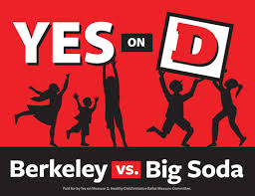
Berkeley’s Measure D
1 cent per ounce tax
Proposed by broad community coalition after BUSD school district garden and nutrition program Federal funding was cut
Extraordinarily diverse community support

Slide 33
YES on Measure D talking points:
The MOST important message: you are a neighbor / parent… and why YOU are volunteering for YES on D. Please consider the source of information when deciding to vote. This is a first step for health – please vote YES for our kids, our community.
BASIC INFO: 1 cent per ounce tax on drinks with added caloric sweetener
We face an urgent health crisis:
  1 in 3 children will get diabetes – rates are closer to 1 in 2 for kids of color (CDC)
  Overwhelming scientific evidence identifies sugary drinks as major cause of diabetes.
Big Soda spends millions to aggressively market drinks to our children.
  This is a tax on the distributors of sugary drinks, not a sales tax on consumers.
This tax is the right first step for our kids’ health – in Berkeley and across the nation.
  Measure D is supported by a broad community coalition: NAACP, Latinos Unidos, Berkeley Federation of Teachers, League of Women Voters, Ecology Center and advocates for child nutrition education over last 20 years.
  All City Council members and candidates have endorsed YES on D – our leaders and community advocates all agree -- YES on D.
  NO on D has received $2.4 million from the American Beverage Association.

Slide 34
Accountability
Creates panel of nutrition, medical and public health experts who must recommend how the money should be spent
Must also evaluate and report on impact
FAQ: Where does the money go? Where is the accountability?
Measure D requires a panel of public health and child nutrition experts to help determine how revenues are spent to improve children’s health. The panel will evaluate priorities in annual reports to Council, similar to the commission that already advises Council on how to distribute general funds for youth services. The City of Berkeley has a decades-long, on-going commitment to child health and nutrition.
First, we need to pass Measure D. Then we can advocate for nutrition education, etc.

Slide 35
Decision to go with a general tax
Because of Prop 13 in California, any designated tax is required to pass by a supermajority – 67% of the vote.
A tax that goes to the general fund only requires a simple majority – 50%.
SF chose the designated tax route – and earmarked funds for public health, recreation, and the schools.
Berkeley made a strategic decision to try the easier win – because we are up against Big Soda which has a lot of money and a lot to lose!
FAQ: Where does the money go? Where is the accountability?
Measure D requires a panel of public health and child nutrition experts to help determine how revenues are spent to improve children’s health. The panel will evaluate priorities in annual reports to Council, similar to the commission that already advises Council on how to distribute general funds for youth services.
Berkeley has a decades-long, on-going commitment to child health and nutrition.
First, we need to pass Measure D. Then we can advocate for nutrition education, etc.

Slide 36
Health Reasons
for doing a
sugary drink tax

Slide 37
Why a sugary drink tax?
40% of all youth will develop diabetes -- 1 in 2 of African American and Latino youth
CDC Journal of American Medicine, 2003

Slide 38
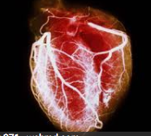

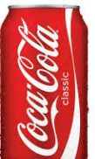
Why a sugary drink tax?
Sugary drink consumption linked to dental decay, diabetes, heart disease, obesity
Just one sugary drink a day can increase risk of DIABETES by 26%
Notes:
26% increased risk of diabetes with one drink / day:
http://www.sugarscience.org/sugar-sweetened-beverages/#.WKNgEbYrJZq

Slide 39
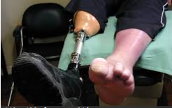

Why a sugary drink tax?
Diabetes will cost $15 billion / year in NEW medical costs in California
Notes:
Public Health Advocates fact sheet is source

Slide 40
Beverage Industry Marketing
Targets communities of color:
  African American children see twice as many ads as white kids
  Latino youth more likely than other youth to visit sugary drinks websites (60% more likely to visit 5HourEnergy.com)
Targets low income neighborhoods:
  convenience stores, fast food – products are cheap and placed prominently
Targets youth
Notes:
Source – Roberto Vargas, UCSF Sugar Science
http://www.sugarydrinkfacts.org/resources/Targeted-marketing-sheets-Black-Hispanic.pdf
http://www.sugarydrinkfacts.org/resources/Targeted-marketing-sheets-Children-Teens.pdf

Slide 41
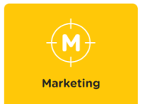
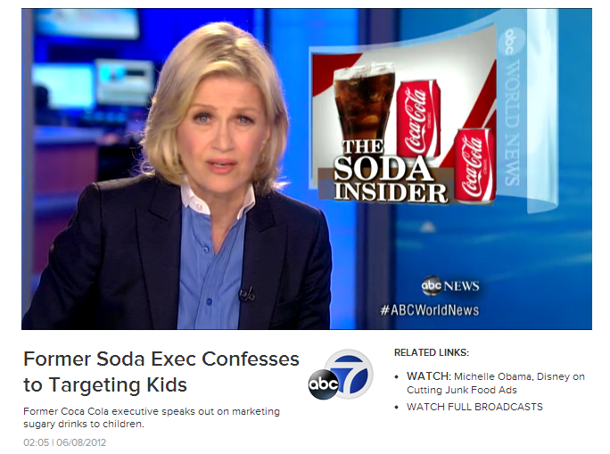
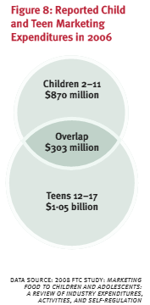
Targeting African American
and Latino Children and Teens
African American children and teens saw 80% to 90% more ads compared with white youth.
Marketing on Spanish-language TV is growing. From 2008 to 2010, Hispanic children saw 49% more ads for sugary drinks and energy drinks, and teens saw 99% more ads.
Hispanic preschoolers saw more ads for Coca-Cola Classic, Kool-Aid, 7 Up and Sunny D than older Hispanic children or Hispanic teens did.
Notes:
Marianne Szeto – UCSF – Clincial & Translational Science Institute
Big Soda clearly targets African American and Latino Youth and Children.
http://www.sugarydrinkfacts.org/resources/SugaryDrinkFACTS_ReportSummary.pdf​
African American disproportionate exposure is partially explained by greater TV viewing times, however some brands appeared to target black youth specifically with their media buys and/or ad content.
In order to reach these groups, industry leaders such as Coca-Cola and PepsiCo have created multicultural marketing teams, which develop targeted campaigns that speak to the cultures and unique social norms of these groups. (Breaking Down the Chain: A Guide to the soft drink industry, ChangeLab Solutions), 2012)
A recent quote from Joe Tripodi from the Coca-Cola company, sums it up from a marketing webinar on March 6, 2014: Winning the Hearts and Minds of the Global Millennial Generation
“Vision 2020 is Coke’s plan to double its business by 2020… This aggressive plan is focused on dramatically increasing consumption of sugary beverages by young people using precision marketing that targets young people, mostly in Latino and African-American communities in the United States and developing countries abroad…” Joe Tripodi, Chief Marketing and Commercial Officer for the Coca-Cola Company
Why does the industry target youth?
Do you feel targeted?
A significant portion of marketing aimed directly at youth ages 2–17. (Commission. UFT. Marketing Food to Children and Adolescents: A Review of Industry Expenditures, Activities, and Self-Regulation. . In. Washington, DC: US Federal Trade Commission; 2008.)

Slide 42
How do taxes improve health?
3 ways tobacco and soda taxes improve health:
Campaigns raise awareness
If Big Soda raises prices, that can reduce consumption
Raise funds for prevention programs
Notes:
Sugary drink taxes are like tobacco taxes

Slide 43
Outcome from Berkeley tax
$1.5 million raised first year:
15% to administer and evaluate - $225,000
Remaining funds divided equally: $637,500 each
  school district garden and nutrition program
  community programs targeting communities with highest diabetes rates

Slide 44
What Berkeley funded in 2015/16
Ecology Center to implement It’s Your Body – Don’t Hate, Hydrate! Program: teen peer education and organizing to change environment.
YMCA to educate Head Start families about healthy drink practices and to implement the Diabetes Prevention Program to reduce diabetes risk.
Healthy Black Families to train residents to educate the community through hands-on cooking classes, water promotion and policy efforts.
Berkeley Youth Alternatives to train teen educators in nutrition education and increase accessibility of fresh produce.
Notes:
$245,874 to Healthy Black Families to enact Thirsty for Change! Which has the following components: 1) community needs assessment; 2) Train a cohort of community residents to educate about: health inequities in Berkeley, the health effects of SSBs, industry’s predatory marketing practices, and encourage tap water; 3) Provide “hands-on” instruction to support African American families to shop smart, cook smart, and eat smart through cooking instruction, family workshops and peer support to change behaviors; and, 4) Promote organizational policies and practices to reduce SSB consumption and encourage consumption of tap water.
$115,266 to the Ecology Center to: 1) develop a cadre of peer health educators to lead the It’s Your Body – Don’t Hate, Hydrate! outreach and education efforts, 2) Increase awareness of health risks of consuming SSB’s and promote consumption of tap water and healthy foods among Berkeley youth ages 14 to 22; 3) Improve the built environment to support healthy beverage choices.
$151,031 to the YMCA for: 1) supporting the CDC Recognized Diabetes Prevention Program 2) to support their Head Start programs to educate and implement healthy drink practices among students, teachers and families; and 3) provide ongoing training for head-start teachers to deepen their understanding of health and nutrition.
$125,000 to the Berkeley Youth Alternatives for: 1) training youth in nutrition education, 2) make fruits and vegetables more accessible to both the BYA youth and also at two faith centers, 3) conduct a social marketing campaign that promotes good nutrition habits free of SSBs and rich in fruit and vegetable consumption.

Slide 45
Berkeley’s Tax WORKS!
Falbe & Madsen study:
Survey of 2,500 residents in low-income, high-foot-traffic commercial areas of Berkeley, Oakland and San Francisco: summers of 2014 and 2015
Shows a 21% drop in the drinking of sugary drinks in Berkeley’s low-income neighborhoods after the soda tax
In San Francisco, where a soda-tax measure was defeated, and Oakland, 2014 saw a 4% increase in sugary drink consumption
Berkeley reported a 63% increase in drinking water
Oakland and SF showed only a 19% rise in water consumption.
Only 2% of the Berkeley residents polled reported that the tax led them to shop for sugary drinks in neighboring cities that do not have a soda tax.
American Journal of Public Health, 8/23/2016, Falbe et al.

Slide 46
Why did Berkeley win?
We won Measure D with 76% of vote – over 30,000 votes. Why?
Community mobilization – engaging key leaders before going public
Berkeley’s track record with nutrition and health
Berkeley voters hate big corporations
We campaigned on the potential of sustaining beloved, existing programs: the school district’s cooking & gardening classes that have lost all funding
Berkeley’s disclosure laws are stricter than many places: all mailings required to state how much was donated and by whom (ABA)
Good policy decisions for winning
Berkeley is a small city (117,000 residents with 80,000 voters):
  Easier to canvass and talk person to person
  Big Soda’s campaign really saturated – and pissed people off
Tola fellows – canvassing and phone banking for stipends
We were winning by 59-69% before Bloomberg’s donation
We worked our butts off!

