Slide 1

WEBINAR POLLING & CHOOSE CHILDREN 2018
January 24
Noon to 1pm

Slide 2
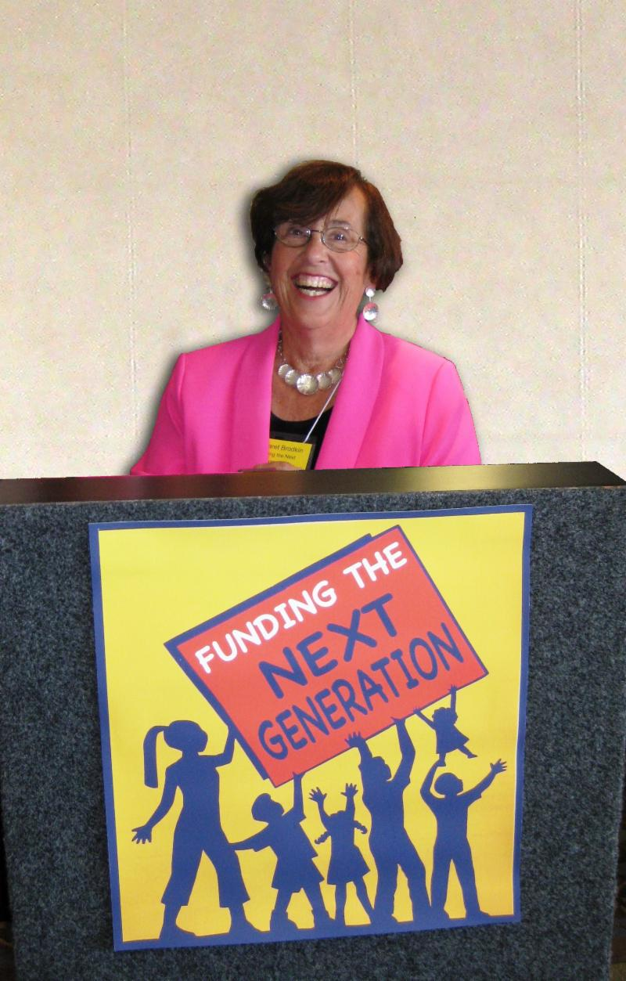
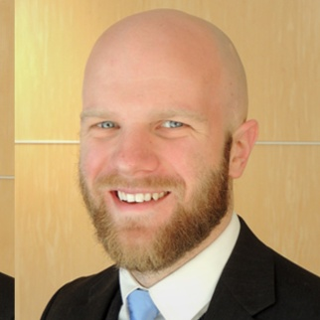
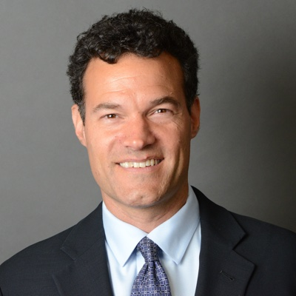
SPEAKERS Margaret Brodkin Pete Weldy Ben Tulchin

Slide 3


San Francisco Citywide Survey Results – San Francisco Children’s Fund
January 2018

Slide 4
Increasing Funding for Children in San Francisco
Tulchin serves on the board of JVS, which provides job training and placement for TAY (transition-age youth).
With the San Francisco Children’s Fund set to expire, Tulchin recognized the opportunity of increasing the amount of the set aside as part of the effort to renew and extend the Children’s Fund to provide more funding for children as well as expanding the age children qualified to 24.
Tulchin worked with JVS and the children’s coalition, led by Margaret Brodkin, to develop and field the survey and advocate for this increase in funding and change in policy, including getting the poll results published in The San Francisco Chronicle.

Slide 5
Survey Methodology
San Francisco citywide survey among 500 Likely November 2014 voters;
Fielding conducted February 9-12, 2014, using live telephone interviewers calling both landlines and cell phones.
Overall Margin of Error is ± 4.38%

Slide 6
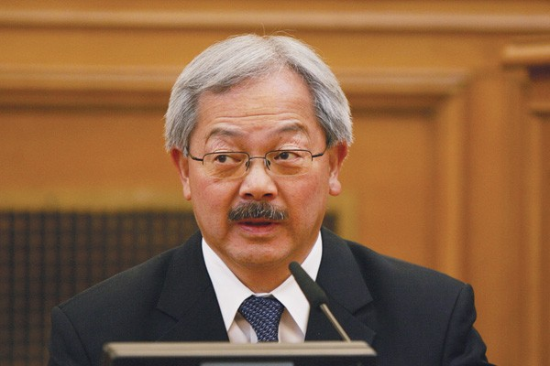

Mayor Lee Initially Opposed Expanding the Children’s Fund
In advance of an election year, the Mayor was not thrilled with a larger set aside
Vs.

Slide 7
Strong Support for Extending and Increasing the San Francisco Children’s Fund
74%
20%

Slide 8
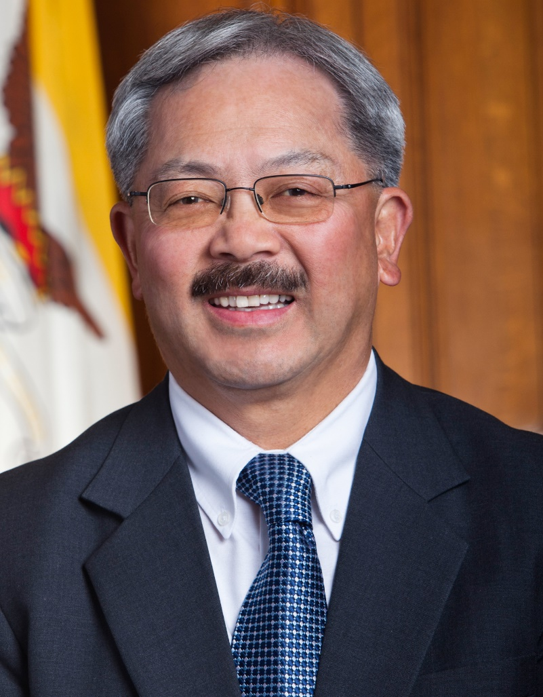
After Polling Revealed Broad Support Citywide, Proposition C was Placed on the November 2014 Ballot with Full Mayoral Support
+

Slide 9
Strong Support for Extending and Increasing the San Francisco Children’s Fund in Polling Reflected Final Election Results
Tulchin Research Poll
(Feb 2014)
Final Election Result
(Nov 2014)
Support/Yes
Oppose/No

Slide 10
San Francisco Citywide Survey Results – San Francisco Children’s Fund
January 2018

Slide 49

FUNDING THE NEXT GENERATION Securing resources for our children and youth today to ensure a healthy, vibrant future for our communities tomorrow. “We are a growing network of city and county-based coalitions committed to meeting the needs of California’s children, youth, families and communities through the creation of dedicated local funding streams that provide future generations with the resources they need to thrive and succeed.” Our Strategies:
Provide technical assistance to coalitions working on local funding streams for children and youth
Sponsor learning community and conferences
Site-level support includes speaking, convening, facilitating, trouble-shooting, coaching, and more.
Manual available “Creating Local Dedicated Funding Streams for Kids: A Guide to Planning a Local Initiative to Fund Services for Children, Youth and Their Families”

Slide 50
CONTACT Margaret Brodkin margaret@fundingthenextgeneration.org www.fundingthenextgeneration.org

