Slide 1
Santa Monica’s Unique Funding for Public Schools
COMMUNITY FOR EXCELLENT PUBLIC SCHOOLS…
ADVOCATING FOR ADEQUATE RESOURCES
2003-2018

Slide 2

CEPS Mission Statement
To promote a shared community vision for excellence in our public schools that includes early childhood and post-secondary education;
To evaluate and pursue a range of short and long term funding measures through state, city and school district policies and elections;
To identify and support issues that will support education and public schools, including early childhood education, after-school programs, and post-secondary public education;
To increase public awareness of the value and uniqueness of our public schools;
To promote accountability for high quality public education by public institutions and public officials.

Slide 3
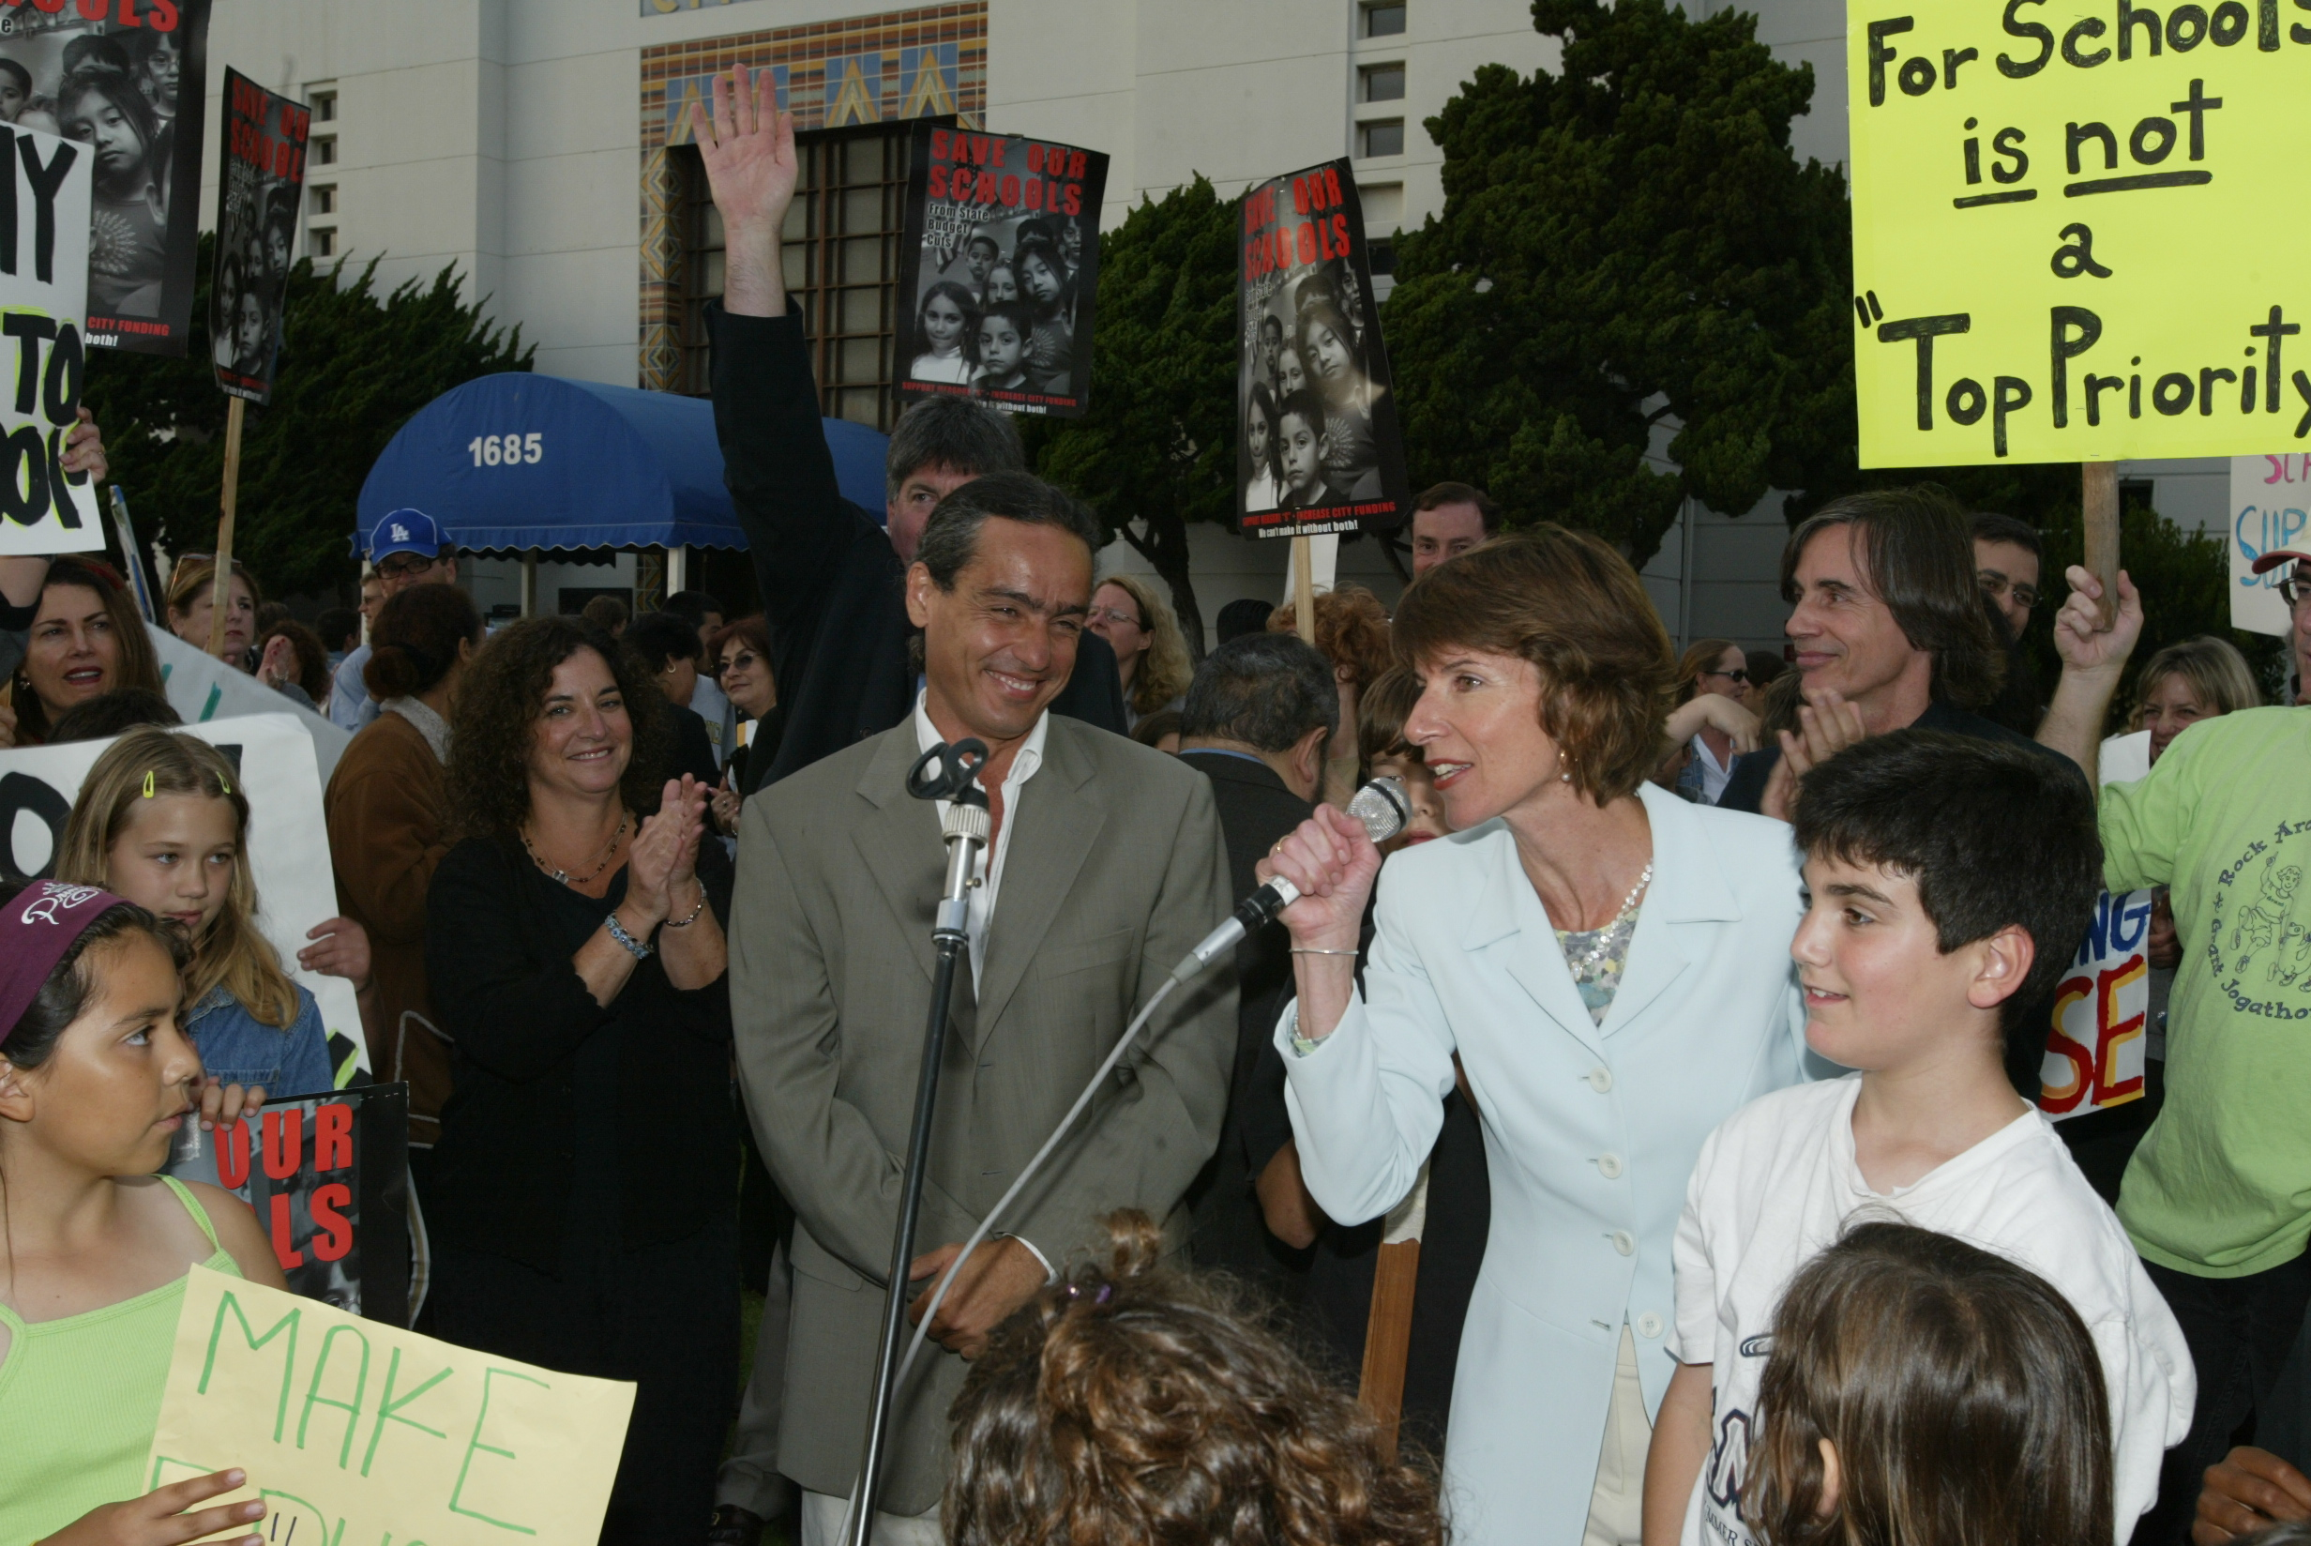
June 2003
From the ballot box to City Hall:
Goal: Annual city budget commitment of $6 million to forestall teacher lay-offs and program cuts caused by state reductions. (Multi-pronged strategy)
Rally at City Hall with Jackson Browne
CEPS organizes hundreds of parents, teachers and students.
Santa Monica’s City Council turns us down.

Slide 4
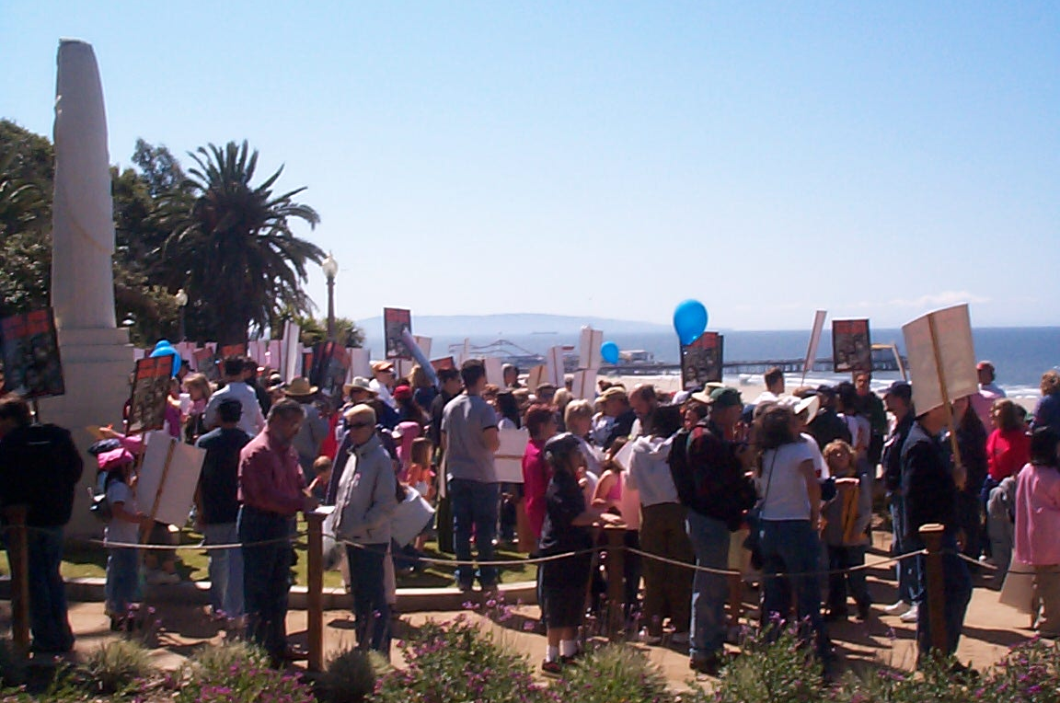
Circulating Petitions to Qualify for Ballot
The failure at City Council and resulting budget shortfall motivates CEPS to pursue an amendment to the City Charter.
The amendment would tie funding for schools to the City’s general fund. Target amount: $6 million per year
With legal language drafted, the effort to qualify for the ballot is launched!

Slide 5
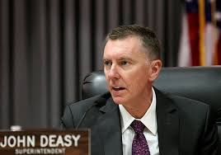
Meanwhile…City and School District Negotiate
As CEPS mobilizes every conceivable strategy to gather the necessary 15,000 signatures* (of registered voters) => => => => =>
* Full-fledged political campaign
Superintendent John Deasy and City Manager Susan McCarthy negotiate terms to convey funds on a contractual basis.

Slide 6
June 2004 – Victory!
CEPS drops ballot measure effort as
Santa Monica City Council NARROWLY votes to approve contract:
$6 million per year
Renewable every 5 years, with CPI increases

Slide 7
“Master Facilities Use Agreement” in June 2018
Annual CPI increases yield:
“AGREEMENT” TOTAL TO DATE:
2004 - $6 million/year…
2012 - $8 million/year…
2018 - $9 million/year…
$101,000,000

Slide 8
Cultivating a Culture of Support for Education Education named one of top 5 City priorities
CEPS has pursued additional political strategies to generate funds:
2006 Facilities bond
2008 Renewal of parcel taxes: CPI increase, no sunset
2010 Budget crisis – parcel tax special election failed
2010 City of Santa Monica Transaction and Use Tax with Advisory
2012 Facilities bond
2016 2nd City of Santa Monica Transaction and Use Tax with Advisory
2016 Community College Facilities bond (Santa Monica College)
2018 Potential Facilities bond
$25 million per year from City to District (Agreement + TUTs)

Slide 9
$300,850,000
TOTAL OPERATING REVENUE* GENERATED
FROM CEPS-LED EFFORTS
2003-2018

