Slide 1

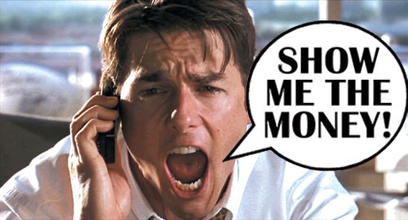
A BUDGET MUST REFLECT OUR VALUES.
FUNDING
THE
NEXT
GENERATION
June 25, 2018
Los Angeles
GENERAFFFTION FUNDS IN U.S.
Preschool – Denver, San Antonio, San Francisco, Cincinnati
Violence Prevention – Little Rock, San Bernardino, Oakland, Santa Rosa
Mental health – 8 counties in Missouri, 3 counties in Ohio
Soda – Philadelphia, San Francisco, Oakland, Albany, Berkeley, Boulder

Slide 2
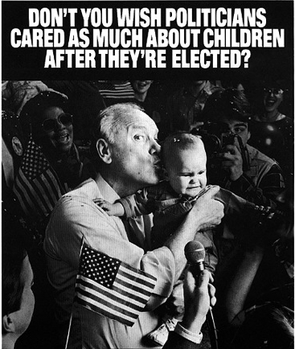

Slide 3
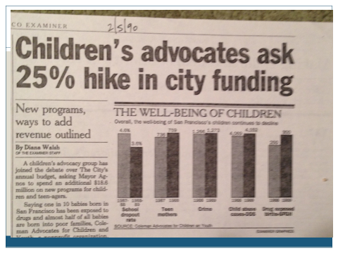
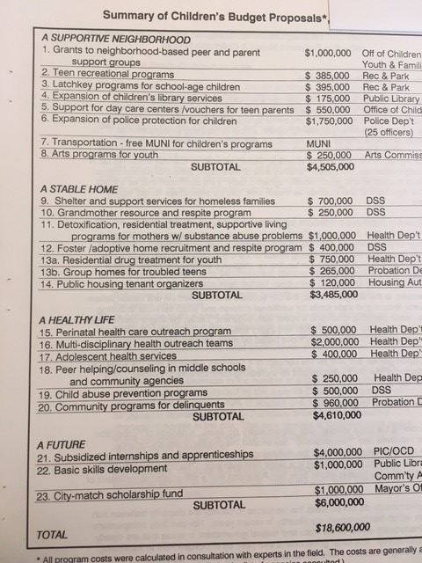
The San Francisco Story
Aha #1
RHETORIC RESOURCES
Children’s agenda – passed by Board of Supervisors, signed by Mayor
Children’s budget submitted 3 consecutive years – Children’s Budget Coalition – 120 agencies strong
Inventing a new policy – the Children’s Fund
  Institutionalizing funding for kids
  Protecting existing funding – Children’s baseline

Slide 4
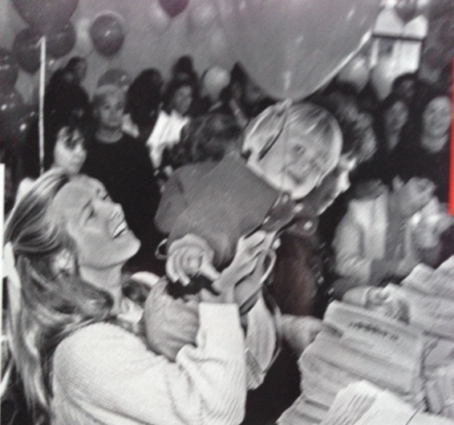
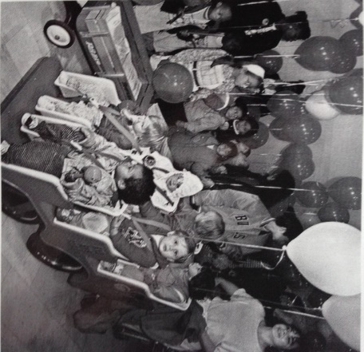

Aha #2
GOING TO THE PUBLIC
Circumventing City Hall
68,000 signatures Power
Elections are powerful – the magic of local campaigns
  Take the initiative – frame the issue
  Political hardball is essential
  Propose a solution
  “Never doubt that a small group of committed citizens can change the world. Indeed it is the only thing that ever has.” – Margaret Mead

Slide 5
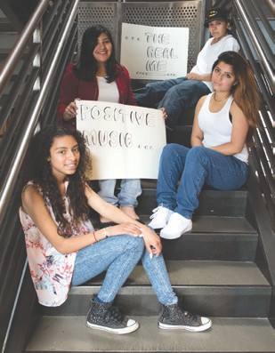
Aha #3
BENEFITS OF THE SAN FRANCISCO CHILDREN & YOUTH FUND
OUTCOME HAS BEEN TRANSFORMATIVE
Focus on prevention
Expanded opportunities for children, youth, families
Powerful department in local government for planning, coordination, accountability, transparency, and community engagement
Policy and systems reform – enabled by discretionary funds and local office for children’s issues
Leveraging of other dollars
Youth leadership in City Hall
Children’s constituency empowered
NOTE: RETURN ON INVESTMENT WAS HUGE.

Slide 6


Slide 7







ELECTIONS 2016 & 2018
NAPA
MARIN
SOLANO
SACRAMENTO
RICHMOND
ALAMEDA
SAN FRANCISCO
Notes:
delete

Slide 8

HOW LONG DOES IT TAKE?
Roadmap For Creating a Dedicated Fund
THERE ARE KEY ELEMENTS OF WORK, BUT NO LINEAR PATH
Making the case
Building the base
Crafting the plan
Mounting the
campaign

Slide 9
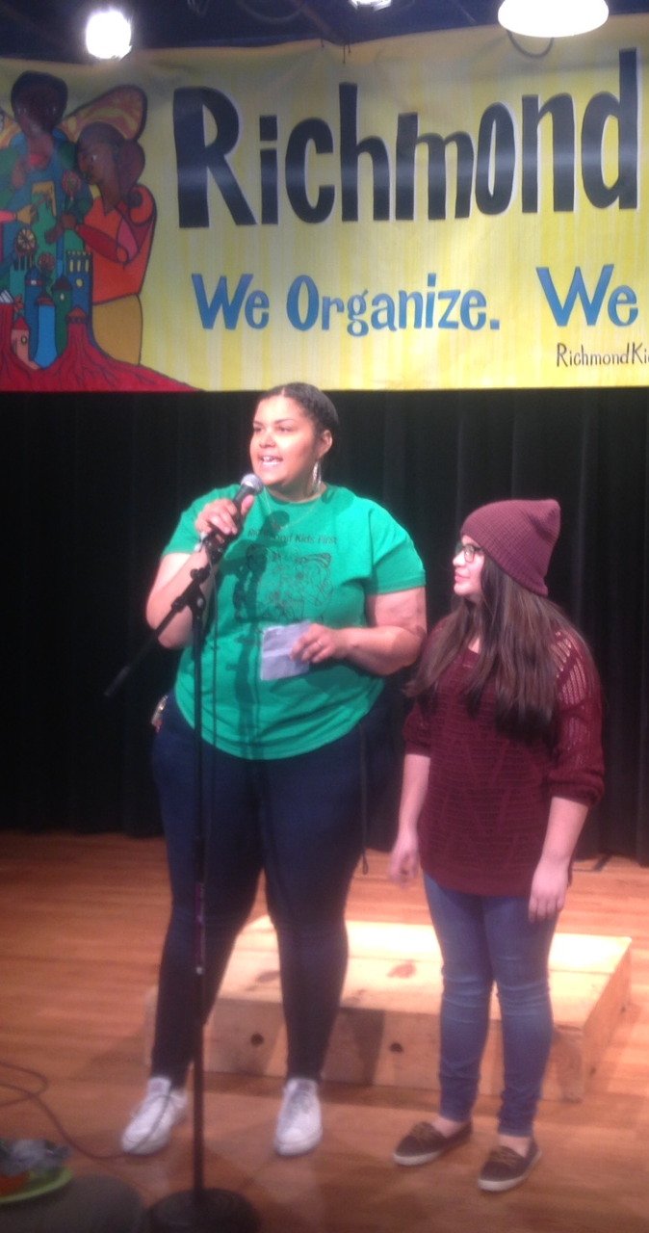
THE MOST IMPORTANT STRATEGY
IT’S ABOUT ORGANIZING.
Increasing the political and social capital of children, youth and families.
Activities can include coalition building, public education, door-to-door outreach, community meetings, house parties, rallies.
Build a powerful organization driven by community.
BEWARE: Always expect opposition – Competition for $, Protecting turf and control, Anti-government, Anti-taxes

Slide 10
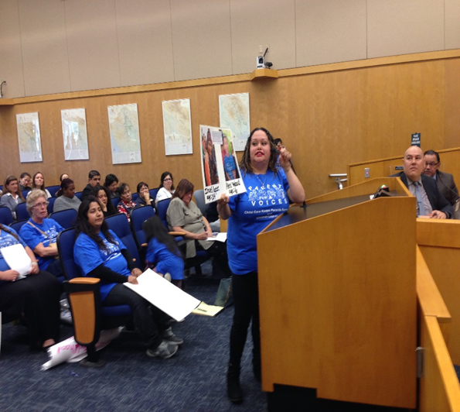
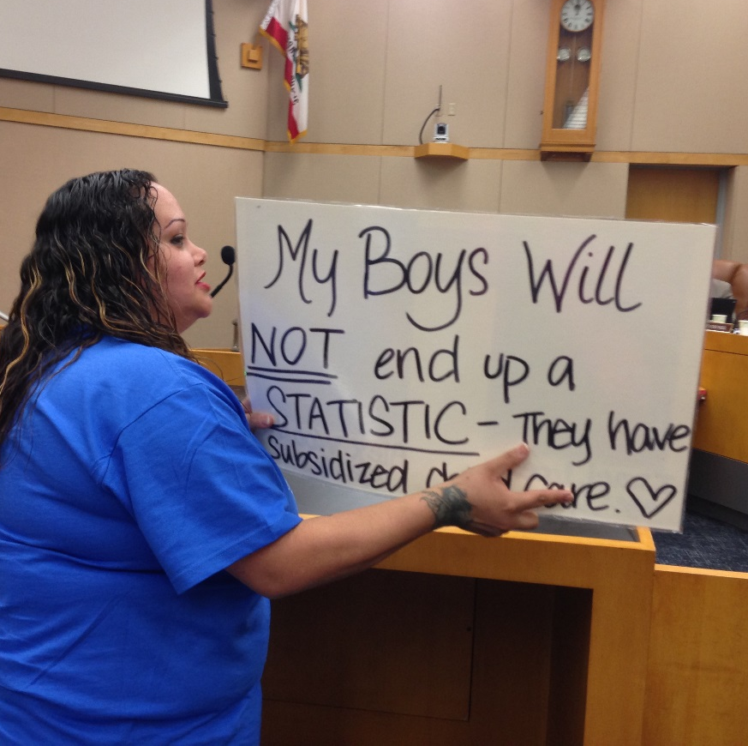
WHERE SHOULD WE START?
ESSENTIAL: A Convening Organization.
Hold a conference
Convene a planning meeting of allies
Become budget advocates
Create a Children and Youth Budget
Testify at a hearing/town hall
Research your legal options
Conduct a poll
DON’T start by going to elected officials to ask if they will support.

Slide 11
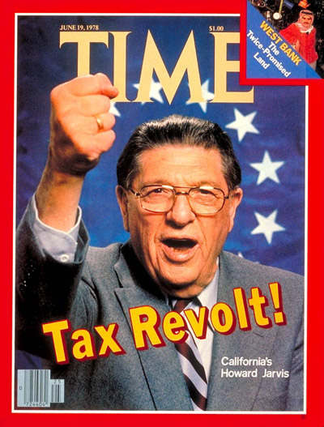

Challenge # 1
2/3 VOTER THRESHOLD
THE REALITIES OF CALIFORNIA ELECTION LAW ARE BRUTAL.
Some options:
Go for it
Workarounds – General taxes, Oversight bodies, Board-approved financial plans, Signature campaigns,
Set-asides
BEWARE: Perfect is the enemy of good.

Slide 12
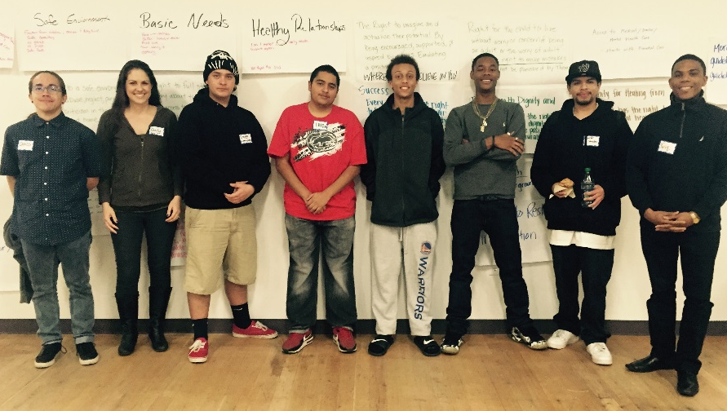
Challenge #2
NON-PROFITS NEED MORE SUPPORT AND POLITICAL PREPARATION
Assets – Tradition of social
justice, Understand problems
close-up, Deep connection
to youth and parents.
Challenges – Financial
conflicts, Political inexperience,
Not knowing legal rights, Lack
funding for advocacy/organizing. Fathers and Families in San Joaquin County with Bill of Rights they have written

Slide 13
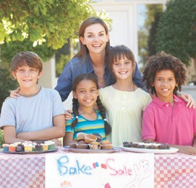
Challenge #3
MONEY FOR A CAMPAIGN
How much do you need? - $100,000 - $2,000,000
Challenge of children’s funds – no natural large donor
Consider potential partners with money in planning the initiative
Community Foundations can support electoral campaigns
Start early – open an account
.

Slide 14
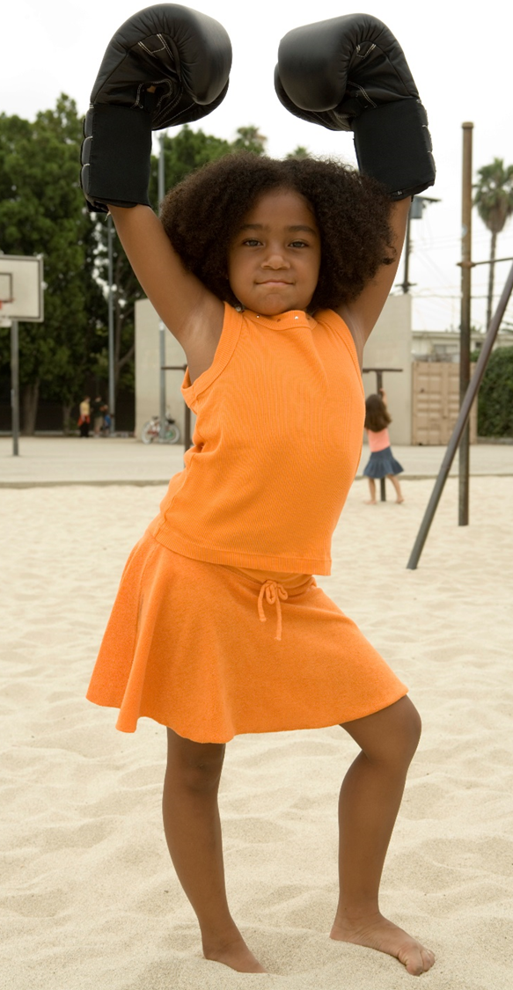
WE HAVE WHAT IT TAKES
WE ARE RIGHT
We can make the case.
We have energy.
There are a lot of us.
We have allies.
Now is the time for local politics.
We can build on the lessons of our pioneering colleagues
Notes:
delete

Slide 15
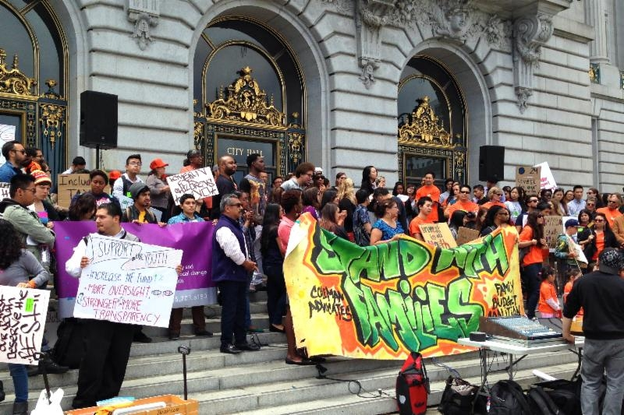
LESSONS LEARNED ABOUT PASSING A MEASURE
  It takes a village.
  It entails hardball politics.
  Youth and parents are powerful.
  Take the initiative.
  Media amplifies the case.
  Drama helps.
  Expect opposition.
  Elections are unique organizing.
  and communication opportunities.
  Power builds power.
  It is exhilarating!
Notes:
Delete unless these are lessons learned from tax and revenue work then keep

Slide 16

FUNDING THE NEXT GENERATION
Provides technical assistance to coalitions working on local funding streams for children and youth
Sponsors learning communities and conferences
Support includes speaking, convening, facilitating, trouble-shooting, coaching, and more.
Numerous tools and resources are available.
CONTACT:
Margaret Brodkin, Margaret@fundingthenextgeneration.org
415-794-4963
www.fundingthenextgeneration.org

