Slide 1


Slide 2


SPEAKERS
Jacky Guerrero
Associate Director
Equity in Community Investments
Margaret Brodkin
Founder/Director
Funding the Next Generation

Slide 3

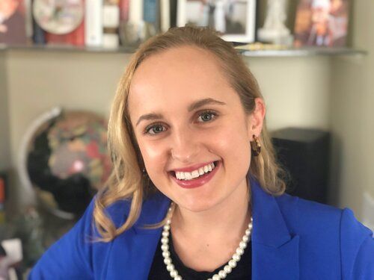
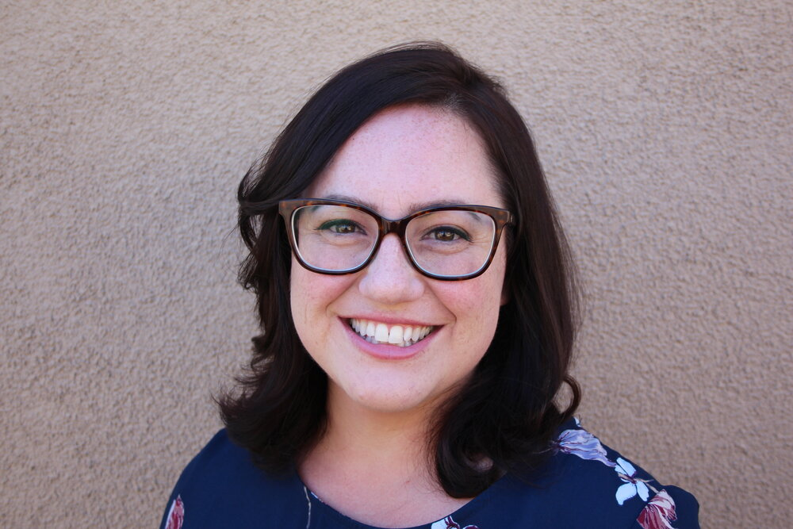
SPEAKERS
Kylie Wheeler
Project Manager
Children’s Funding Project
Jen Dietrich
Director of Policy
Partnership for Children and youth
Kim Kruckel
Executive Director
Child Care Law Center

Slide 4
AGENDA
Introduction and purpose of meeting
Overview of American Rescue Plan – Children’s Funding Project
Education funding to schools – Advancement Project and Partnership for Children and Youth
Child Care funding – Child Care Law Center
Direct funding to counties and cities with advocacy tips and examples – Advancement Project and Funding the Next Generation

Slide 5
PURPOSE OF MEETING
Provide overview of ARP funding for California kids
Learn entry points and timelines for advocacy
Learn sources of additional information
Inspire effective advocacy
Get some creative ideas for funding
MEETING INFO
Tape and materials will be sent to all registrants after the meeting.
Q & A after each section
Put questions, ideas, examples in chat. Relevant parts of chat will be shared.
There will be some repetition – hopefully that helps.

Slide 6
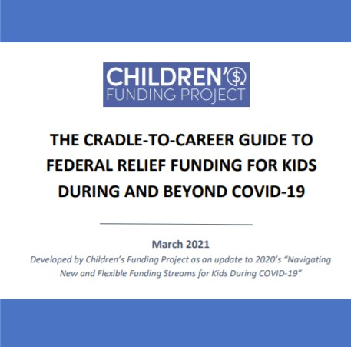
NEW & UPDATED FOR 2021: CFP’s “Emergency Funding Guide”
Read now!
“Cradle-to-Career Guide to Federal Relief Funding For Kids During and Beyond COVID-19”
Notes:
AMELIA
So in response to Covid and realizing that alignment is the key strategy, we hustled hard to put this new resource out, NAVIGATING NEW AND FLEXIBLE FUNDING STREAMS FOR KIDS DURING COVID-19, or what I may refer to as the Emergency Funding Guide.
We felt we needed a public record of both the 1. new funding available through the federal stimulus packages and 2. a compilation of the flexible uses for common funding streams for children and youth programs

Slide 7


NATIONAL CONTEXT & CLIMATE: Federal priorities and state & local opportunities
Beyond COVID-19 recovery money, the Biden Administration aims to direct major resources to child and family-serving programs and services—particularly child care
Just last week, the Administration announced plans to raise the capital gains tax, which could generate $113 billion over 10 years
States and localities are anticipating huge infusions of federal recovery funds without adequate capacity or infrastructure at the ready to maximize the dollars
More than 50 localities across the country have established dedicated local revenue streams to benefit children, youth, and their families
States and communities have an unprecedented opportunity to strategically align funding and other resources for the benefit of kids

Slide 8
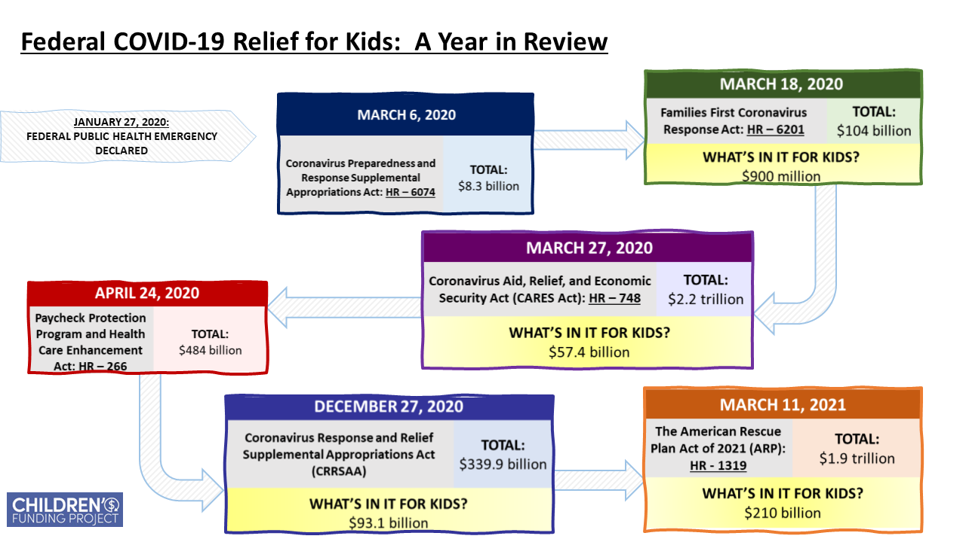
FEDERAL COVID-19 RELIEF FUNDING FOR KIDS NATIONALLY:
A year in review

Slide 9
AMERICAN RESCUE PLAN ACT OF 2021 (ARP): Overview of child & youth related funding
OVERARCHING FUNDING
$219.8 billion – Coronavirus State Fiscal Recovery Fund
$130.2 billion – Coronavirus Local Fiscal Recovery Fund
$1 billion – Pandemic Emergency Assistance
EARLY CARE AND EDUCATION
$39 billion – Child Care Development Block Grant/Child Care Stabilization Fund
$1 billion – Head Start
$150 million for MIECHV
EDUCATION
$122.8 billion – Elementary and Secondary School Emergency Relief Fund (ESSER III)
$39.6 billion – Higher Education Emergency Relief Fund (HEERF III)
$2.75 billion – Emergency Assistance to Non-Public Schools
BEHAVIORAL HEALTH
$250 million – Child Abuse Prevention and Treatment
$20 million – Youth Suicide Prevention
$30 million – Project AWARE
$10 million – National Child Traumatic Stress Network
Temporary Child Tax Credit & Child and Dependent Care Tax Credit Reform!
$852 million -- Corporation for National and Community Service
$3 billion – IDEA Parts B & C
MORE THAN $500 BILLION TO DIRECTLY OR INDIRECTLY BENEFIT CHILDREN AND YOUTH!

Slide 10

AMERICAN RESCUE PLAN ACT OF 2021 (ARP): Funding coming to California
FUNDING STREAM | TOTAL $ | RECIPIENT(S) | DATES TO REMEMBER | ACCOUNTABILITY & TRANSPARENCY
State Fiscal Recovery Fund | $26.1 billion | State Government | MAY 11, 2021: Deadline for metro cities and counties to receive first half their Local Fiscal Recovery Fund allocations DECEMBER 31, 2024: Deadline to spend State and Local Coronavirus Fiscal Recovery Funds | Awaiting guidance!
Local Fiscal Recovery Fund - Counties | $8.1 billion | County Governments
Local Fiscal Recovery Fund – Cities | $8.4 billion | Metropolitan Cities (Directly) & Non-metro cities (via State)
Child Care Stabilization Funding | $2.3 billion | California Department of Education | SEPTEMBER 30, 2022: Funding must be obligated SEPTEMBER 30, 2023: Funding must be spent | States can reserve up to 10% for administrative costs Supplement not supplant
Child Care Development Fund Flexible Funding | $1.4 billion | California Department of Education | SEPTEMBER 30, 2023: Funding must be obligated SEPTEMBER 30, 2024: Funding must be spent | Supplement not supplant LIKELY will require a report to HHS describing state plan for funds CCDF plan amendment required for any substantial program change
Education Stabilization Fund (ARP ESSER III) | $15.1 billion | California Department of Education | JUNE 7, 2021: SEA State Plans must be submitted SEPTEMBER 30, 2023: Funds must be obligated | LEAs accountable to SEAs for meeting requirements Documented, meaningful engagement with community required for state and local planning Maintenance of Effort and Maintenance of Equity requirements ARP ESSER funds must be tracked separately from ESSER I & II

Slide 11
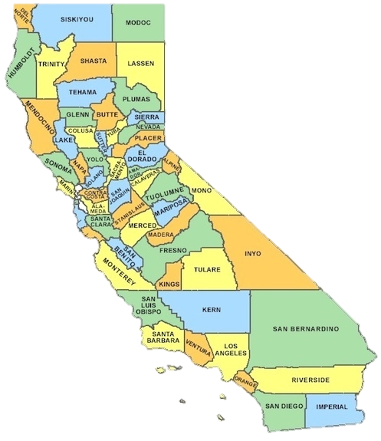
ARP FUNDING FROM STATE TO SCHOOL DISTRICT
EXAMPLE: California and San Bernardino County, Cities, and School Districts (funding estimates)
 | CORONAVIRUS FISCAL RECOVERY FUNDS | ESSER III
STATE | $26.1 billion ($42 billion total with state, city, county and capital funds) | $15.1 billion ($13.6 billion to CA LEAs)
COUNTY | $422.8 million | `
METRO CITIES | $314.3 million (all metro cities in San Bernardino County)
SCHOOL DISTRICT |  | $242.8 million ($48.6 million for learning recovery) – San Bernardino Unified, one of 13 districts in county.
Federal allocations to SEAs and SEA allocations to school districts are both governed by Title I Part A
Sources: OESE.ed, HelpKidsRecover.org, National League of Cities, NCSL, NACo

Slide 12

What's In The American Rescue Plan for
California’s Children and Youth?
COVID-19 Relief Funding

Slide 13

COVID-19 Federal Relief Funding:
K-12 Schools

Slide 14
Federal K-12 Relief Funding Overview
Elementary and Secondary School Emergency Relief Fund (ESSER Fund):
Established under the CARES Act, the Fund was set up to support local schools' weather the impacts of the pandemic. Since then, the subsequent federal relief bills have utilized ESSER to distribute education funds.
U.S. Department of Education
California Department of Education
Local Education Agency
ESSER funding is separate from the Governors Emergency Education Relief (GEER Fund), a much smaller fund, which provided Governors with extra funds to support local schools.
Notes:
CARES Act: $13.5 billion via Elementary and Secondary Emergency Education Relief (ESSER) Fund. (Mostly expended)
December Relief Package: $54.3 billion in supplemental funding ESSER II. (Distributed)
American Rescue Plan: $126 billion, in supplemental funding ESSER III. – (In Pipeline)

Slide 15

California Specific:
K-12 Federal Covid-19 Relief Funding Overview
CARES Act
March 2020
CRRSA Act
December 2020
American Rescue Plan
March 2021
$1.6 billion via ESSER I
$6.7 billion via ESSER II
$13.5 billion via ESSER III
Notes:
CARES Act: $13.5 billion via Elementary and Secondary Emergency Education Relief (ESSER) Fund. (Mostly expended)
December Relief Package: $54.3 billion in supplemental funding ESSER II. (Distributed)
American Rescue Plan: $126 billion, in supplemental funding ESSER III. – (In Pipeline)

Slide 16
K-12 Federal Relief Funding – Distribution Methodology
States receive funds based on the same proportion that they receive under the Title I, Part A.
States must distribute at least 90% of funds to local education agencies (LEAs) based on their proportional share of ESEA Title I, Part A funds.
Funding apportionments to LEA’s are made quarterly .
ESEERiii funds require a local planning process, which will most likely be integrated into the LCAP (Local Control Accountability Plan) community process and presents an advocacy opportunity.
The K-12 dollars will be focused on helping schools reopen and helping students catch up on learning they have missed during the pandemic.
Districts must spend at least 20% of the money addressing learning loss for student subgroups disproportionately impacted by the pandemic to address their academic, social, and emotional needs.
Notes:
Uses include:
Coordination with public health departments,
Activities to address unique needs of low-income students, children with disabilities, English learners, foster youth, and other vulnerable student populations.
Purchasing educational technology,
Planning for long term closures,
Training and supplies for sanitation,
Mental health support,
Summer school and after school programs,
Funds for principals to address local needs
Other activities to continue school operations and employment of existing staff
Developing strategies and implementing public health protocols, including, to the greatest extent practicable, policies in line with guidance from the CDC for the reopening and operation of school facilities to maintain the health and safety of students, educators, and other staff.

Slide 17
K-12 Federal Relief Funding – Distribution Timeline
First quarterly allocation in May/June
ESSER I (CARES Act)
ESSER II (CRRSA Act)
ESSER III (Rescue Plan)
Deadline – Sept. 30, 2022
Deadline – Sept. 30, 2023
Deadline – Sept. 30, 2023
Funds mostly expended (Over 50%)
Not yet allocated

Slide 18
Maintenance Effort Requirements to ESSER III
Maintenance of Effort: Upon agreeing to receive ESSER III Funds, California has agreed to maintain their levels of funding for K-12 education for FY22 and FY23 at the same funding levels as in the previous three years.
Maintenance of Equity: Upon agreeing to receive ESSER III Funds, California must also agree not to make financial cuts to schools and districts with high numbers of low-income students. This means that LEA’s must then not make budget cuts to high-need schools, e.g., no staffing reductions.

Slide 19
Los Angeles Unified School District Example
CARES Act
CRRSA Act
Rescue Plan
$845 million*
$1.2 billion
$2.6 billion
$534 million for equity!!!
Total in Relief Funding:
$4.7 billion
*This total also includes Governor’s GEER Funding.
Source: EdSource.org
Notes:
Source: https://edsource.org/2021/california-districts-and-charter-schools-get-covid-relief-funding-under-american-rescue-plan-act/650922
$3.8 billion still at play – focusing on equity may be surest bet to ensure money is set aside for student priorities

Slide 20
Key Insights on Government Uses of Funds
Pay attention to fiscal outlook on revenues and deficits.
Funds may be used for pet projects and/or for other non-equity aligned spending.
Need for community groups to align their priorities and lead a united front.
Utilizing data and community surveys will increase your campaigns success.
Make the case for federal relief funding as seed funding towards more long-term sustainable funds for your programs and services.
Notes:
AH – takeaways from our analysis

Slide 21


Raise Your Voice:
Engage, advocate, and make afterschool and other youth programming a priority in your community
Jen Dietrich, Director of Policy

Slide 22

Slide Title
American Rescue Plan Act (ARPA)
Elementary and Secondary School Emergency Relief Fund (ESSER III)
$15.1B
State set-asides
10%
Local Education Agencies 90%
At least $150.7 million (1%) must be spent on evidence-based comprehensive afterschool programs
At least $150.7 million (1%) must be spent on evidence-based summer learning and enrichment programs
At least $2.7 billion (20%) must be spent on evidence-based learning loss recovery interventions
At most $11 billion (80%) can be spent on a broad list of activities (any activity authorized by ESEA, IDEA, AEFLA, or Perkins CTE)
At least $753.4 million (5%) must be spent on evidence-based learning loss recovery
Estimates from Congressional Research Service. March 8, 2021
22

Slide 23
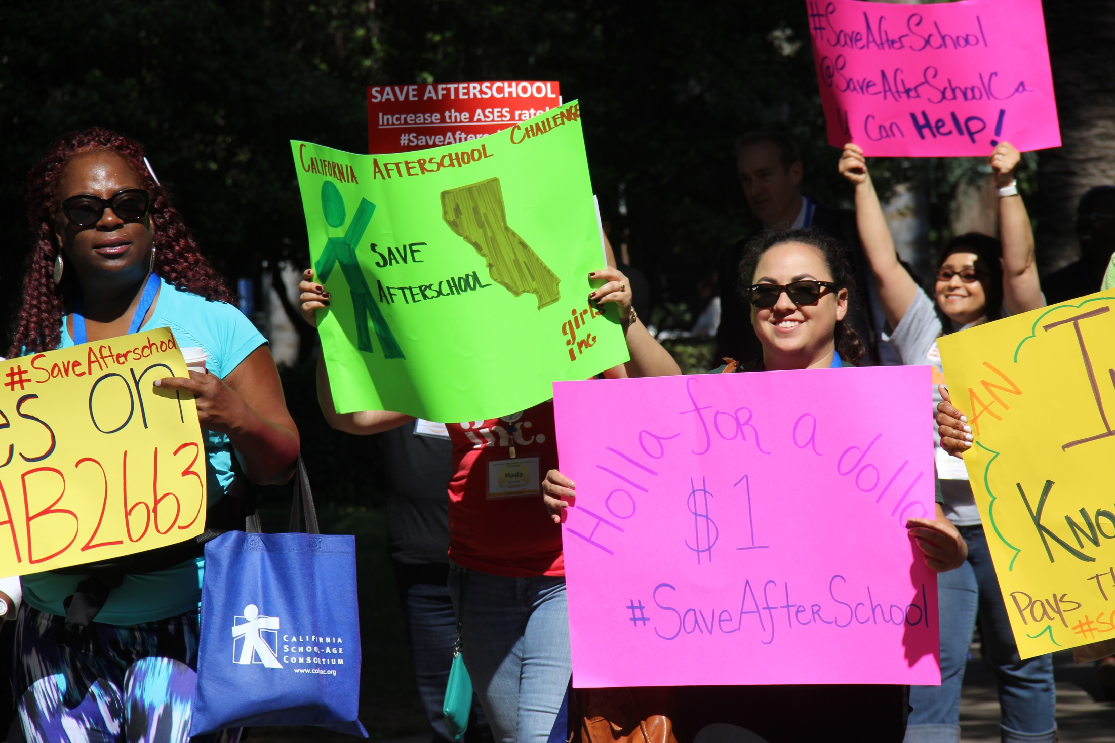
Slide Title
Preparing for Advocacy
Understand context
Highlight data and stories of impact
Identify challenges and creative solutions
Build on your relationships
Ask and follow up
23

Slide 24
Slide Title
Funding Sources: Federal
Funding Source | Type | Allocation & Current Status | Authority | What Types of Related* Services Can Be Provided | Spent By | Additional Resources
ESSER II | Stimulus, one-time | CA: $6.7B, 90% to LEAs ($6B) Funding by LEA LEAs that do not receive Title I funds are not eligible Status: LEAs have filed for funds | Coronavirus Response and Relief Supplemental Appropriations (CRRSA) Act in the Consolidated Appropriations Act, 2021, December 27, 2020 | Broad use. No restrictions on supplanting. | Obligated by September 30, 2023 | CDE: info
ESSER III | Stimulus, one time | CA Estimates: $15.3B including - $753.4M for Learning Loss - $150.7M for Summer Enrichment - $150.7M for AfterSchool -$13.7B (90%) to LEAs Status: Waiting for more information from the state on distribution of funds | American Rescue Plan Act (ARPA), March 11, 2021 | Broad use but LEAs need to spend at least 20% on learning loss with academic and social and emotional support, meals and snacks | Obligated by September 30, 2023* | ESSER & Afterschool Handout Education Week Summary of Funding Alliance for Excellence Education - Summary of K–12 Education Provisions
24

Slide 25
Slide Title
Funding Sources: State
Funding Source | Type | Allocation & Current Status | Authority | What Types of Related* Services Can Be Provided | Spent By | Additional Resources
After School Education & Safety (ASES) Program | Ongoing | $650M statewide 2020-21 funding by LEA Status: Funding out to grantees | State Education Code 8482-8484.65 CDE COVID-19 guidance | Before and after school and summer programs | Grant Extension: Announcement Details Coming Soon | COVID-19 Updates from CDE Expanded Learning Division
In-Person Instruction (IPI) and Expanded Learning Opportunities (ELO) Grants | One- time | $6.6B statewide, $4.6B for expanded learning Status: Funding expected in May 2021 and August 2021 | AB 86 | IPI: Broad use for in-person ELO: Expanded learning, supplemental instruction and support strategies | Spend by August 31, 2022 Key Dates | CDE: Press Release, Info Page, Supplemental Instruction and Support Plan Input Session, Template and Instructions
Local Control Funding Formula (LCFF) | Ongoing | $64.5B statewide, including a 3.84% increase Status: PROPOSED, will be decided in June 2021 | Governor’s proposed FY 2021-22 budget | Broad use, some funding targeted for heavily impacted student groups | Unspent funding can roll over to next year
25

Slide 26

Slide Title
Understand context, use the spotlight
26

Slide 27
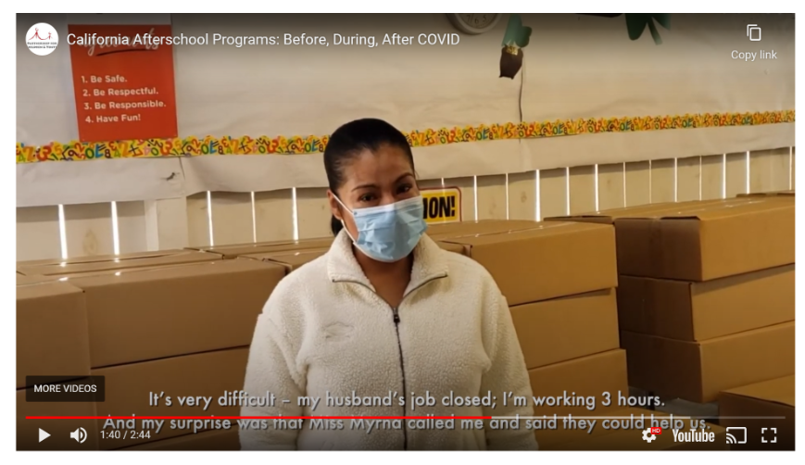

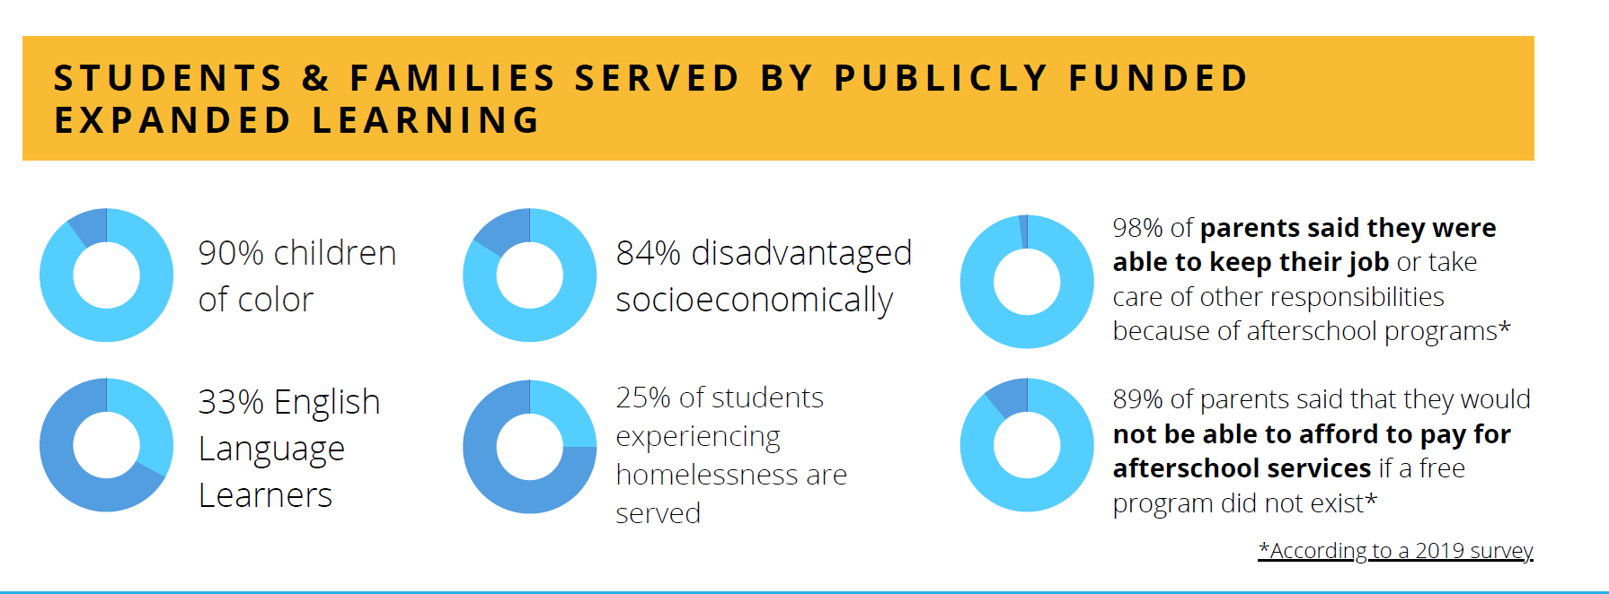
Slide Title
Highlight data and stories of impact
27

Slide 28
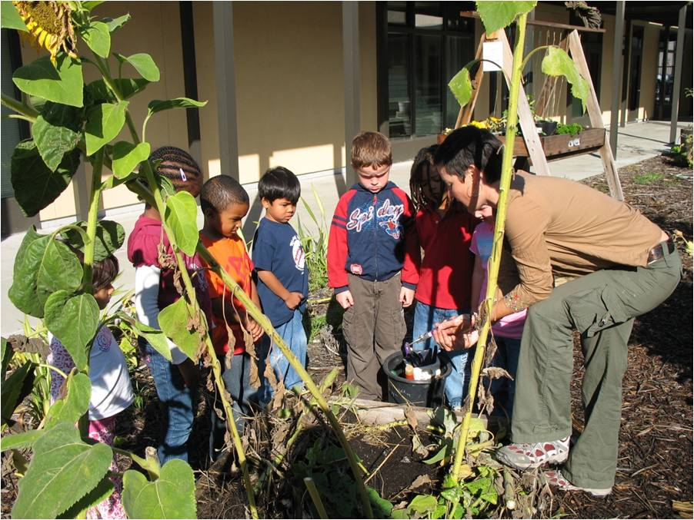
Slide Title
Creative solutions
Paid work opportunities for high school students
Peer mentoring
Increased summer learning experiences focused on relationships and social-emotional learning
Field trips
Programs that build capacity between out-of-school time and school-day instruction
Youth-led community service and project based learning
Mental health supports, mentoring
Enrichment
Outdoor education
28
28
28

Slide 29

Slide Title
Build on your relationships
29

Slide 30
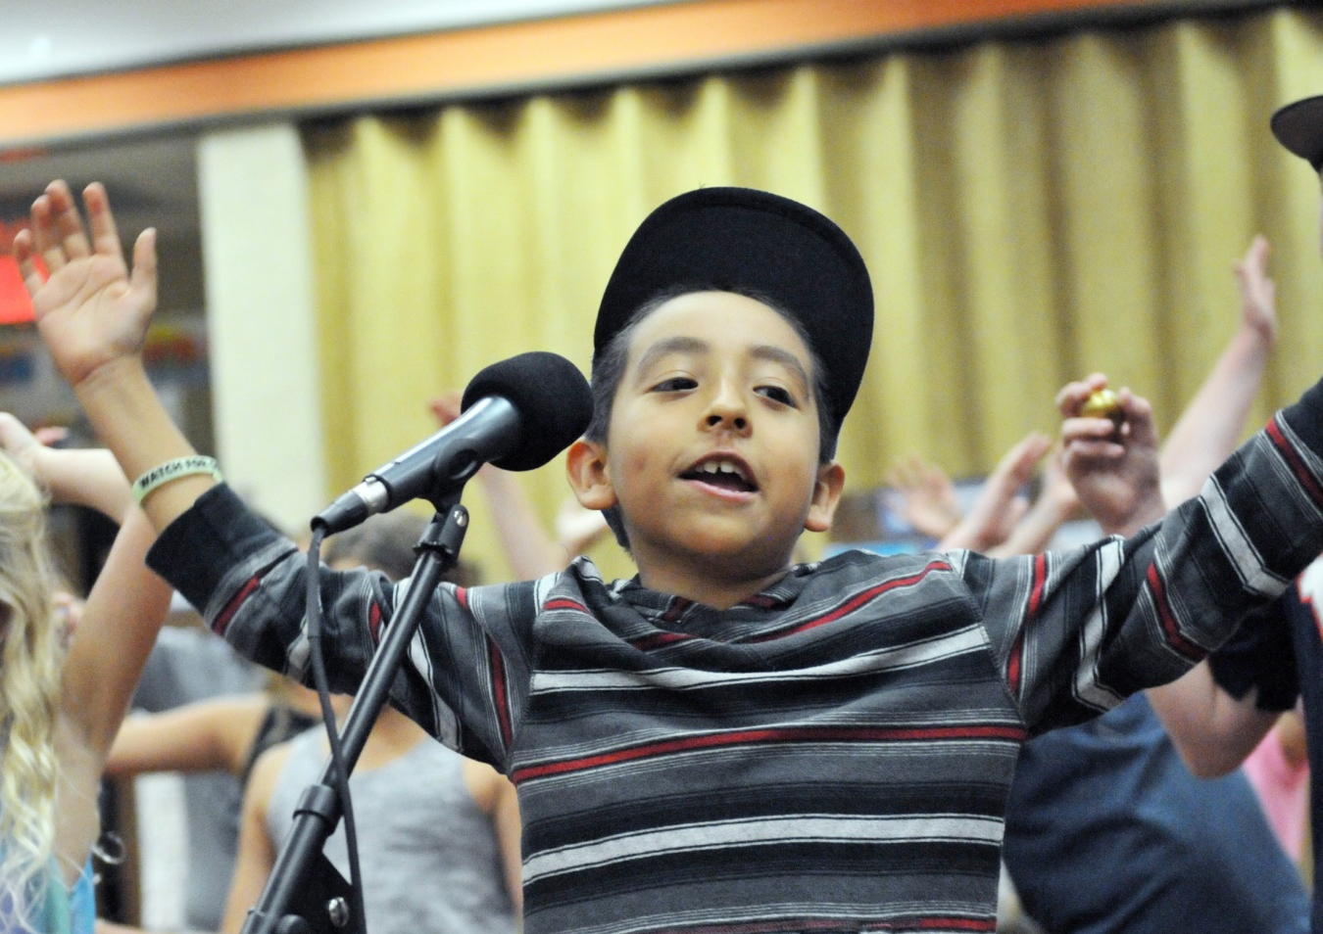
Ask and follow up
Slide Title
Helpkidsrecover.org - to see ESSER III estimates by Local Education Agency (LEA)
LEAs must consult with stakeholder groups and publish a plan for use of funds within 30 days of receiving funding
30

Slide 31
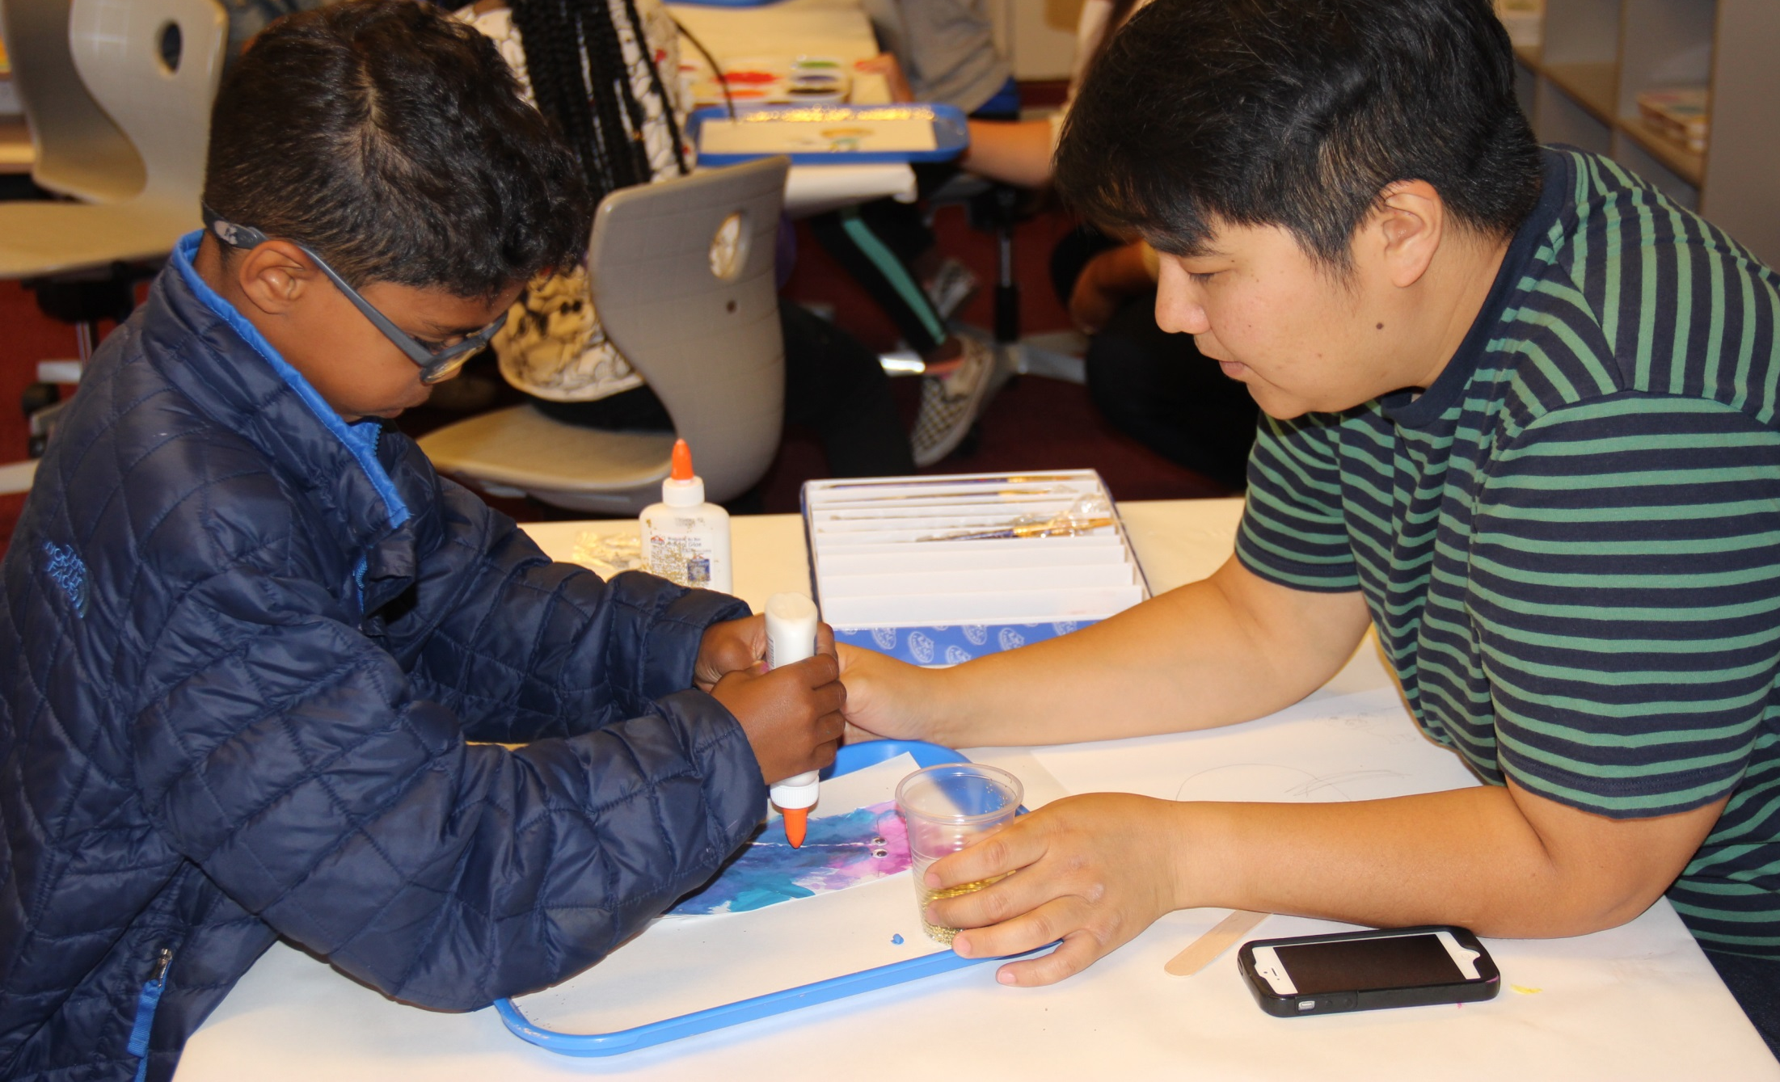
Slide Title
You are an advocate!
You are an advocate!
You are the expert on your program
Your stories make a difference
Decision-makers need your input to make informed decisions
31

Slide 32

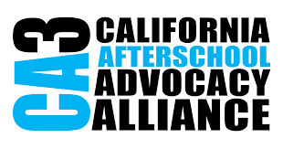


Jen Dietrich
jdietrich@partnerforchildren.org
SaveAfterSchool.com
@SaveAfterschlCa
@SaveAfterschoolCA
PartnerForChildren.org
@partnr4childrn
@PartnerForChildren
32

Slide 33

Funding to Save Child Care
in the American Rescue Plan
April 28, 2021
Kim Kruckel, Executive Director
CHILD CARE LAW CENTER
© 2020 Child Care Law Center

Slide 34

Quick Context: State of Child Care
Before pandemic, child care system was ineffective and inequitable
Pandemic exacerbated these structural issues, bringing system to brink of collapse
  Many providers closed -- for good
  Others closed temporarily, and need help to re-open
  Some stayed open by making tough financial decisions
  while they wait for help
  Parents lost jobs or income,
  & unable to pay for child care
  Women dropped out
  of workforce to cover care
  needs
Notes:
Temporarily closed: spaces for 294,357 children (4947 centers and 3098 fcch); Permanently closed: 33,387 spaces (355 centers and 1805 fcch) [info as of October 2020]

Slide 35
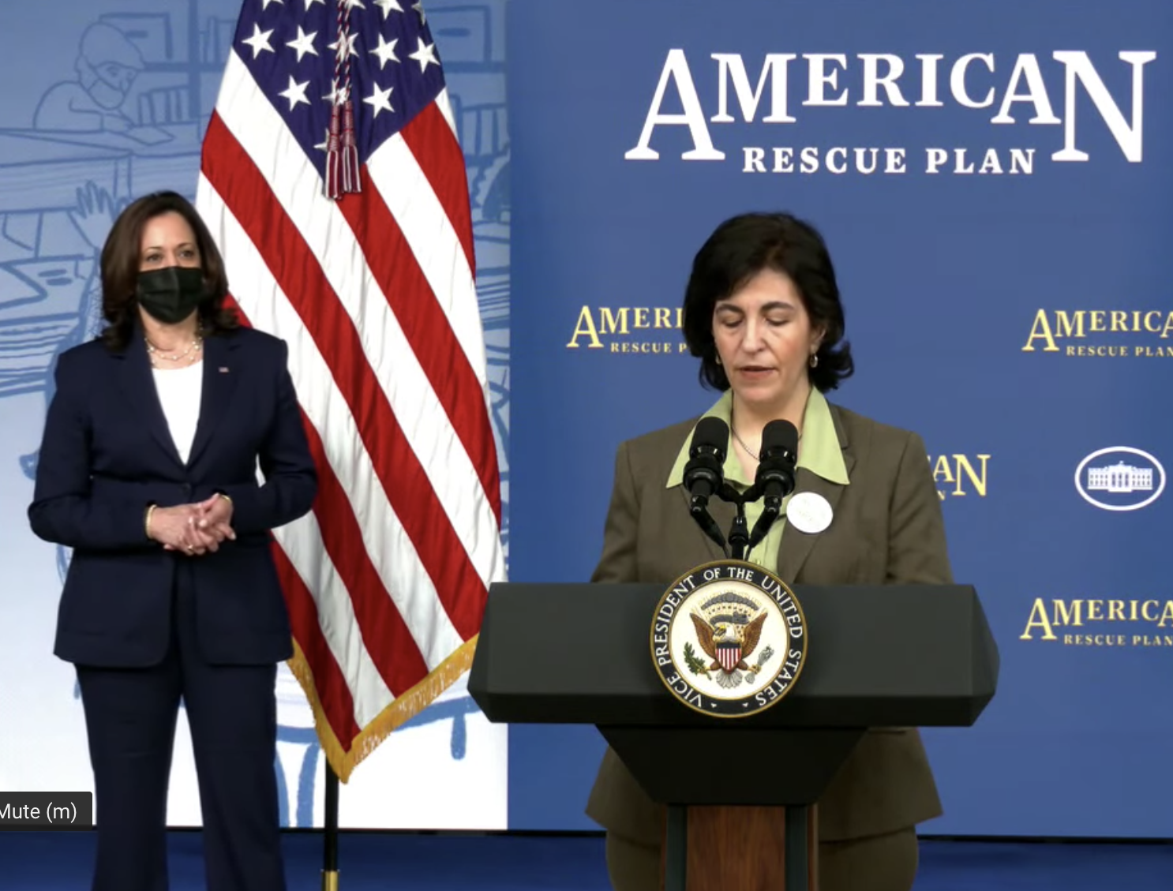

Overview: ARP Child Care Funding
Largest investment in child care since WWII
Two main funding streams:
  Child Care and Development Block Grant COVID-19 Relief (Section 2201)
  Child Care Stabilization Grants (Section 2202)
Funding is largely one-time, but can be spent out over several years
States have flexibility to determine how money is spent within certain federal bounds

Slide 36
CCDBG COVID-19 Relief
~$15 billion overall, with ~$1.4 billion for CA
What is funding for?
  Support State child care assistance programs for low-income families through CCDBG
  Additional flexibility to serve essential workers who are not income-eligible

Slide 37
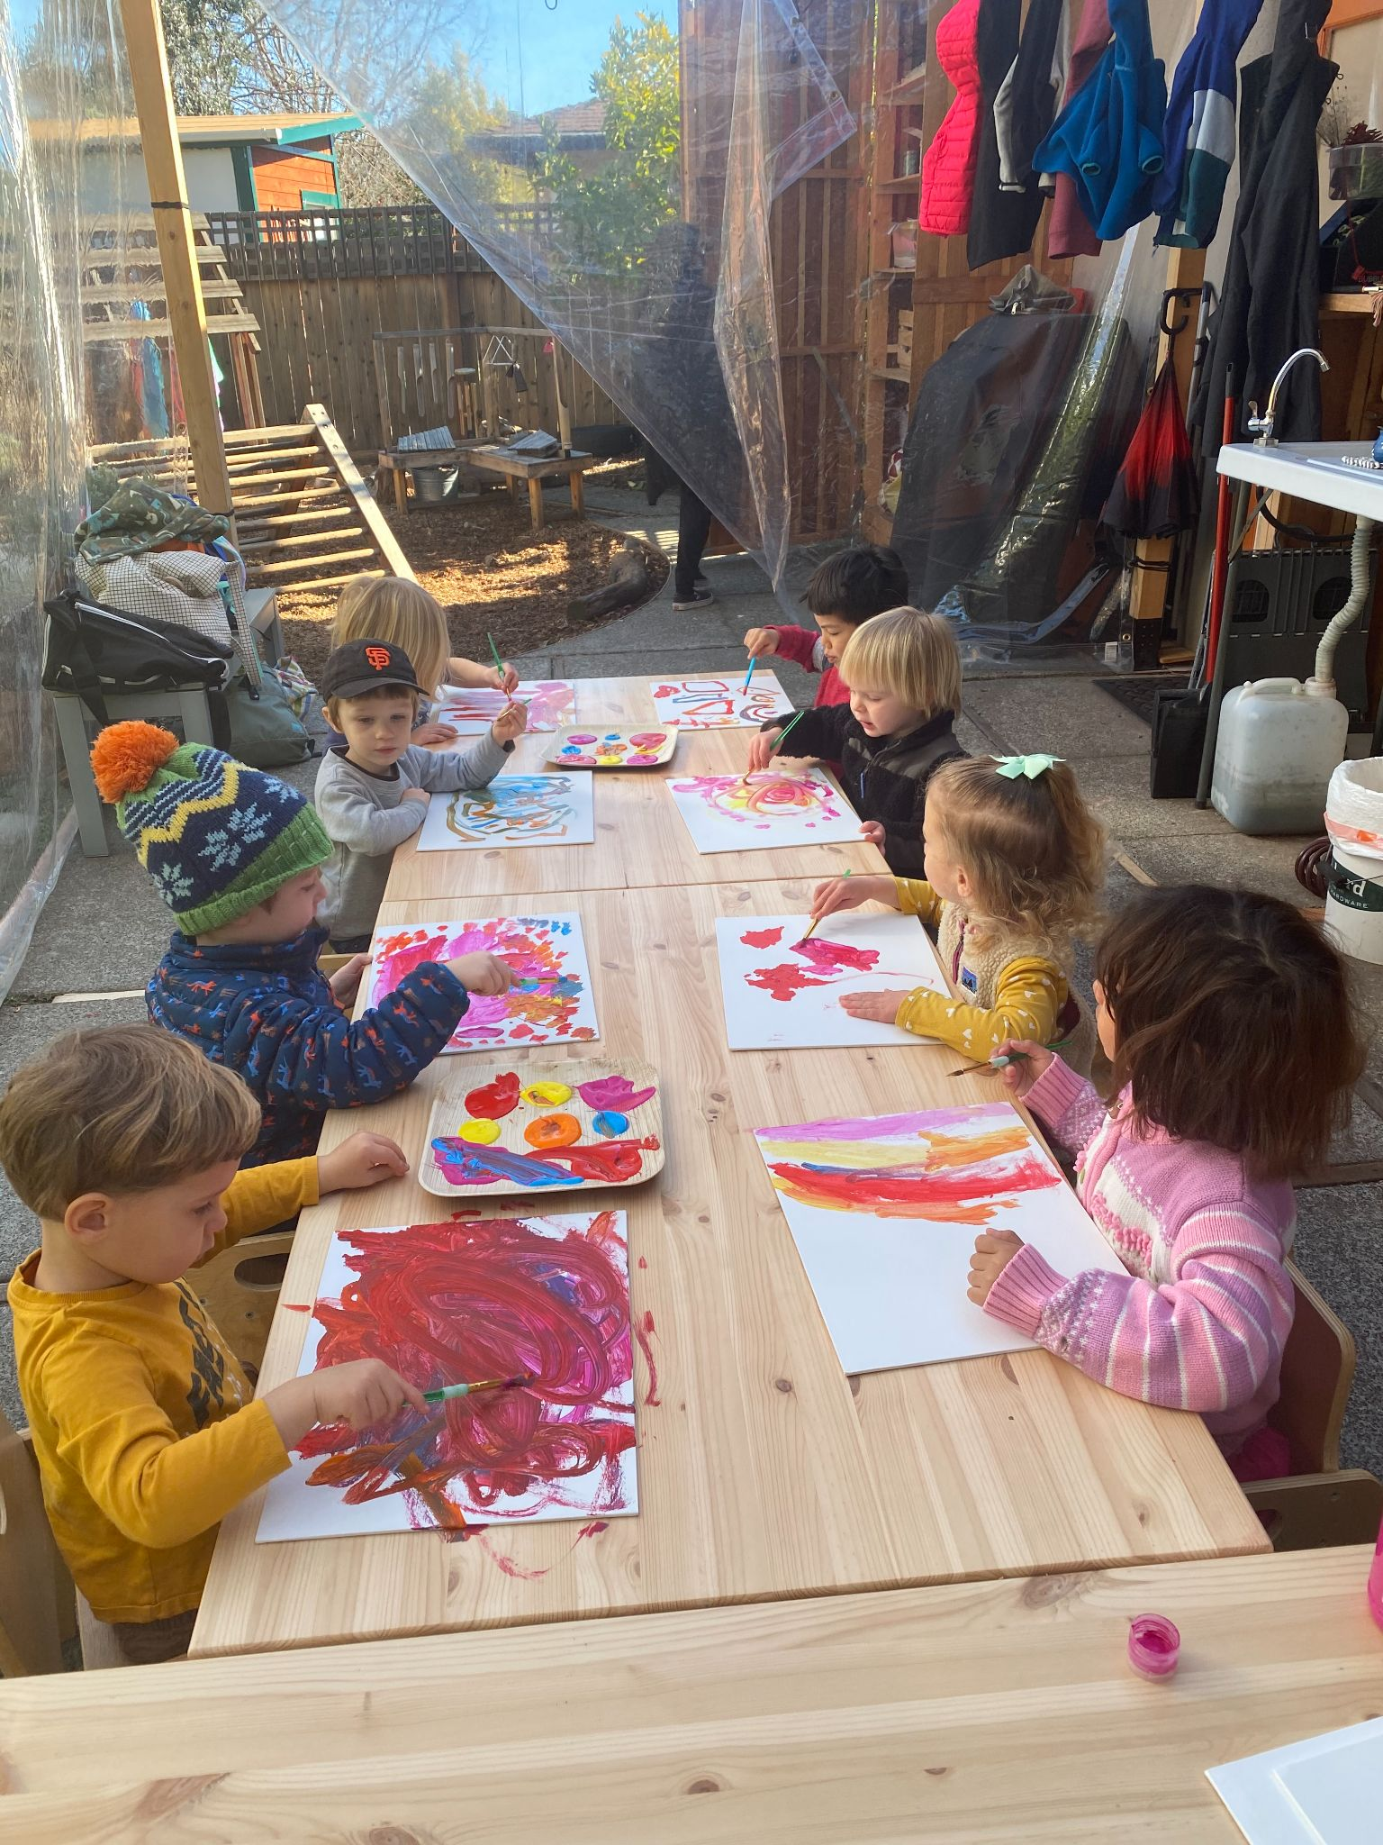
Child Care Stabilization Grants
~$24 billion overall, with ~$2.3 billion for CA
What is funding for?
  Stabilizing child care providers,
whether currently receiving
subsidies or private pay
  Grants to help providers re-open
+ operate safely by covering expenses like rent, personnel costs, PPE, mental health supports, and more
  Can be used to reimburse for expenses already incurred
  Providers that receive these funds
have to meet certain requirements

Slide 38
CA ECE Coalition Budget Asks
Increase rates paid to providers & pay based on enrollment, not attendance
Waive family fees for next 3 years
Expand child care assistance to more families
Provide grants to subsidy & private providers, with higher grants for those in neediest communities
Make investments in other needed areas, including:
  Comprehensive services for families
  Professional development for educators
  Child care facilities
  And more!

Slide 39
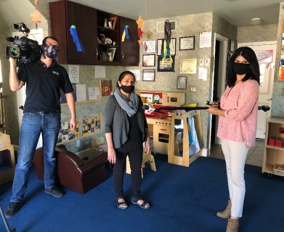
Opportunities to Engage
Share stories of issues facing child care providers and families with press and policymakers
Weigh in with the Governor’s office and state legislature now to influence...
  Governor’s May budget revise
  Legislature-Governor final budget agreement
When funding is available, help get the word out, especially in underserved communities

Slide 40
Other Resources
Child Care Law Center Explainer on ARP Child Care Funding
White House Fact Sheet on ARP Child Care Funds
California ECE Coalition Letter

Slide 41

COVID-19 Federal Relief Funding:
States and Local Governments

Slide 42
American Rescue Plan - State & Local Aid Funding
$350 billion in emergency funding for state, local, tribal, and U.S. territories
  State Government & Washington D.C. - $195.3 billion
  Local Government - $130.2 billion
  Tribal Governments & U.S. Territories - $24.5 billion
Bottom line – the local aid amount would more than double what the CARES Act provided … and with fewer restrictions on use.
Notes:
Of the total $350 billion, 60 percent would be allocated to states and 40 percent to local governments
Stress that even more local aid will come in indirectly via the education and health-directed funding that’s part of the ARP

Slide 43
American Rescue Plan - Allowable Uses
Allowable Uses
Allocation Methodology
  Respond to and mitigate the public health emergency and/or its negative economic impacts
  Funds expended over multiple years (into 2024).
  Half of the local government aid will go to counties using a Community Development Block Grant (CDBG) allocation methodology
Notes:
Cover costs incurred as a result of the pandemic
Replace revenue that was lost, delayed or decreased, anchored in pre-pandemic estimates

Slide 44
American Rescue Plan – Timeline for Funding Dispersal
February
Senate and House deliberation.
March
May
First half of aid available at the local level. Second half will be available in May 2022.
June
Typical budget adoption timeline for local governments; meaning aid funding could be rolling out by this time.
Legislation was signed.

Slide 45
Estimated California Allocation – $42.3 billion
Source: U.S. House of Representatives, Estimates as of 2.25.21

Slide 46
Examples of Uses for Children, Youth, and Families
Child Care Relief Funds – Set aside funding for providers who were hurt financially due to pandemic.
Bridging Digital Divide – Provide technology, internet, and other services for families to access the internet.
Grants to Children & Youth Program Providers – Funding to extend programming or provide supplemental programming for children and youth after school.
Individual Income Assistance – Provide low-income individuals with direct financial income to cover food, mortgage, utilities, telecommunication, etc.
Notes:
San Mateo Example - https://www.smcgov.org/press-release/supervisors-provide-2-million-launch-child-care-relief-fund-update-county-response

Slide 47
Budget Advocacy Recommendations
Budget capacity building for parents and students can build their understanding on how budget decisions are made and where inequities exist.
Use available data to make a case for an equity-based school funding formula in order to correct historic inequities.
Develop your own parent and student survey to learn what investments schools and students need.
Collect community stories and examples to aid in your advocacy.
Organize rallies, attend school board meetings, LCAP stakeholder meetings, submit letters to bring attention to the needs parents and students have.
Notes:
Source: https://edsource.org/2021/california-districts-and-charter-schools-get-covid-relief-funding-under-american-rescue-plan-act/650922
$3.8 billion still at play – focusing on equity may be surest bet to ensure money is set aside for student priorities

Slide 48


jguerrero@advanceproj.org

Slide 49
FISCAL RECOVERY FUNDS
HOW MUCH WILL EACH CITY AND COUNTY RECEIVE:
Check this link from the National League of Cities:
http://www.fundingthenextgeneration.org/nextgenwp/wp-content/uploads/2021/04/National-League-of-Cities-State-and-Local-Allocation-Output-02.25.21-2.xlsx
Examples of amounts:
San Joaquin County $148M; City of Stockton $85M
Monterey County $84M; City of Salinas $50M
Santa Clara County $374M; City of San Jose $223M
Deadlines:
May 11, 2021 – First half of money dispersed
May 11, 2022 – Second half of money dispersed
December 31, 2024 – Deadline to spend

Slide 50

Eligible Use for Fiscal Recovery Fund $
Possible Child-Serving Use
To respond to the public health emergency with respect to the Coronavirus Disease 2019 (COVID–19) or its negative economic impacts, including assistance to households, small businesses, and nonprofits, or aid to impacted industries such as tourism, travel, and hospitality;
Cash assistance for families or transitional youth
Vouchers or support for childcare or summer programming
Youth internships, jobs, peer support, civic engagement
Child and youth focused behavioral health supports
To respond to workers performing essential work during the COVID–19 public health emergency by providing premium pay to eligible workers of the State, territory, or Tribal government (of the metropolitan city, non-entitlement unit of local government, or county) that are performing such essential work, or by providing grants to eligible employers that have eligible workers who perform essential work;
Premium pay for childcare providers, youth workers, teachers and community outreach workers.
For the provision of government services to the extent of the reduction in revenue of such State, territory, or Tribal government (such metropolitan city, non-entitlement unit of local government, or county) due to the COVID–19 public health emergency relative to revenues collected in the most recent full fiscal year prior to the emergency
Sustaining local agencies (including non-profit agencies contracted by government) and policy bodies that serve children and youth
To make necessary investments in water, sewer, or broadband infrastructure.
Consider how your state and/or community can treat services for children and youth as critical SOCIAL infrastructure, as well as infrastructure targeted to young people – such as transportation, internet and technology.
Family support services

Slide 51
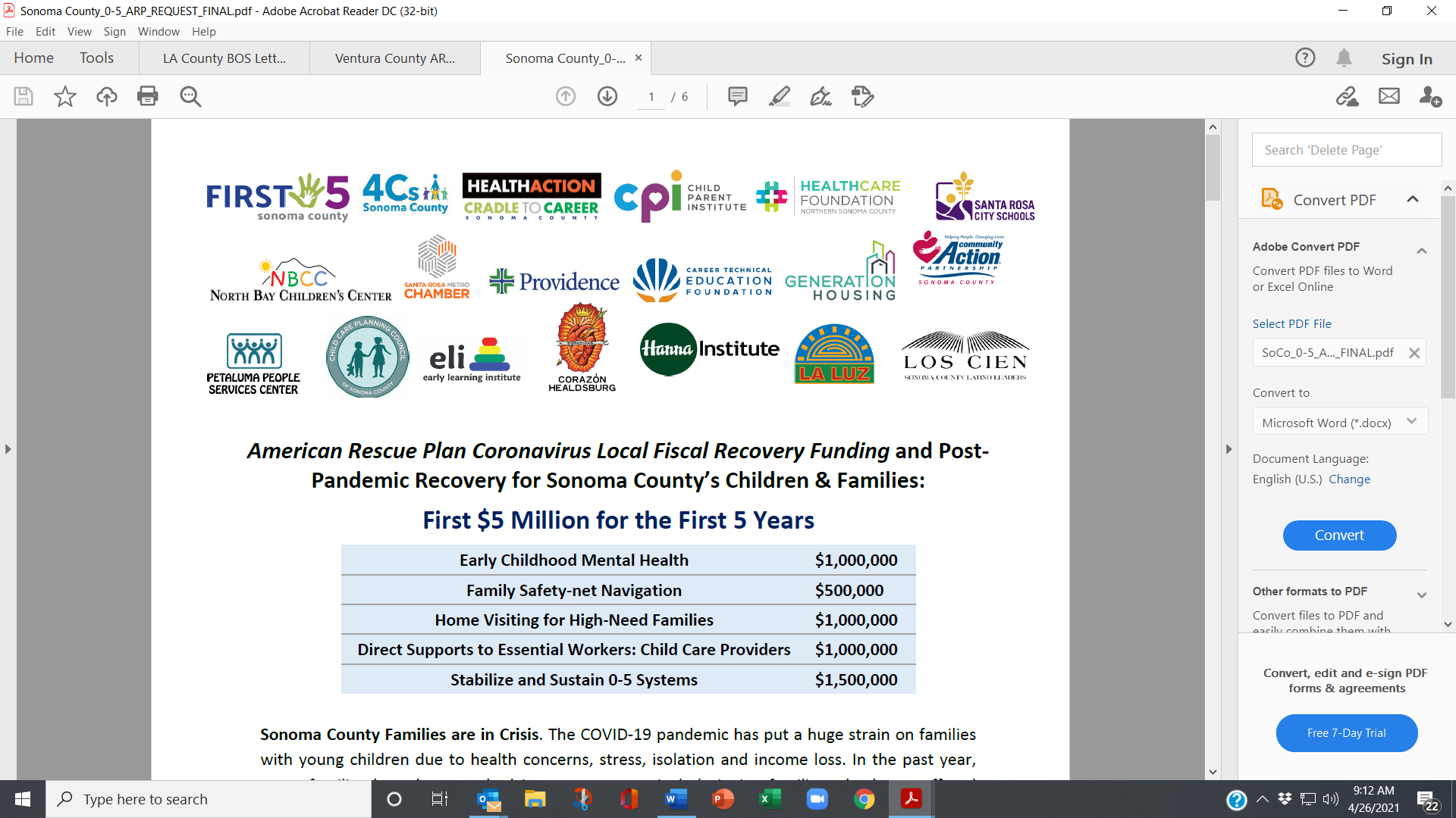
SONOMA COUNTY PLAN SUBMITTED TO BOARD OF SUPERVISORS AND CITY COUNCILS

Slide 52
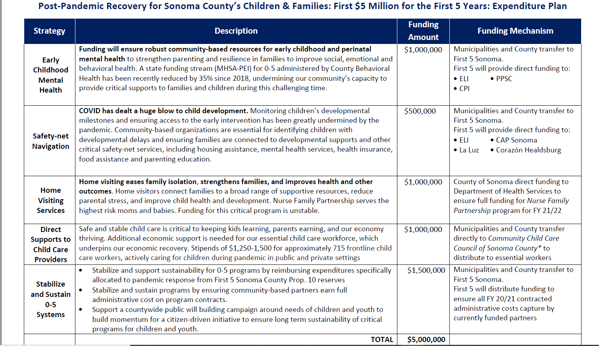

Slide 53
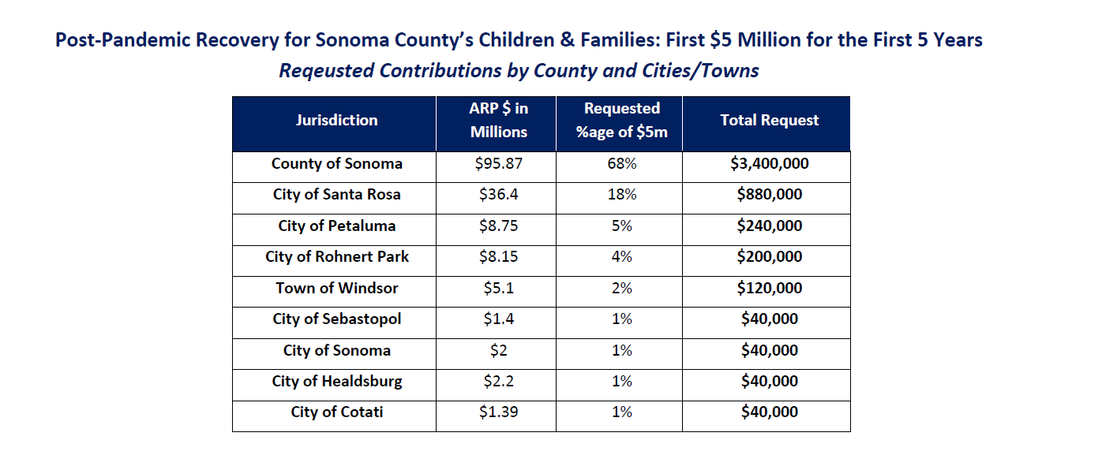

Slide 54
ADVOCACY TIPS
Focus on equity
Demand transparency
Start now – be bold
Learn city/county financial position re: pandemic spending and future plans
Assess competing needs
Work in coalition
Identify champion on Board or City Council
If time, conduct survey
NOTE: Can be groundwork for revenue ballot measure
PROPOSAL GUIDELINES
Provide specific funding recommendations, w. cost and documentation
Relate to conditions created by pandemic
Suggest ways funds will be leveraged
Propose allocation mechanism
Frame as helping government, not asking for support
Include cities and county

Slide 55
FOR MORE INFORMATION:
Kylie Wheeler, Children’s Funding Project – Kylie@childrensfundingproject.org
Jacky Guerrero, Advancement Project – jguerrero@advanceproj.org
Kim Kruckel, Child Care Law Center – kkruckel@childcarelaw.org
Jen Dietrich, Partnership for Children and Youth – jdietrich@partnerforchildren.org
Margaret Brodkin, Funding the Next Generation – margaret@fundingthenextgeneration.org

