Slide 1

STARTING A CHILDREN AND YOUTH BALLOT MEASURE CAMPAIGN FOR 2024
Margaret Brodkin, Director Funding the Next Generation
Orientation to Children and Youth Funds and process for creating them
Jesus Sanchez, Founder/Director Gente Organizada
Case example – Why the Pomona campaign is starting now for 2024
Nicole Derse, Founder/Principal 50+1 Strategies
Overview of campaigns – Steps, timelines, funding
July 19, 2022
Webinar for funding the next generation

Slide 2
WHY A BALLOT MEASURE?
Notes:
1., change LA Co0….to Greater LA Summer Matters Network
2 add 2018 to the date

Slide 3
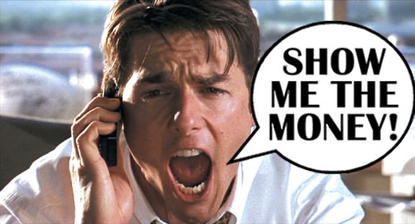
Why We Need Local Dedicated Children and Youth Funds
CHLDREN’S FUNDS IN U.S.
How we spend our money reflects our values – a budget is a moral document.
Children and youth are in crisis. Achieving good outcomes for kids costs money.
Funding inequity is a major social justice issue.
The real money is in the public sector.
Acting locally has great potential – often untapped.
“What gets funded, gets done.”

Slide 4
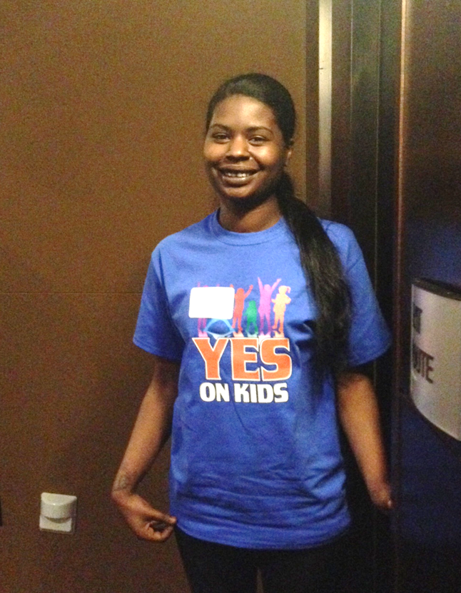
BENEFITS OF LOCAL CAMPAIGNS FOR FUNDING FOR CHILDREN AND YOUTH
LOCAL GENERAL FUND IS FLEXIBLE
“MAGIC MONEY”
Local level – where engagement happens, foundation of children’s movement
Fills gaps in services
Leverages state, federal, private dollars
Promotes innovation, coordination and systems reform
Focuses on prevention
Facilitates local accountability, leadership and local infrastructure
Generates public support – people see outcomes
Leads to more local funding

Slide 5
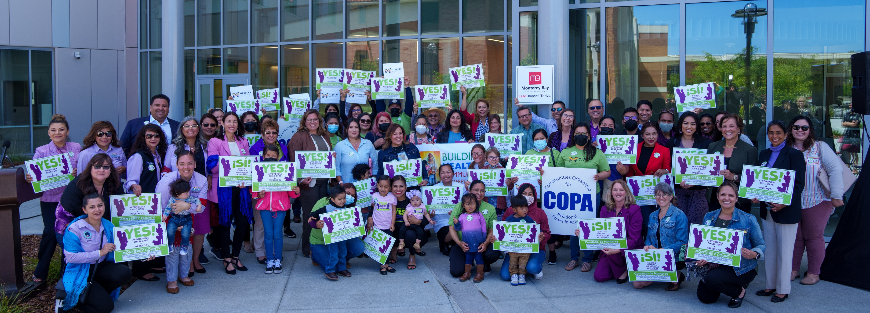
BENEFITS OF BALLOT VS. ANNUAL BUDGETS
Only way to raise NEW money - in most cases
More sustainable – not dependent on annual political debate
Builds community visibility, knowledge and support – momentum for future issues
Built-in accountability

Slide 6
WHY START NOW?
Notes:
1., change LA Co0….to Greater LA Summer Matters Network
2 add 2018 to the date

Slide 7

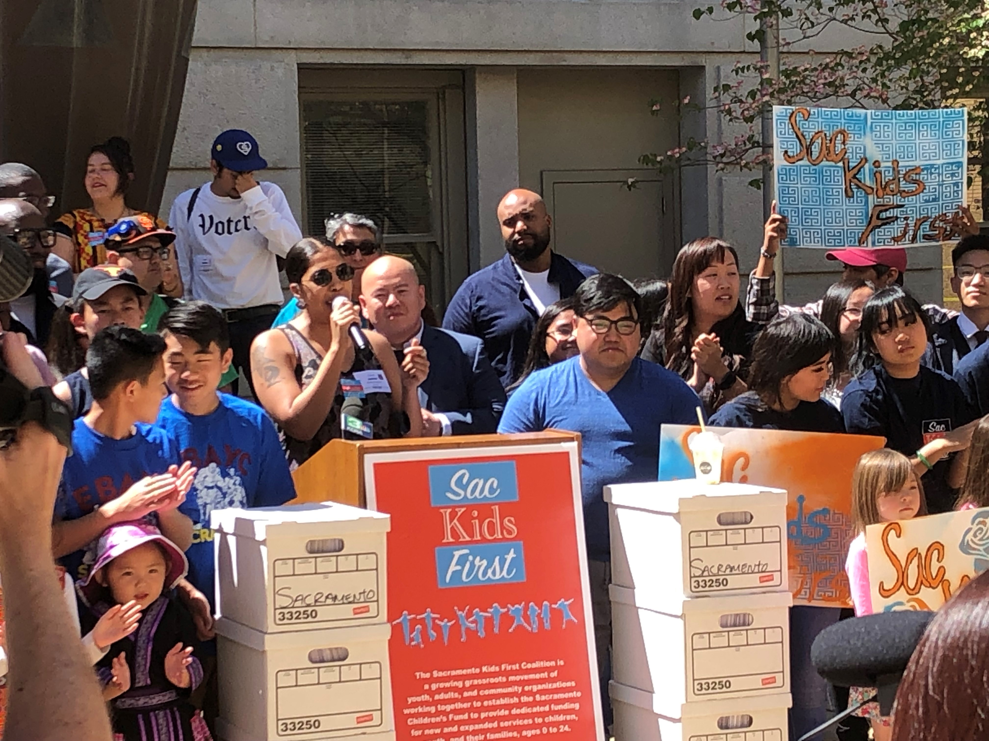
Maximize Our New Opportunity!
CHILDREN’S FUNDS IN U.S.
Notes:
1. Just note where King County is Ca?

Slide 8









OVERVIEW of THE TIMELINE
Legislative bodies put measures on ballot 2.5 – 3 months before elections. For 2024 general – 8/24
Ideally allow 6 months to collect signatures. Counties can take up to 1.5 months to count, verify, and potentially debate. For 2024 general – submit signatures – early 4/24
Start signature process (submission, printing, collecting) – from 10/23 on – the earlier the cheaper
Draft measure – 3 - 4 months – 7/23 latest start
Build the case, Communicate the need, Organize the base, Research legal and revenue options, Make major decisions about framework of measure. START NOW!
ARPA funds must be allocated by end of 2024, and spent by end of 2026

Slide 9






TENTATIVE POSSIBLE TIMELINE – Assuming early signature gathering Add 3 months for later signatures (higher rates) Add 6 months or more if local legislature will put on ballot.
AUGUST 2022 – MAY 2023
MAKE CASE
BUILD BASE
RESEARCH OPTIONS
JUNE 2023 – SEPTEMBER 2023
HIRE LAWYER
DEVELOP PROPOSL
DRAFT MEASURE
MAY – NOV. 2024
PLAN, FUNDRIASE, MOUNT A CAMPAIGN
PLACED ON BALLOT IN AUGUST
OCT. 2023 – APRIL 2024
SUBMIT MEASURE FOR SUMMARY GATHER SIGNATURES – 6mo
SUBMIT SIGNATURES
NOVEMBER 5
ELECTION
2024
WIN!
FUNDRIASE FUNDRAISE FUNDRAISE FUNDRAISE

Slide 10

WHAT NEEDS TO BE IN PLACE?
Convening organization
Dedicated staff support
Diverse network/coalition that can work
together
CBOs/ALLIES prepared for political engagement
Baseline information on community needs
Moderate agreement about priorities
Passion and willingness to take risks
Time and motivation to organize the base
Political champion (if possible)
Resources to lay groundwork, potential resources for an electoral campaign

Slide 11
STEPS IN PREPARING A BALLOT MEASURE FOR KIDS
Notes:
1., change LA Co0….to Greater LA Summer Matters Network
2 add 2018 to the date

Slide 12

Roadmap For Creating Dedicated Funding
THERE ARE KEY ELEMENTS OF WORK, BUT NO LINEAR PATH
TIMELINE – 2 – 6 YEARS – BUILDING POLITICAL CAPITAL
Making the case
Building the base
Crafting the proposal
Mounting the campaign

Slide 13
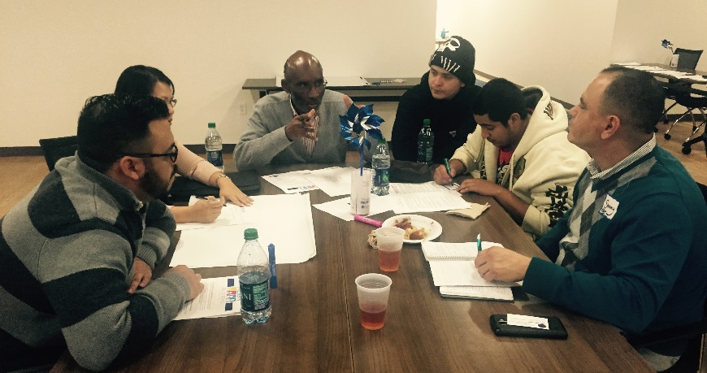
MAKING THE CASE
STRATEGIES CAN VARY
DEPEND ON LOCAL CULTURE
Document need
Report Card on state of kids
Fiscal map of current funding
Identify major gaps
Build a consensus agenda
Bill of Rights
Communicate the case for investing in children – to public and policymakers
Stockton youth drafting a Children and Youth Bill of Rights
Passed by San Joaquin County Board of Supervisors
Restorative interventions and justice when we make mistakes including opportunities to heal from trauma
Healthy supportive relationships - mentors and support systems that offer dignity and respect, and encourage and inspire as we move toward our dreams and goals
Communities free of violence, drugs and gangs with safe outdoor places to explore and play.
Activities that enrich and inspire our lives including exposure to arts, athletics, culture and technology
Access to equitable quality education
Opportunities to prepare for workforce - affordable higher education
Timely affordable physical, dental and mental health care

Slide 14
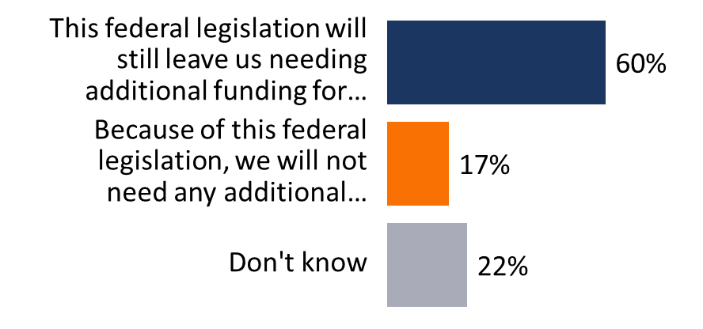
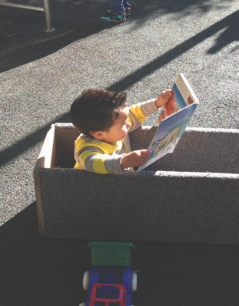
LESSONS FROM POST PANDEMIC POLLING
CHILDCARE – Heightened awareness of importance of childcare to economy and to family stability.
MENTAL HEALTH – Strain of pandemic highlights need for social and emotional health of children.
LOCAL FUNDING SOLUTIONS – Less than 1 in 10 trust state and federal funds will be the answer. Many are unfamiliar with new funding but maintain position even when educated.
When asked about funding for childcare:

Slide 15
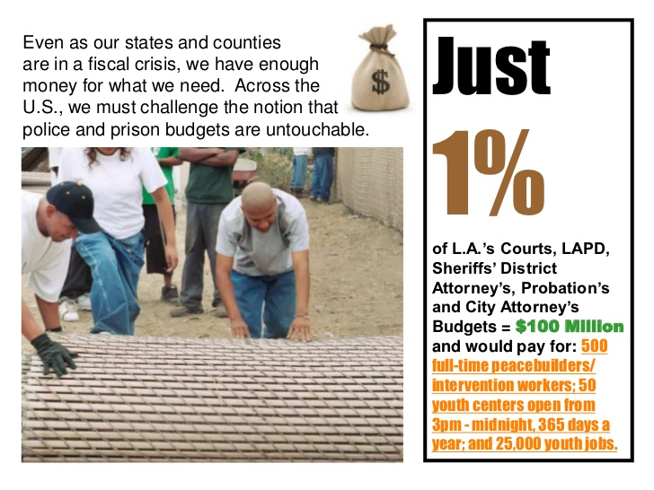
Notes:
1., change LA Co0….to Greater LA Summer Matters Network
2 add 2018 to the date

Slide 16
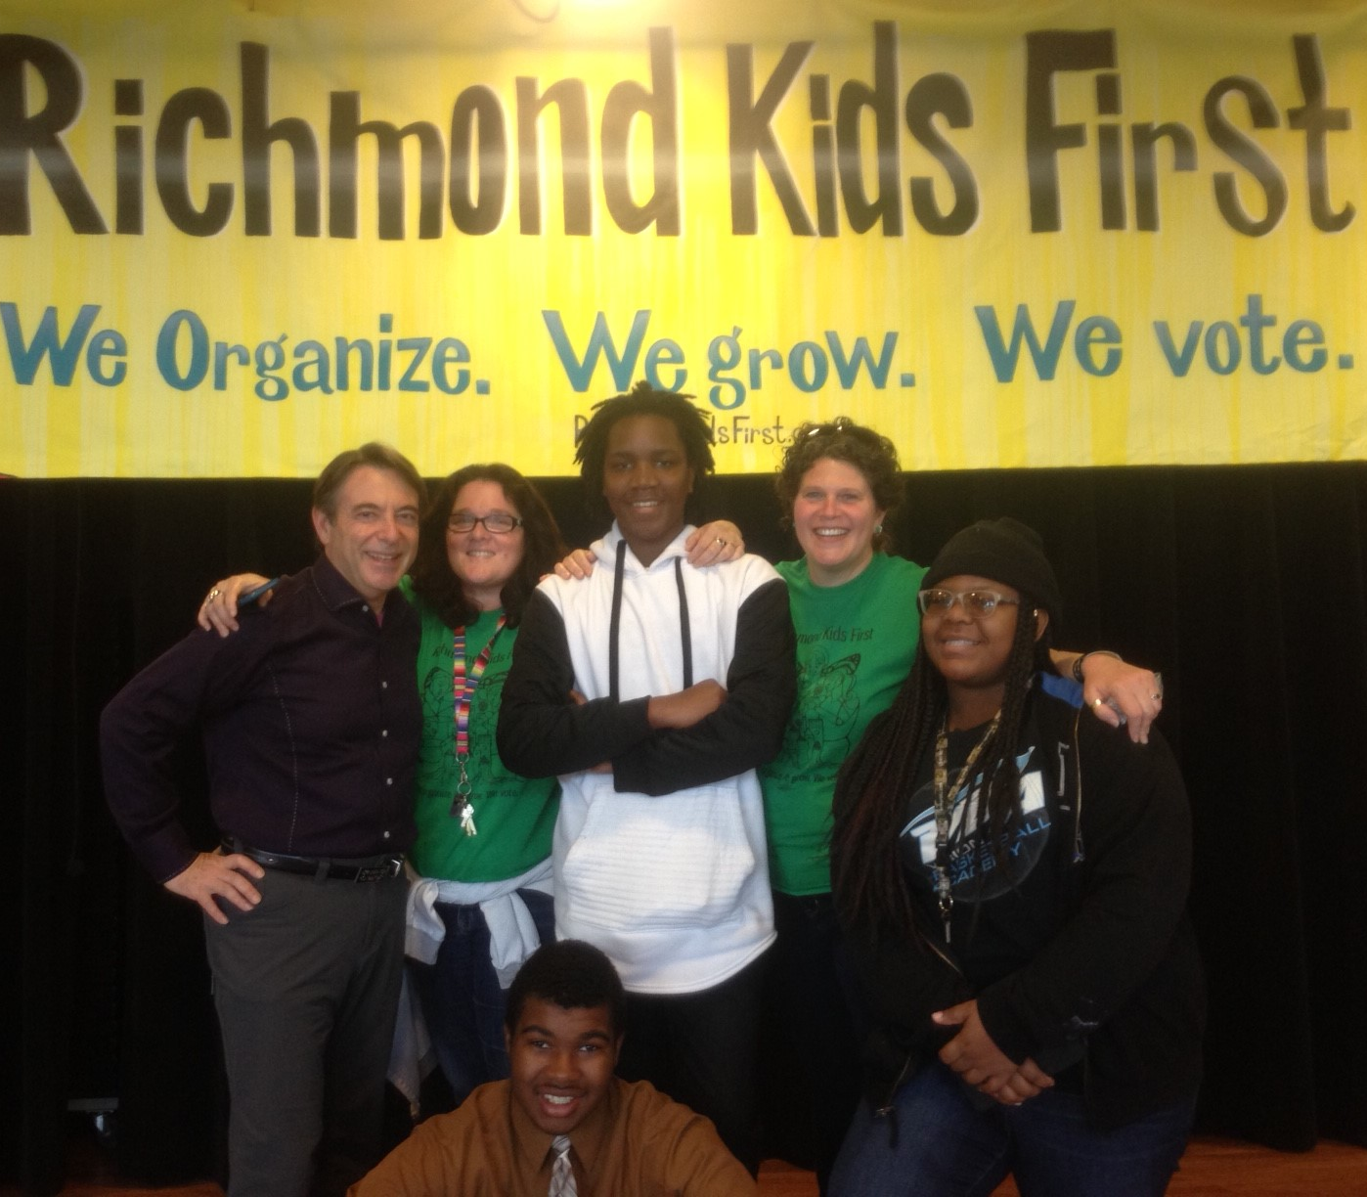
BUILDING THE BASE
OFTEN OVERLOOKED
Increasing the political and social capital of children, youth and families.
Activities can include coalition building, public education, door-to-door outreach, community meetings, house parties, rallies.
Build a powerful organization driven by community.

Slide 17
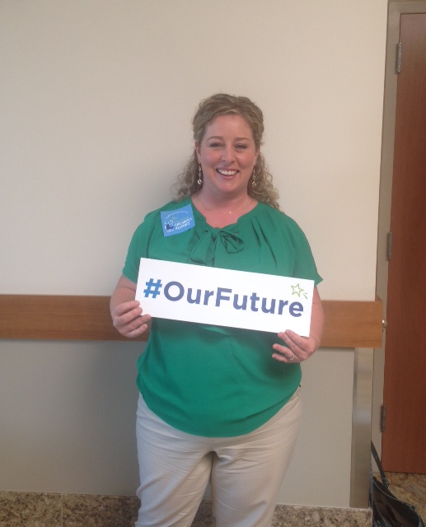
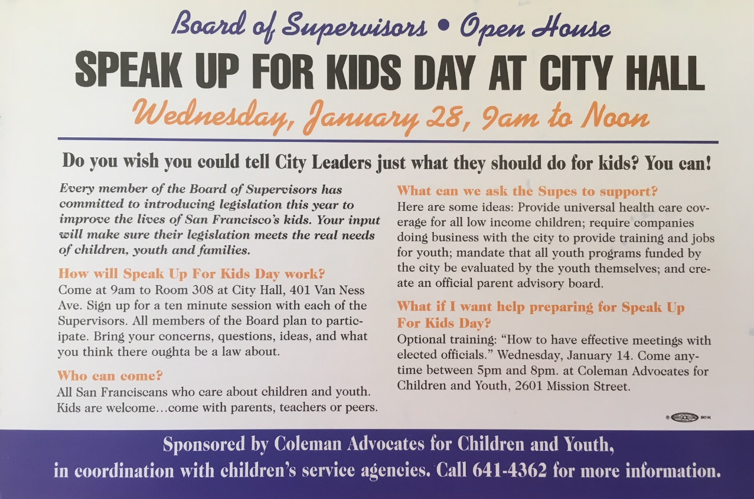
ORGANIZE PUBLIC SUPPORT
Social media
Outreach to community groups
Conferences and public forums
Mailings and newsletters
Forums for speaking out

Slide 18
CRAFTING A PROPOSAL
Be open to unexpected opportunities – and compromises
WHAT DO YOU WANT FUNDED?
Gaps in services – priority needs
LEGAL CONSIDERATIONS
Options and constraints
POLITICAL CONSIDERATIONS
Political feasibility and public opinion
Political champions and allies
Strength of opposition
Visible outcome
Builds political capital
ORGANIZATIONAL CONSIDERATIONS
Consensus of sponsoring coalition
Potential volunteers
Potential to rally parents and constituents
Resources of advocates
BIG ENOUGH TO MATTER
SMALL ENOUGH TO WIN

Slide 19
ELEMENTS OF A REVENUE MEASURE
RATIONALE FOR MEASURE
What are you committing to? (ex. racial equity, prevention, civic participation, best practices, the need for collaboration, leveraging resources, maximizing partnerships, accountability, affordability)
What specific populations will this measure target? (ex. children in poverty, children in all neighborhoods, homeless children, youth impacted by systems)
What models of care will be prioritized? (ex. high quality early care and education, workforce development, evidence-based services, etc.)
What outcomes are anticipated? (ex. all children ready for kindergarten, all youth have opportunities for positive development, all providers make a living wage)
What goals will this measure help the community meet? (Ex. the health, safety, and school success for individual children; gather data on welfare of children; )
Rationale for measure - findings
Title of ordinance – GIVE IT A NAME
Purpose and goals – e.g. prevention
Fund – amount, revenue source, name
Services eligible for funding – ages, types, not eligible
Prevent supplantation – baseline budget
Oversight – power, appointment
Administration – department, contracting, costs
Planning and accountability – public process, evaluation, transparency

Slide 20

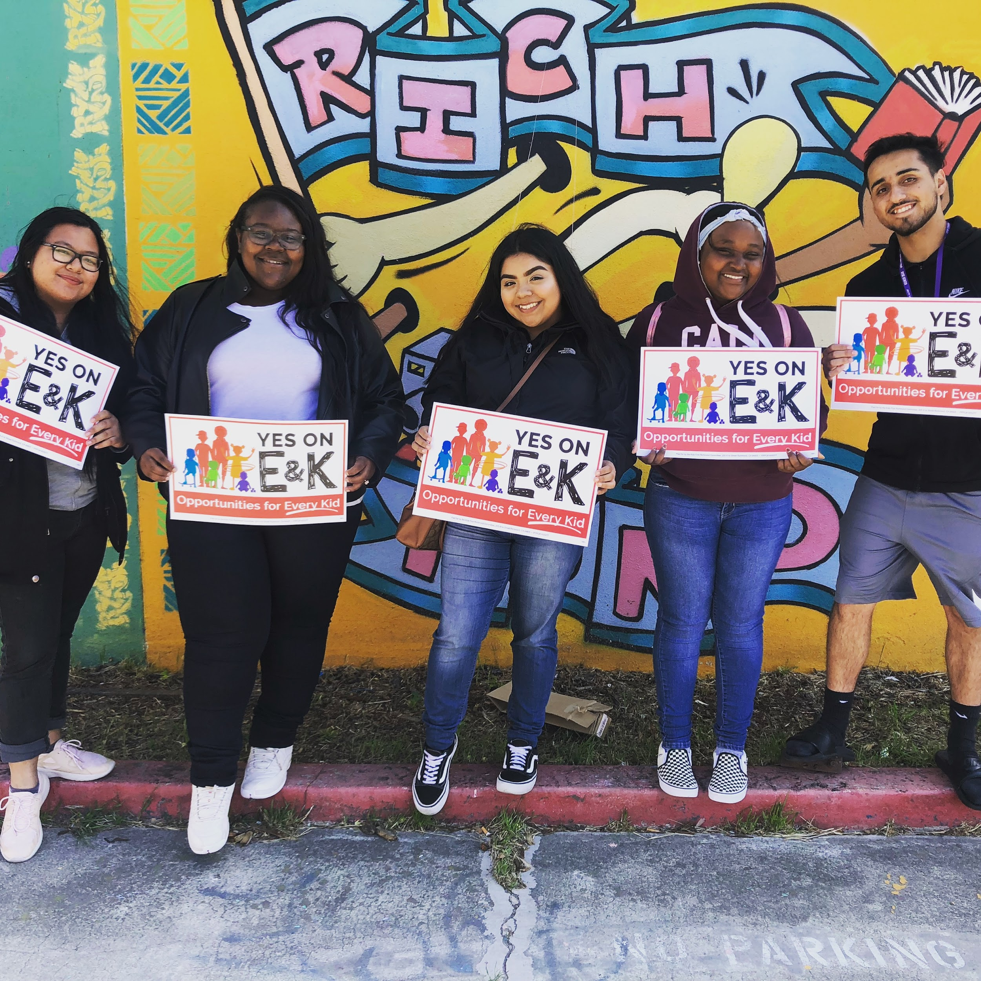
Goals of RFCY
To ensure that Richmond’s children, youth and young adults are physically, emotionally, mentally and socially healthy, educated, successful in school, and live in stable, safe and supported families and communities;
To increase safety for children, youth, young adults, their parents/guardians, families and the communities in which they live by preventing problems and enhancing the strengths of children, youth, young adults and their families;
To ensure young people are provided with gender-responsive, trauma-informed, population-specific and culturally-competent services;
To strengthen collaboration among public agencies and community-based organizations around shared outcomes among all service providers for children, youth, young adults and their parents/guardians;
To ensure an equitable distribution of resources to all of Richmond’s young people in recognition of the importance of investment in their futures from birth through young adulthood;
To fill gaps in services and leverage other resources whenever feasible.
www.richmondyouth.org
Notes:
Context & Opportunity: LC, HIAP, BMOC, OST, BHC, etc.
How Listening Campaign Findings influenced - Speaks to what youth said they needed – l
LC Goals: Listen, inform and create
Listen with empathy, alternatives to what they see, opportunities for engagement
What we heard from youth: trusting adults, active agents, etc.
Systems and environmental change
Additional Research
Intergenerational drafting process
Activities

Slide 21
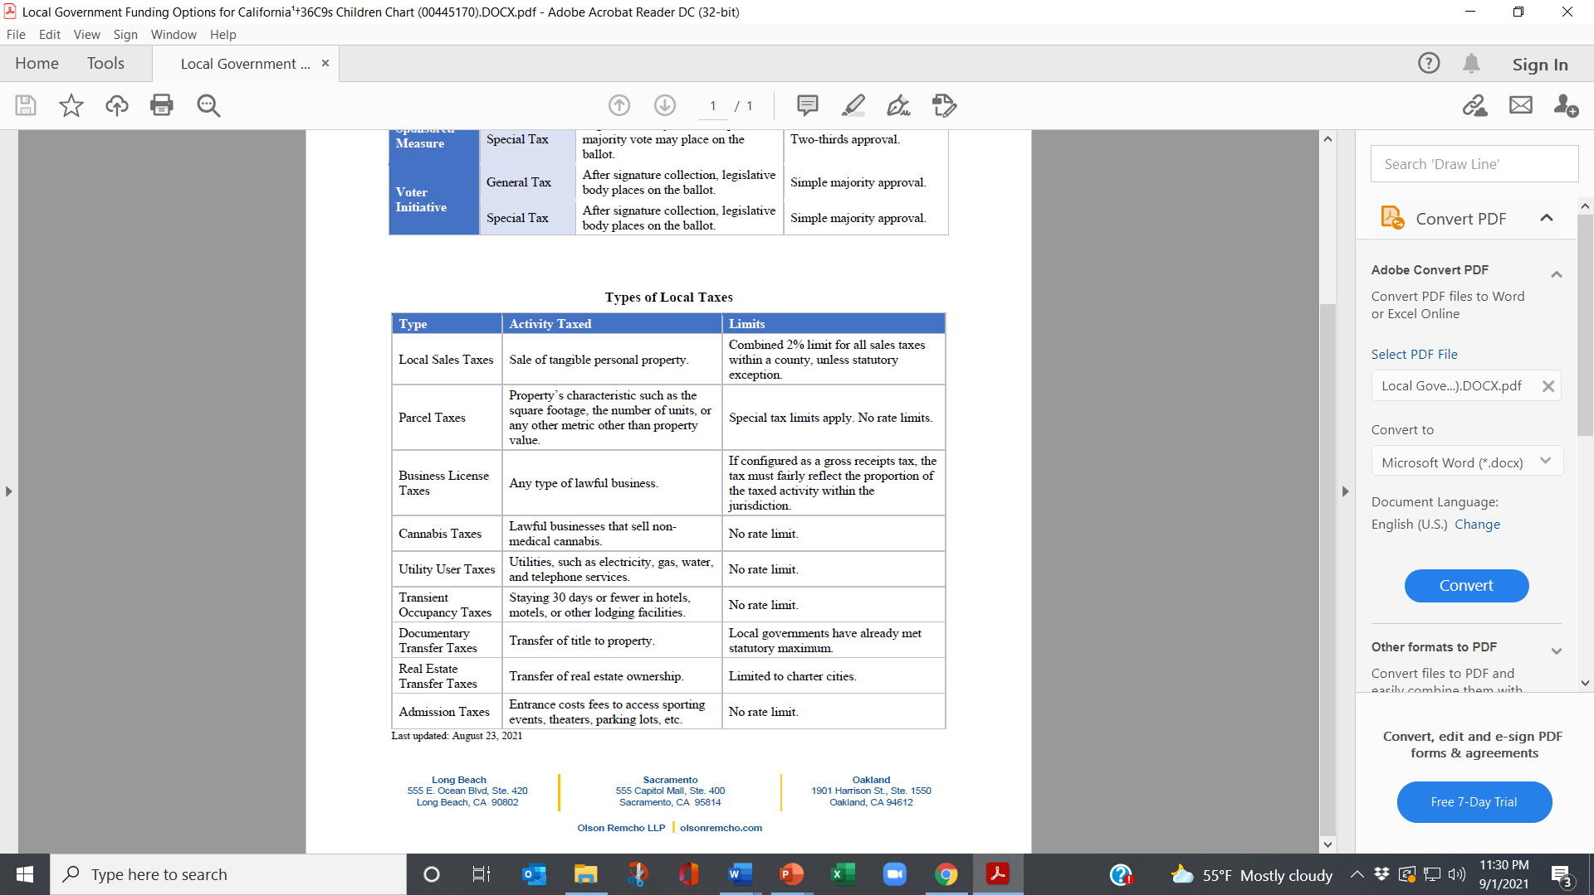
Set-asides/Carve-outs
Dedicated portion of existing revenue to children and youth.
Can be done in charter cities and counties.
No limit on amount – only what is politically feasible.
Generally require voter initiative.
Kids' needs
Your capacity
Political reality
SWEET
SPOT

Slide 22
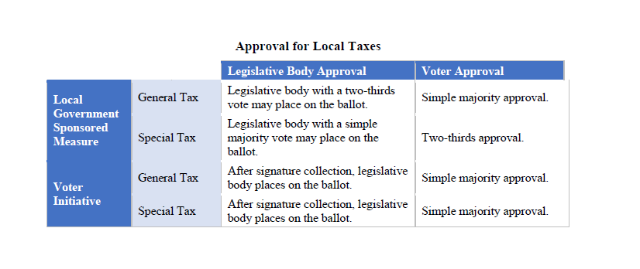

After signature collection, legislative
body places on the ballot.
Simple majority approval
Set-asides
Require amendment of charter – two-thirds of Legislative body to place on ballot.
Simple majority of voters with voter initiative.

Slide 23
LESSONS LEARNED FROM BALLOT MEASURE CAMPAIGNS
Notes:
1., change LA Co0….to Greater LA Summer Matters Network
2 add 2018 to the date

Slide 24
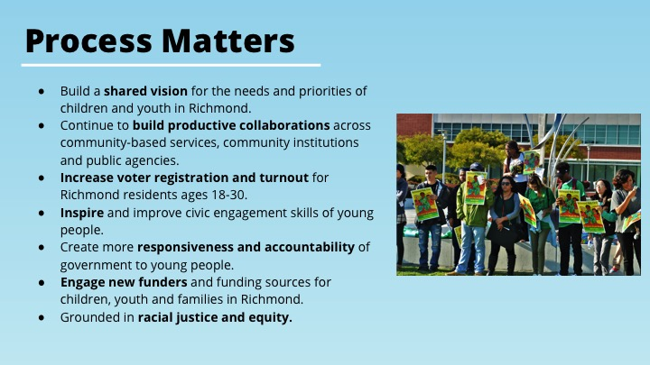
Process Matters

Slide 25
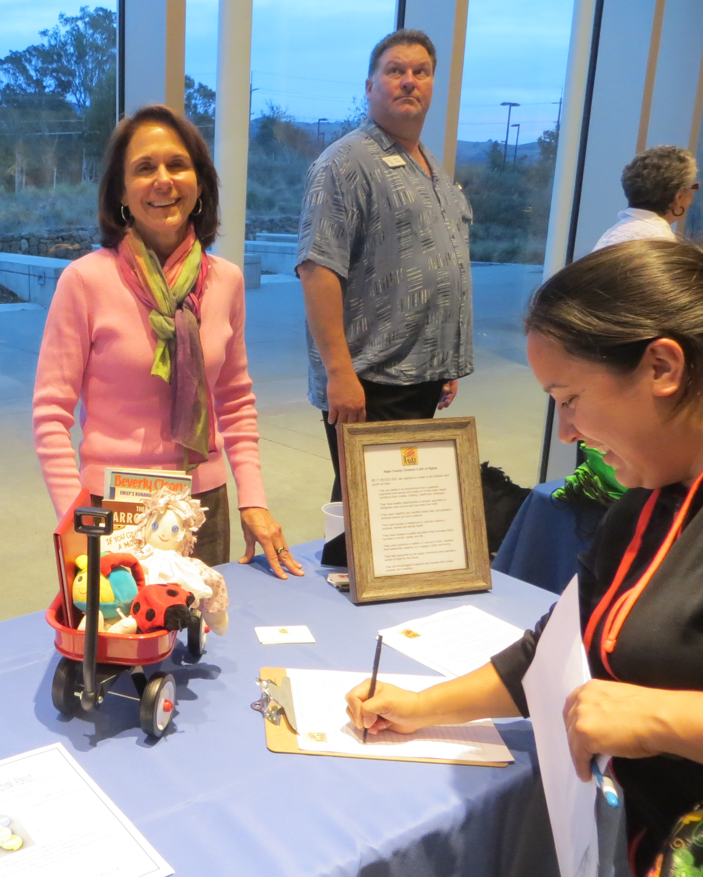
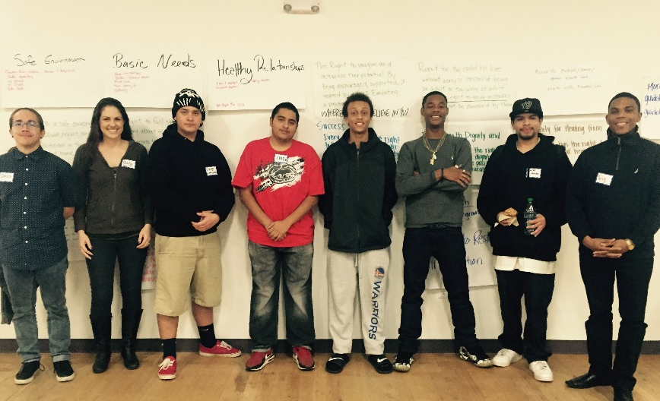
Non-profits can lead Untapped political power
Youth and parents – Powerful voice
Assets – Tradition of social justice, Understand problems close-up, Connected to program participants, Highly motivated.
Challenges – Funding to lead campaign, Political inexperience, Funded by government, Limited collective action in local budget battles.
.

Slide 26
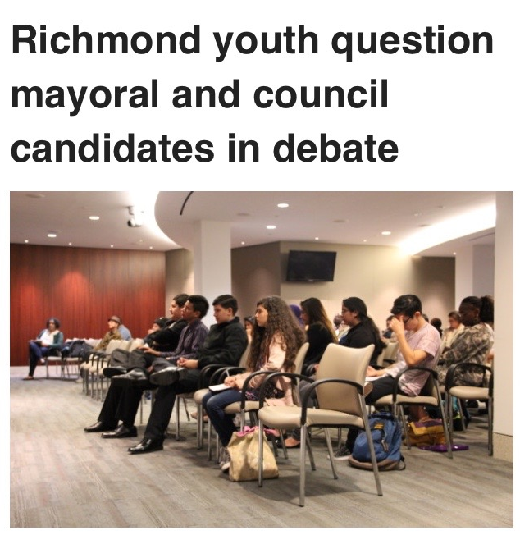
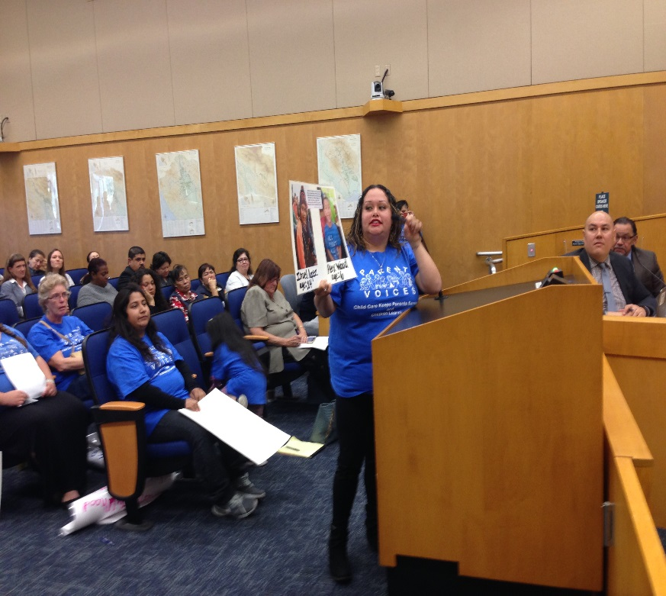
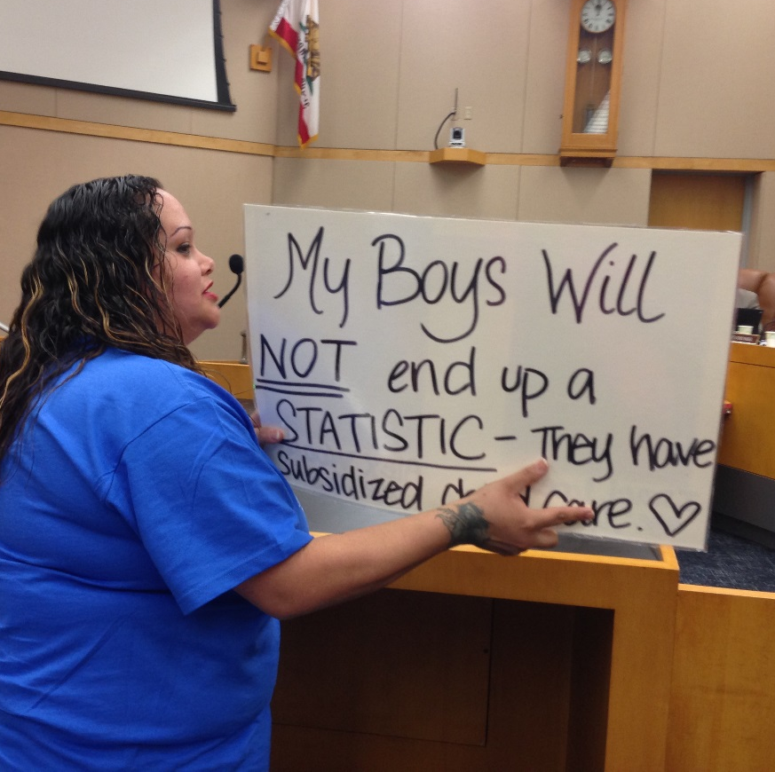
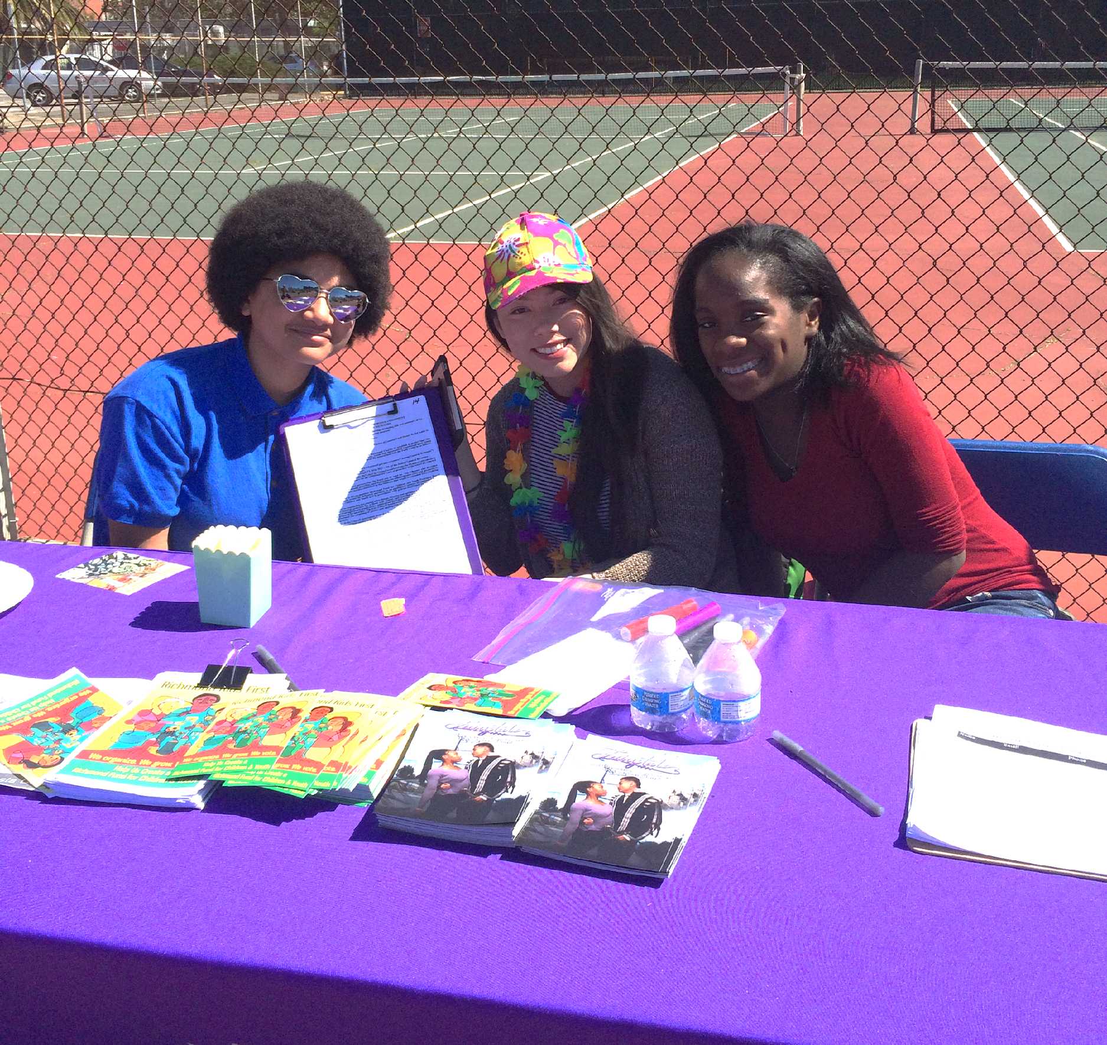
Youth & Parent Engagement
Youth and Parent Engagement:
Youth and parents at all coalition meetings for major decisions incl. Adding youth to Dept/Fund Oversight Board (requirement for coalition members)
Youth centered space for training and development: political education, understanding the city budget, campaign development, power mapping, research, understanding the poll, media/ messaging training. .
Civic Engagement: Host Candidate Forums during election seasons, voter registration.
Incentives for youth and parents
Team Building , networking & Fun!
Campaign - Field & Communications:
Storytellers and campaign ambassadors - Educate their peers, family and community.
Social Media and Communications - trained spokespeople
Canvassing, door-to-door knocking, phone/text banking etc. + volunteer recruitment -- engage families too!
Voter (pre)Registration
Attend relevant city council meetings
Hosting Community & Celebration Events
Notes:
Engaging youth and families
Meaningfully engagingly youth from the start; under 18 can’t hold the petition but they can cultivate the signature
incentives
take k
childcare
translation
canvassing their own neighborhoods - high validation rate
Notes:
Provide input into all aspects of the ballot measure and initiative
Participates in key decisions about the initiative and measure
Outreach
Promote and encourage signatures, post card collection and GOTV
Produces and participates in social media
Supports campaign events
Creates media
Educates their peers and community on the campaign.
Receives incentives
High traffic locations
Door-to-door canvassing
grocery stores
cafes
calendar of events (not too many numbers but good presence) - assign attendance at meetings
outside of schools
bart stations
all out weekends (big collective push)

Slide 27
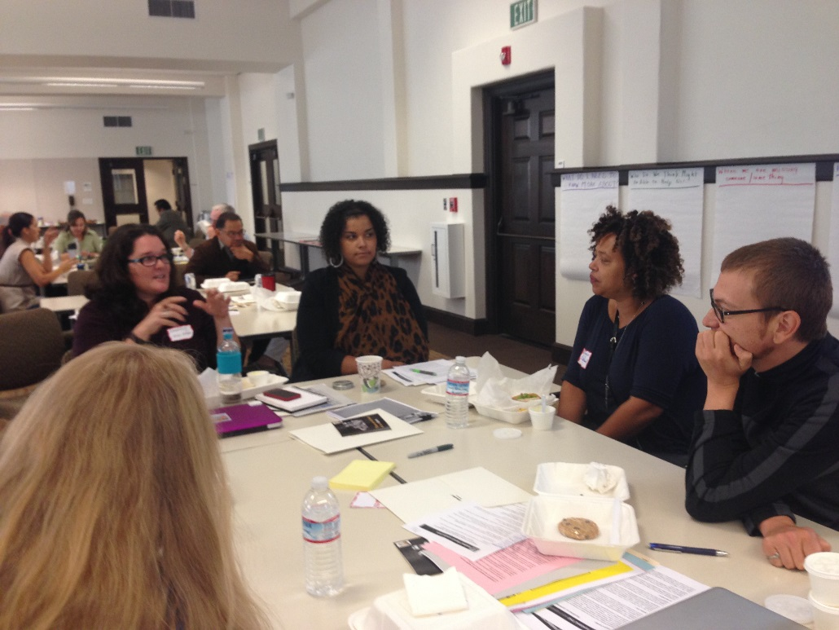
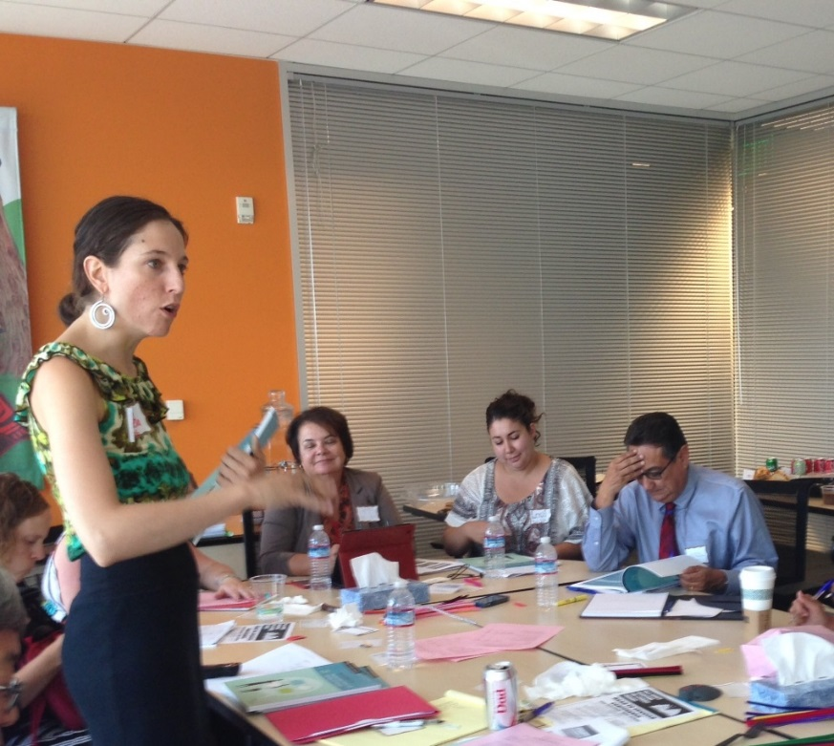
COORDINATING THE WORK
STAFF IS ESSENTIAL.
Lack of staff is major barrier to moving forward.
Staff can mobilize the resources of a network and ensure ongoing momentum:
Research
Convene meetings
Develop materials
Train youth, parents, volunteers
Liaison with decision-makers
Outreach to media
Build the coalition

Slide 28
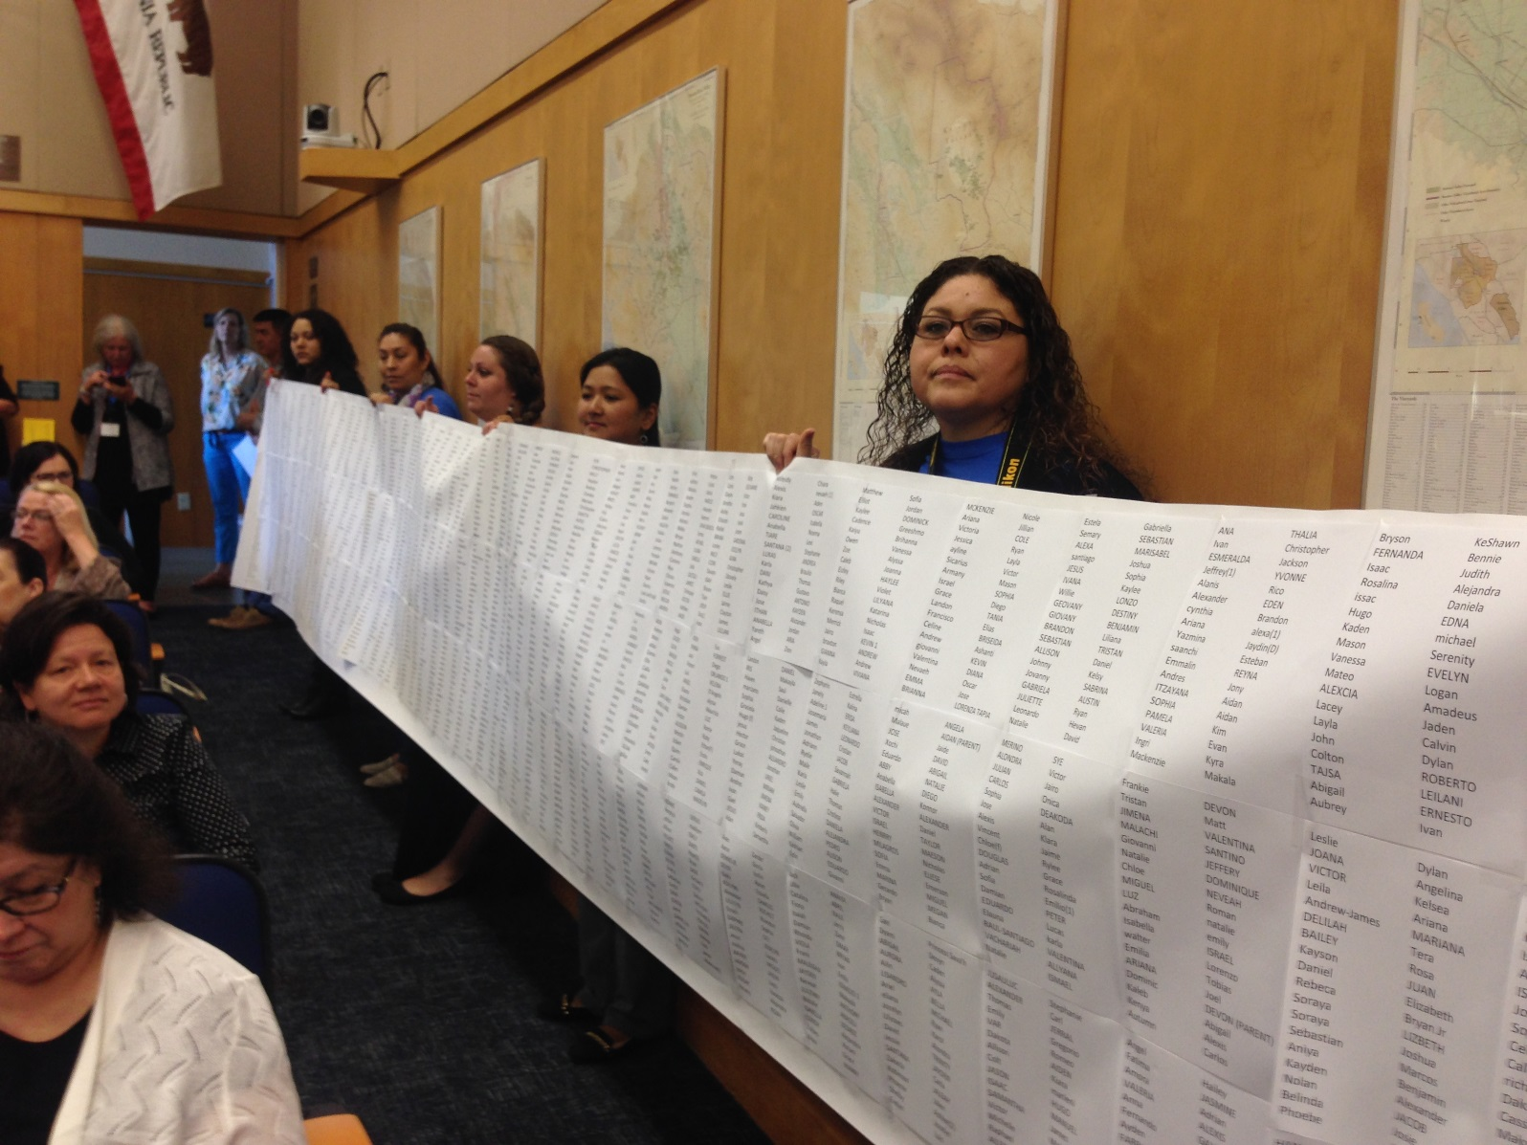
DRAMA HELPS

Slide 29
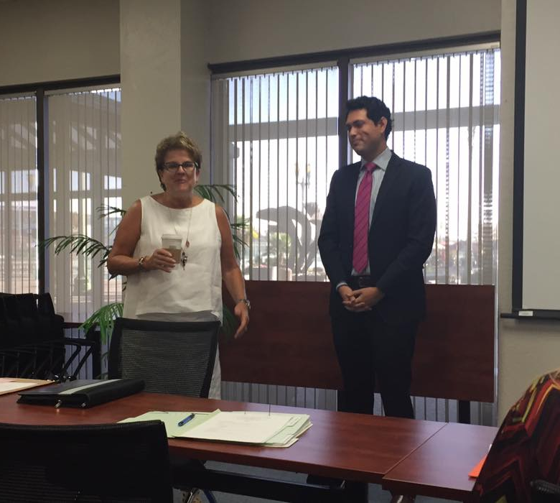
POWERFUL CHAMPIONS AND ALLIES IN GOVERNMENT
Often there are folks within the bureaucracy who want change as much as outside advocates – Find them and strategize together.
Elected officials may be champions of your cause. Your job is to make it easier for them to convince their peers.

Slide 30
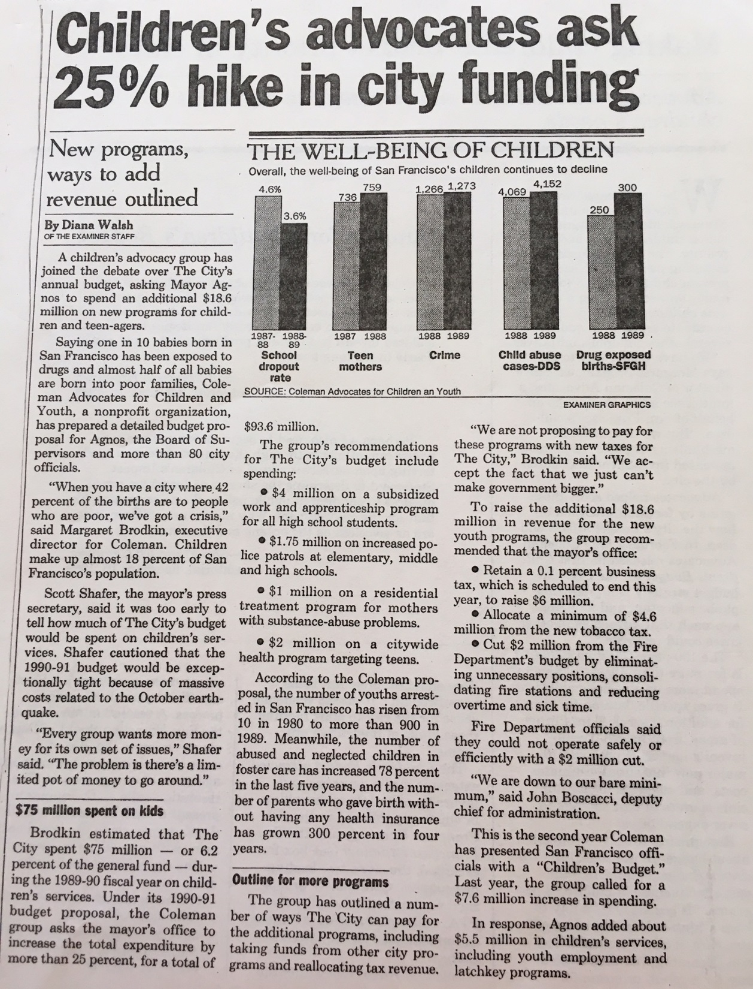
USE THE MEDIA
HAVE A SIMPLE MESSAGE
Press conferences
Op-eds
News releases
Feature stories
Follow the c’s – crisis, conflict, constumes, celebrities
Find a news hook.
OFTEN MORE IMPORTANT TO TALK TO THE MEDIA, THAN DIRECTLY TO DECISION-MAKERS.

Slide 31

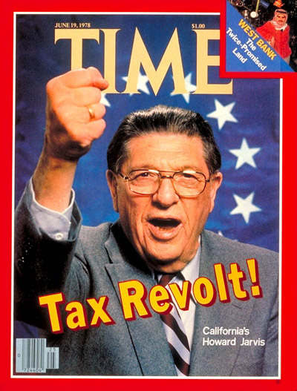
PREPARE FOR OPPOSITION
Anti-tax, Anti-government
Protecting turf and status quo
Competing priorities – roads and cops
Not the right time
Not the right approach

Slide 32
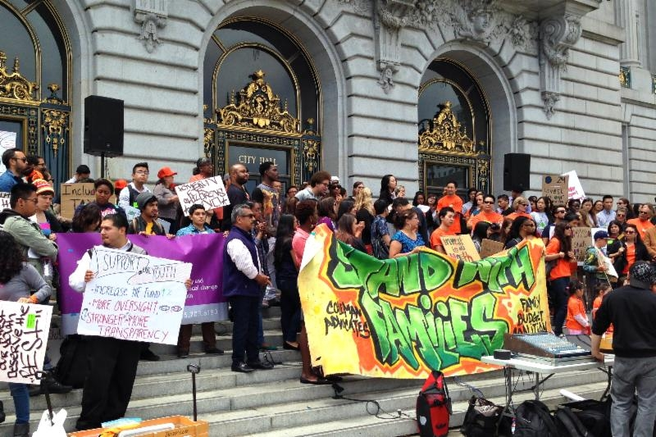
PERSUASION AND PRESSURE
PERSUASION
Information, Reports, Meetings, Letters, Testimony, Op-eds, Site visits, Calls
POLITICAL HARDBALL
Demonstrations, Petitions, Direct critique/report cards, Guerilla theatre, Press events, Circumventing the traditional process

Slide 33
TENTATIVE POSSIBLE TIMELINE
AUGUST 2022 – MAY 2023
MAKE CASE
BUILD BASE
RESEARCH REVENUE OPTIONS
JUNE 2023 – SEPTEMBER 2023
HIRE LAWYER
DEVELOP PROPOSL
DRAFT MEASURE
MAY – NOV. 2024
PLAN, FUNDRIASE, MOUNT A CAMPAIGN
OCT. 2023 – APRIL 2024
SUBMIT MEASURE TO COUNTY GATHER SIGNATURES
SUBMIT SIGNATURES
NOVEMBER 5
ELECTION
2024
WIN!
FUNDRIASE FUNDRAISE FUNDRAISE FUNDRAISE

Slide 34

Not yet ready for a single dedicated measure?
CONTINUE TO BUILD THE MOVEMENT.
NO MONEY NO JUSTICE.
Keep eyes open for emerging local measures. Get a seat at the table when new money could become available.
Form alliances with related advocacy and social justice groups – homelessness, mental health, housing.
Consider creating civic infrastructure first – departments, offices, cabinets, councils.
Keep vision of full funding alive. Don’t let anyone think that the problem is solved – until it is.
Build alliances with organizations and people with money for campaigns – public employee unions, hospitals, teachers unions.

Slide 35

FUNDING THE NEXT GENERATION
Provides technical assistance to coalitions working on local funding streams for children and youth – A team of experts will hold your hand.
Sponsors learning communities and conferences
Support includes speaking, convening, facilitating, trouble-shooting, coaching, and more.
Numerous tools and resources are available.
CONTACT:
Margaret Brodkin, Margaret@fundingthenextgeneration.org
415-794-4963
www.fundingthenextgeneration.org

