Slide 1

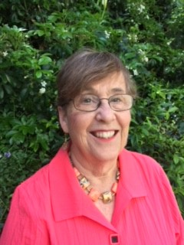
DIGITAL TOOLS: MEETING THIS MOMENT WHERE PEOPLE ARE - ONLINE sponsored by Funding the Next Generation
Moderator - Margaret Brodkin, Founder/Director Funding the Next Generation
What we do:
Provide inspiration and technical assistance to coalitions in California working on local funding streams for children and youth – through budgets, policy and the ballot.
We sponsor learning opportunities of all kinds; facilitate and speak at local and state forums; provide coaching and trouble-shooting; and work to build new tools and strategies to ensure equitable resources for kids.
JULY 14, WEBINAR
RECORDING WILL BE POSTED
ON WEBSITE: WWW.FUNDINGTHENEXTGENERATION.ORG
margaret@fundingthenextgeneration.org

Slide 2

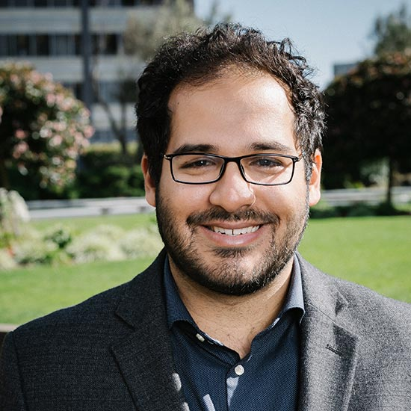
SPEAKER – SALIM ZYMET VICE PRESIDENT, DIGITAL @SalimZymet

Slide 3

FUNDING THE NEXT GENERATION
FOR INFORMATION AND TECHNICAL ASSISTANCE ON LOCAL DEDICATED FUNDING FOR CHILDREN AND YOUTH
FOR RECORDING, NOTES AND ANNOUNCEMENTS
OF UPCOMING MEETINGS
E-mail Margaret Brodkin, Margaret@fundingthenextgeneration.org
415-794-4963
Or sign up on website
www.fundingthenextgeneration.org

