Slide 1

GET MORE MONEY FOR KIDS IN YOUR CITY AND COUNTY 2024 - 2025 BUDGET
Margaret Brodkin, Director Funding the Next Generation
Ed Harrington, Former SF Controller, Expert in Public Finance
Dec. 8, 2023
Webinar
Will be posted on funding the next generation website

Slide 2


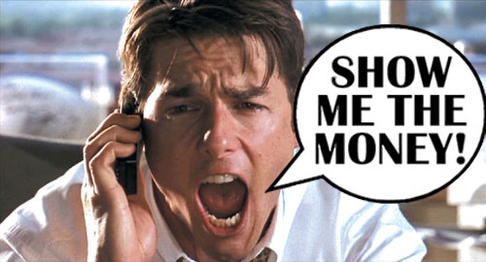
BUDGET ADVOCACY –> NEW BUDGET PRIORITIES
De-mystify budgets and the budget process
Inspire one do-able action in the local 2024-25 budget process
Develop credibility in the fiscal arena
Start building knowledge and capacity for ongoing budget and fiscal advocacy

Slide 3
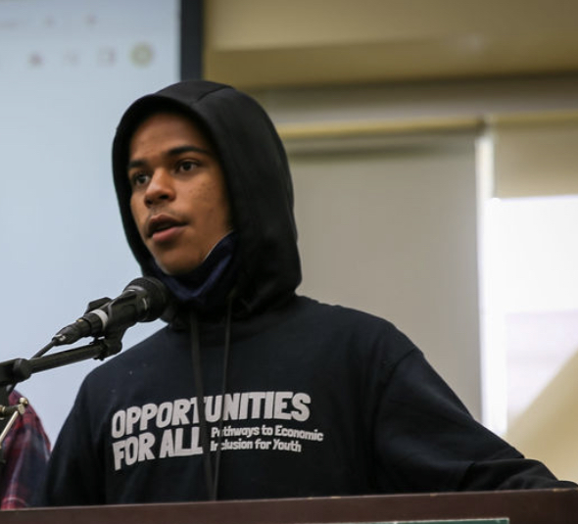
WHY BUDGETS MATTER?
A budget is a moral document that reflects community values.
Funding inequity is a social justice issue.
What kids need costs money.
Lack of resources is greatest resistance to change

Slide 4
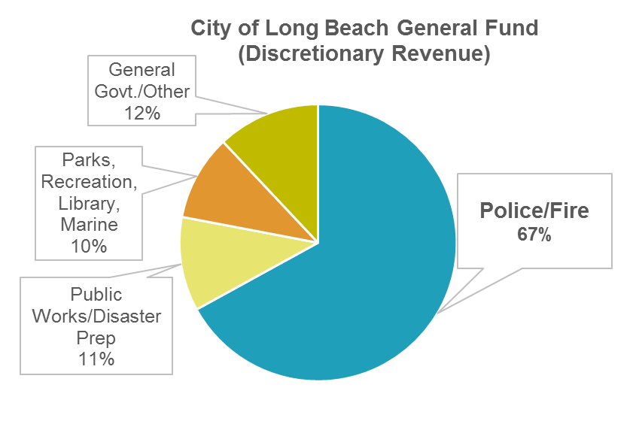
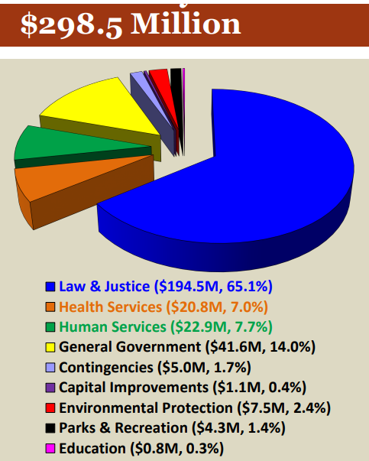
WHAT’S WRONG WITH THIS PICTURE?
San Joaquin County General Fund

Slide 5
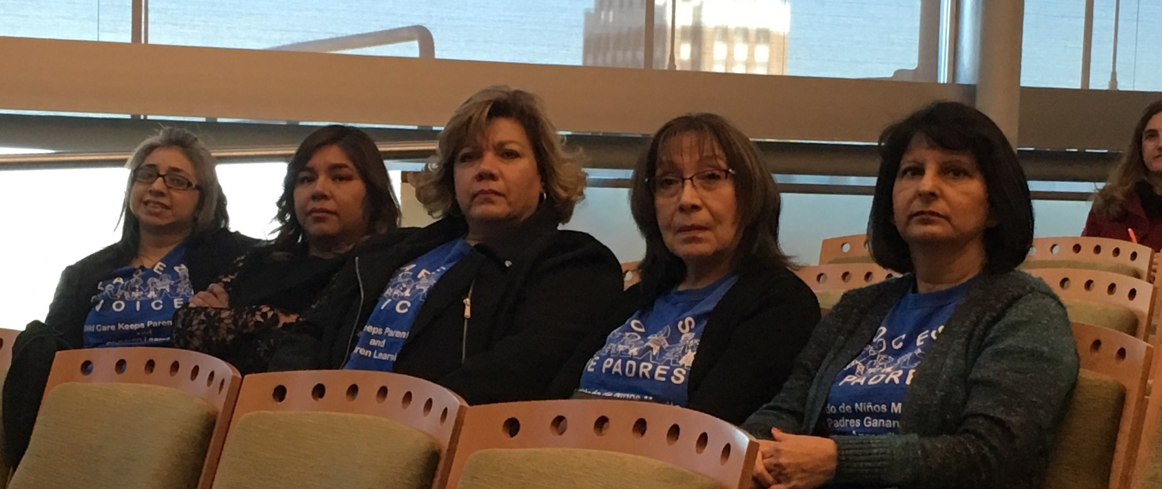
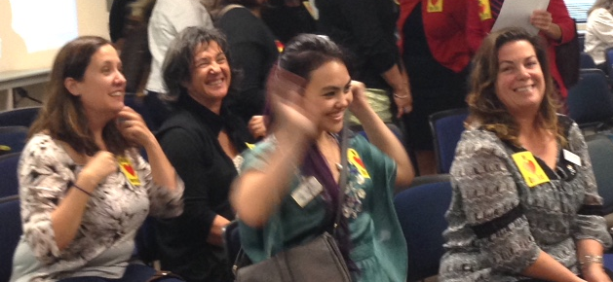
BASIC PRINCIPLES
CREATING A PUBLIC BUDGET IS A YEAR-ROUND PROCESS
Changing budget priorities is a sustained multi-year process of building power, expertise and credibility.
Maximize potential of every budget opportunity - Showing up is half the battle. There is always money for something – i.e., a pilot, half a year, etc.
Persistence is essential. It is always a struggle – there is always opposition! Be the folks who won’t go away.
Numbers count. Bring a crowd.
Celebrate victory when you can.

Slide 6
BUDGET ADVOCACY STEPS
Notes:
1., change LA Co0….to Greater LA Summer Matters Network
2 add 2018 to the date

Slide 7
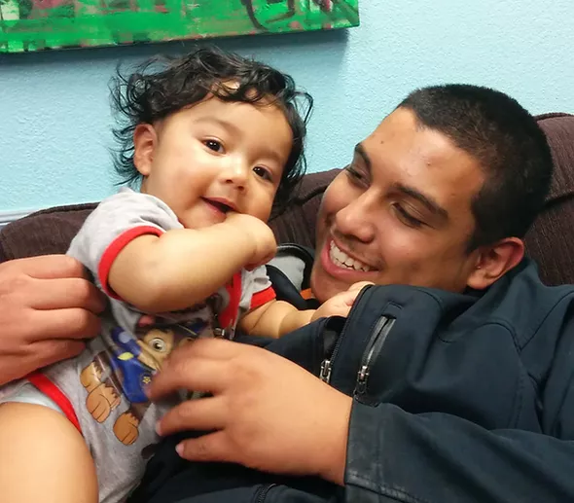
CONTINUUM OF BUDGET ADVOCACY OPTIONS
Ask questions. Demand information. Raise issues.
Prevent budget cuts in key programs.
Expand existing programs, i.e., end waiting lists.
Add new line items/programs.
Work in coalition on comprehensive issue agenda.
Work in budget justice coalition for broader structural changes.
Reform the budget process.
Create new funding stream through ballot.

Slide 8

BUDGET ADVOCACY STEPS
Assess local budget landscape
Develop budget “ask”
Create compelling fact sheet/proposal/booklet
Communicate budget “ask” to decision-makers and to public
Organize/mobilize supporters
Participate in all aspects of budget process – provide testimony
Advocate and campaign for budget “ask”

Slide 9
WHAT TO ASK FOR?
Notes:
1., change LA Co0….to Greater LA Summer Matters Network
2 add 2018 to the date

Slide 10

QUESTIONS TO ASK AS YOU REVIEW THE BUDGET
Are children and youth getting their fair share?
Where are glaring inequities and disparities?
What are the major gaps in services?
Could more lives be saved with greater investment in prevention?
Should state or federal dollars be more focused on prevent?
Are there large expenditures with limited accountability?
Have children and youth been losing ground over time?
What portion of discretionary dollars are spent on kids?
Are there best practices that should be expanded?

Slide 11
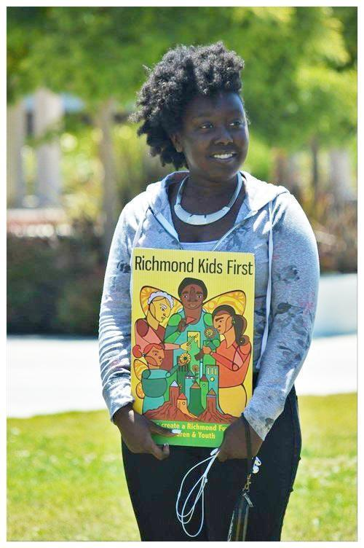
CONSIDERATIONS FOR DEVELOPING “ASKS”
Big enough to matter - Small enough to win!
Availability of resources
Popular with public - responds to felt need
Supporters willing to engage
Cost benefit
Visible results
Builds power – prepares for next fight
Engages impacted parents and youth

Slide 12


MAKE THE “ASK” CONCRETE
Need, Cost, Program, Population served, Administrator, Outcomes, Cost-Benefits
Family Resource Center for teen parents
Youth Center in underserved neighborhood
Wages Plus fund for childcare workers
100 summer jobs for youth
Community based case managers as alternative to detention
Wellness center(s) in high school(s)
Childcare slots for homeless families
Expanded after-school program(s)
Renovate a playground

Slide 13
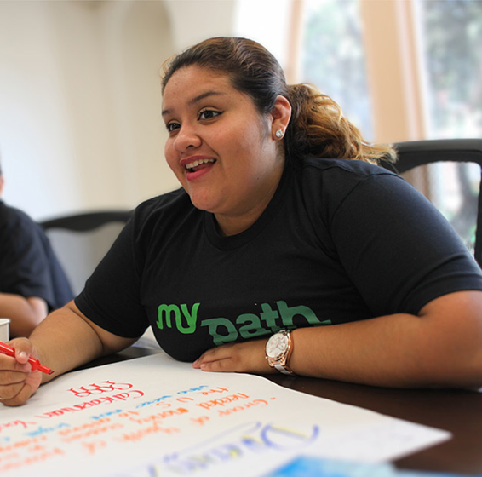
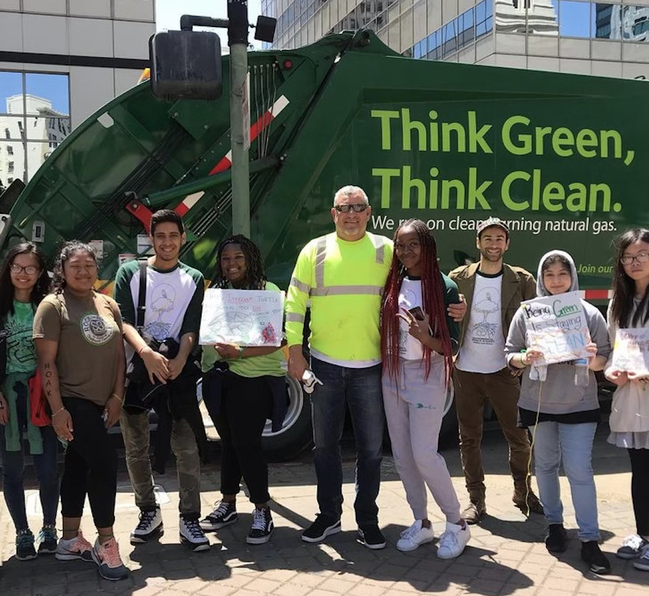
WHAT TO PUT IN A BUDGET FACT SHEET
NAME OF REQUEST/PROGRAM/LINE ITEM
Jobs for opportunity youth
RATIONALE/PROBLEM/NEED
75% of youth in the foster care and juvenile justice systems report they don’t have constructive activity after school. 90% report that their families need resources that could be provided by summer jobs. Youth employed in constructive work avoid getting into trouble and develop important skills that support their future aspirations.
DESCRIPTION OF REQUEST
Afterschool jobs program for 100 youth involved in the juvenile justice or foster care system in local businesses or non-profit agencies. The program would be managed by an experienced non-profit which would develop job slots, recruit, provide training for job supervisors and support for employed youth.
IMPLEMENTATION/ADMINISTRATION
Issue an RFP for a non-profit administrator through the office of youth development/office of economic development/or rec and park dept.
COST
$750,000
COST-BENEFIT
Job opportunities reduce recidivism. The cost of an average stay in detention is $80,000.
SUPPORTERS
Teachers' union, CASA, Chamber of Commerce, YMCA, Boys and Girls Clubs, Youth Uprising Coalition, Parents United, Kiwanis Club…..

Slide 14
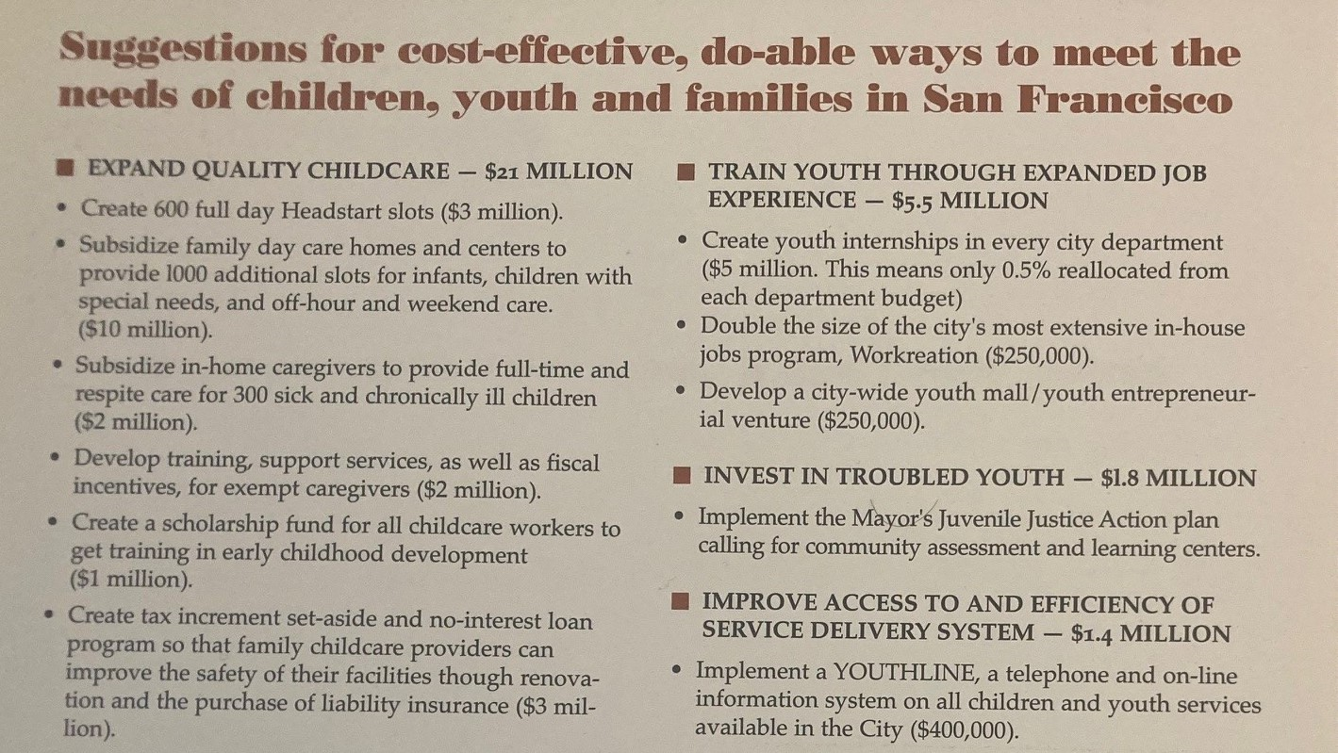

Slide 15
ADVOCACY TIPS Pick one or two ideas.
Notes:
1., change LA Co0….to Greater LA Summer Matters Network
2 add 2018 to the date

Slide 16
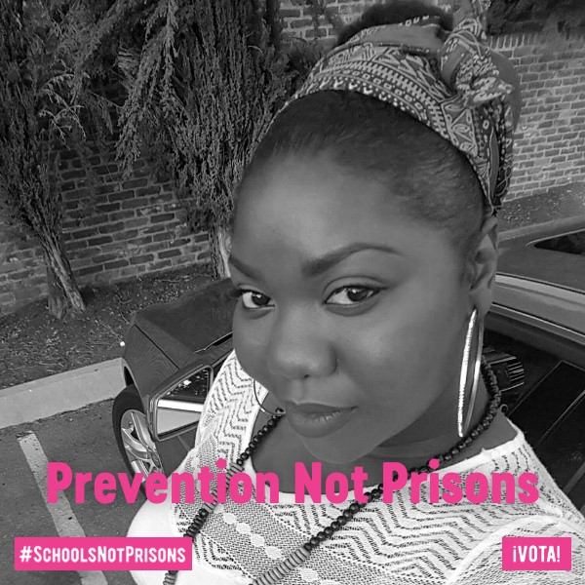
CHALLENGES
PRESERVING THE STATUS QUO
SACRED COWS
TURF
NEVER THE RIGHT TIME
NEVER THE RIGHT APPROACH
NO NEW MONEY
PURPOSEFUL MYSTIFICATION
NON-PROFITS LACK EXPERIENCE & FEAR POLITICAL REPURCUSSIONS.

Slide 17
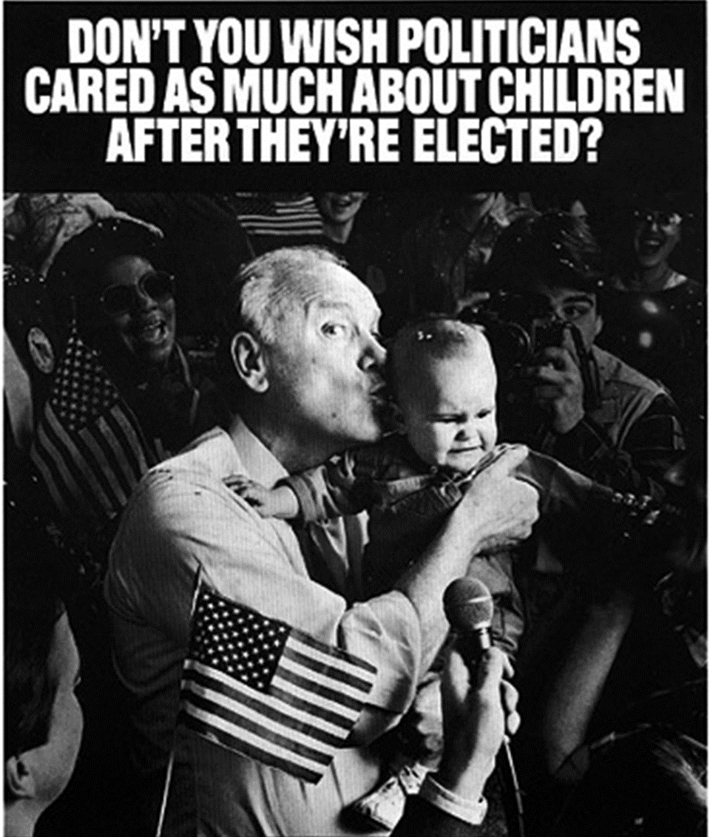
PERSUASION AND PRESSURE
TRADITIONAL TACTICS – reports, meetings, letters, testimony, op-eds, site visits, phone calls, media, social media
POLITICAL HARDBALL – demonstrations, sit-ins, petitions, public challenges and direct criticism, guerilla theatre, dramatic press events, persistence
Budget campaign from
Children’s Defense Fund

Slide 18
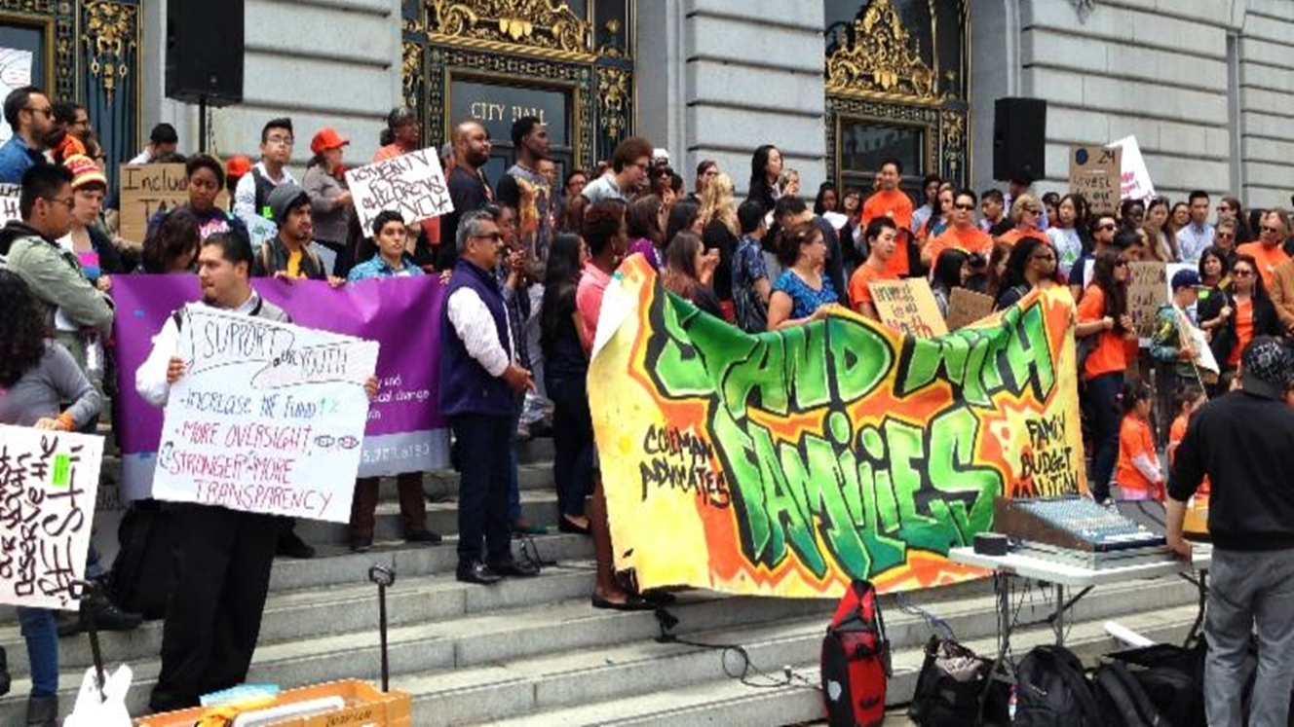

Slide 19
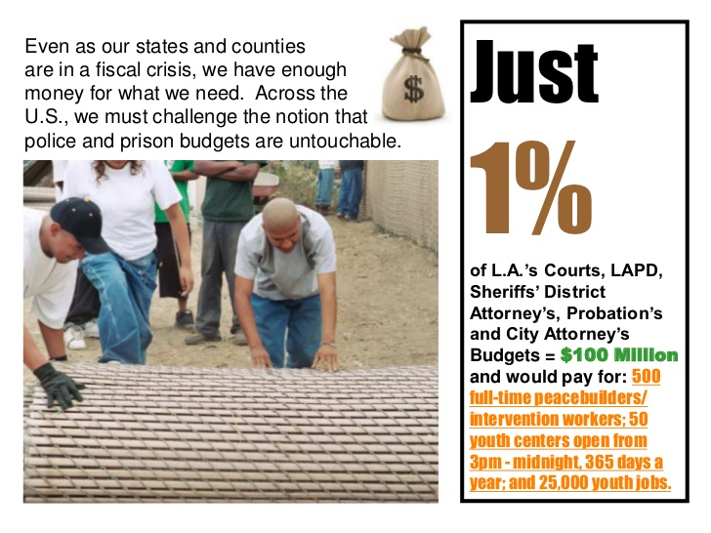
Notes:
1., change LA Co0….to Greater LA Summer Matters Network
2 add 2018 to the date

Slide 20
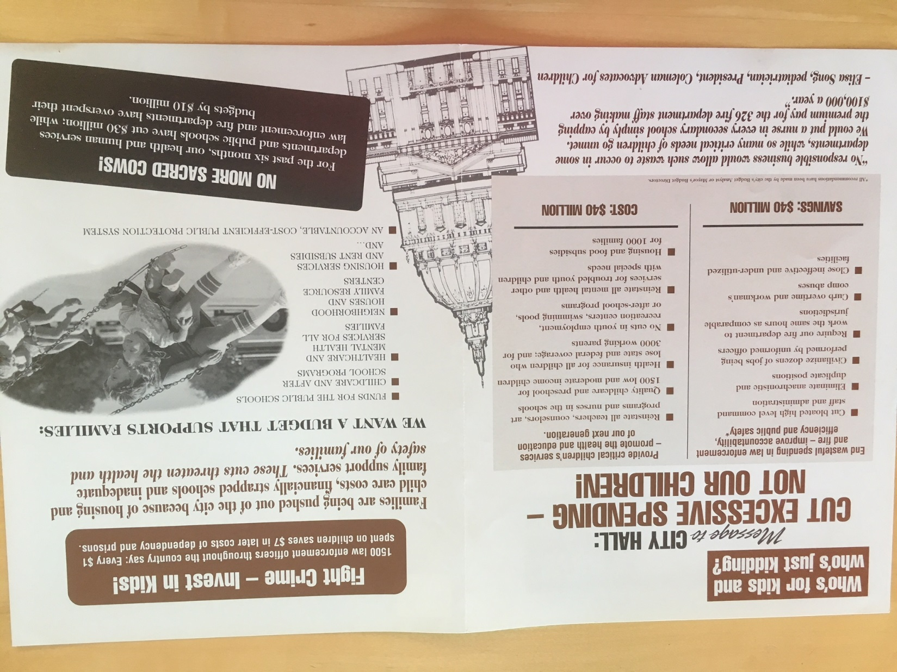
,

Slide 21
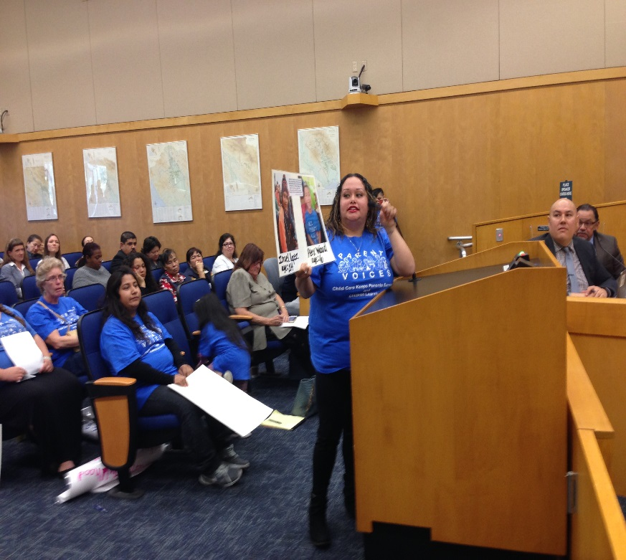
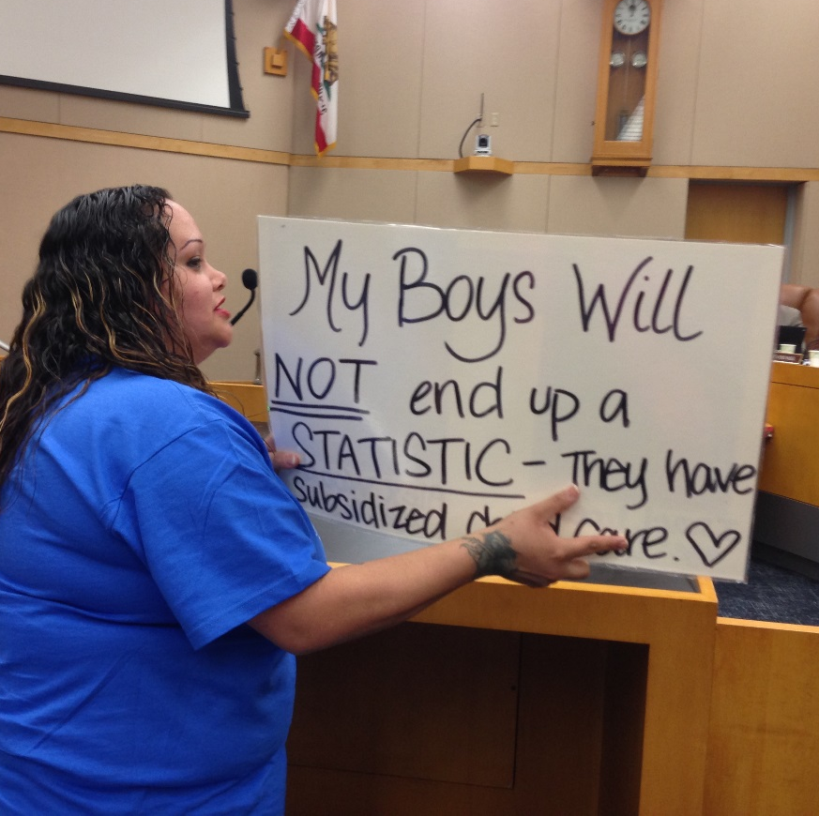
COMMUNICATING THE NEED
USE PUBLIC FORUMS – TESTIFY AT HEARINGS
Reports and facts have an important place, but alone they don’t change budgets.
Decision-makers have short attention spans.
3 minutes is all you get in public testimony.
Avoid jargon and too much data.
Tell stories.
Make it personal.
The voices of youth and parents are the most powerful.
You can start by showing up for open public comment.

Slide 22
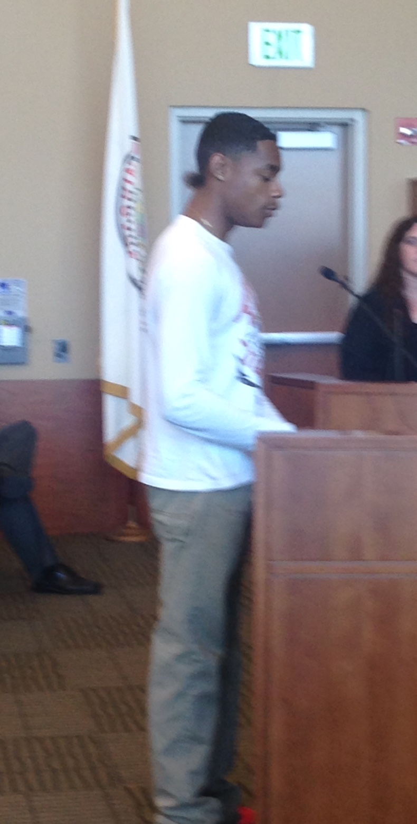
VOICES OF YOUTH AND PARENTS
Elected official to advocates: Whatever you do, stop bringing all those kids.
Advocates to selves: I guess we’ll double the number of kids that we get engaged.
Harder to say no to kids and parents, and folks telling their own real needs.

Slide 23
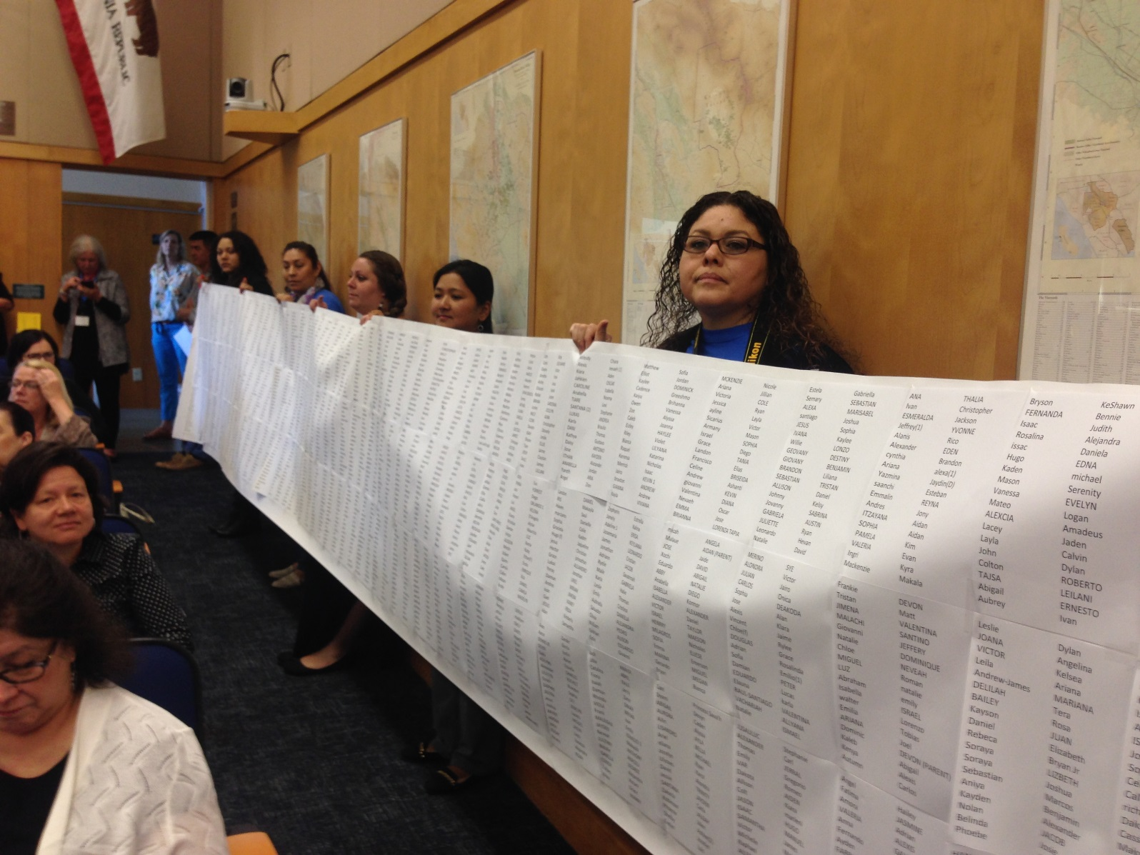
DRAMA HELPS
Parents holding names of children on childcare waiting list at public hearing.

Slide 24
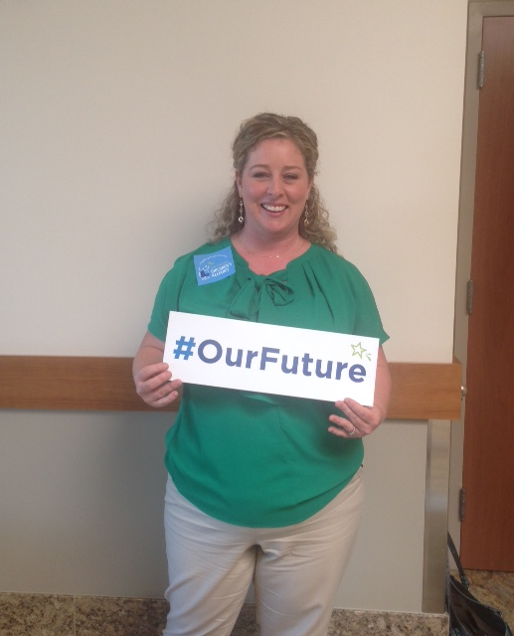
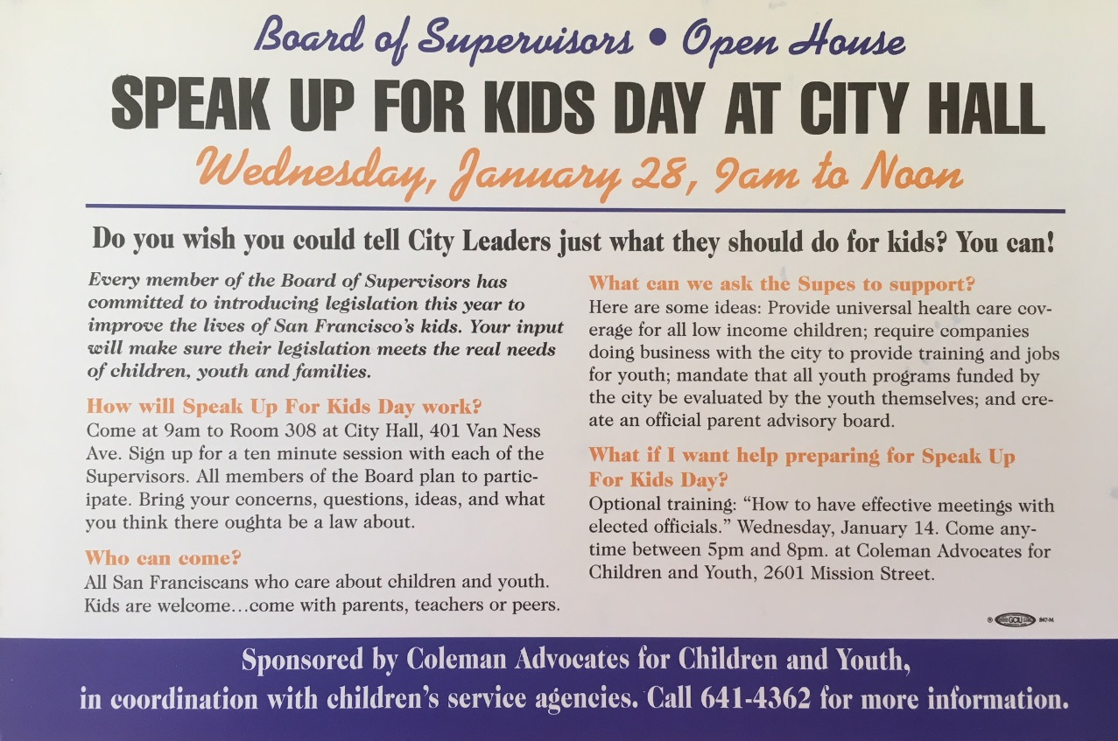
ENLIST PUBLIC SUPPORT
Social media
Outreach to community groups
Conferences and public forums
Mailings and newsletters
Speak up for kids' days

Slide 25
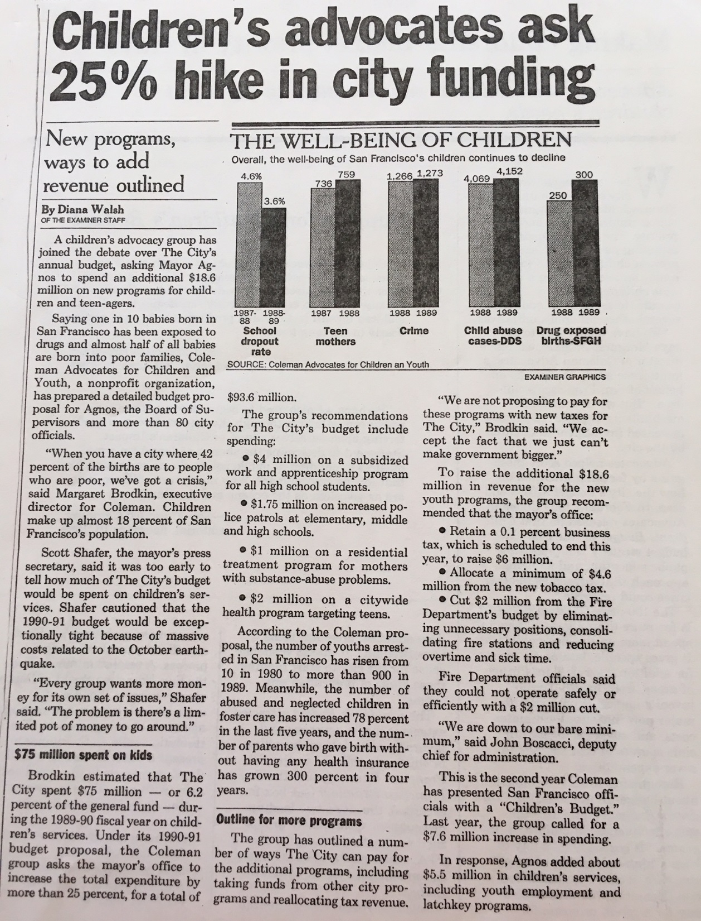
USE THE MEDIA
HAVE A SIMPLE MESSAGE
Press conferences
Op-eds
News releases
Feature stories
Follow the c’s – crisis, conflict, costumes, celebrities
Find a news hook.
OFTEN MORE IMPORTANT TO TALK TO THE MEDIA, THAN DIRECTLY TO DECISION-MAKERS.

Slide 26

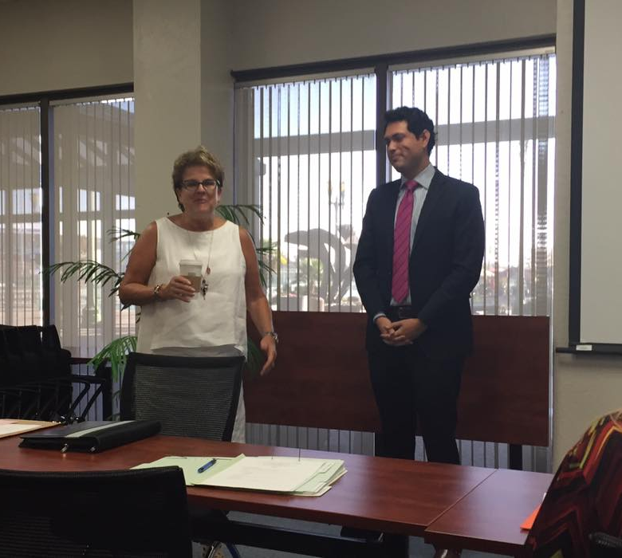
USE POLITICAL ALLIES AND CHAMPIONS INSIDE GOVERNMENT
Often there are folks within the bureaucracy who want change as much as outside advocates – Find them and strategize together.
Elected officials may be champions of your cause. Your job is to make it easier for them to convince their peers.
San Joaquin County Board of Supervisor members chairing children’s task force advocated for by children’s coalition.

Slide 27
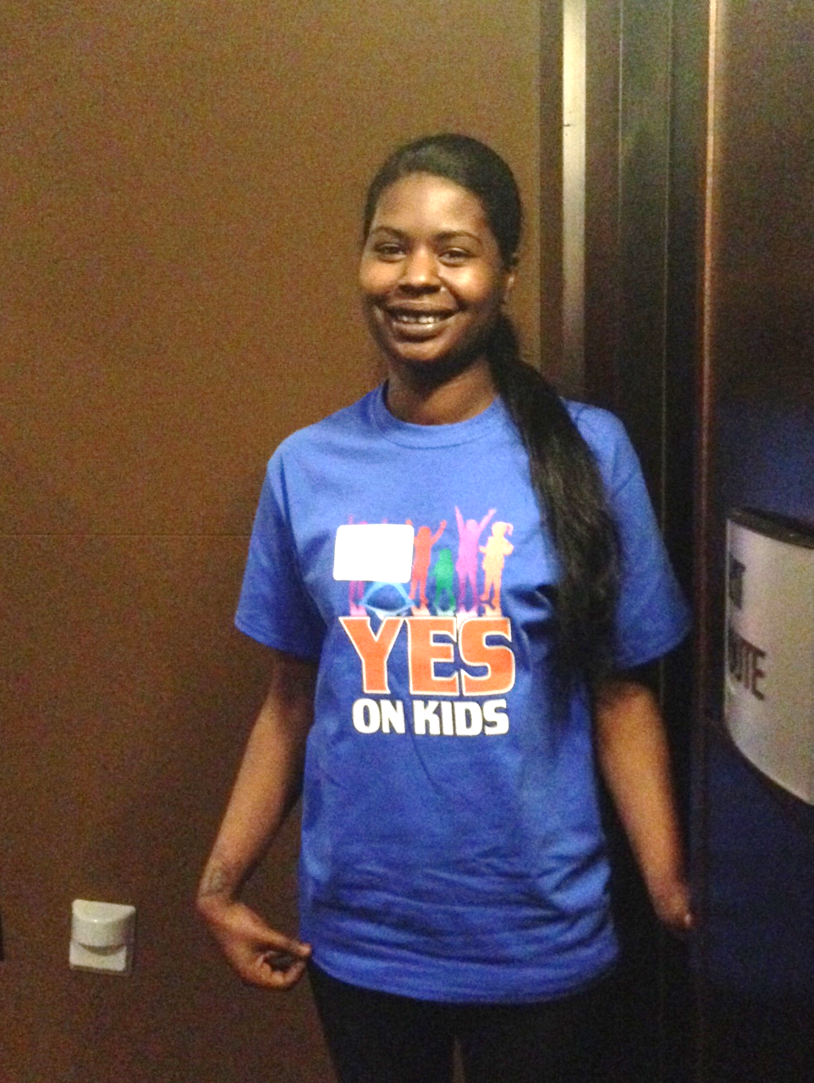
BUILD COALITIONS AND ALLIES
San Francisco Budget Justice Coalition
ACCE AFT 2121 AIDS Legal Referral Panel API Council Arts for a Better Bay Area Bay Area Community Resources (BACR) Causa Justa::Just Cause Chinese Progressive Association Coalition of Agencies Serving the Elderly Coalition on Homelessness Coleman Advocates for Children and Youth Community Alliance of Disability Advocates Community Housing Partnership Community Partnership for LGBTQQ Youth (CPQY) Dolores Street Community Services (DSCS) El/La Para TransLatinas Hamilton Families Homeless Emergency Service Providers Association (HESPA) HIV/AIDS Provider Network (HAPN) Hospitality House Jobs With Justice Larkin Street Youth Services LYRIC New Door Ventures NEXT Village SF Parent Voices St. James Infirmary San Francisco Child Care Planning & Advisory Council San Francisco Housing Rights Committee San Francisco Human Services Network San Francisco Immigrant Legal & Education Network (SFILEN) Senior and Disability Action Service Employees International Union, Local 1021 Sheroes Project South of Market Community Action Network (SOMCAN) Supportive Housing Provider Network (SHPN) TGI Justice Project Young Women's Freedom Center

Slide 28
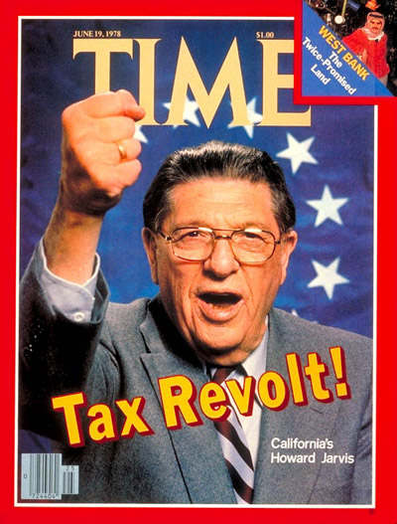

PREPARE FOR OPPOSITION
The Taxpayer revolt is alive and well. New items in the budget threaten increased spending and therefore new taxes.
Policymakers are often leery of funding for new items since it implies an ongoing commitment.
Opposition is often behind the scenes – particularly when status quo and turf is threatened.
BUDGET ADVOCACY IS ONE BATTLE AFTER ANOTHER.
Must be the folks who never go away.

Slide 29
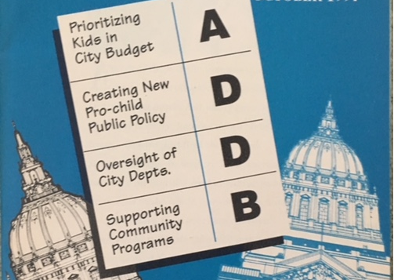
BUILD IN ACCOUNTABILITY
Hold decision-makers accountable after the budget process – for negative AND positive decisions.
Newsletters
Report cards
Follow-up meetings
Newspaper ads
Accountability sessions
CHILDREN’S BUDGET COALITION GRADES THE SF BOARD OF SUPERVISORS

Slide 30
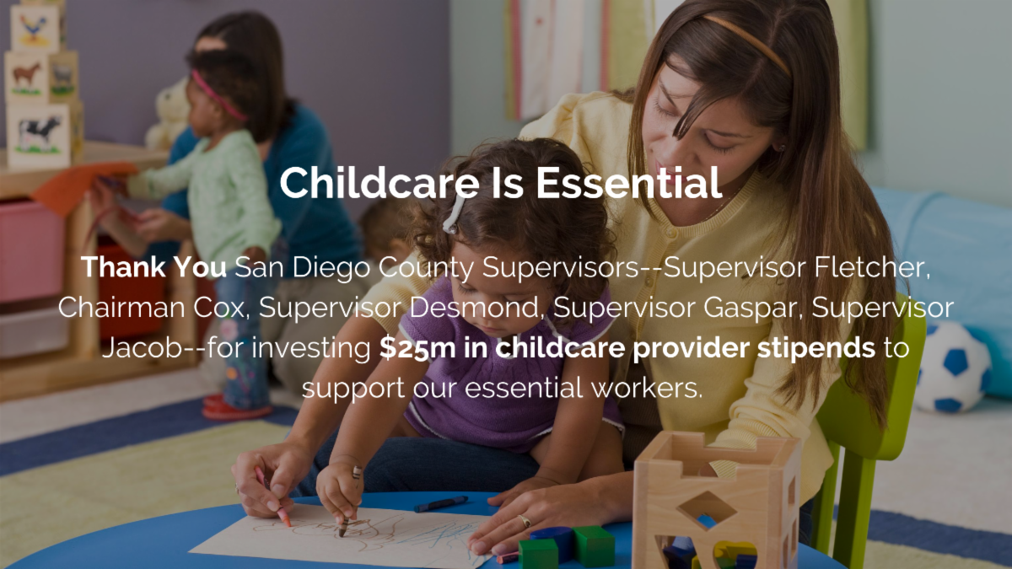
BUILD IN ACCOUNTABILITY
Hold decision-makersaccountable after the budget process – for negative AND positive decisions.
Newsletters
Report cards
Follow-up meetings
Newspaper ads
Accountability sessions
CHILDREN’S BUDGET COALITION GRADES THE BARD OF SUPERVISORS

Slide 31

REFORM THE PROCESS
Focus on engaging stakeholders.
Create accessible forums for public input at all levels and at all points in the process
Ensure public access to budget decision-makers
Empower the legislative body
Strengthen budget policy support
Make TRANSPARENCY a priority
Quote to the right: From the National Advisory Council on State and Local Budgeting, which was published by the Government Finance Officers Association, and reflects the work of a blue-ribbon committee representing 9 national governmental organizations. This report is entitled “Recommended Budget Practices: A Framework for Improved State and Local Government Budgeting.” It represents a milestone in budgeting, stating “in one document governments now have a comprehensive set of processes and procedures that define an accepted budget process.”
From the National Advisory Council on State and Local Budgeting, which was published by the Government Finance Officers Association, and reflects the work of a blue-ribbon committee representing 9 national governmental organizations. This report is entitled “Recommended Budget Practices: A Framework for Improved State and Local Government Budgeting.” It represents a milestone in budgeting, stating “in one document governments now have a comprehensive set of processes and procedures that define an accepted budget process.”
“A budget process that effectively involves all stakeholders….and reflects their needs and priorities will serve as a positive force in maintaining good public relations and enhancing citizens’ and other stakeholders’ overall impression of government.”

Slide 32

FUNDING THE NEXT GENERATION
Provides technical assistance to coalitions working on local funding streams for children and youth – A team of experts will hold your hand.
Sponsors learning communities and conferences
Support includes speaking, convening, facilitating, trouble-shooting, coaching, and more.
Numerous tools and resources are available.
CONTACT:
Margaret Brodkin, Margaret@fundingthenextgeneration.org
415-794-4963
www.fundingthenextgeneration.org

