Slide 1

BUDGET 101
Notes:
1., change LA Co0….to Greater LA Summer Matters Network
2 add 2018 to the date

Slide 2


Goal for today
Learn enough
to make you feel comfortable
starting a conversation
about your interests in your County/City budget
With the goal of getting more money for kids

Slide 3
As an advocate, what do I want to know about the budget?
Enough to make your argument—no need to become a budget expert
(you pay city/county staff to do that for you.)
Some idea of size of the total budget and where your local taxes go
How much is spent on children services—almost impossible to figure out
If you want to add to the budget-- be specific
If they ask you where the money will come from…

Slide 4
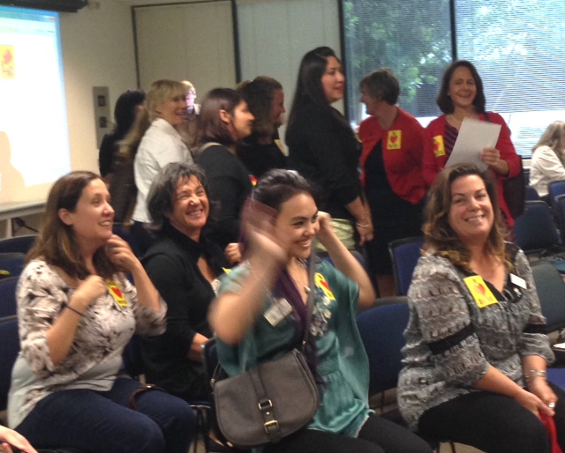
General thoughts- Attitudes
Assume Good Intentions
Seek first to understand
  – ask questions
No perfect time to engage
Yours, mine and ours

Slide 5
Budgets -just like your checkbook
Money from prior year or reserves
+Current year revenues/sources
- Current year expenditures
Remaining fund balance/reserves

Slide 6
Budget Basics
There are no rules for budgeting
  NACSLB (National Advisory Committee on State and Local Budgeting) best practices
Proposed Budget:
  Executive Summary/Transmittal Letter – Prepared by CAO, City Manager, Mayor – policy statement
    Budget summaries, demographics, organization charts, fiscal policies, priorities
  Typically some information by department, goals, performance measures, budget changes
  Some level of State Controller or other detailed accounting schedules
Adopted Budget (by fiscal office)-Annual Appropriation Ordinance:
  Some portion of Transmittal letter
  Budget detail schedules

Slide 7
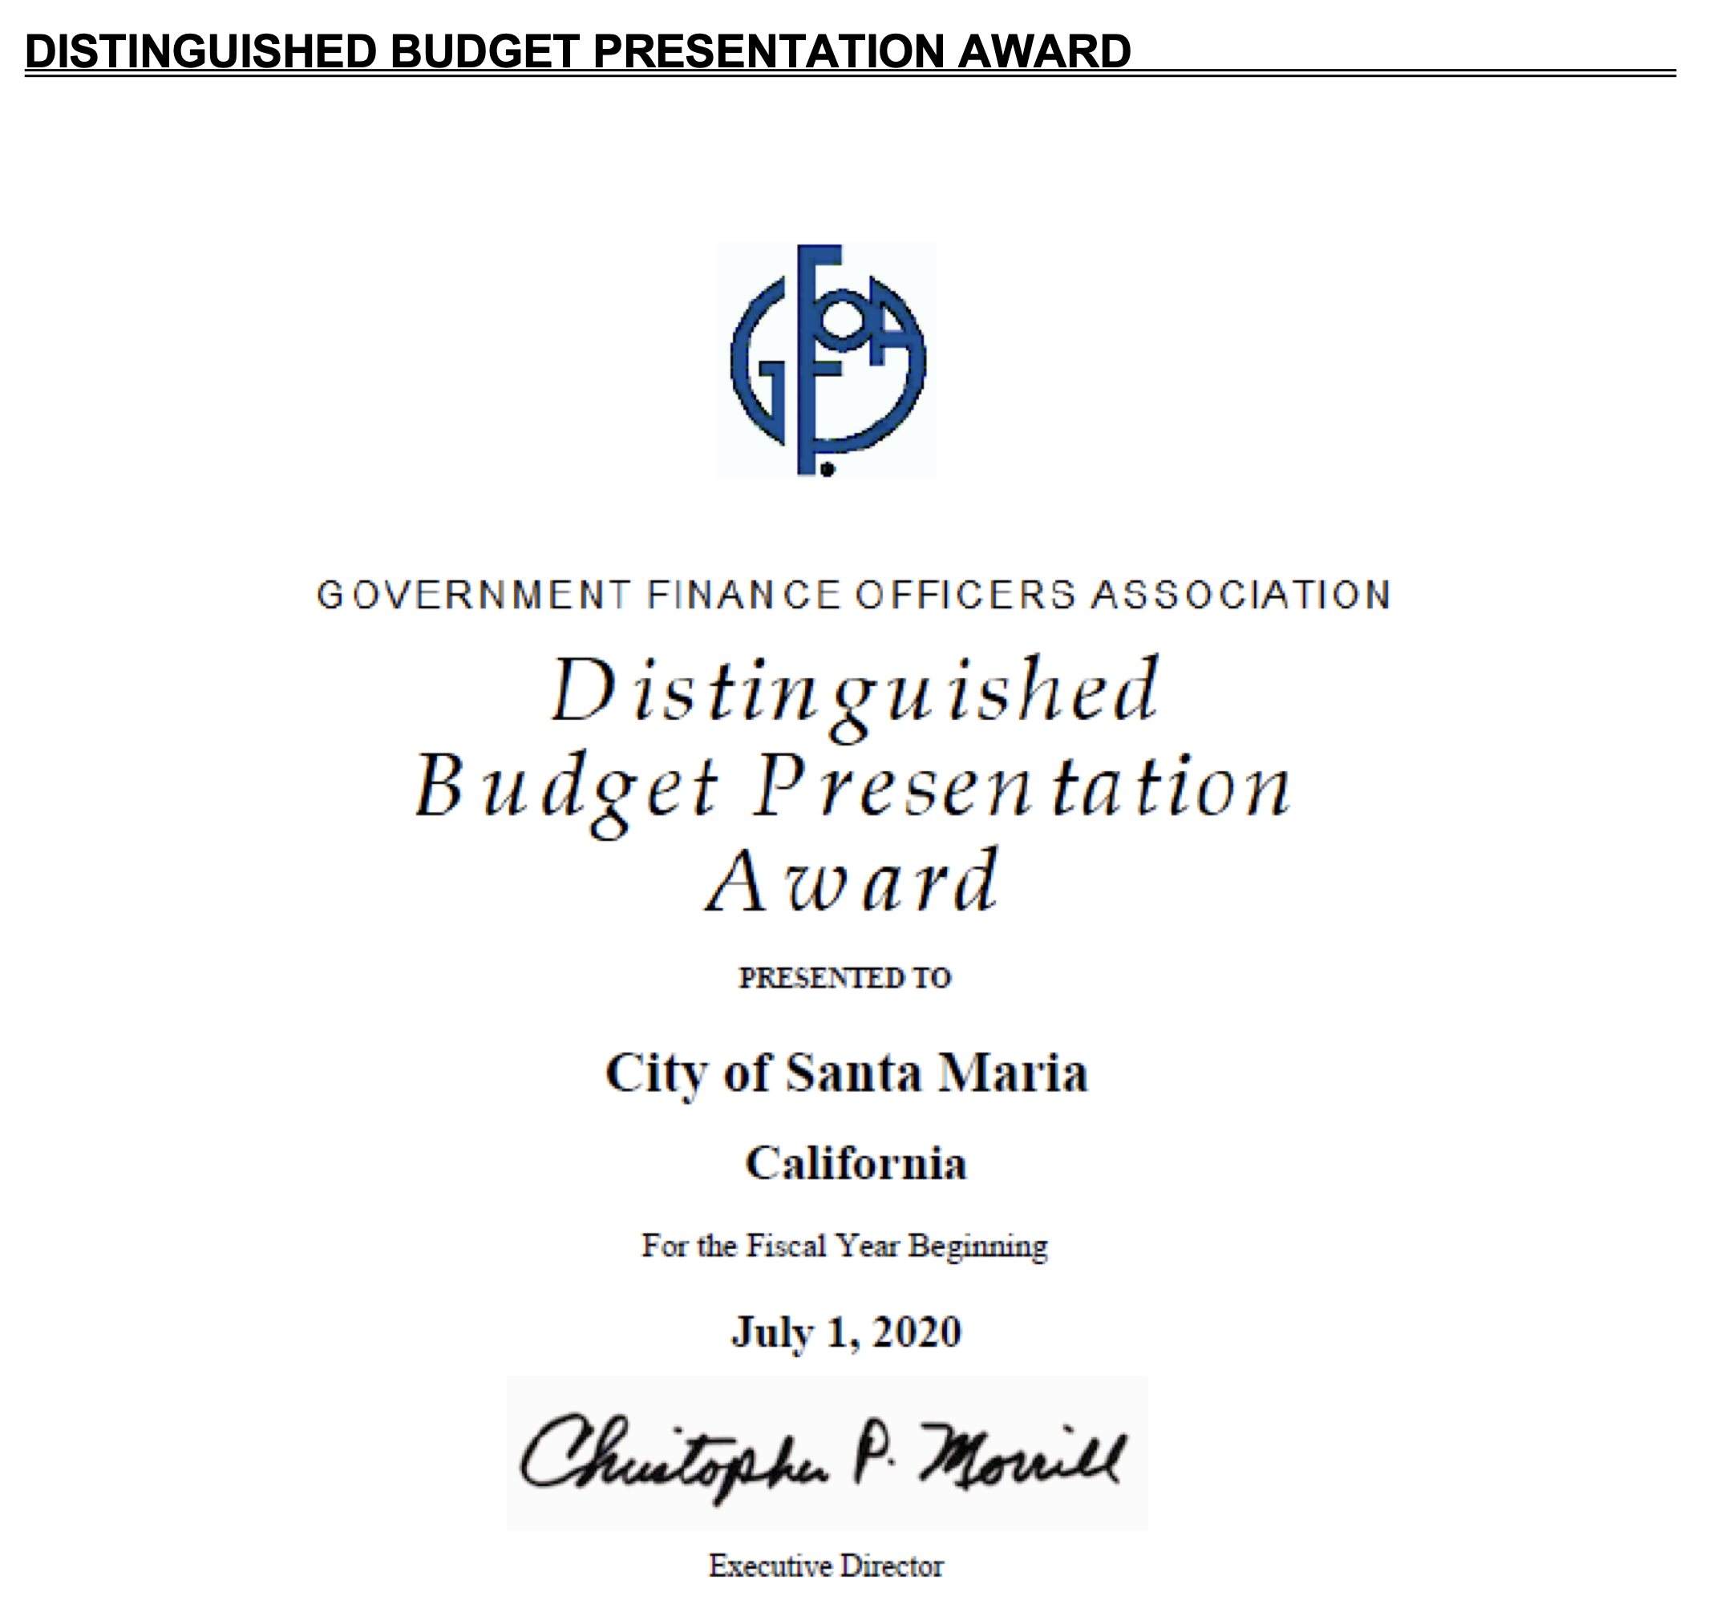
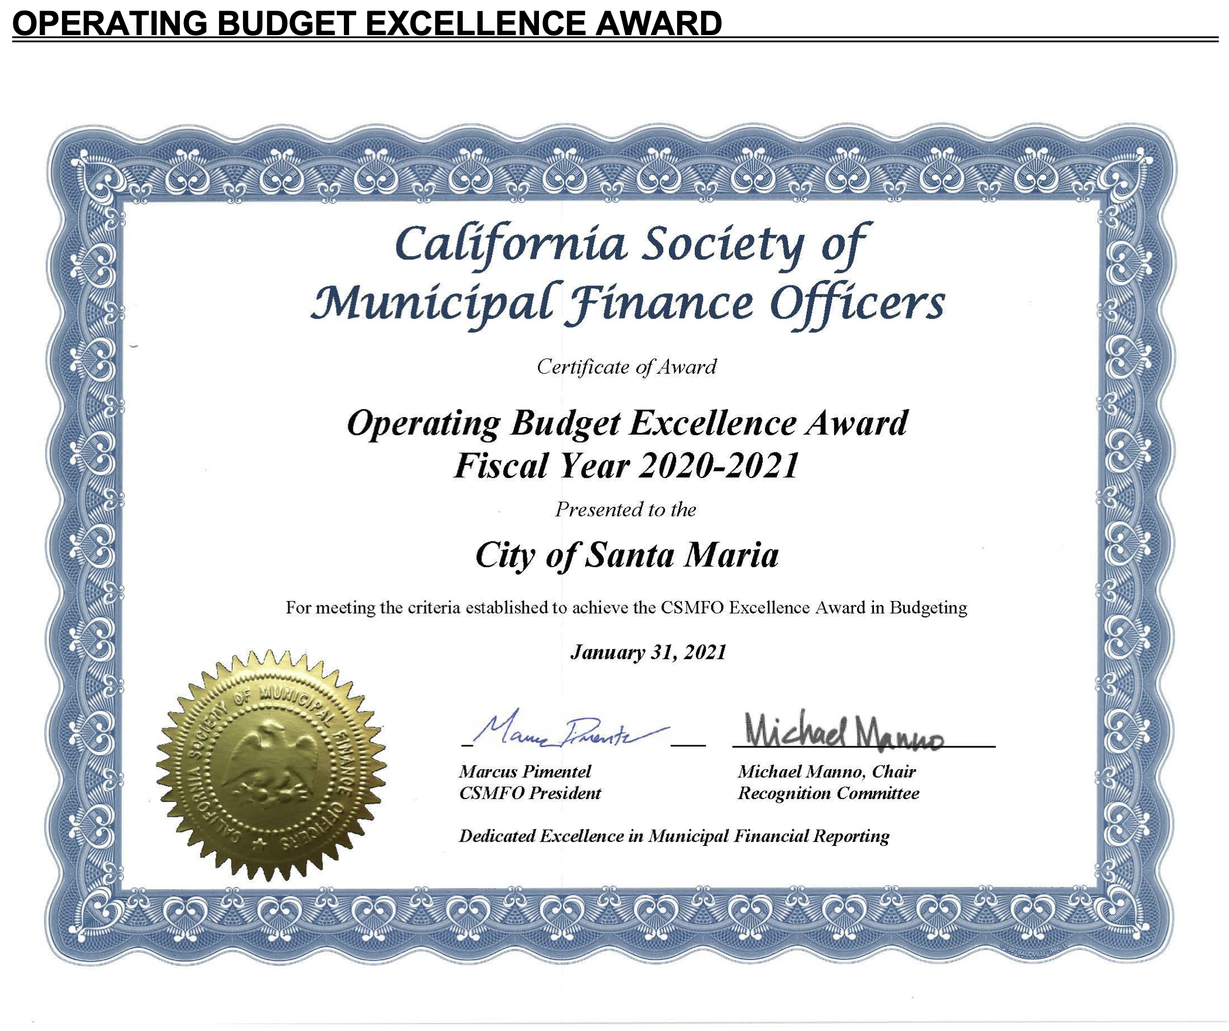
Budget Awards

Slide 8

Budget Timelines
October- December Budget Instructions
January-March Departmental preparations, hearings
April-May budget Office/Auditor-Controller
June Board of Supervisors

Slide 9
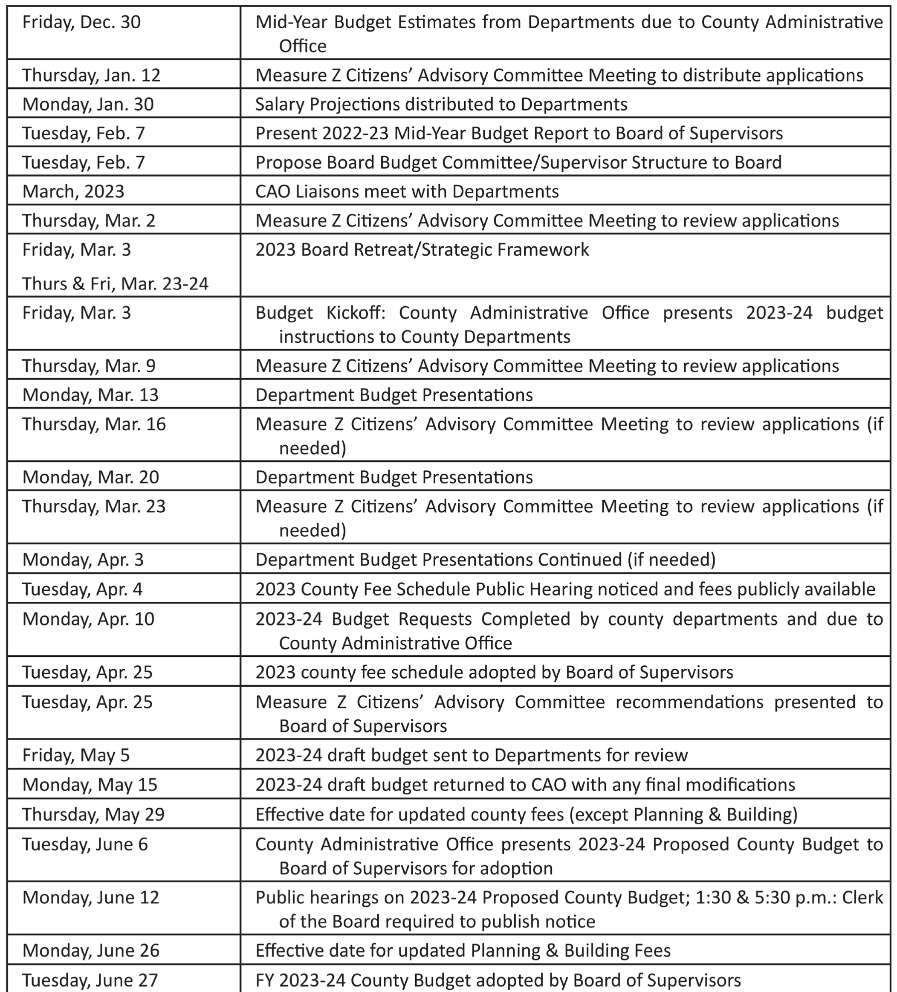
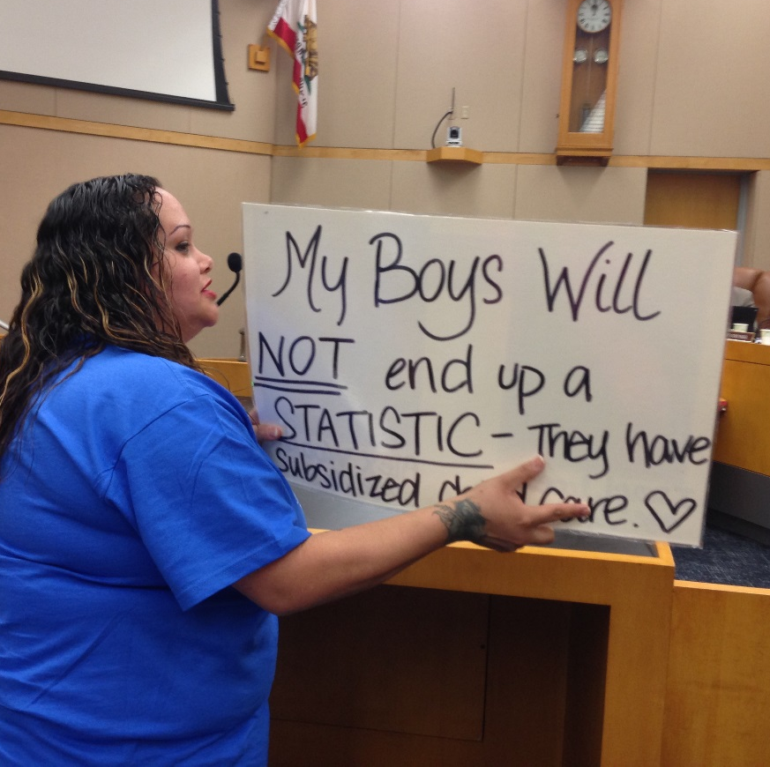
Humboldt Calendar

Slide 10
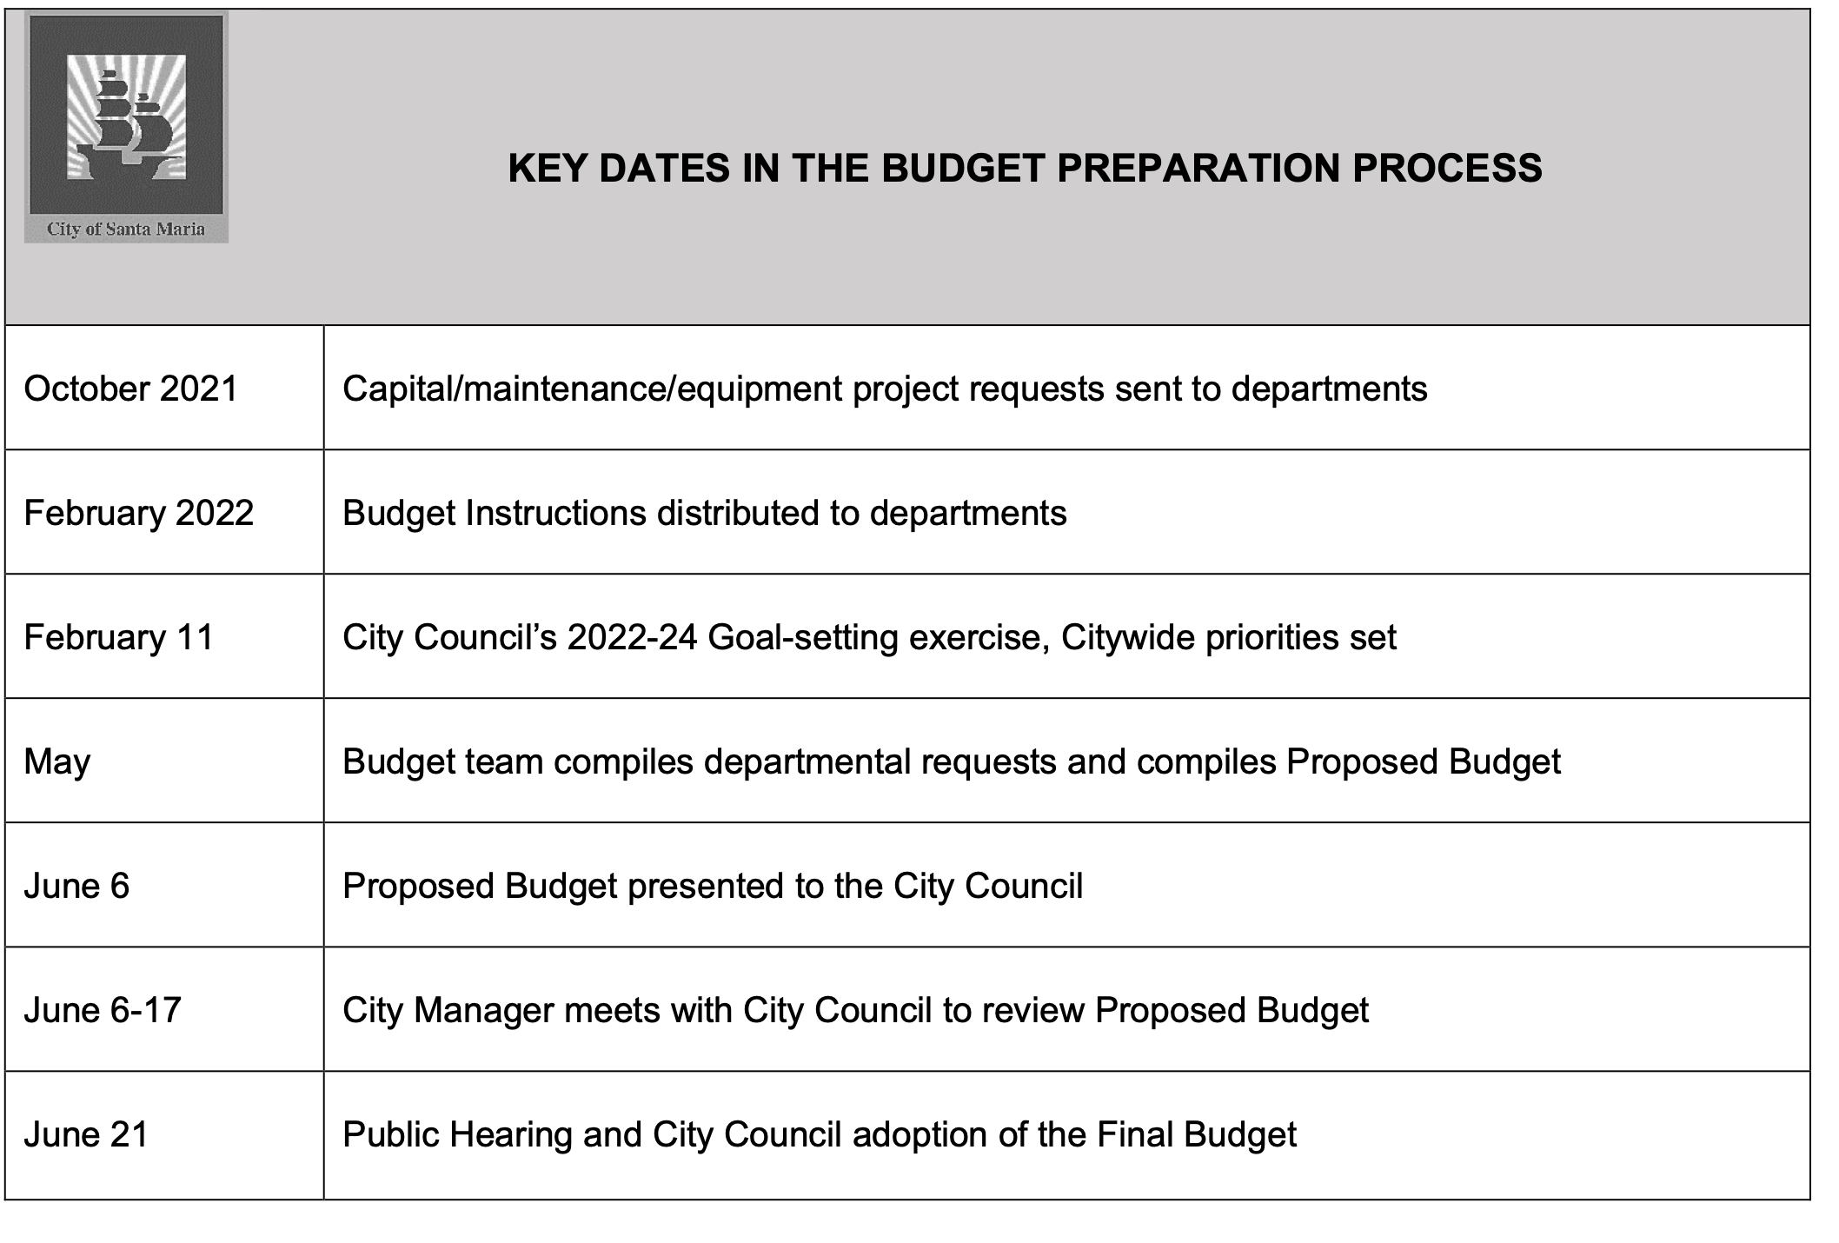
Santa Maria Calendar

Slide 11
When/How to insert yourself?
Budget Instructions to Departments
Board working/study sessions
Departmental Budget Prep
County Administrator Deliberations
Initial Budget Hearings
Final Budget Hearings

Slide 12
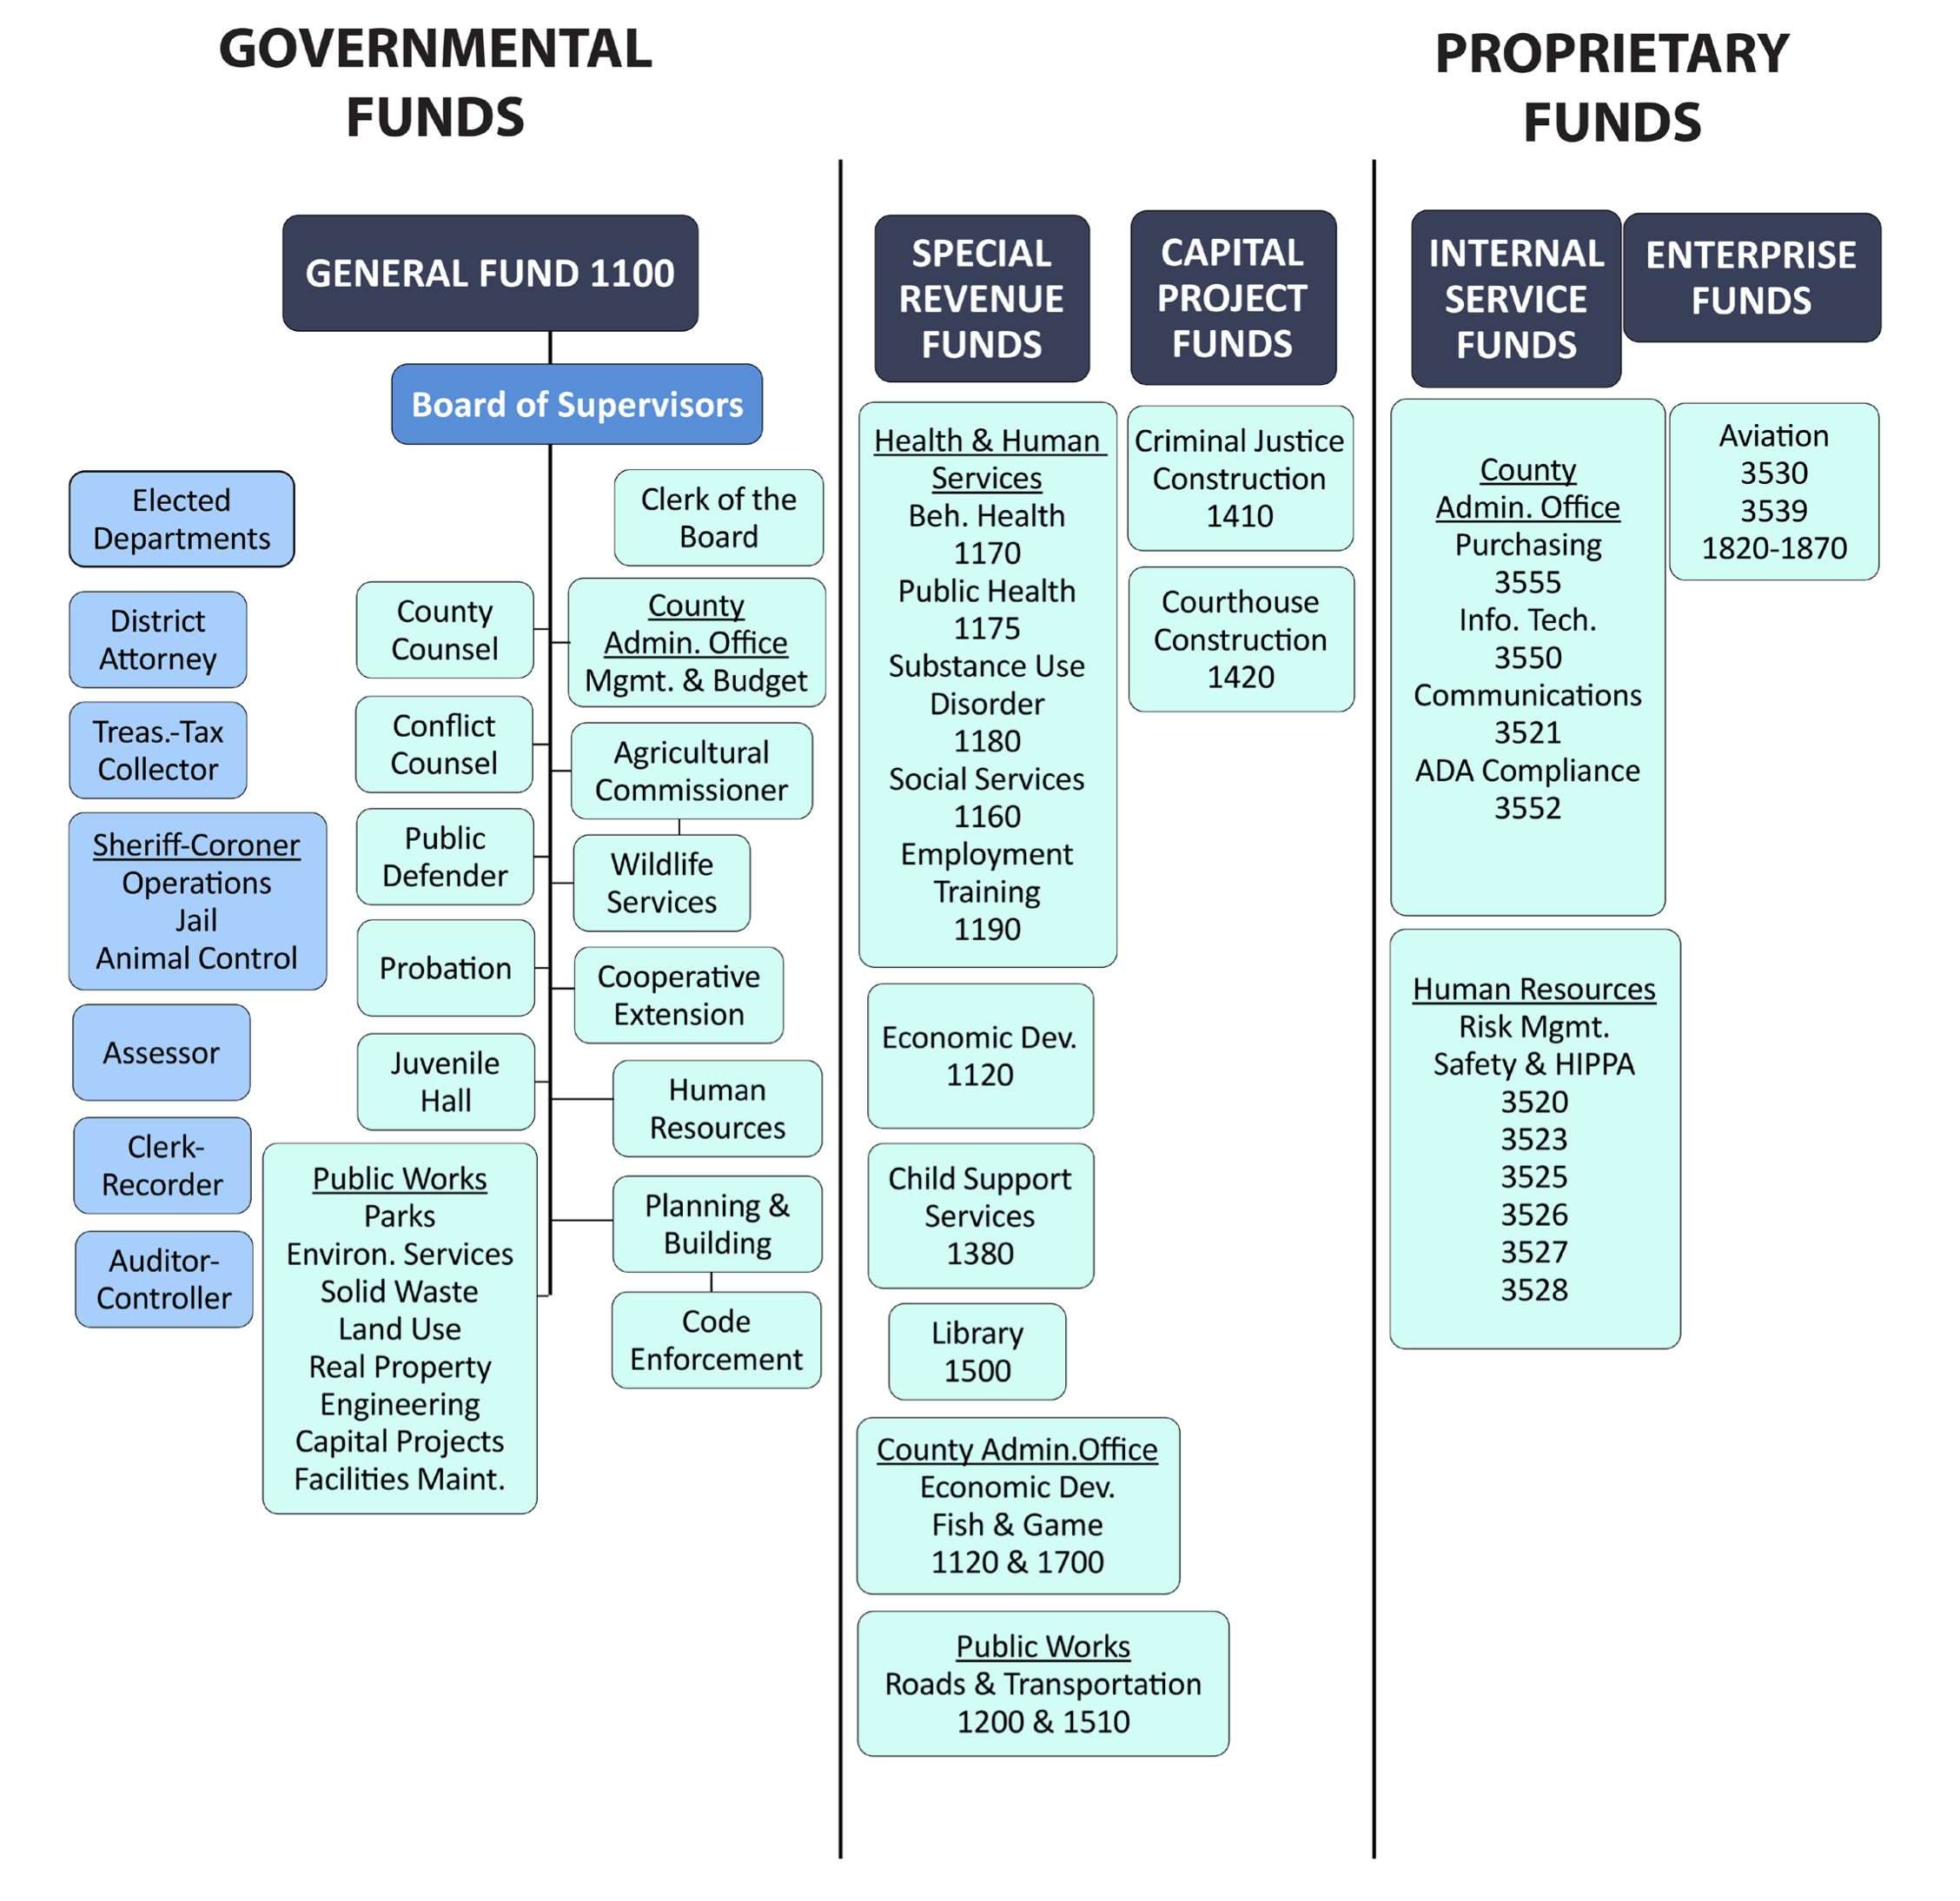

Budgets are based on Funds -Humboldt

Slide 13
Budget Transmittal Letter/Summary
Notes:
1., change LA Co0….to Greater LA Summer Matters Network
2 add 2018 to the date

Slide 14
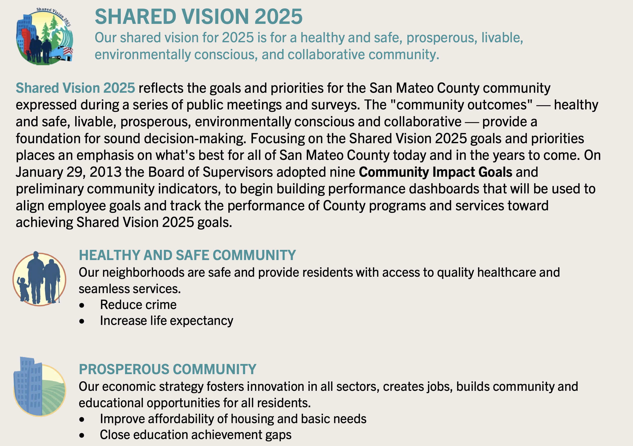
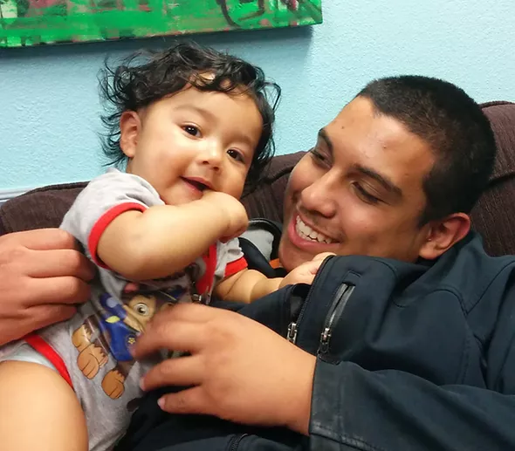
San Mateo County

Slide 15
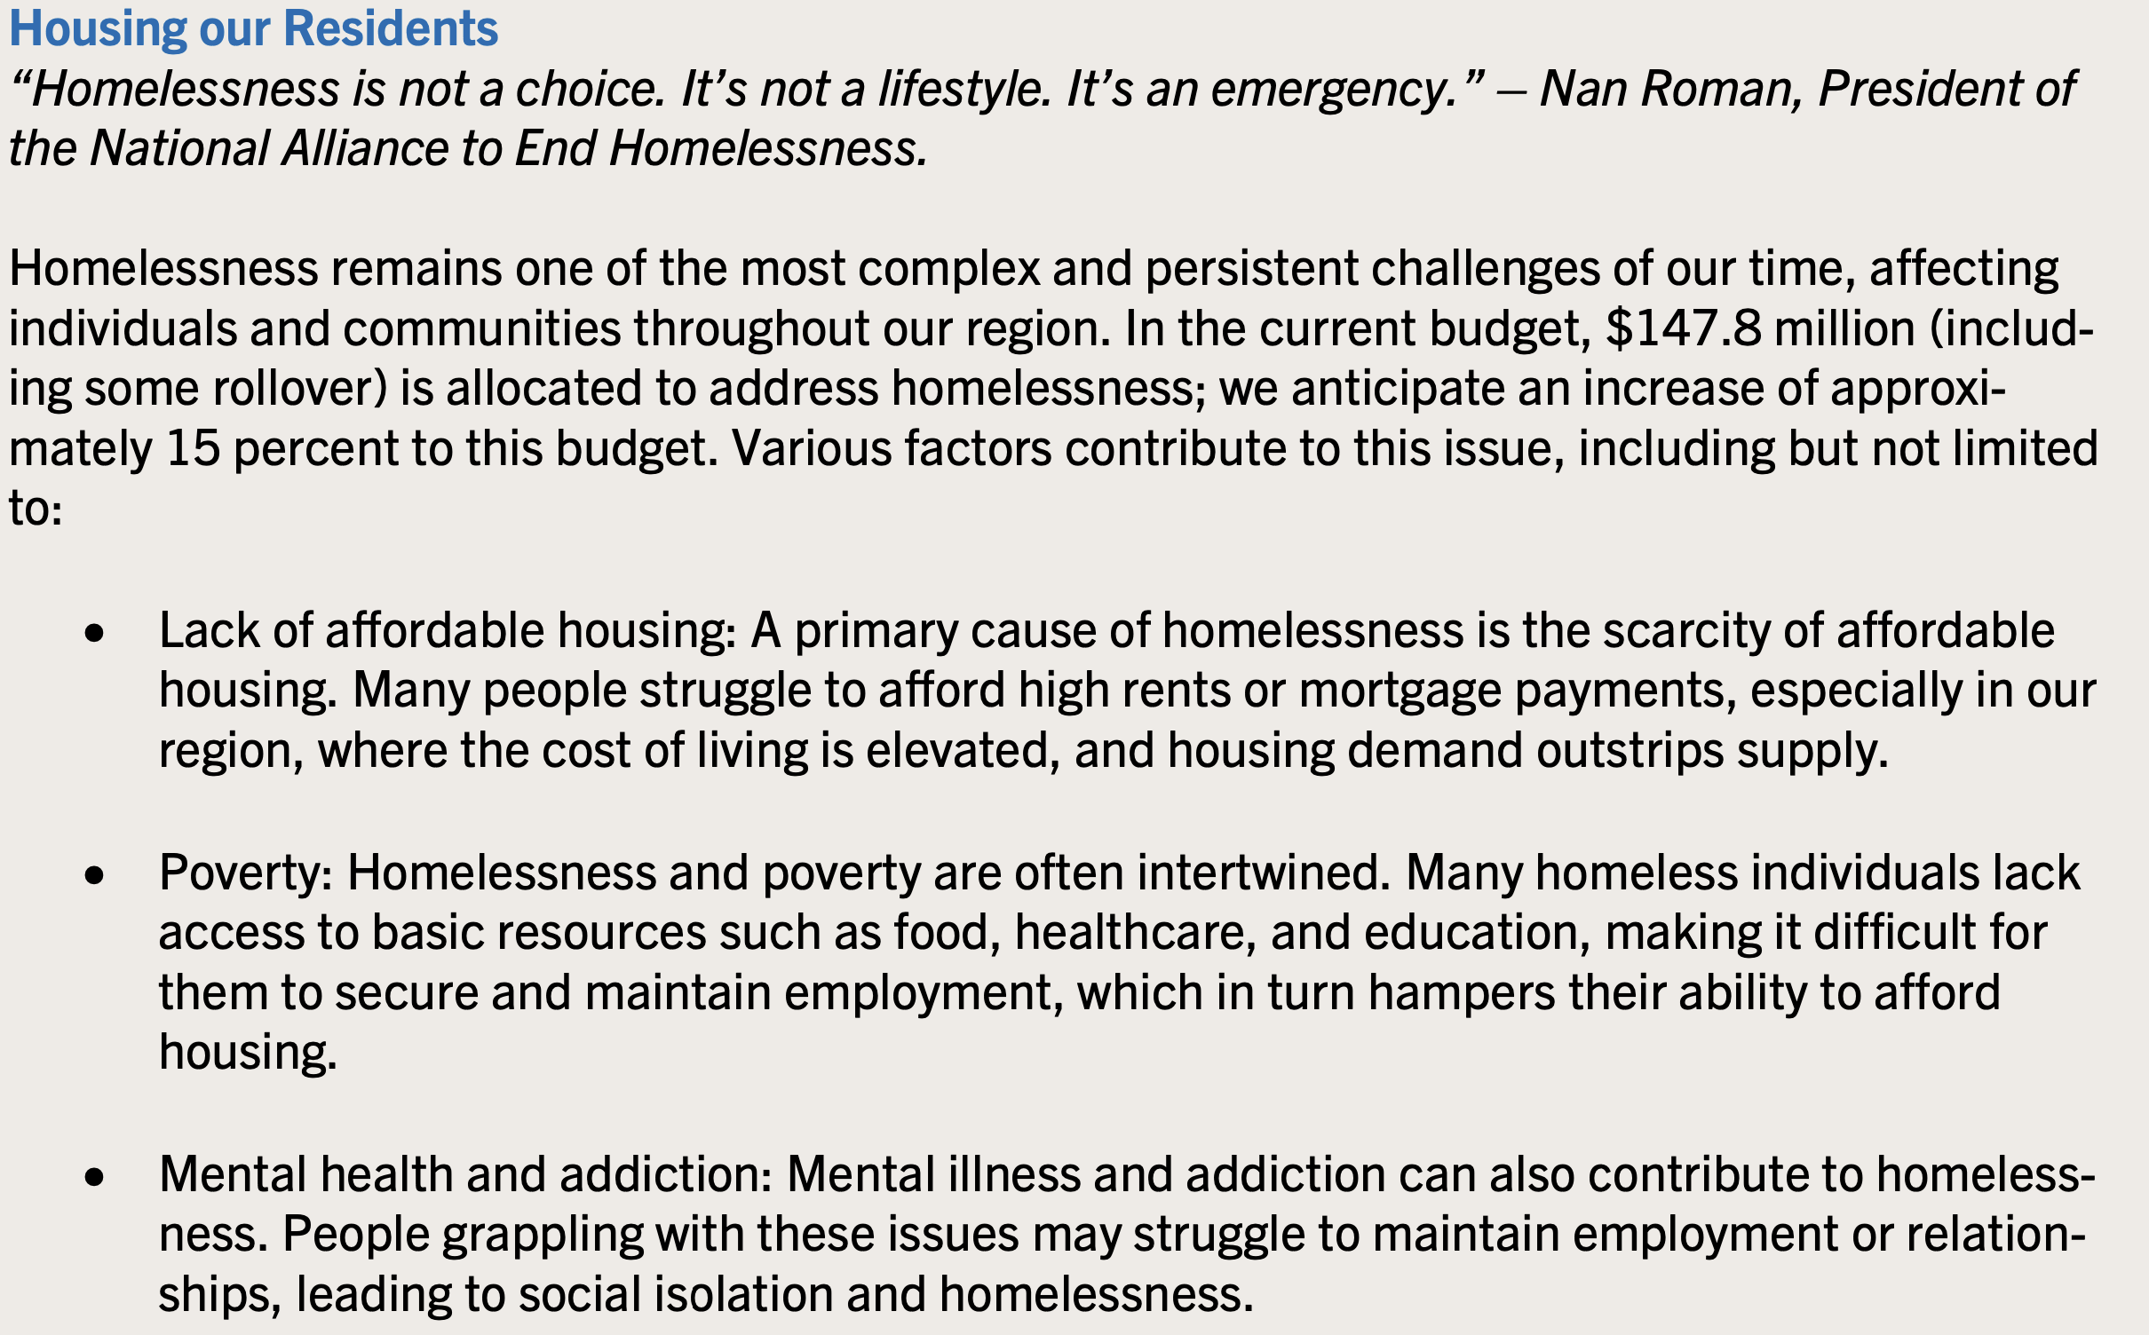
San Mateo County

Slide 16

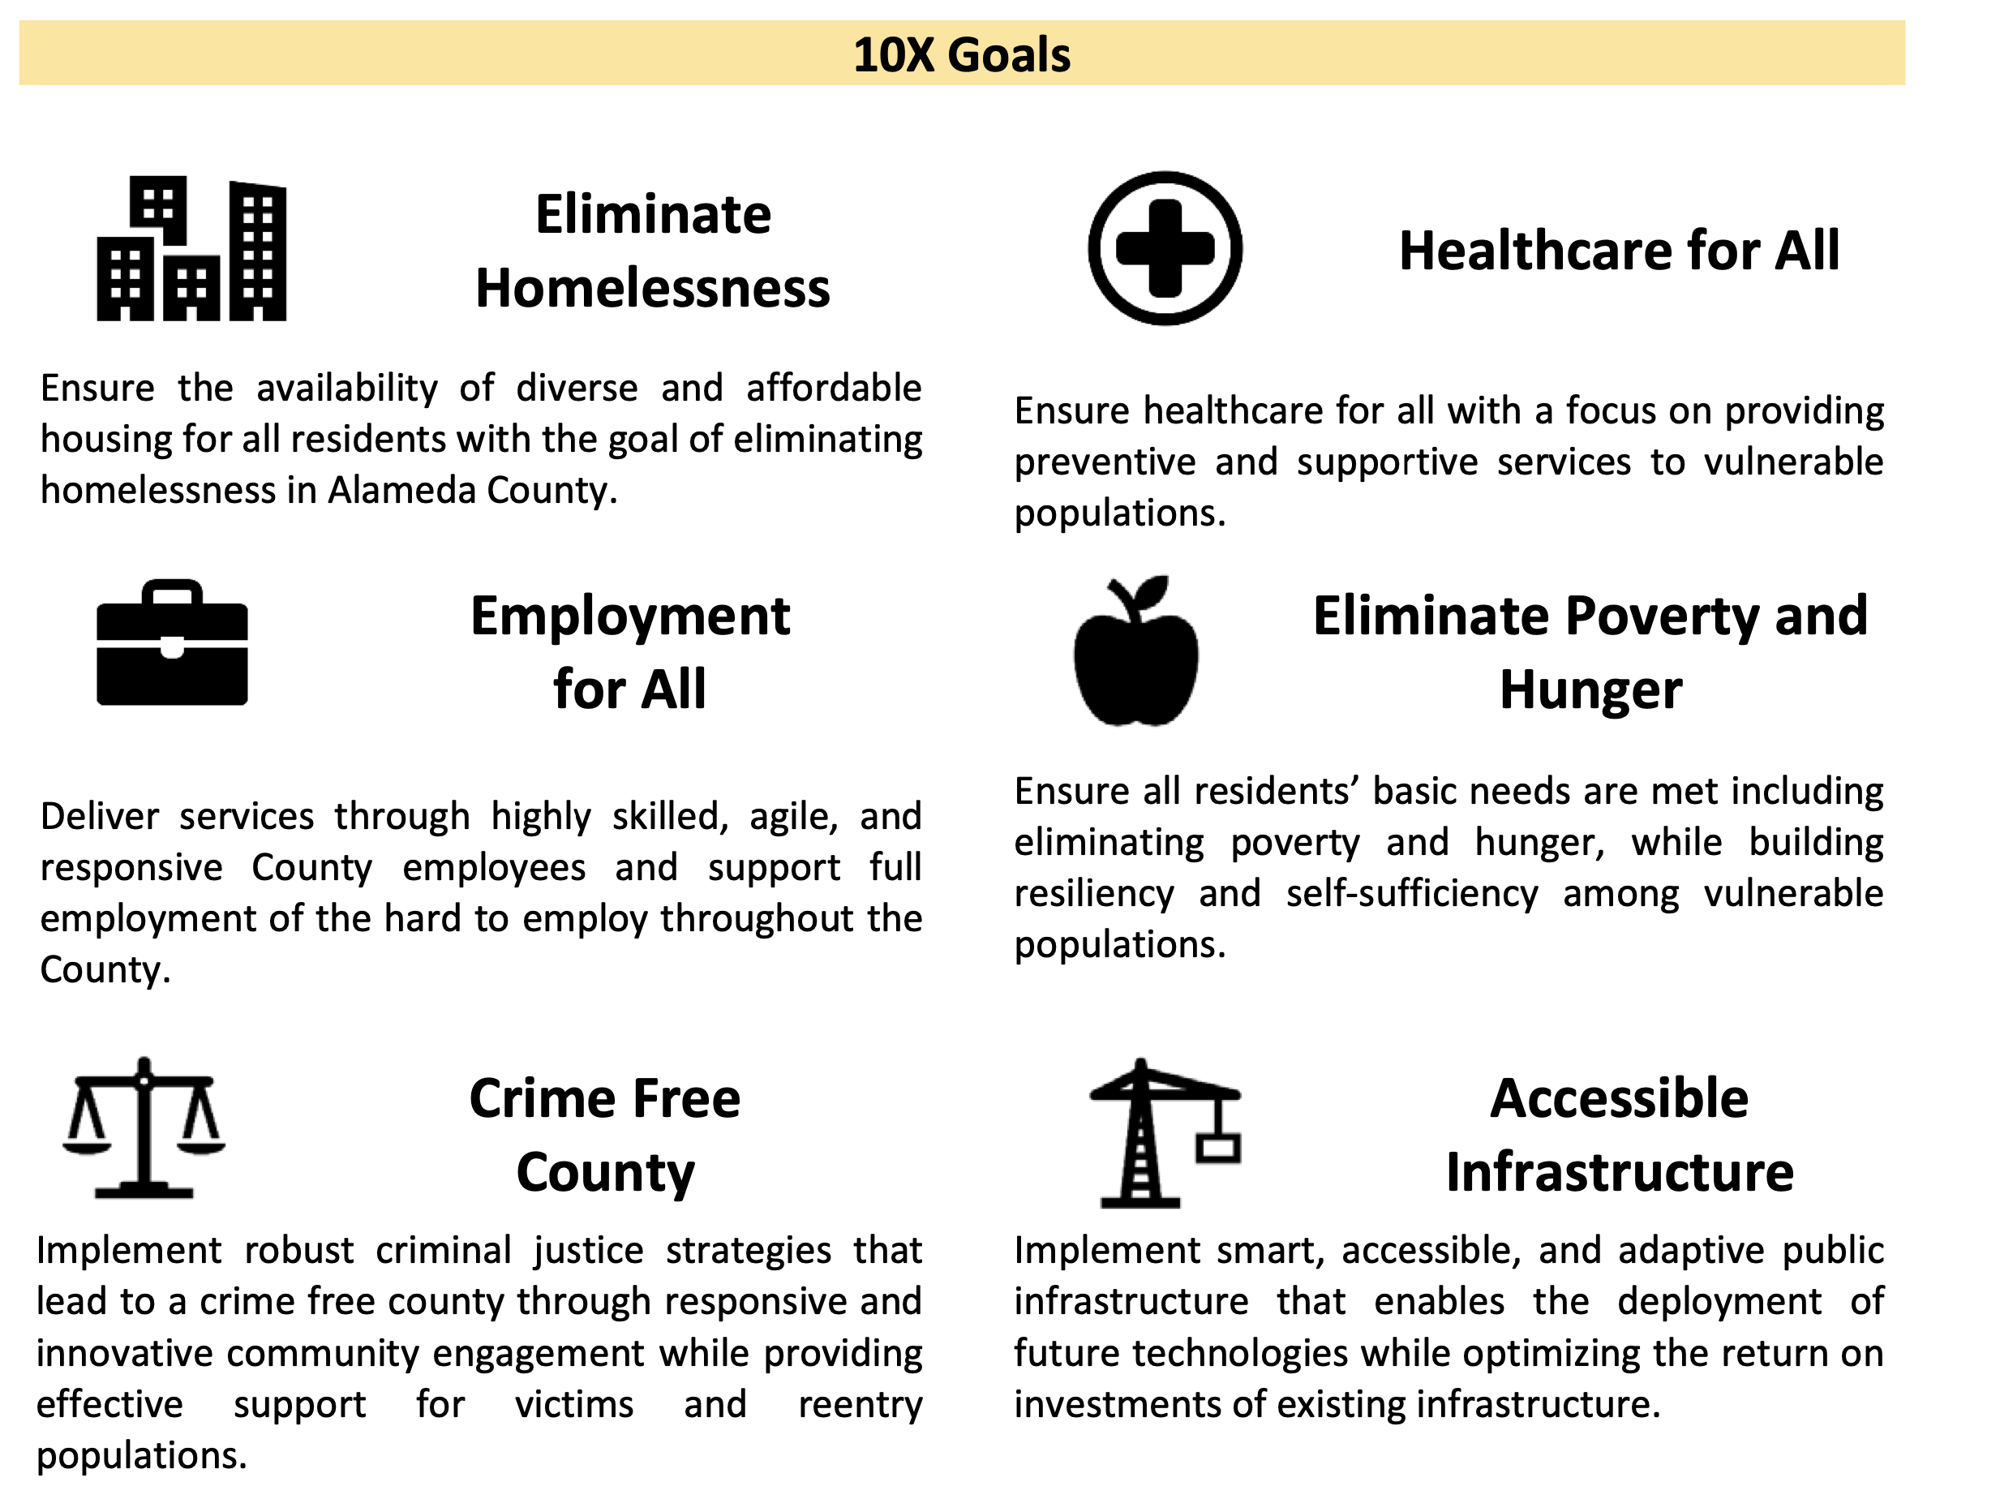
Alameda County

Slide 17

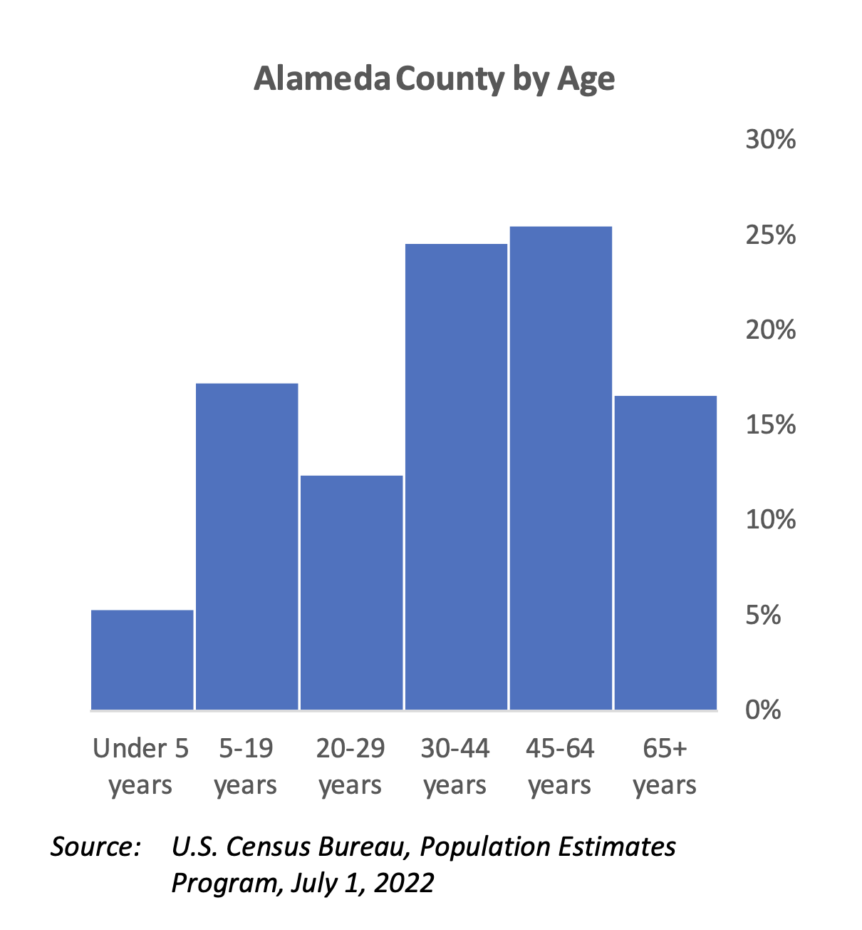
Alameda County

Slide 18
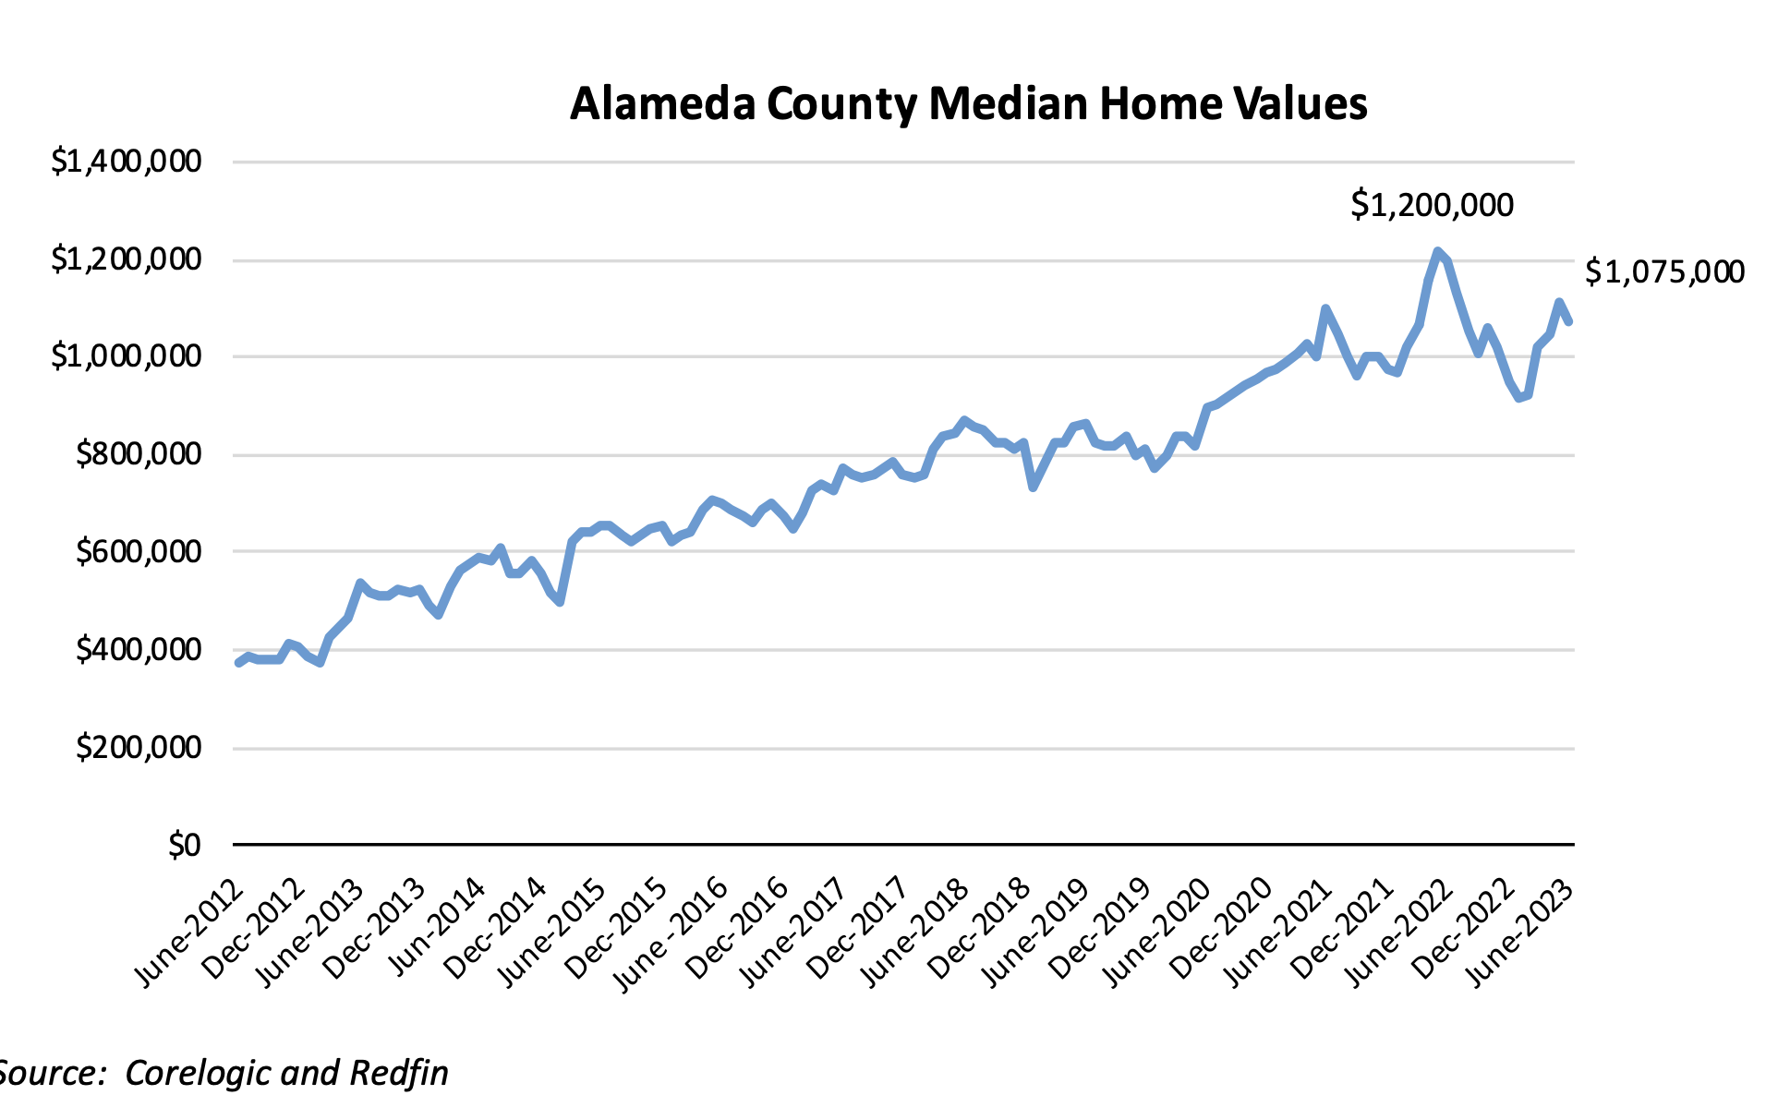
San Mateo

Slide 19
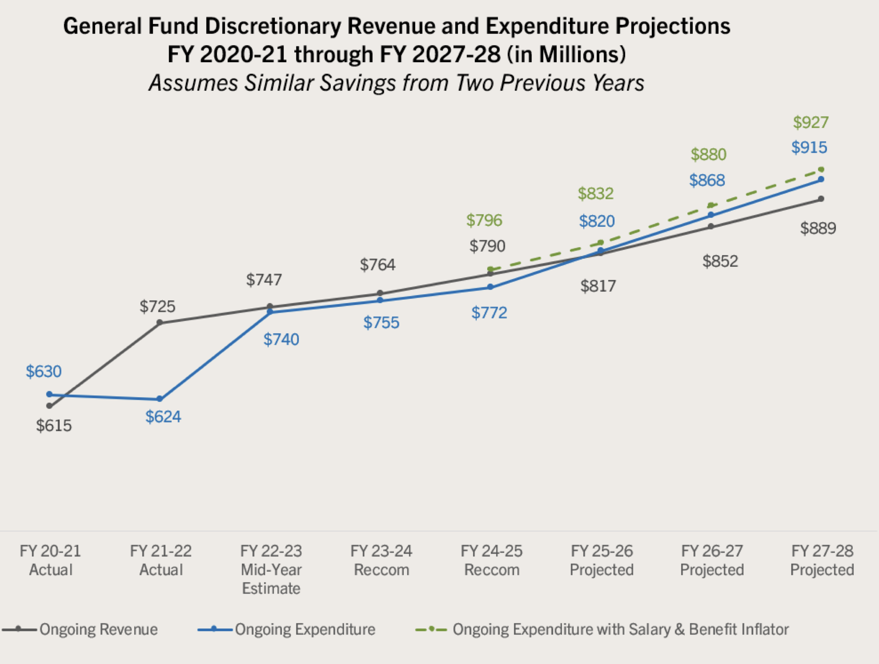

San Mateo

Slide 20
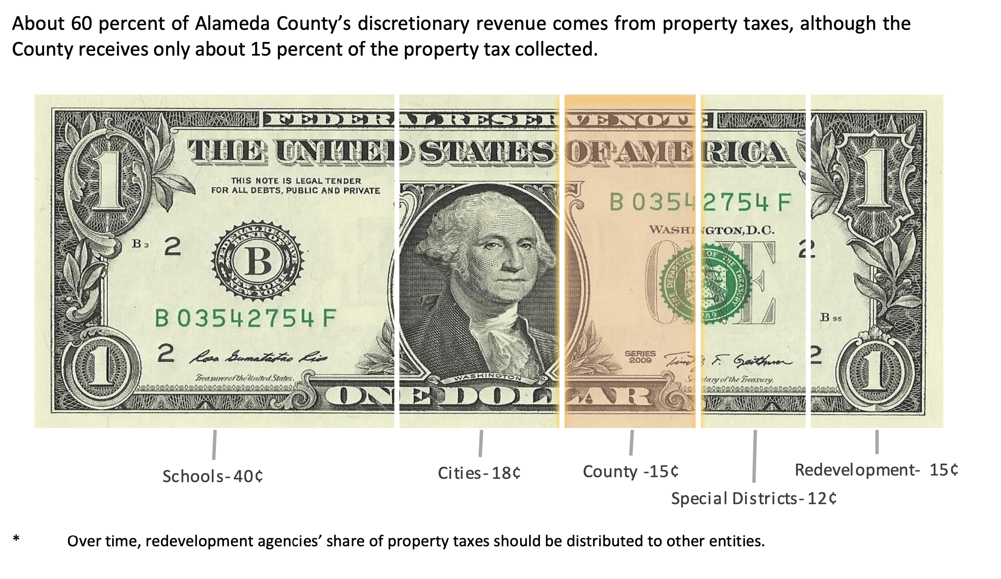
Alameda County

Slide 21
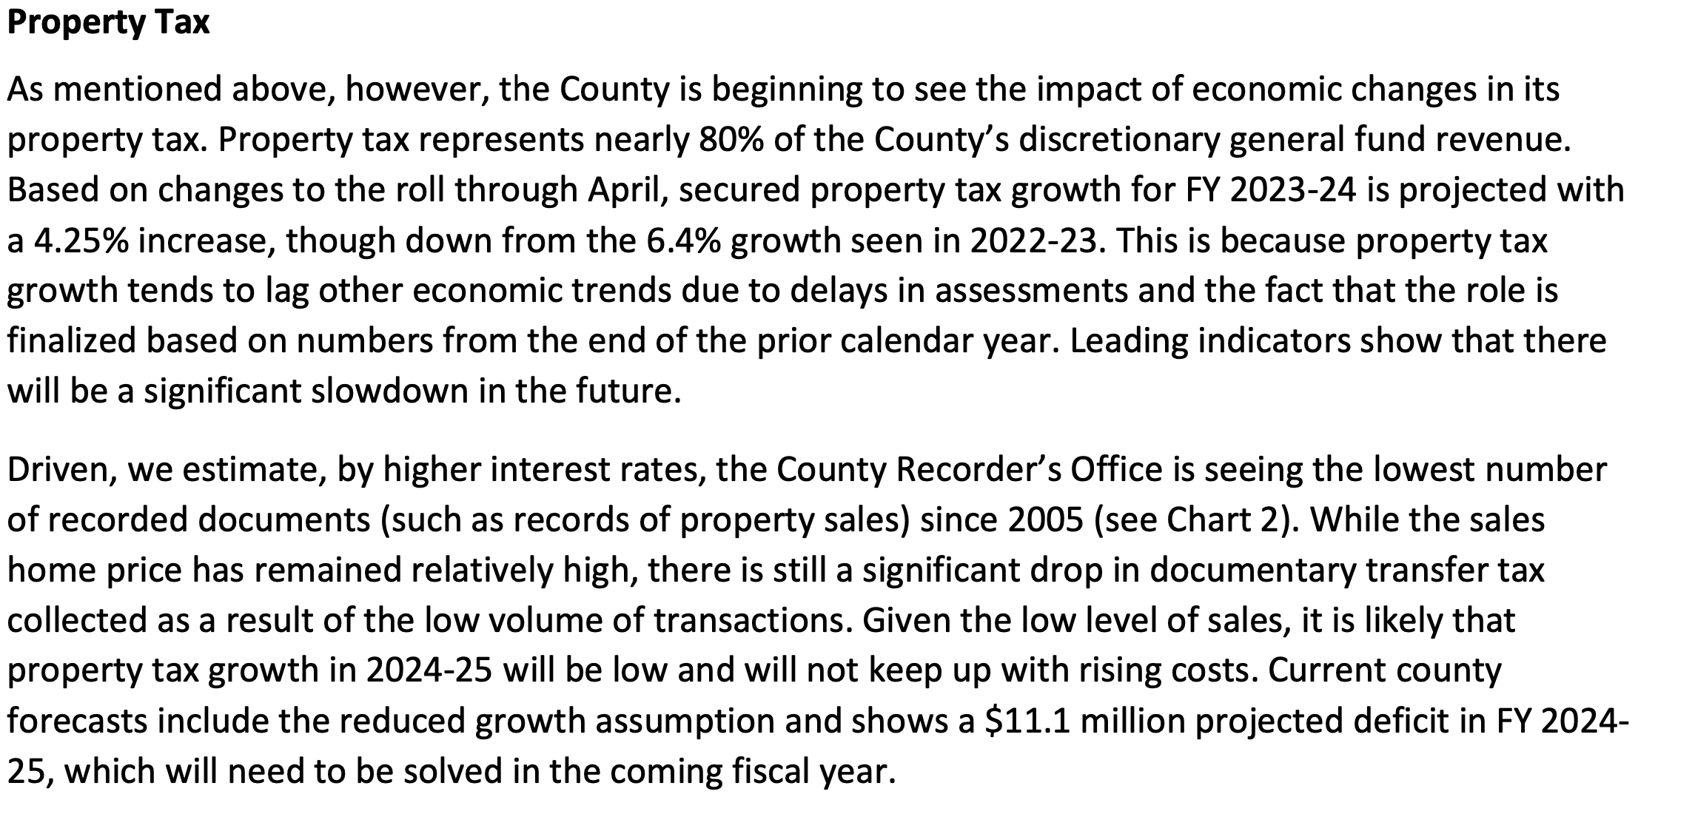
Sonoma County

Slide 22
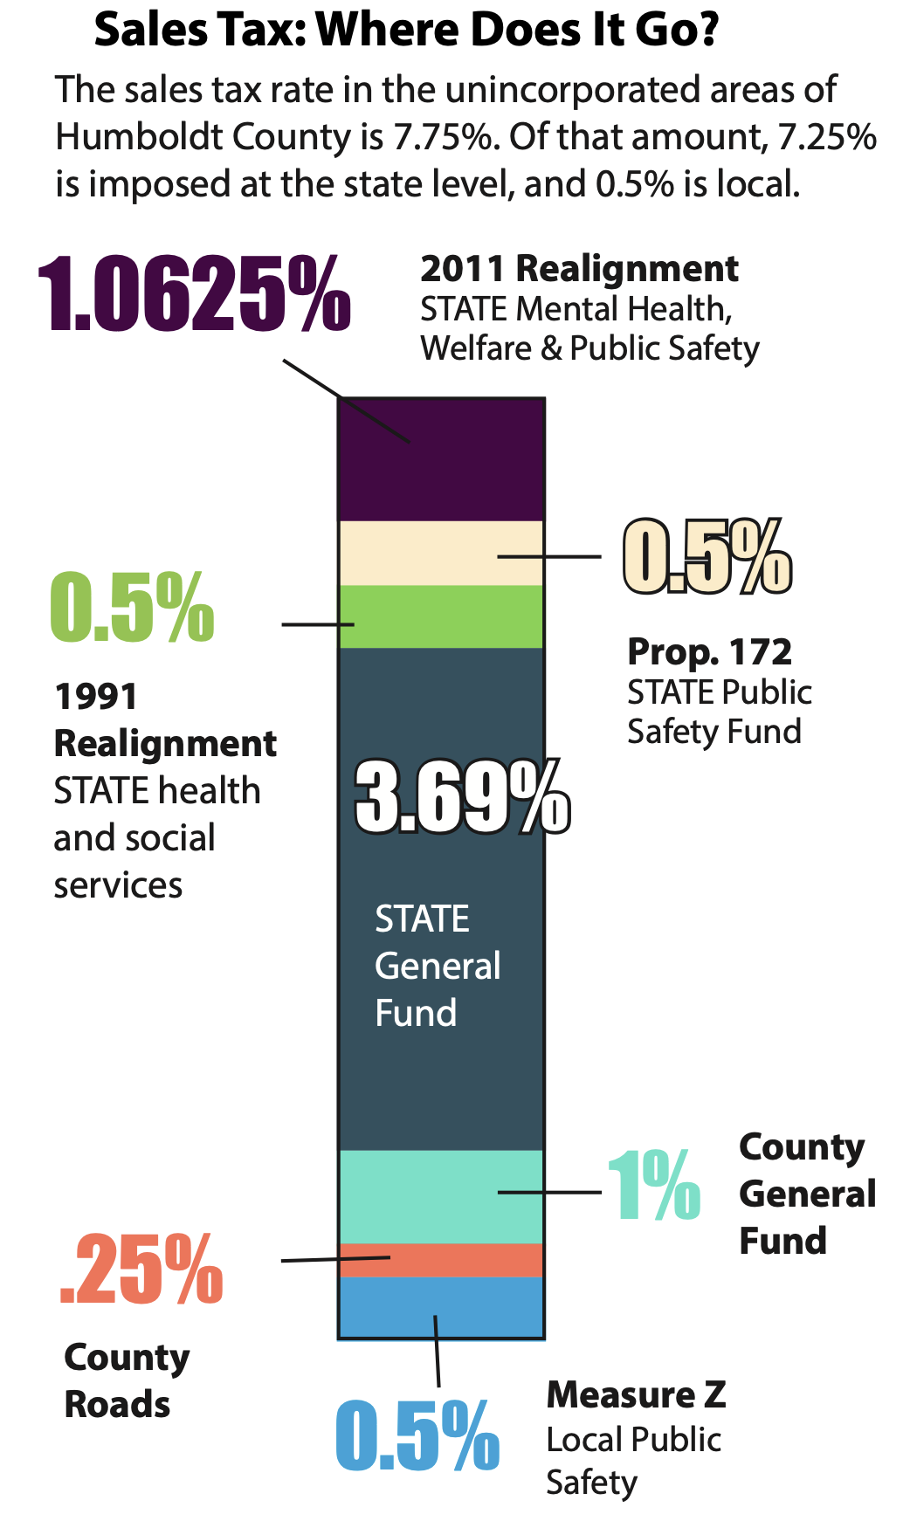
Humboldt

Slide 23
Budget Summary Schedules
Notes:
1., change LA Co0….to Greater LA Summer Matters Network
2 add 2018 to the date

Slide 24
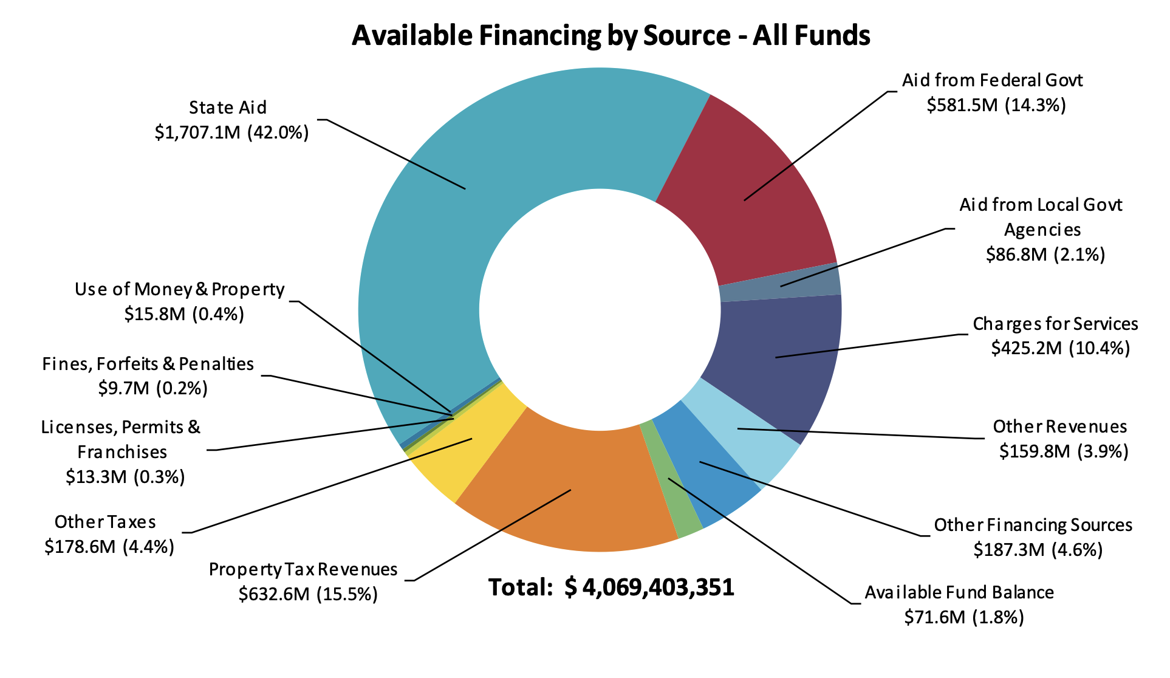
Alameda County All Funds

Slide 25
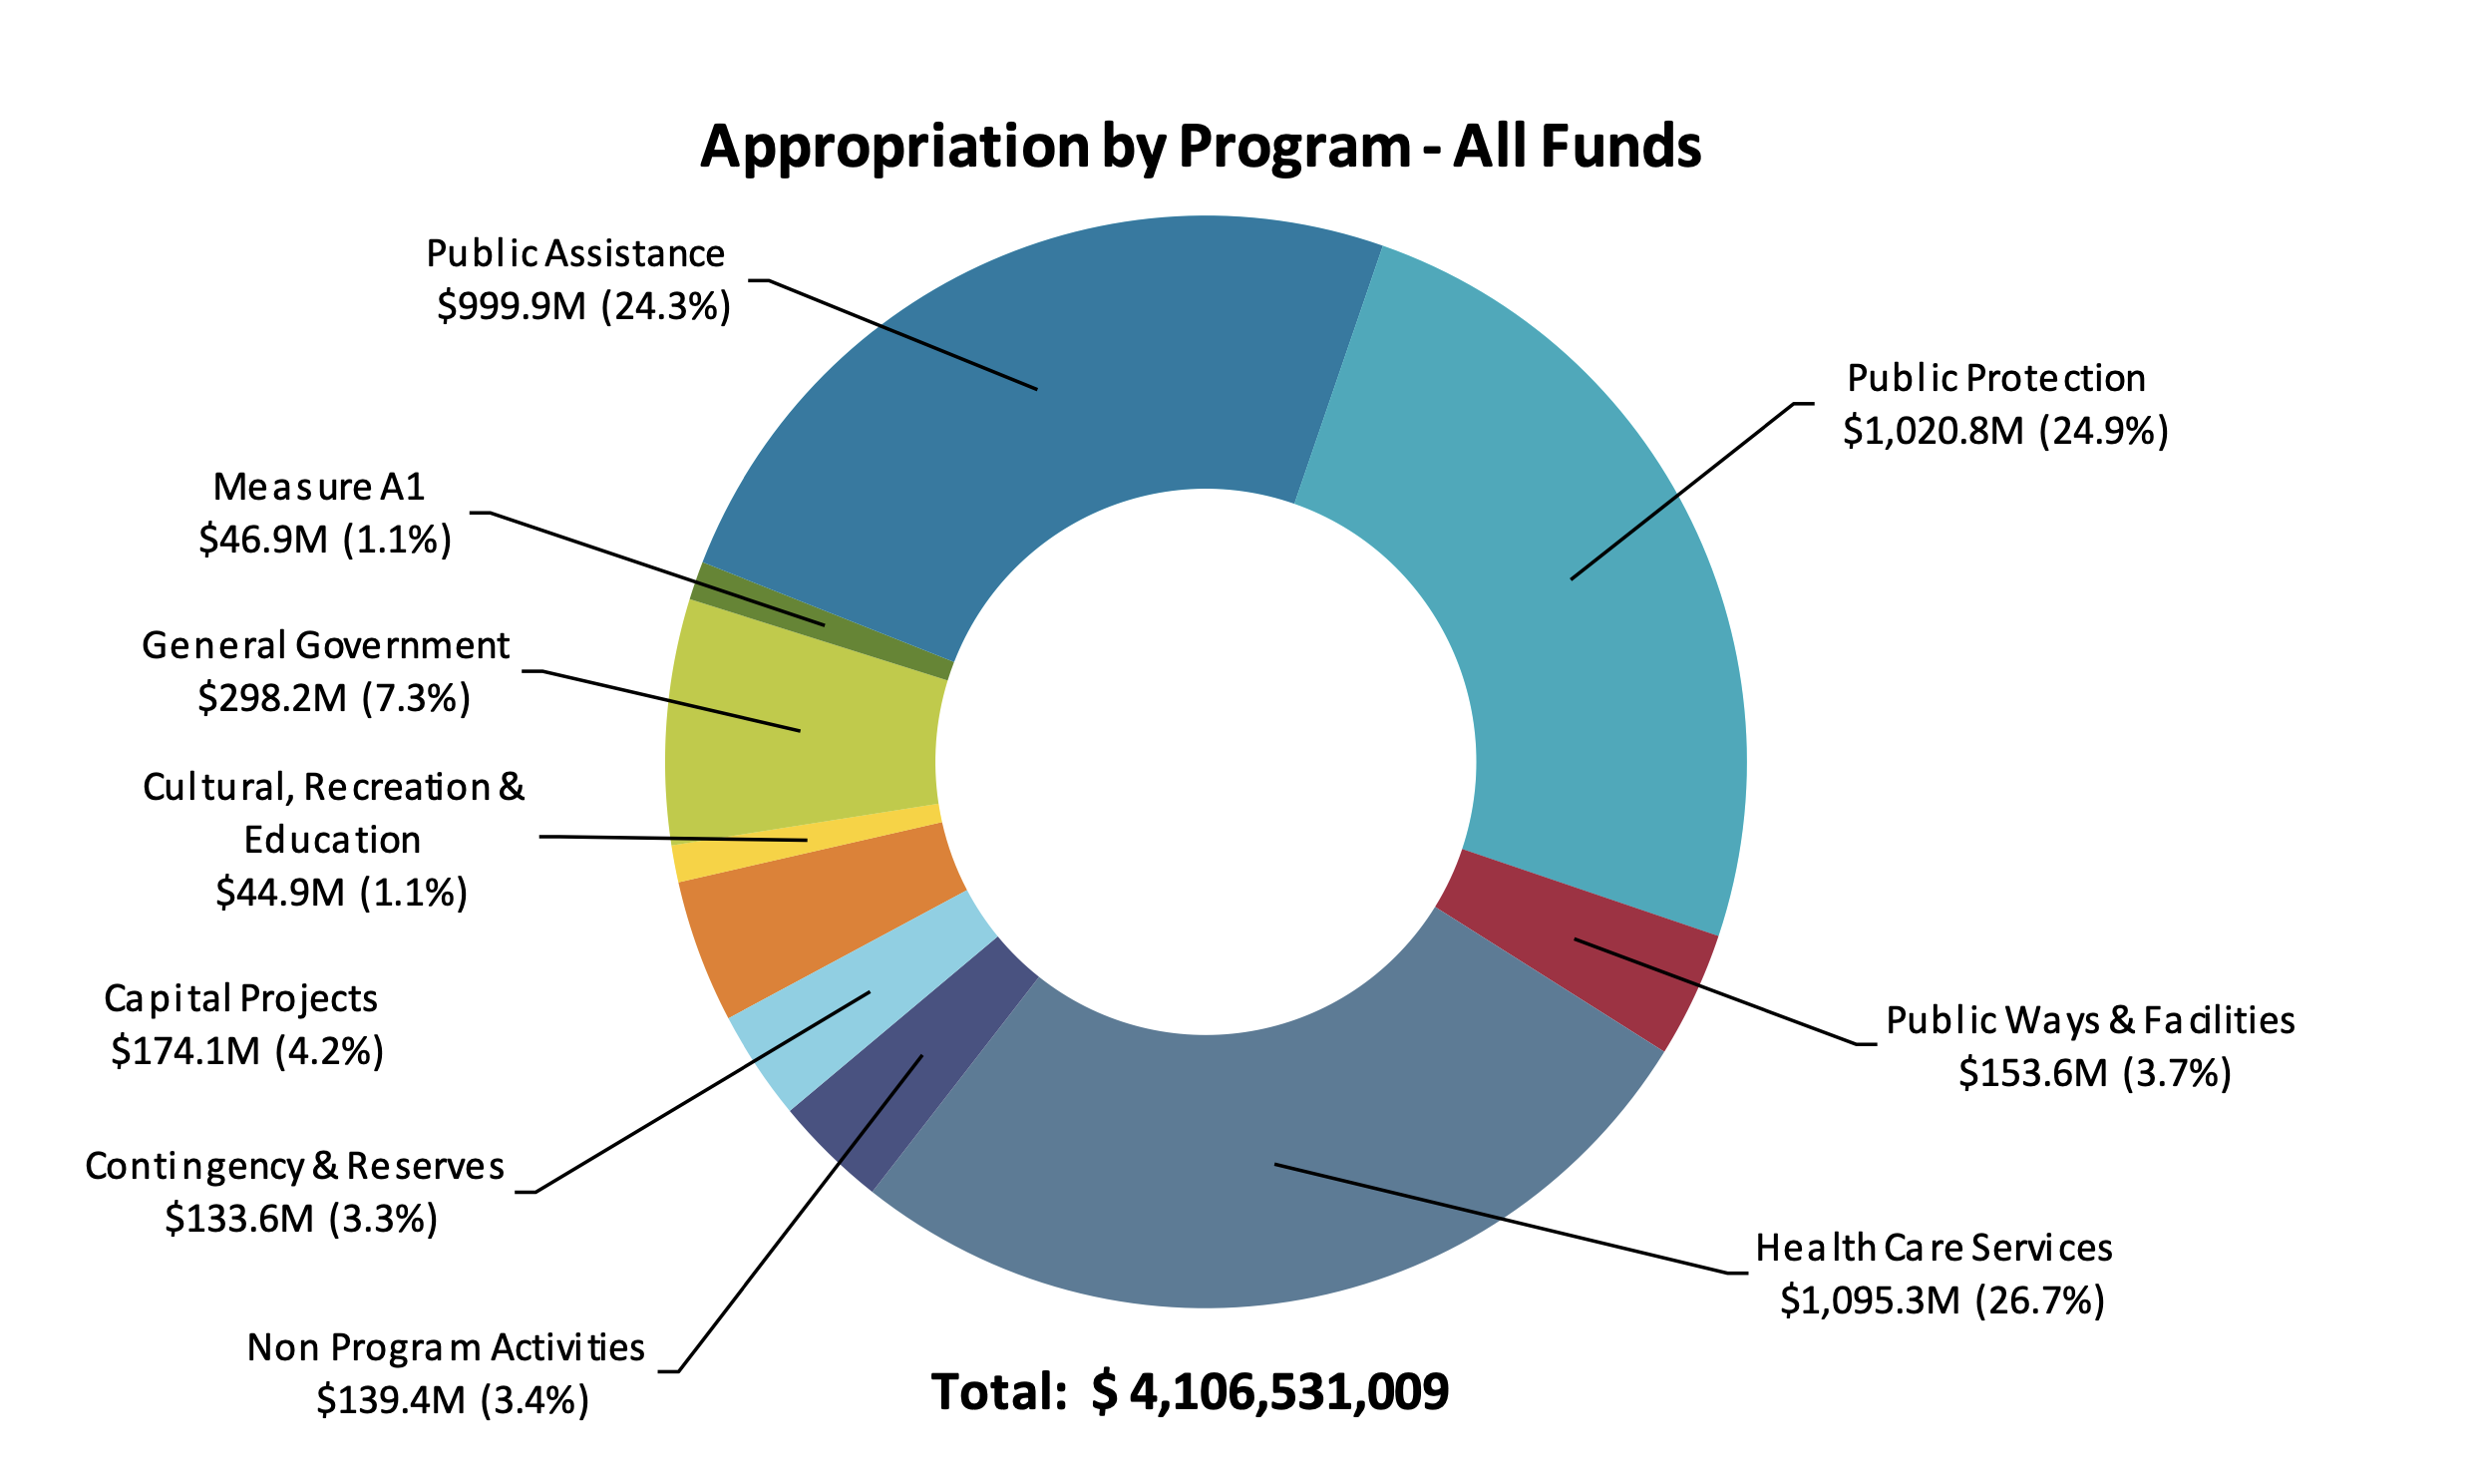
Alameda County All Funds

Slide 26
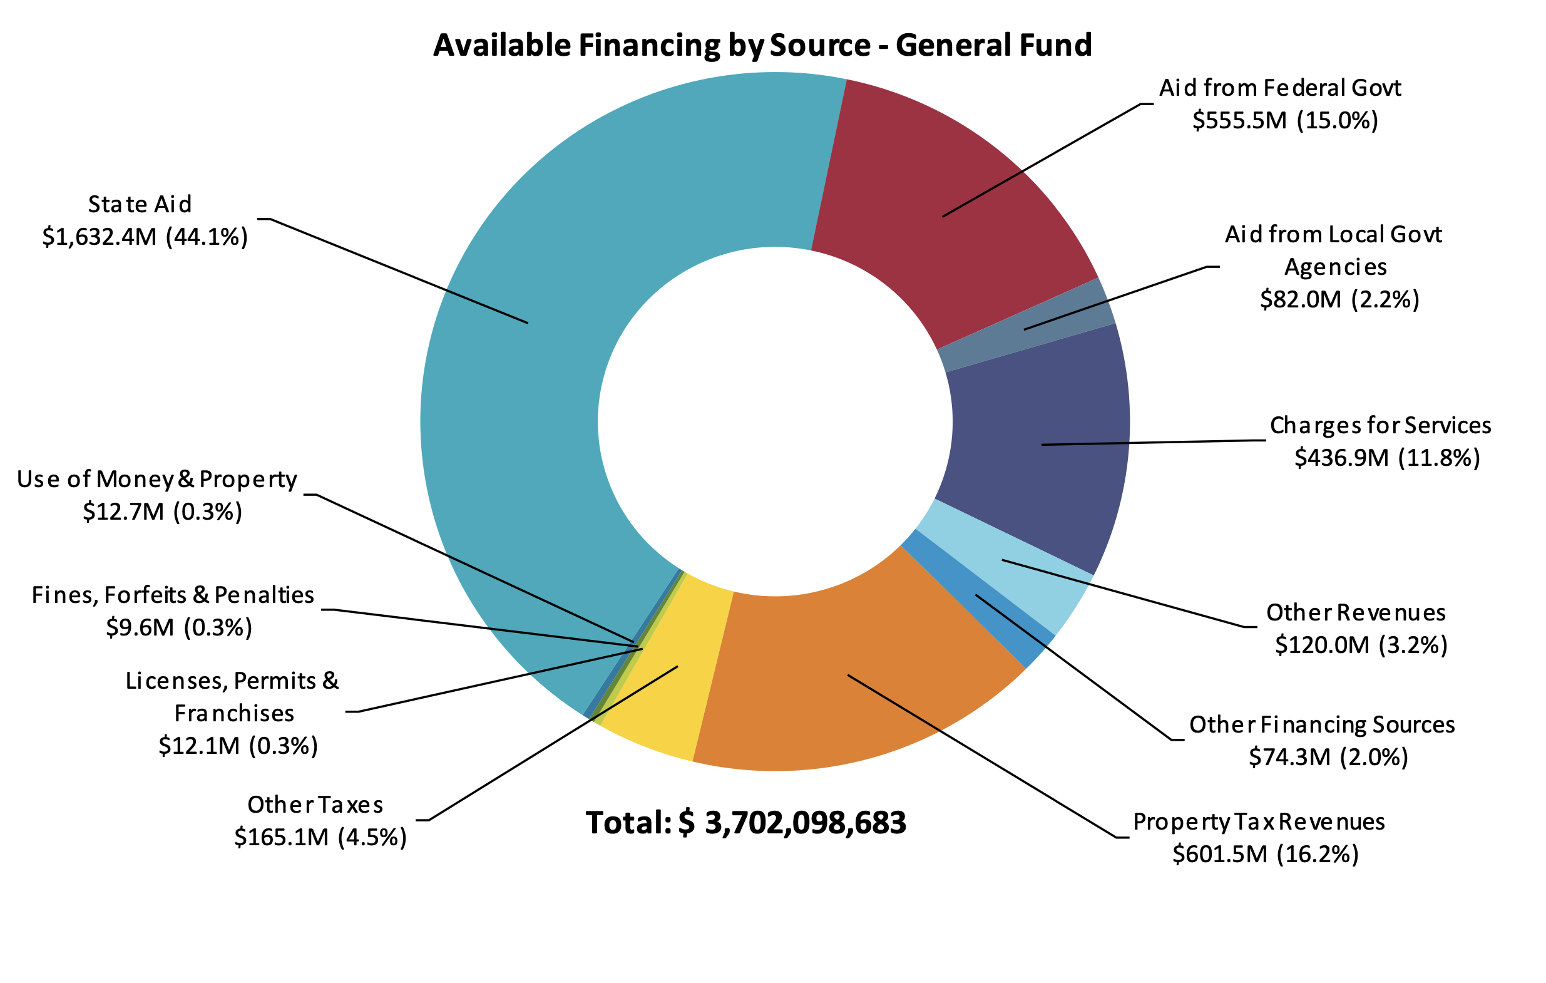
Alameda County General Fund

Slide 27
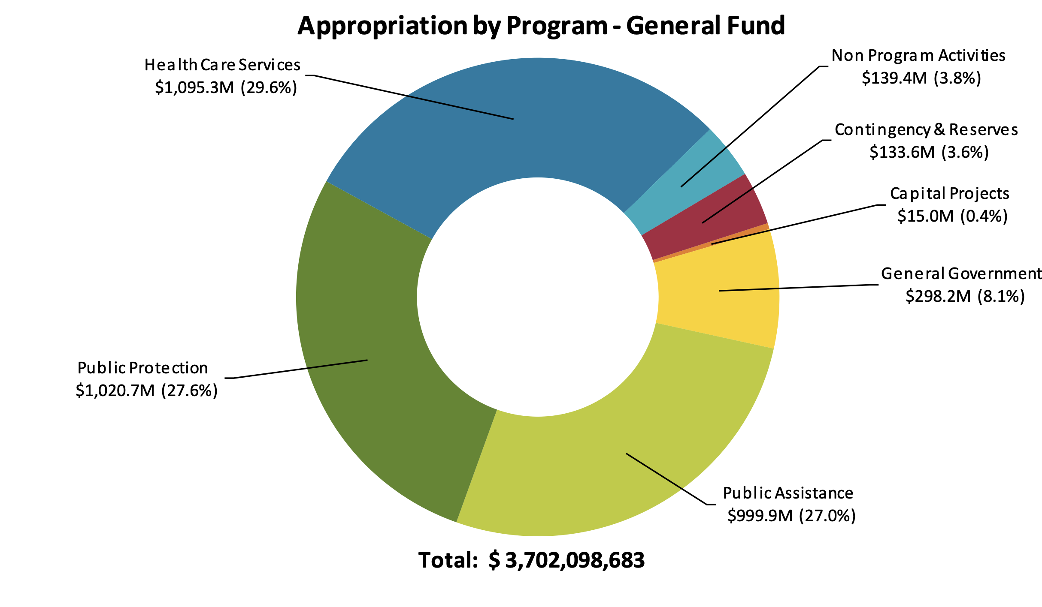
Alameda County General Fund

Slide 28
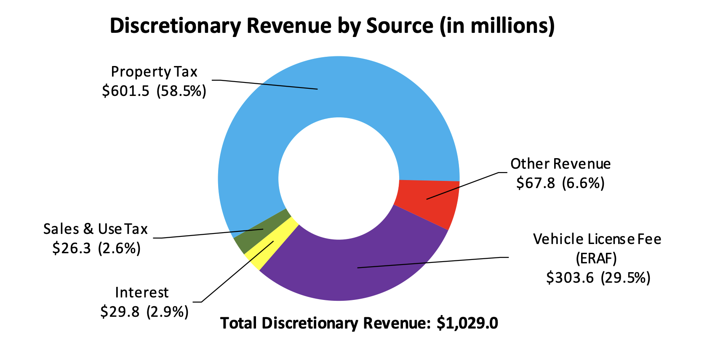
Alameda County Discretionary Revenue

Slide 29
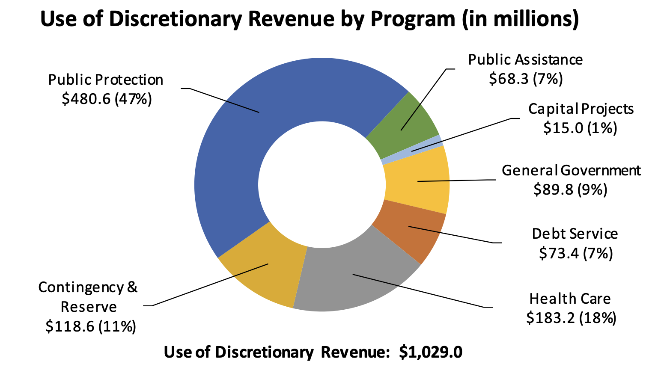
Alameda County Discretionary Spending

Slide 30
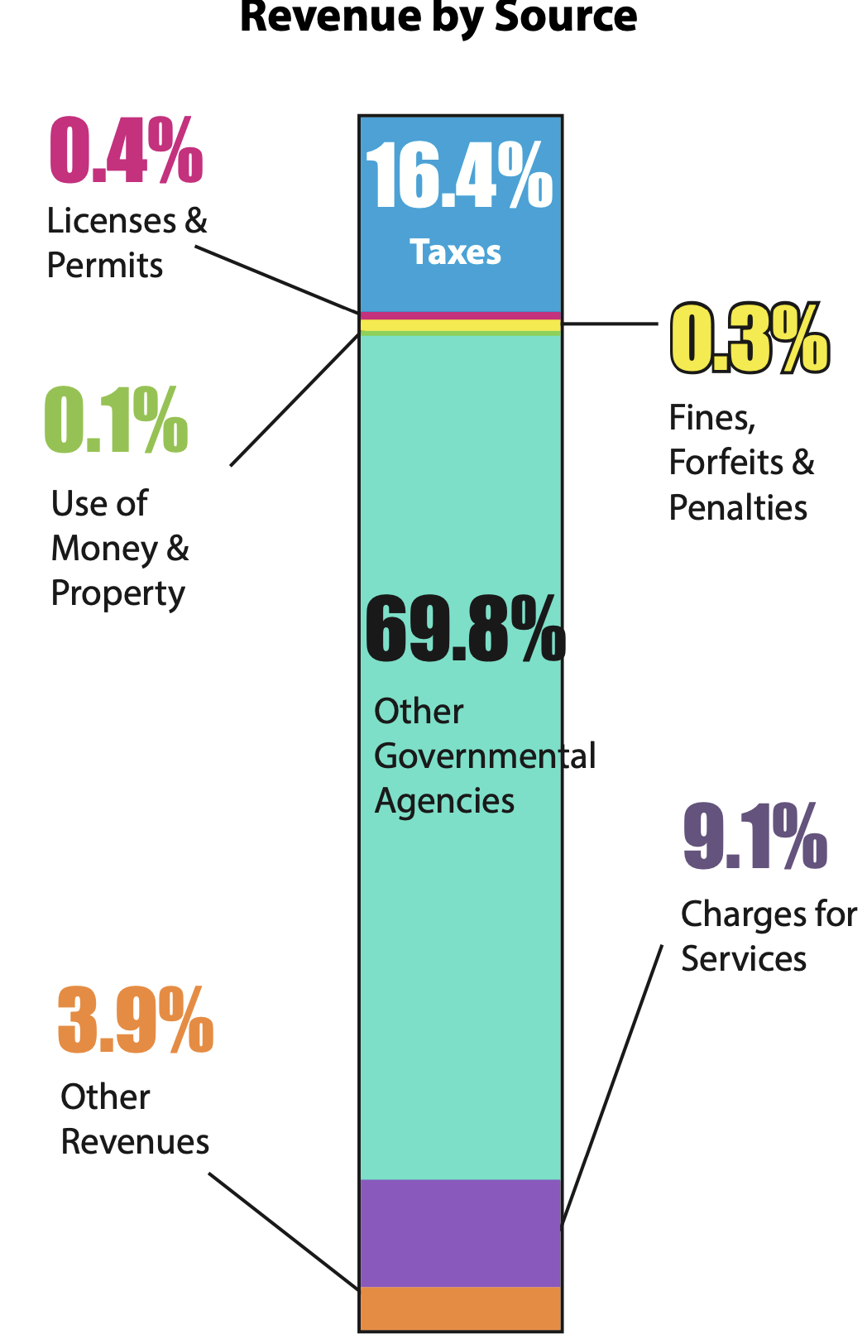
Humboldt County Revenues

Slide 31
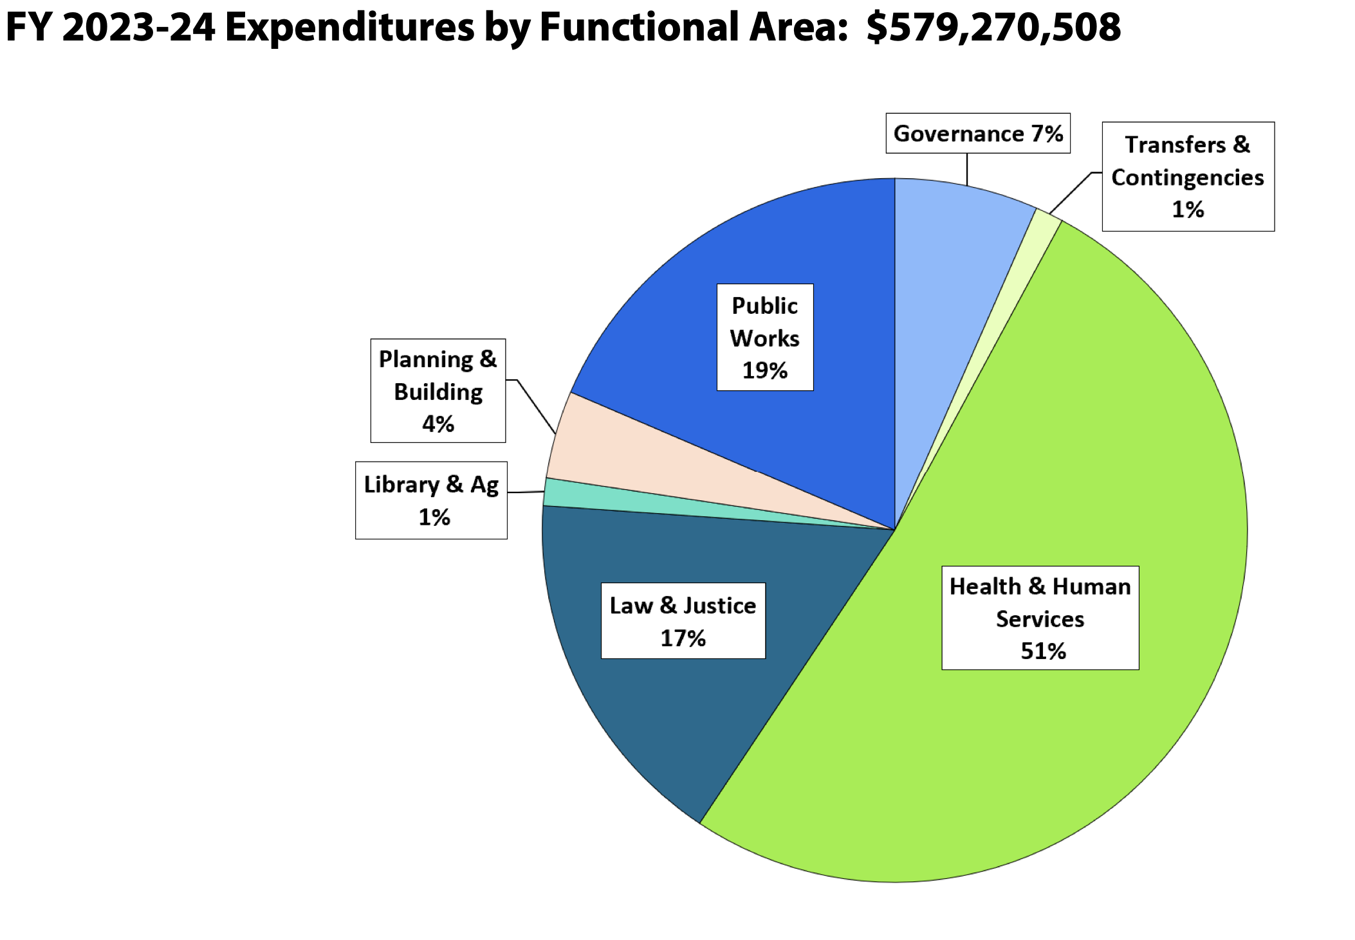
Humboldt County Spending

Slide 32
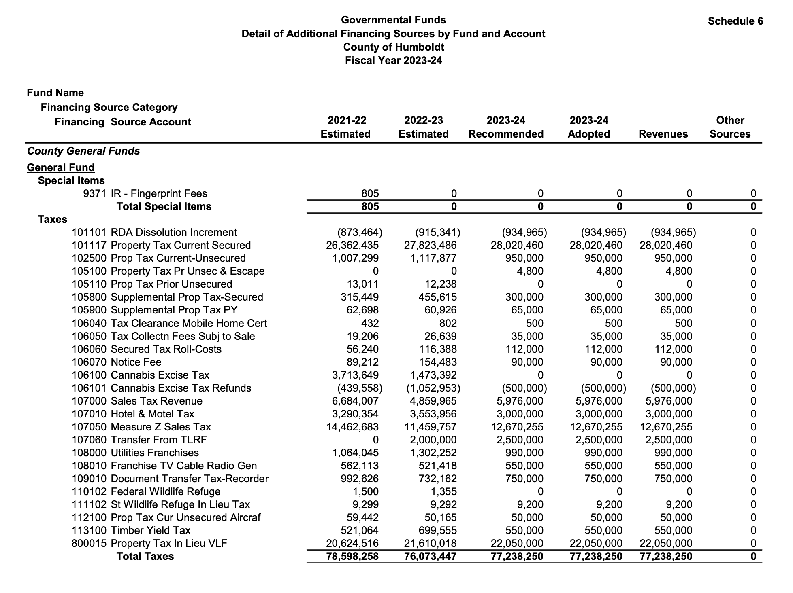
Humboldt County Revenues
State Controller Schedule 6

Slide 33
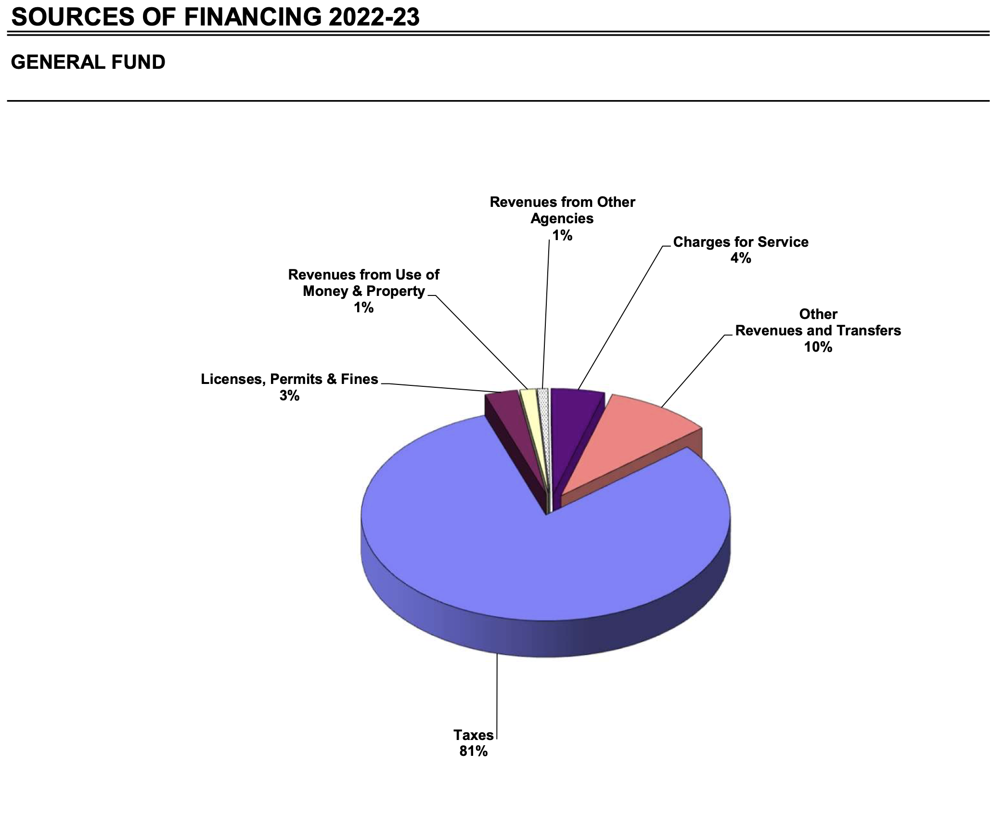
Santa Maria Revenues

Slide 34
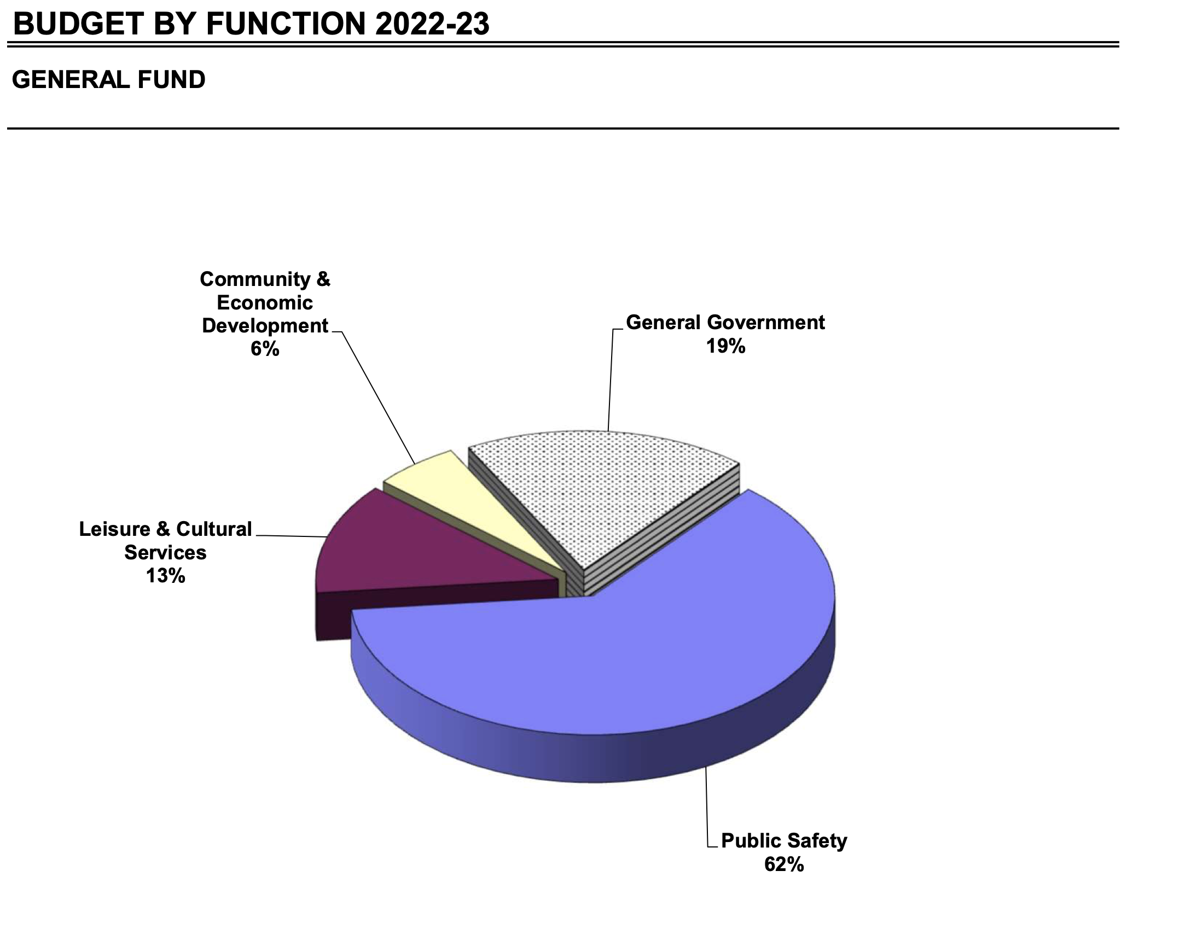
Santa Maria Spending by Function

Slide 35
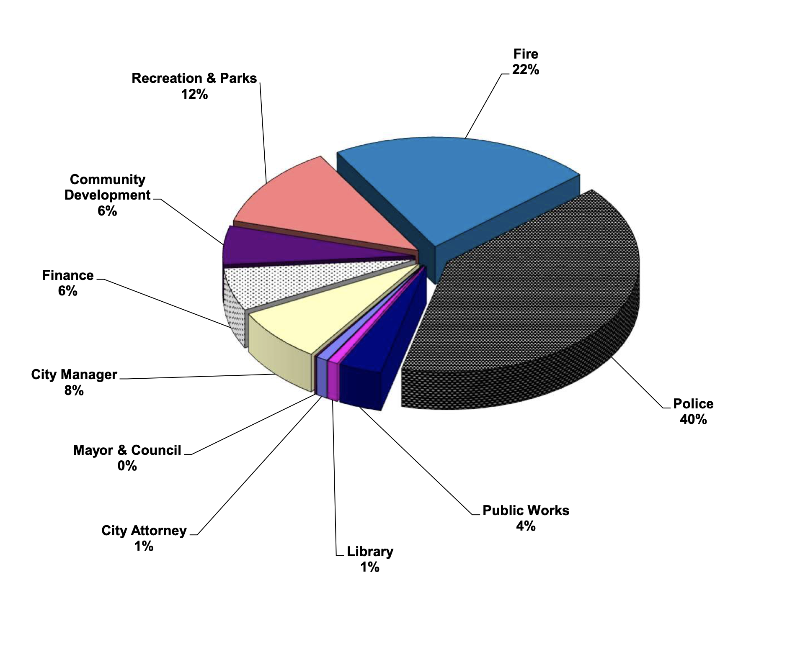
Santa Maria Spending by Department

Slide 36
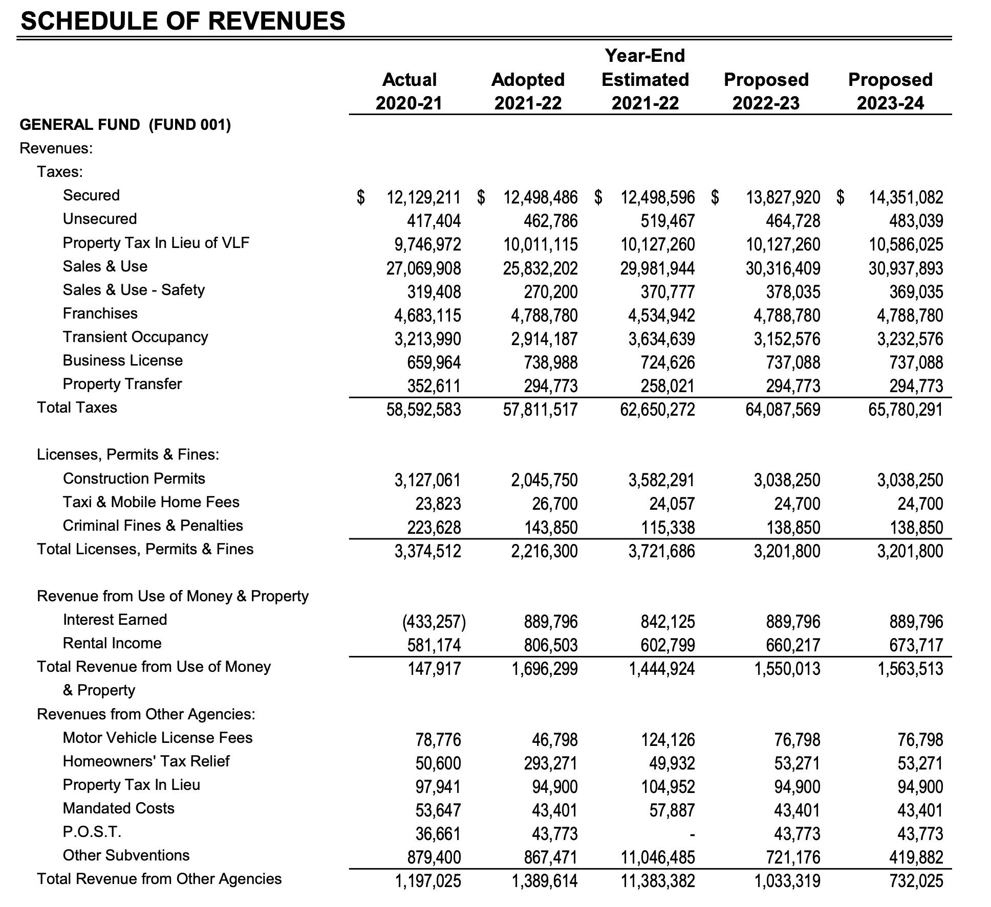
Santa Maria Tax Revenues

Slide 37
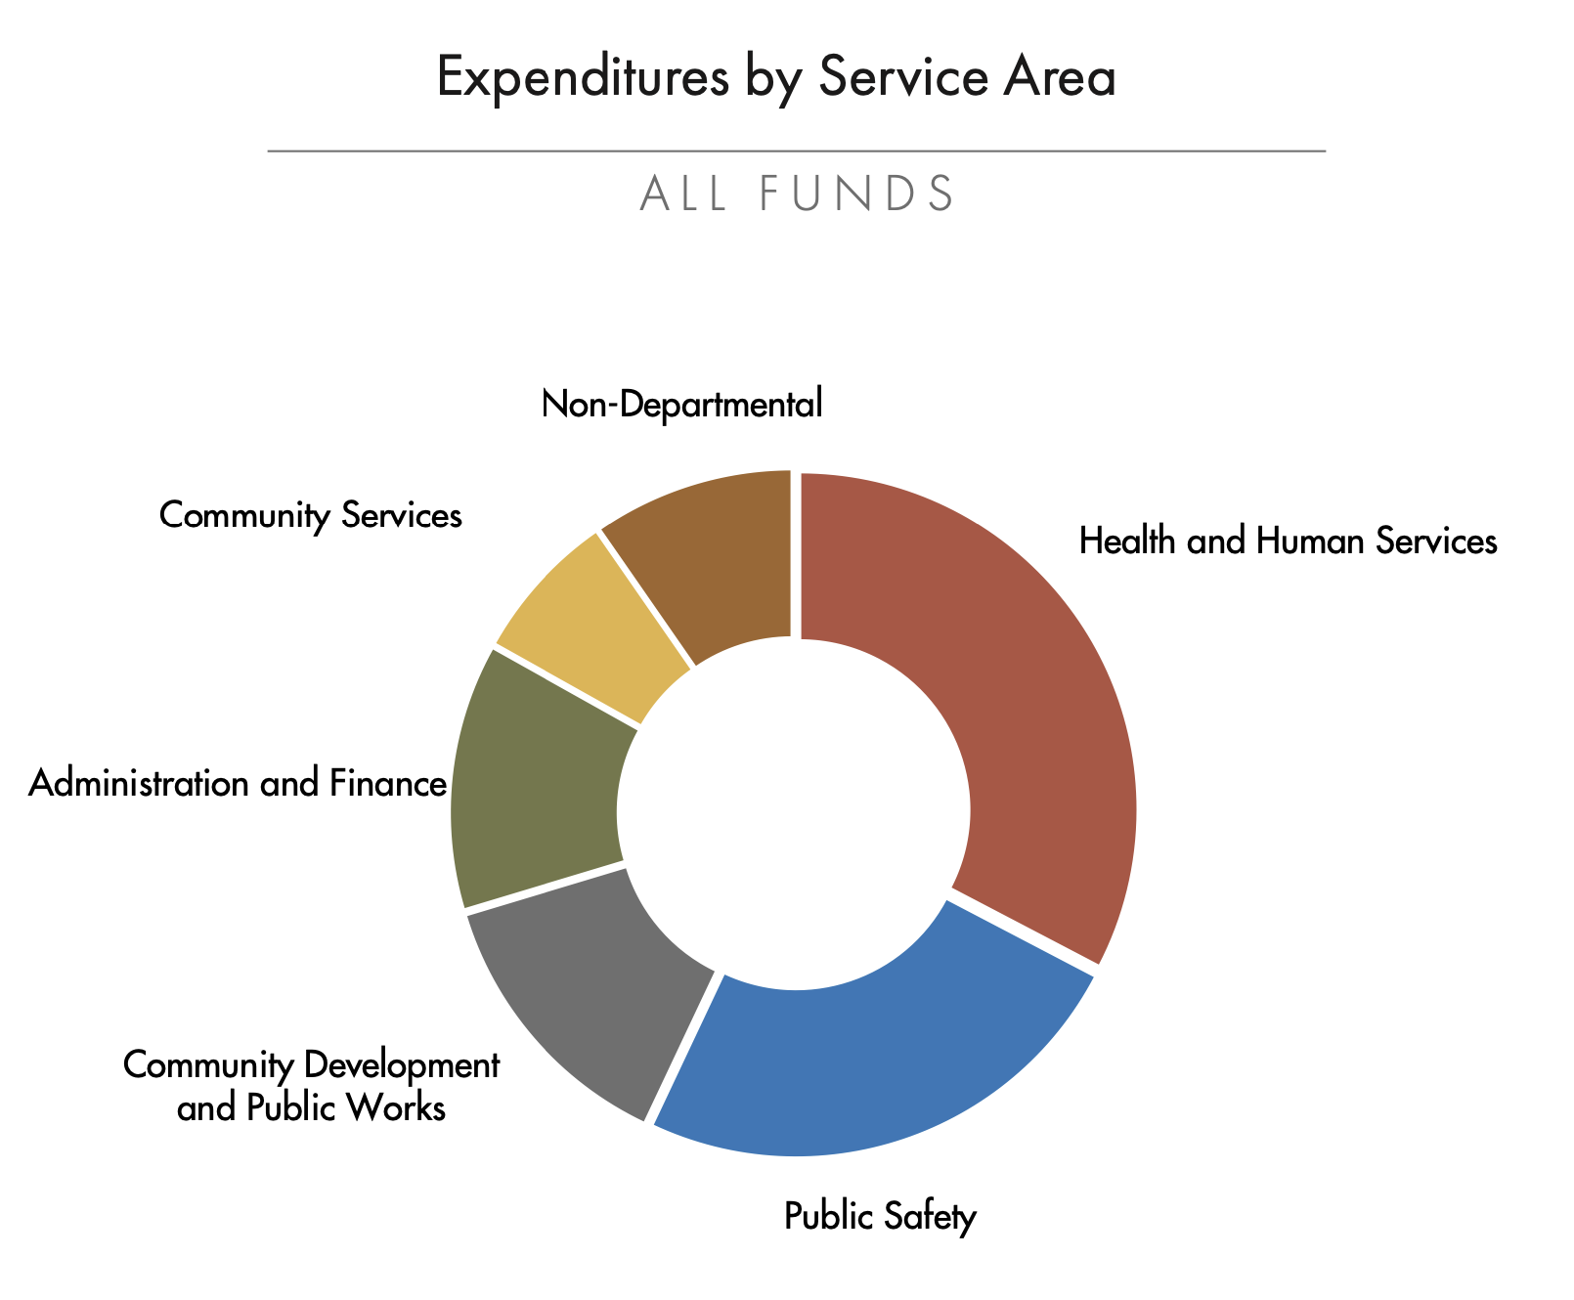
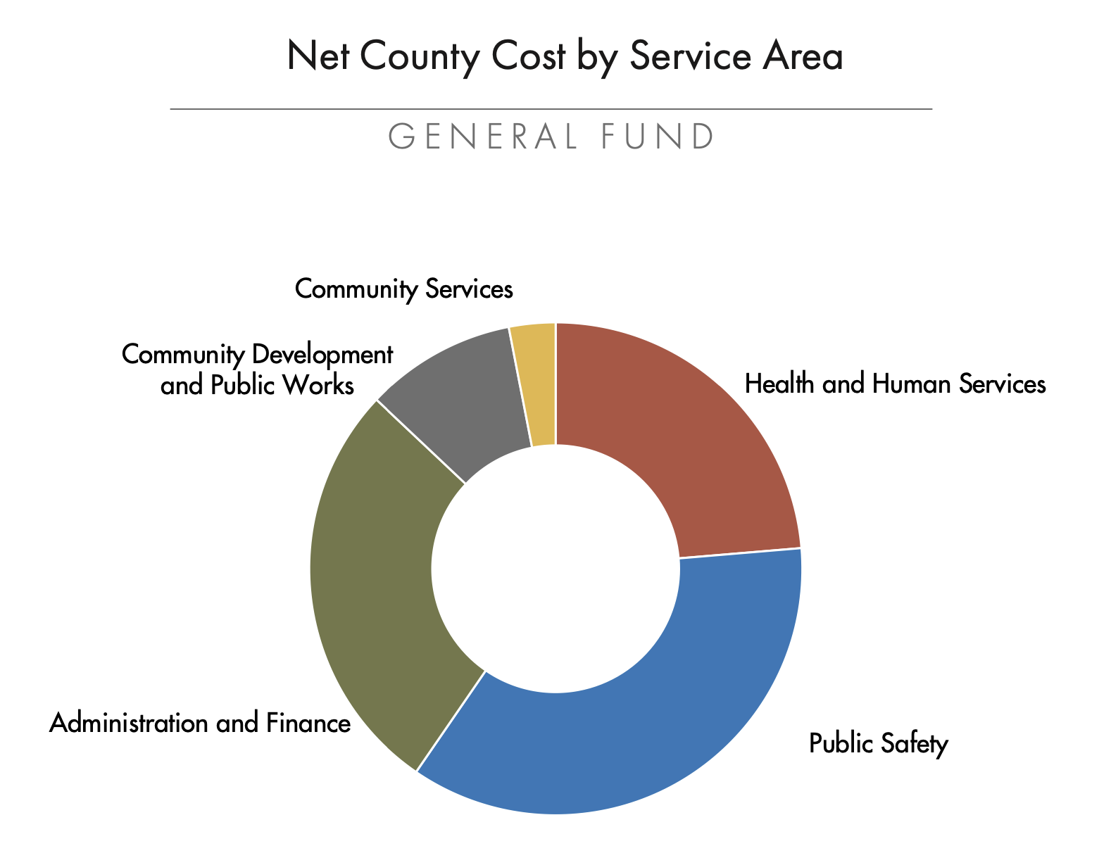
Marin County Net County Costs

Slide 38
Other Things To Think About
Notes:
1., change LA Co0….to Greater LA Summer Matters Network
2 add 2018 to the date

Slide 39

ASSESSING THE BUDGET LANDSCAPE
Cuts or increases in revenue
Valuable programs threatened
Specific competition for annual budget resources
Priorities of decision-makers
EXAMPLE:
Is the cannabis tax increasing? Is it spoken for?

Slide 40
Fund Balances/reserves
Purpose
  Protect against risk
  Cash Flow
Typical
  Basic reserves 2-3 months or 15-25% of appropriations
  Higher in smaller communities, fewer taxes, fewer customers, etc.=higher risk
Watch for multiple reserves

Slide 41
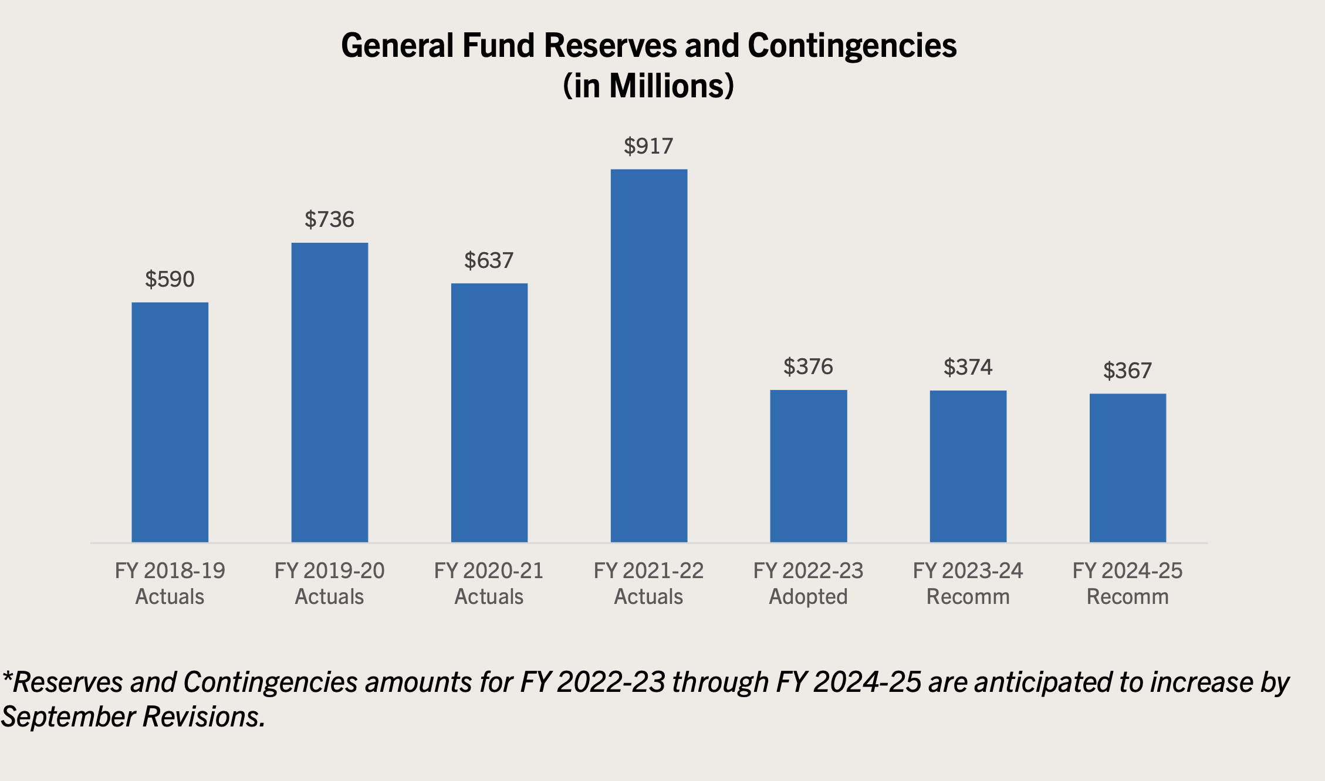
San Mateo County Reserves

Slide 42
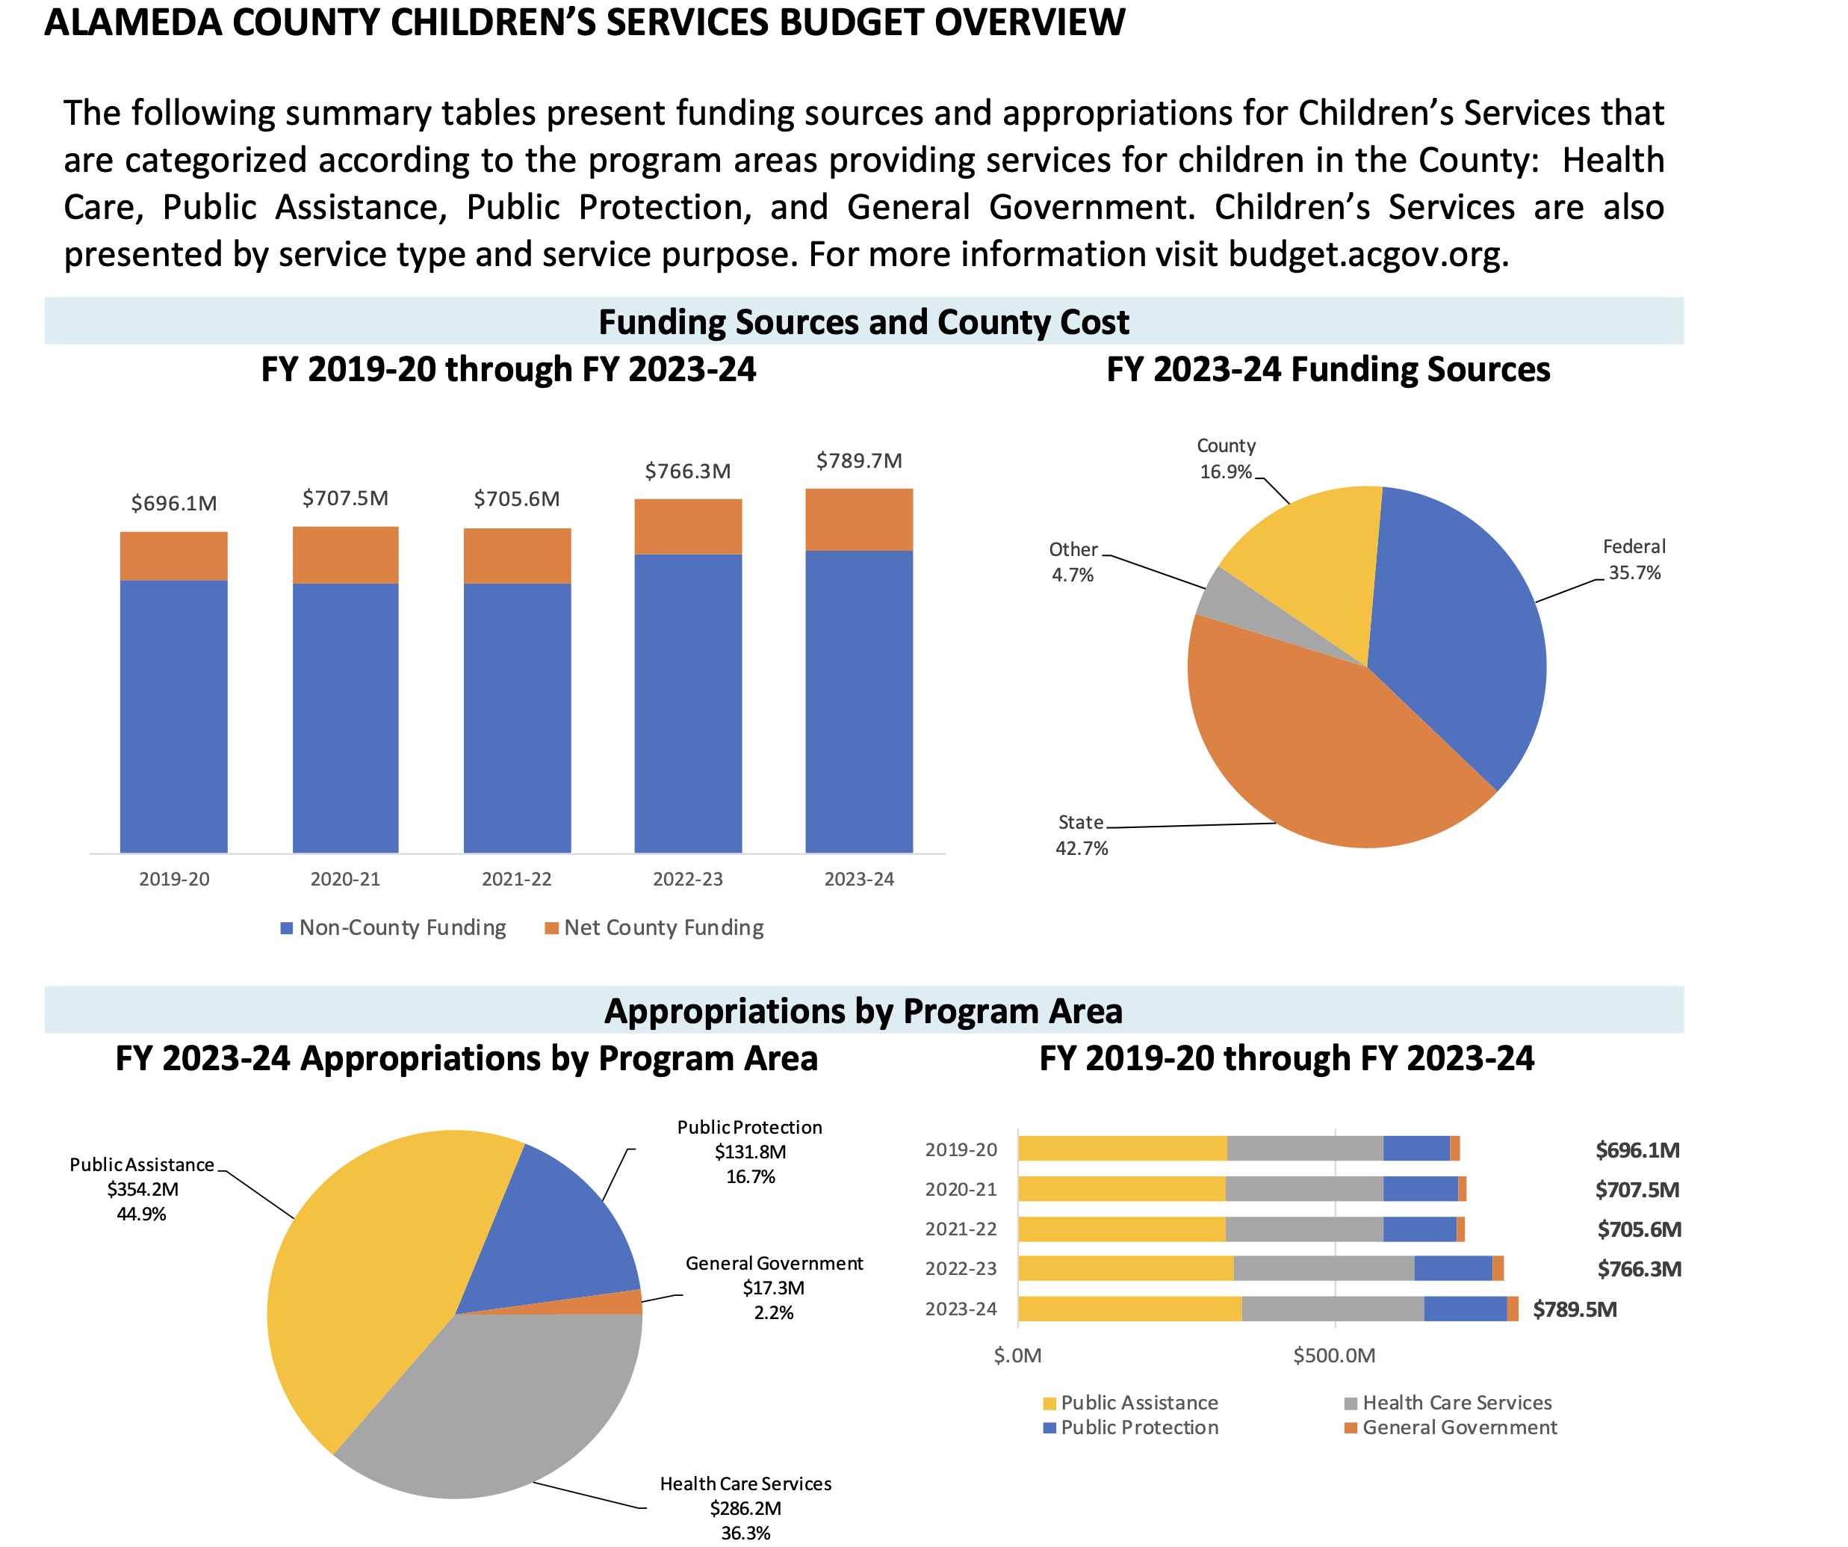
Alameda County Children’s Services

Slide 43
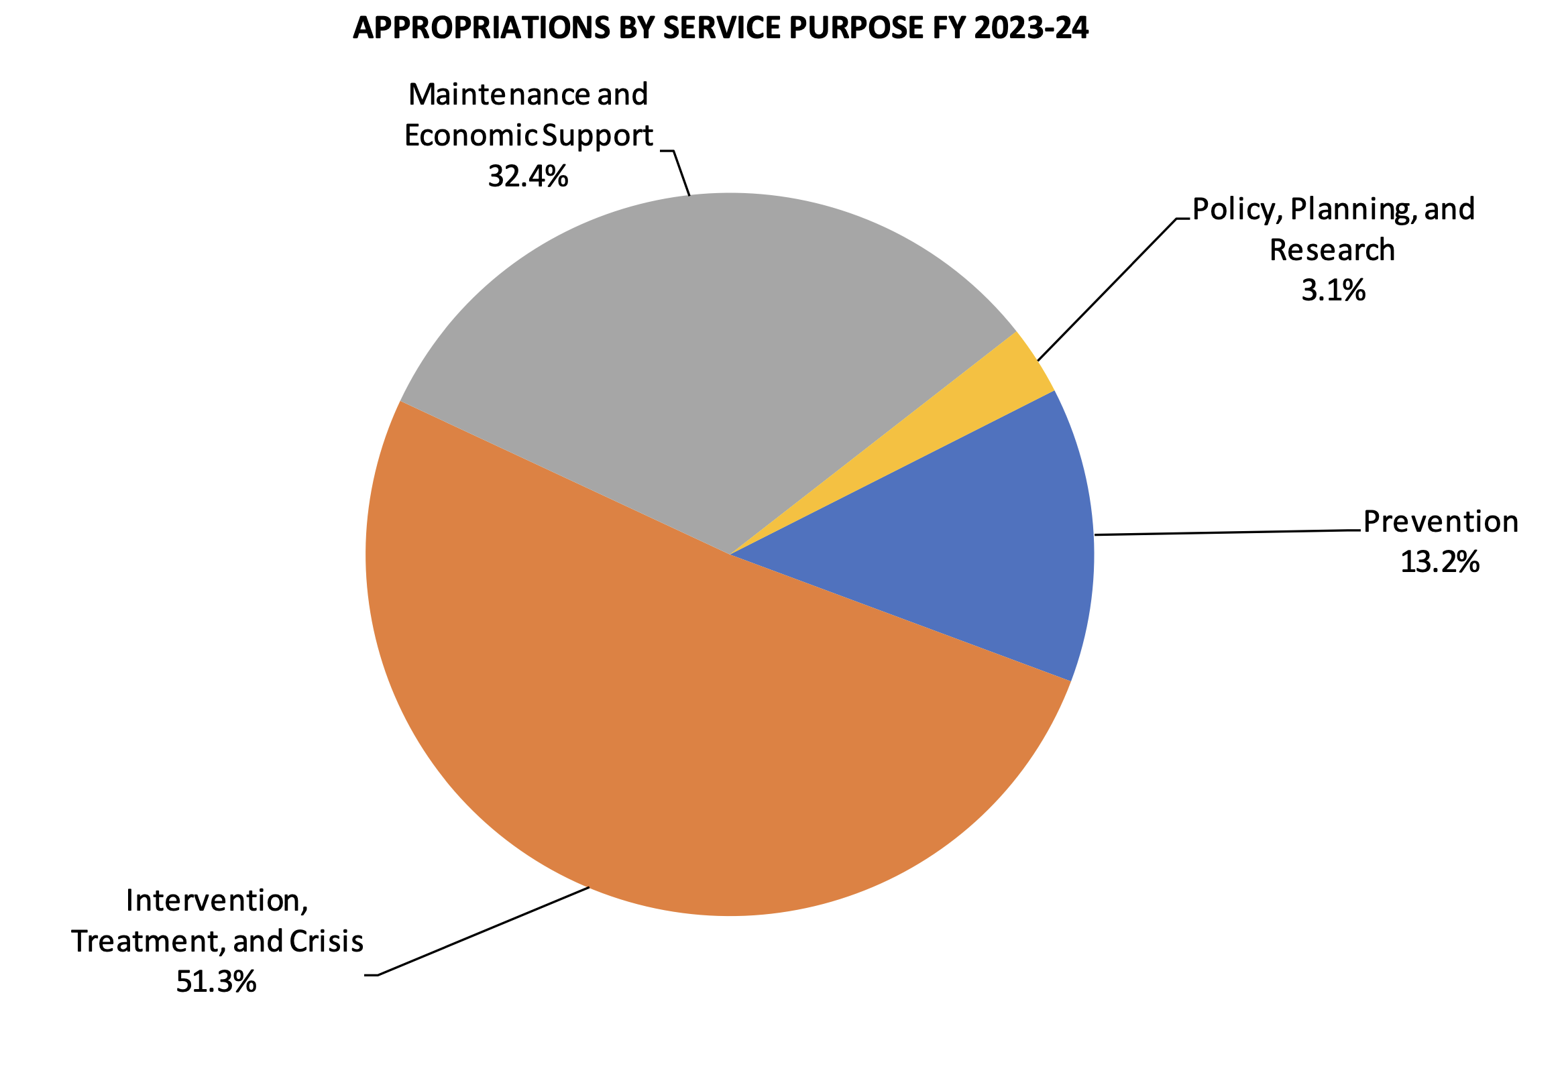
Alameda County Children’s Spending

Slide 44
First year start-up Budget Issues
  Pilot Projects
    Get in early or you will be too late. Need to show results in time.
  Partial Year budget
      Settle for partial budget as long as it is a full budget for a partial period. Then make sure it is “annualized” in the next budget.

Slide 45

Pension (and Retiree Health Benefits)
Isn’t the future at least as important as the past?
We have a legal obligation to our past for retiree pension costs
We have a moral obligation to our future to take care of our kids

